Slide 1



Accelerator and
Investment Readiness Programs: A Practitioner’s Guide
10 practical Lessons from We-Fi - supported Programs Focused on Women Entrepreneurs in Emerging Markets
Luciana Markstein – Research & Knowledge Consultant
October 27, 2026
Notes:
Thank You Wendy
Hello everyone, thank you for joining us for this session. We’re very excited to be presenting this new practice note with you
Today I’ll be sharing the 10 practical lessons, tools and other resources we’ve identified in this practitioners guide on acceleration and investment readiness programs that work for women entrepreneurs.

Slide 2

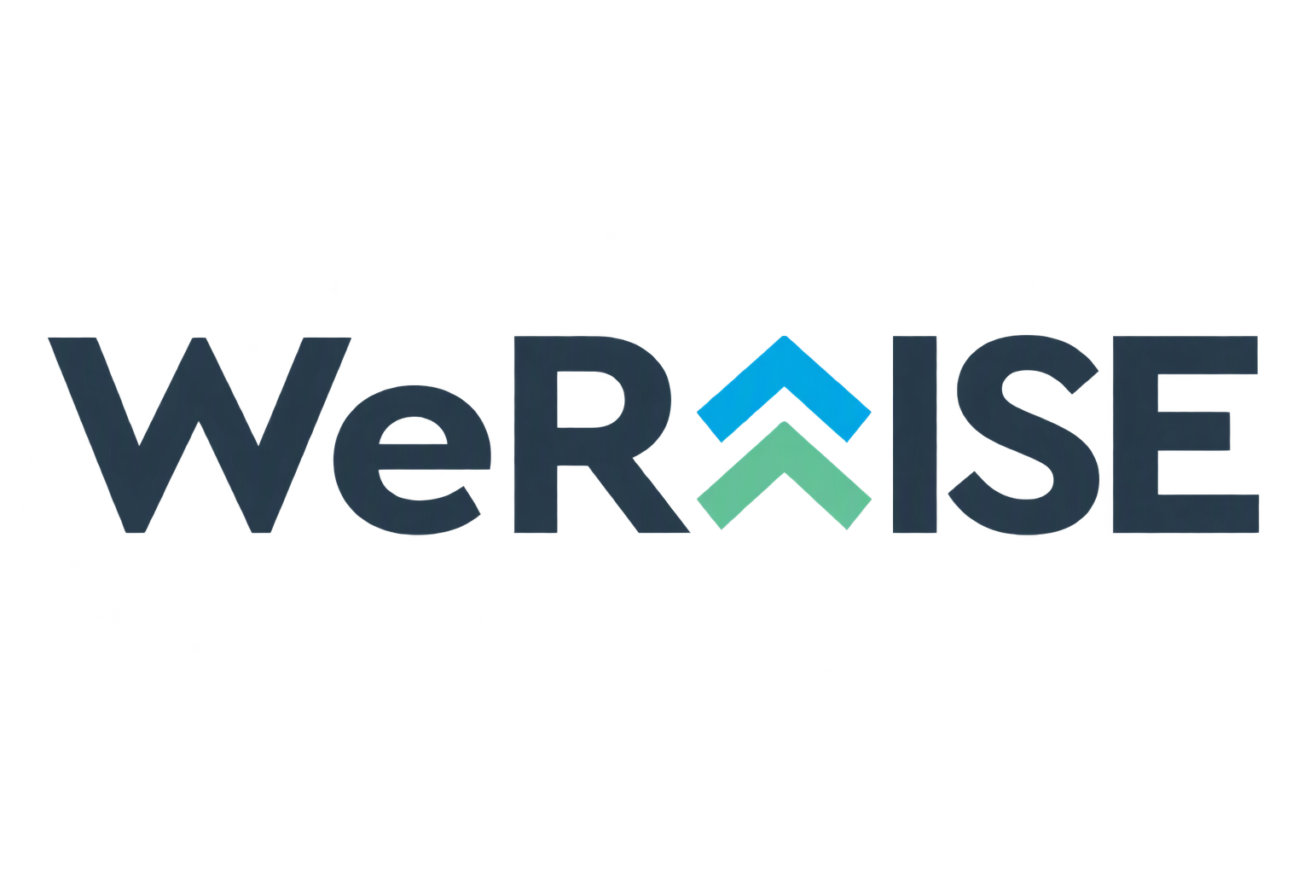
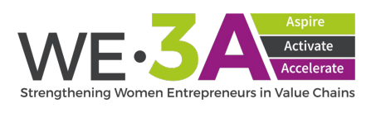
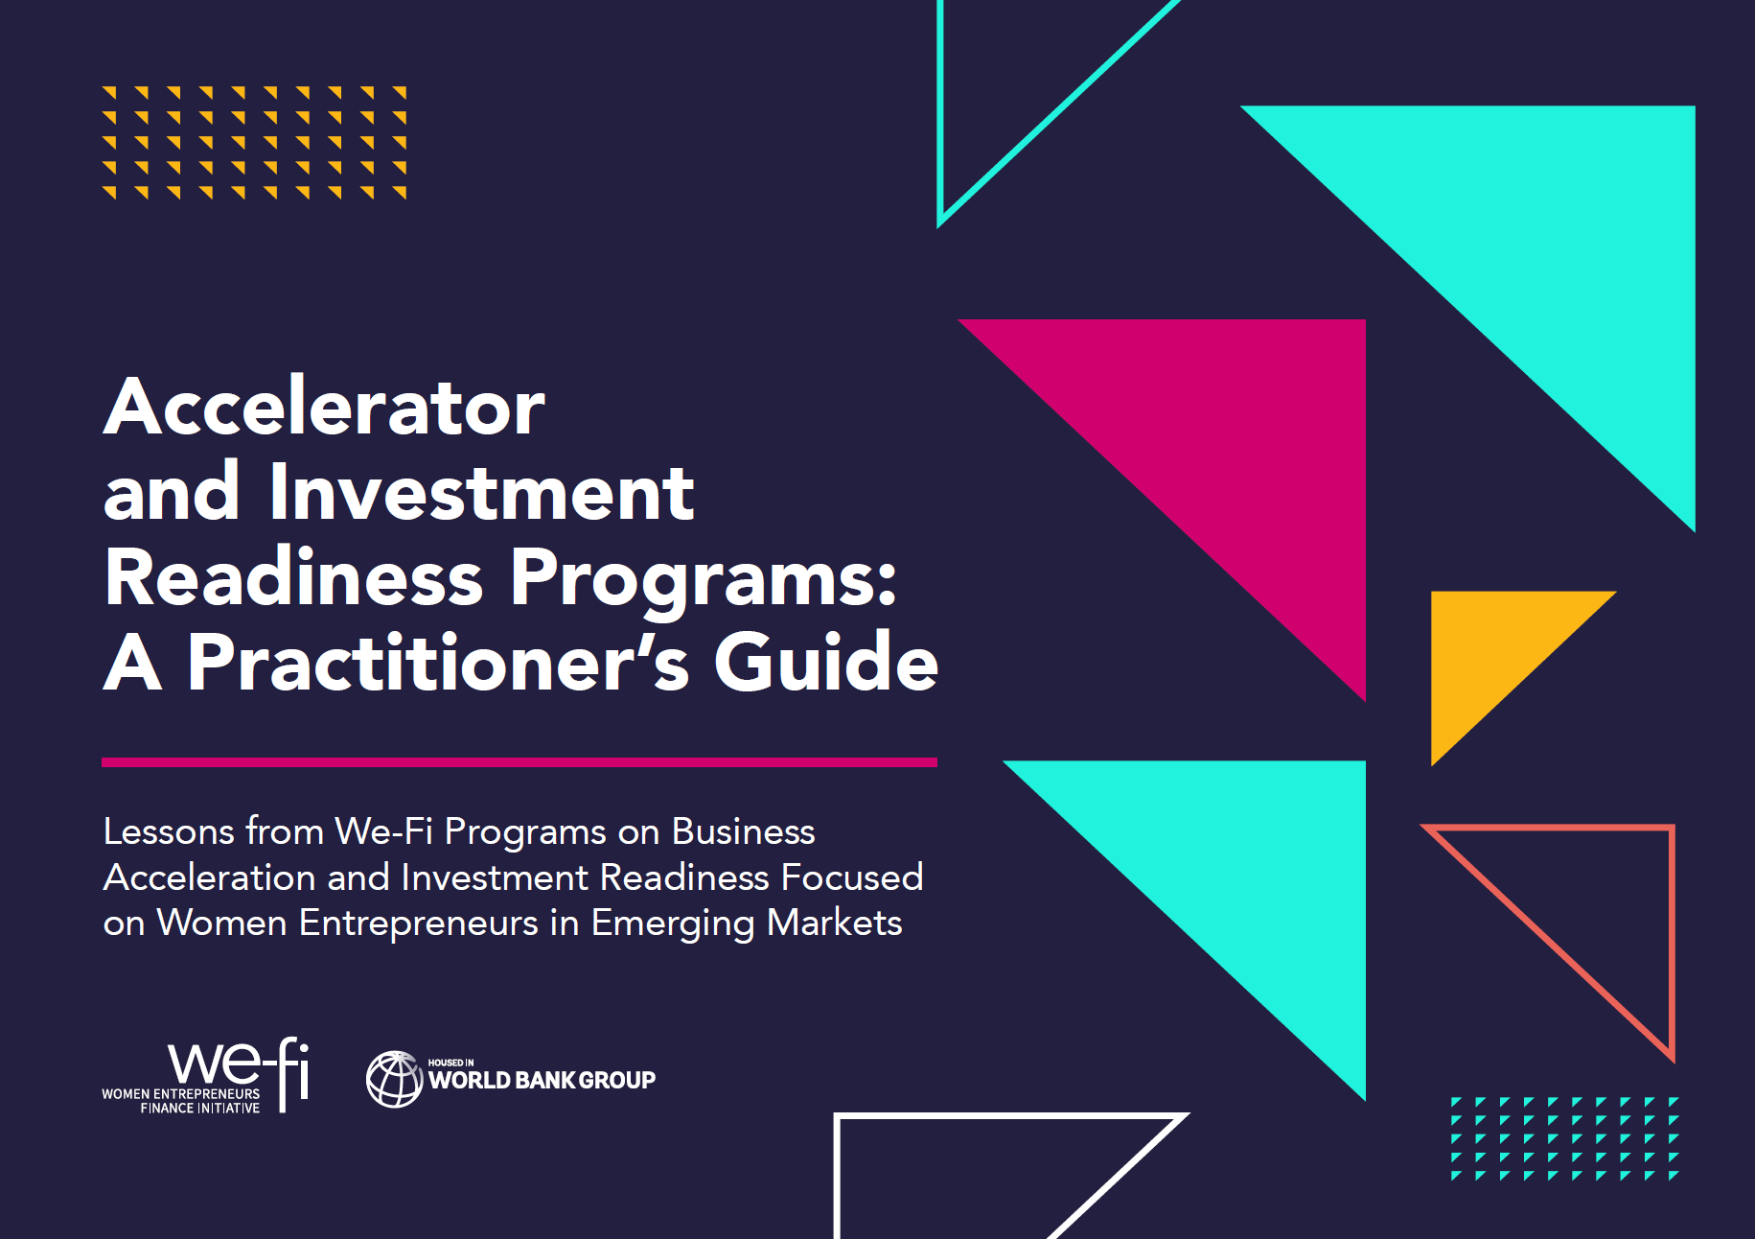

What is this Guide?
Accelerators and IRPs help businesses grow and fundraise, but women entrepreneurs face systemic barriers:
This is not a pipeline
problem; it’s a
design problem.
Fewer applications: women-only founding teams make up only 13% of accelerator applicant pools, even though they have similar acceptance rates (GALI 2020).
Financing gap: accelerated men-led ventures increased their equity financing considerably (1.5 times) more than non-accelerated ventures, while women-led ventures saw little or no comparable gain (Village Capital, IFC, and We-Fi 2020)
Intentional design and implementation can unlock significant impact
10 operational lessons
Templates + Tools
For practitioners
02
Notes:
So lets start from the beginning: What is this guide? Where does it come from?
Evidence shows that, despite their potential, women entrepreneurs face barriers both to entering these programs and to benefiting from them.
These findings put program design under the spotlight, and highilight how intentional design and implementation can unlock significant impact.
To surface operational knowledge, this notes draws learning from 3 We-Fi-supported projects that piloted innovative initiatives and shows very successful results: WE3A Accelerate, WeRaise Pakistan and She Wins Arabia.
- From them we distilled ten operational lessons, with templates and tools for practitioners.

Slide 3

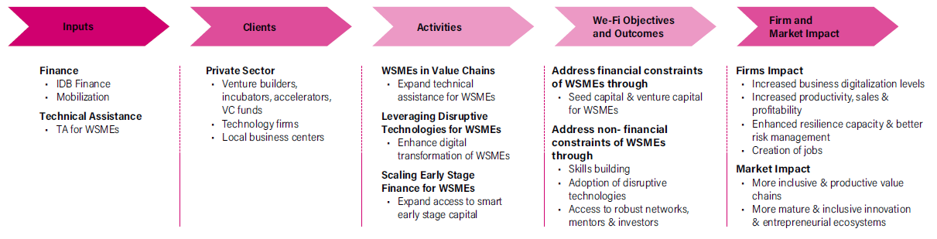
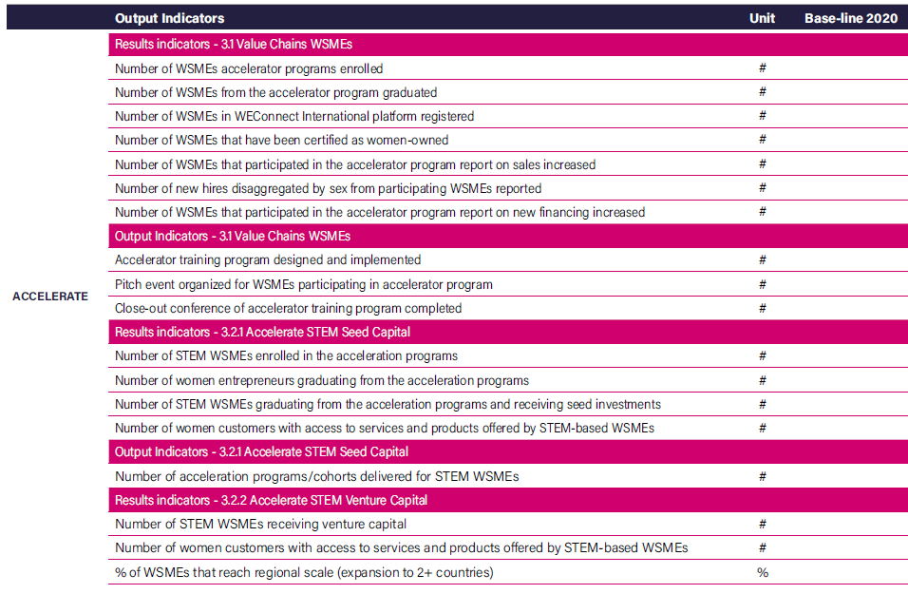


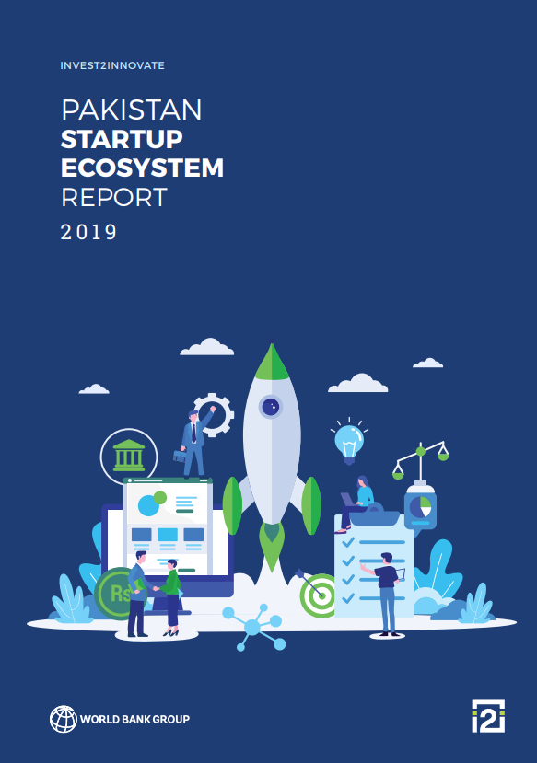
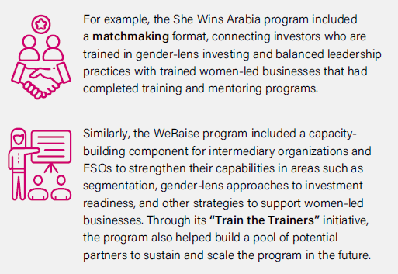

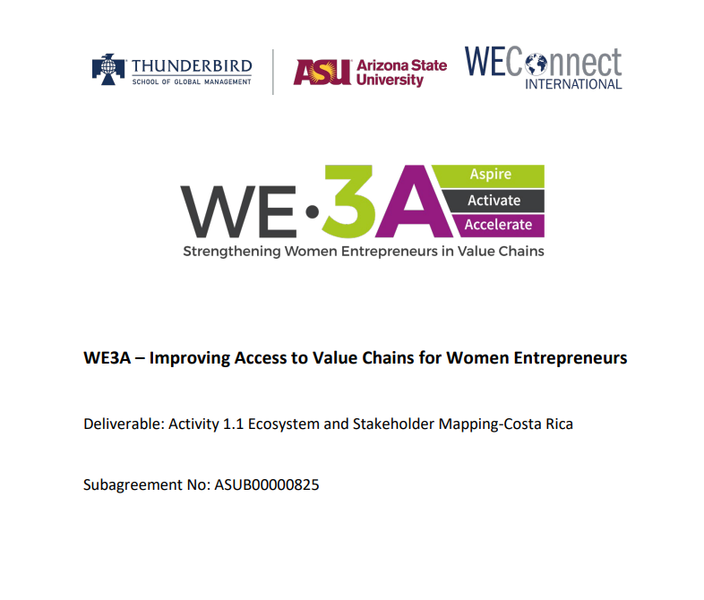
Program Set-Up
1. Put Gender at the Core of Program Design
A gender-focused theory of change and results framework address
women’s barriers from the outset, guiding program goals,
staffing, and internal processes.
WE3A Example ToC + Results Framework
Evaluation Metrics
2. Understand & Target the Right Segment
Segment women entrepreneurs so targeting can ensure support is tailored to their specific needs.
We-Fi Segmentation Toolkit
“Ecosystem approach” examples
Diagnostics should identify the specific barriers women face,
as well as map ecosystem actors with the interest, capacity, or experience to effectively serve women entrepreneurs.
3. Design Around Women’s Realities
Diagnostic and ecosystem reports
03
Notes:
The 10 lessons are separated in half: 5 for program set-up and 5 for program implementation.
The first three lessons are about foundations.
Lesson one: put gender at the core. A gender-focused theory of change links the barriers women face to the activities that address them and to the outcomes you want to track. In the note you can find an example ToC from WE3A and their results framework. The ToC can also shape the decision of whether to run a women-only or a mixed program. One practical metric for mixed programs is to compare women to men ratios across applications, participation and fundraising, to find bottlenecks.
Lesson two: Segment women entrepreneurs so targeting can ensure support is tailored to their specific needs. The We-Fi segmentation toolkit distinguishes, for example, Wealth Creation entrepreneurs, who are open to equity and a natural fit for investment readiness, from Stability entrepreneurs, who benefit more from core business skills, mentoring and peer networks. That distinction should shape what you offer.
Lesson three: Design around Women’s realities and their local ecosystem. A key step here is to conduct diagnostic studies or ecosystem analysis. For example, WE3A mapped support organizations and potential buyers in each of their operation countries, reflecting its value chain focus. WeRaise did an Investor mapping and deal flow analysis in Pakistan, reflecting its fundraising focus. Programs also showed the importance of engaging the wider ecosystem, for example by training fund managers on gender-lens investing, and Train the Trainers initiatives to build a pool of ESO partners to sustain the work

Slide 4
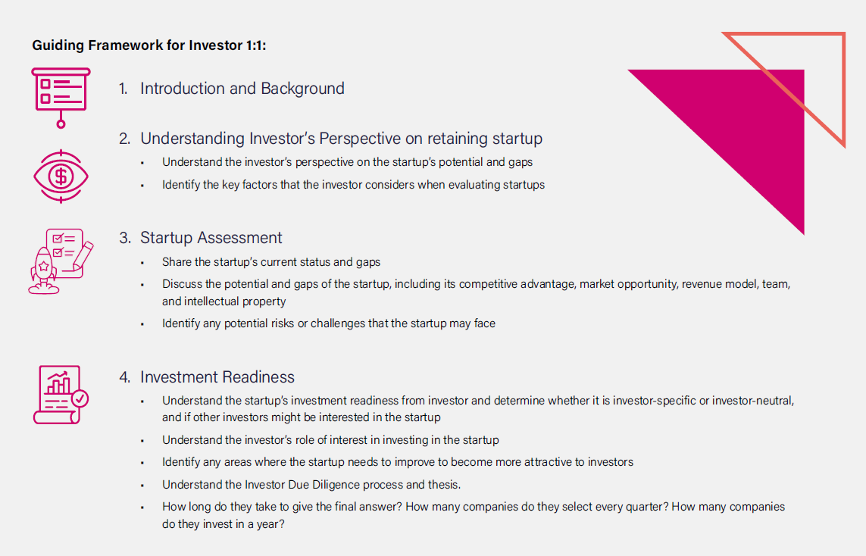


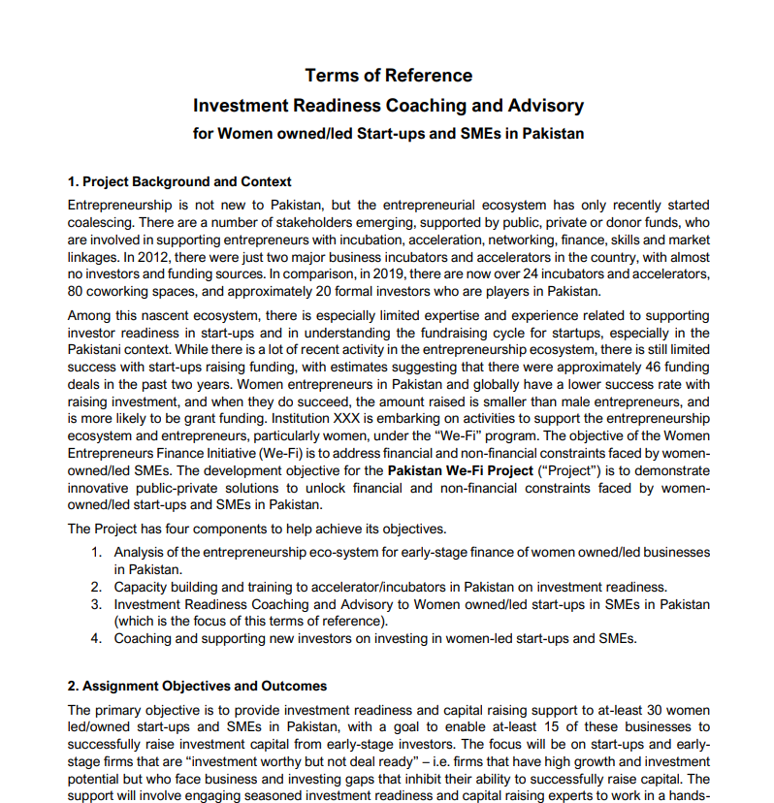
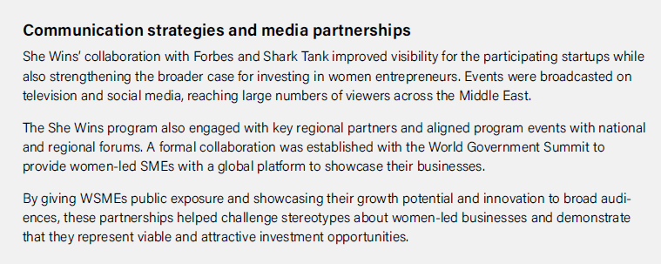
Program Set-Up
WeRaise Framework for Investor 1:1
4. Engage Investors Early & Regularly
Early exposure builds confidence and connections for women entrepreneurs through regular scheduled interactions and by tracking investor engagement.
Example metrics to track investor engagement
5. Establish Strategic Partnership in the Ecosystem
Partner with experienced local service providers and organizations that have robust investor networks and platforms to ensure program ownership and continuity.
SheWins Media Partnership example
Template for Outcome-based Contracting
04
Notes:
The next two lessons are about relationships.
Lesson four: engage investors early and regularly, identifying those who are interested in and ready to invest in WSMEs. Innovative initiatives included one-on-one meetings and investor mock boards that let founders get feedback and understand investor expectations before the final pitch. Creating more informal spaces for interaction helped women entrepreneurs approach investors more easily. WeRaise also used regular meeting between the program team and investors to judge which startups were investment ready. The guide includes a framework for these conversations and a list of metrics useful to track investor engagement, such as investor type, ticket size, past experience with women entrepreneurs, and follow up after introductions.
Lesson five: build strategic partnerships. Local providers bring relationships and continuity beyond a funding cycle, so providers with real fundraising experience and strong investor networks are crucial. 2 models emerge: linking provider’s compensation to the share of participants who raised capital, or onboarding provider to co-design the program from the begging, both strategies aim for to strengthened ownership and results. Key partnerships also include those that raise visibility and the reputation of the program in the local ecosystem: She Wins built media partnerships, including with Forbes and Shark Tank, to raise visibility for women-led businesses.

Slide 5
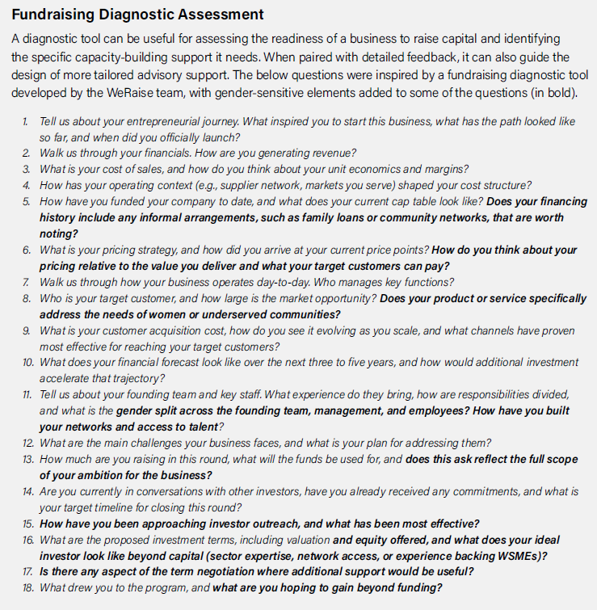

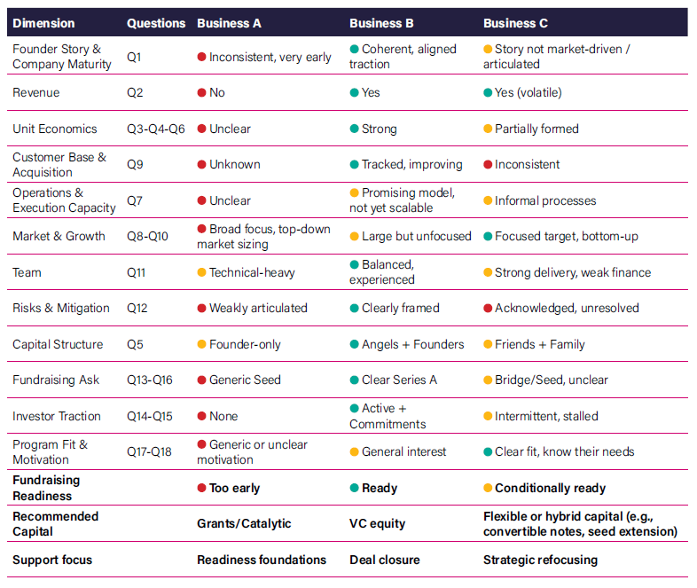

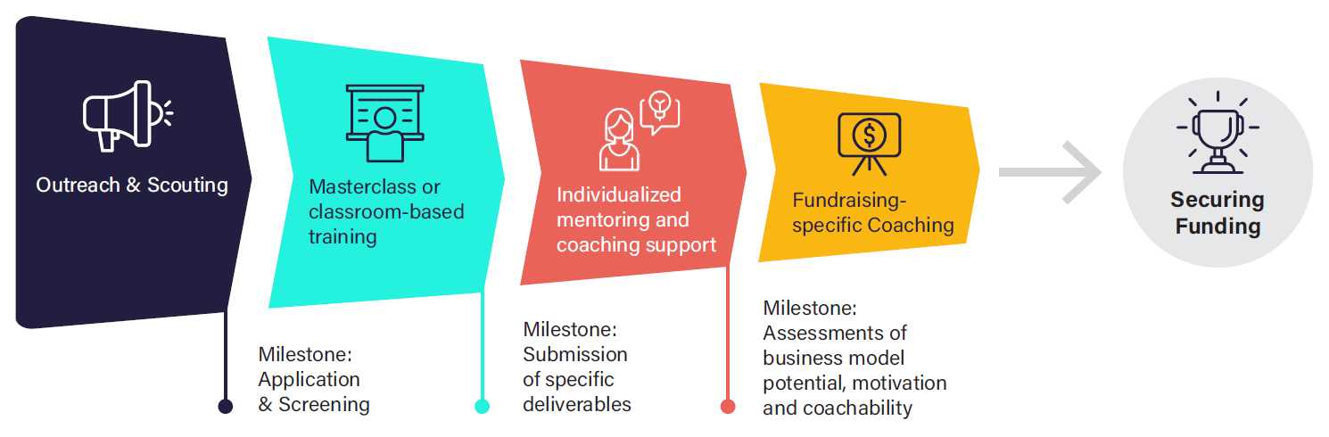

Program Implementation
Fundraising Diagnostic Assessment and application example
6. Use gender-sensitive communication
Craft scouting messages with inclusive language and highlight tailored program features such as flexible formats or childcare services.
7. Design selection processes to counter bias
Implement rigorous selection processes with safeguards against bias and consider a funnel approach to focus resources on promising participants.
Flexible schedules, hybrid formats, and strong onboardings help women
balance business and care responsibilities while addressing digital access and skills gaps tailored to their contexts.
8. Build flexibility into programs delivery
Funnel Approach example
05
Notes:
Now to implementation.
Lesson six is on communication. Scouting messages should use inclusive language and state practical features clearly, such as flexible schedules or childcare. This helps women judge whether taking part is realistic. It is also important to leverage the local entrepreneurial ecosystem, through universities, business association to expand reach while being aware of how networks can also reinforce existing biases and limit programs’ additionality, Programs should balance referrals with broader and more inclusive outreach efforts.
Lesson seven is on selection. Use consistent criteria and guard against bias to make sure support gets to those who would benefit the most from it. Research shows investors tend to ask men about growth and women about risk. The guide includes questions that cover both risk and opportunity for every applicant, and includes a fundraising diagnostic to assess readiness and support needs. A funnel approach is also a strategy to focus support were it can have the most impact: do that offering broader light-touch support first and concentrates intensive help on those more ready to benefit. WeRaise and She Wins Arabia both did this., and the note includes more detail on their approaches.
Lesson eight is flexibility. Share the schedule early, provide strong onboarding, wraparound services and combine live and self-paced digital learning, this helps women balance business and care responsibilities. But do not assume digital readiness. For example in WE3A, partners in Guyana used in-person sessions, printed materials and weekend activities to fit local realities.

Slide 6
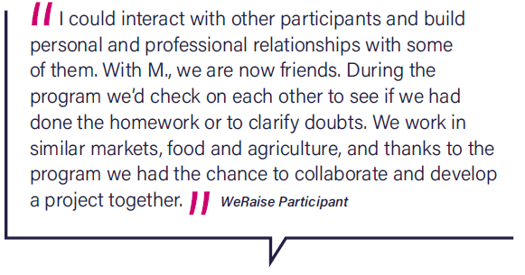

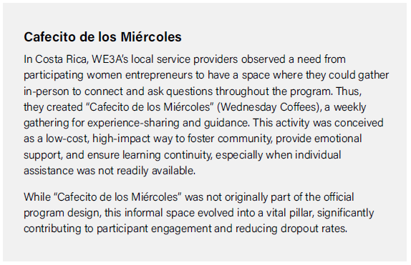

Program Implementation
9. Leverage the right mix of coaches and mentors
Deliver results through a tailored combination of international technical
expertise and local ecosystem knowledge, helping women entrepreneurs build key skills and connect with the right partners.
Reference to hybrid formats:
Fishbowl mentoring
Rotating mentorship pods
WE3A Peer-Learning Example
10. Integrate peer-to-peer learning as a must-have component
Foster safe peer spaces (online or in-person) for women entrepreneurs to share knowledge, build confidence,
and address unique challenges.
06
Notes:
The last two lessons are about the people who support learning.
Lesson nine: find the right mix of coaches and mentors. WeRaise learned that local coaches gave the crucial day-to-day support and ecosystem connections, while international experts added specialized fundraising knowledge, such as valuations and term sheets. Onboarding mentors on the local context and on women entrepreneurs’ needs is part of good delivery. Individual support can be expensive, so the guide also describes formats that can bring some of its benefits, while reducing costs. For example, in fishbowl mentoring, one entrepreneur is coached while peers observe and learn.
Lesson ten: peer learning is a must-have. Participants valued safe spaces to discuss fundraising bias, care responsibilities and impostor syndrome. In Costa Rica, WE3A’s local partners created “Cafecito de los Miércoles”, a weekly in-person coffee that was not in the original design. It became a pillar of the program and helped reduce dropout. The lesson is to listen to participants and make room for exchange, leveraging existing channels, for example WhatsApp groups, and informal spaces.

Slide 7
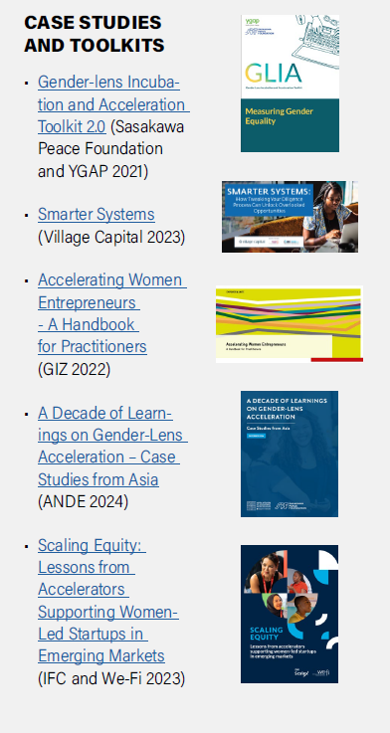
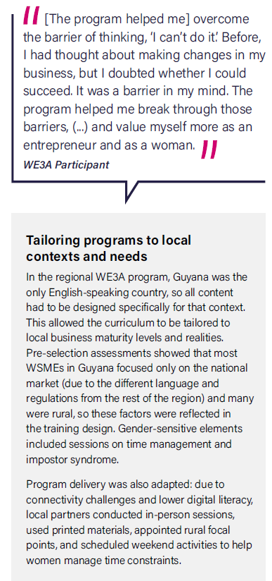
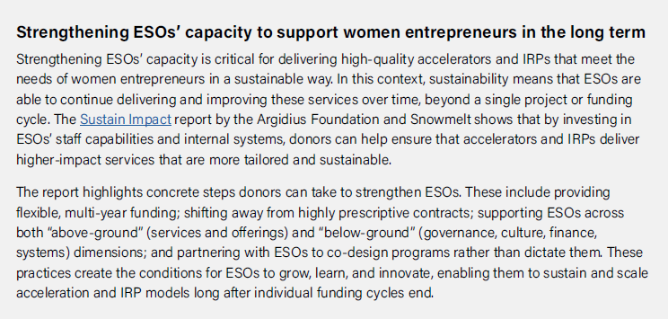
More…
Applied examples
Frameworks for assessments, investor engagement, etc.
Innovative initiatives (e.g. fishbowl mentoring)
Indicators for tracking and evaluation
Templates (e.g. Terms of Reference)
Resource box with more case studies and toolkits
Stronger outcomes start with intentional design and implementation choices
05
Notes:
Around these the ten lessons, the guide includes applied examples that you can adapt directly: assessment frameworks, investor engagement tools, indicators for tracking results, sample terms of reference, and a resource box with further case studies and toolkits.
The central message: stronger outcomes start with intentional design and implementation choices.

Slide 8
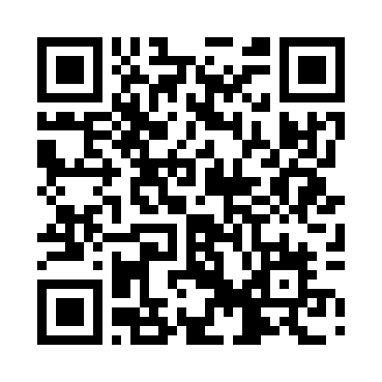
Thank You
Download the full Practitioner’s Guide for tools, templates, and detailed examples.
Luciana Markstein – Research & Knowledge Consultant
lmarkstein@worldbank.org
07
Notes:
Thank you so much. You can already download the publication through the QR in the screen or using the link in the group chat.
Happy to take any questions after the panel discussion.

