Slide 1
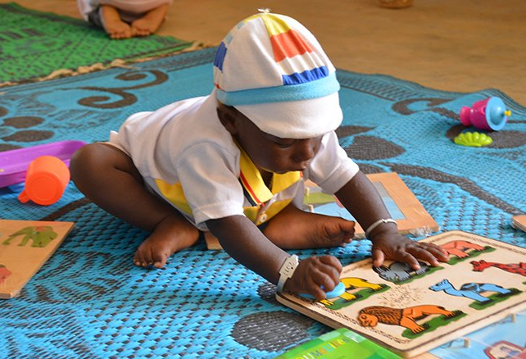
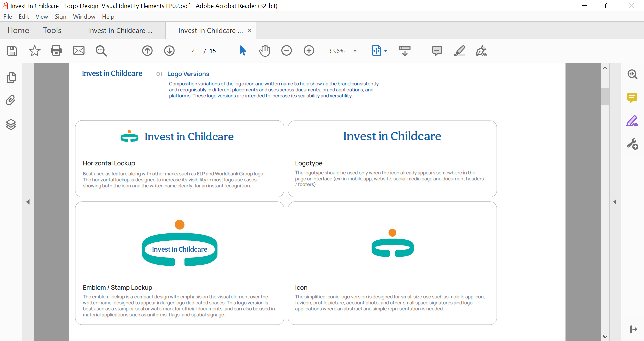


Childcare entrepreneurship programs: quality and safeguarding
Frances Beaton-Day
September, 15 2026
Notes:
Picture is from Mobile Creches, Burkina Faso

Slide 2
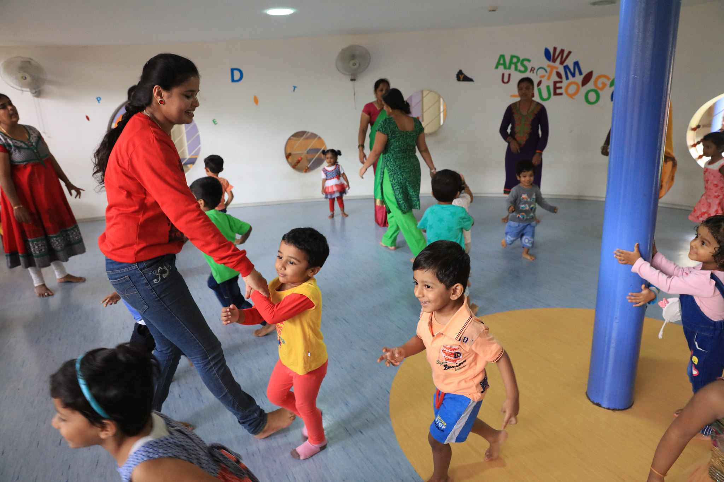
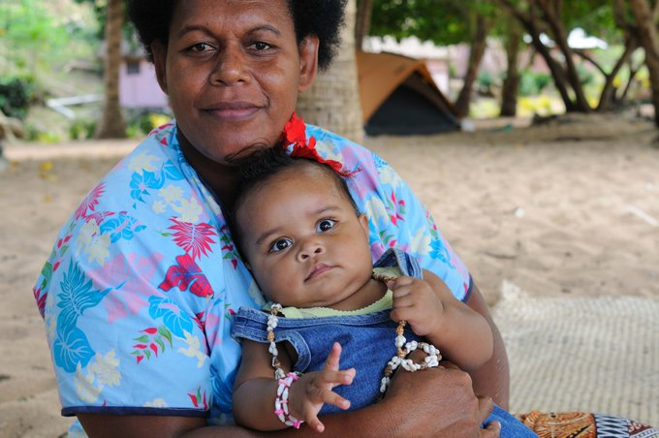
Why does quality childcare matter?
Keeping children safe from physical and psychological harm (including neglect and emotional abuse)
Risks for younger children given vulnerability and difficulty communicating
Small-scale fragmented (and often unregistered) provision further elevates the risks
Good quality provision linked with a range of positive child development outcomes
Low-quality settings can lead to no benefits or have detrimental effects
Parents and guardians more likely to use childcare services that are trusted and perceived to provide quality care
Supports parents to take up economic activities and be more productive
Notes:
Including better nutrition, improved school readiness
In some contexts childcare services are considered more of a basic babysitting service, but trust and quality are core aspects of take up and essential to driving up enrollment (supporting the sustainability of services) and achieving the economic outcomes.

Slide 3
Common challenges result in childcare providers not having access
to the support and resources needed to implement quality improvements
In many countries, key pieces of the enabling environment to support childcare quality are lacking or inadequate
  Access to training programs is very limited (and practitioner frameworks and certification is often lacking)
  Quality standards are often lacking or inadequate
    Most low and middle-income countries do not have clear quality standards for all types of providers
    If they do exist, standards may be unrealistic, or focused only on structural elements
    Variety of contexts and levels of resource make it difficult to design and implement quality standards
  Unrealistic requirements can deter providers from registering leading to high levels of unregulated provision
  Monitoring systems are lacking, and visits may be carried out by officials without specialized training and tools to support them
Challenges are magnified for small-scale childcare business: often isolated, fragmented, operating without support and lack resources and / or knowledge to implement quality improvements
Invest in Childcare has developed guidance on childcare quality and safeguarding
Guidance forthcoming on entrepreneurship support and workforce development
Notes:
Guidance looks at what are the essential elements of quality and how can these be put in place. I’ll spend a couple of minutes highlighting some of these essential elements of quality and then look at how quality and safeguarding can be supported.

Slide 4
Essential elements of quality: overview of core components
Many systems focus more on structural elements - these are necessary and lay strong foundations but are insufficient
Structural quality
Focuses on physical environment and basic characteristics of childcare services
Process quality
Is about children’s experiences and relies heavily on interactions with and capabilities of practitioners
Both critical & depend on each other
Key principles include:
physical environment is safe and secure, with enough space, free from hazards, adequate ventilation and light and appropriate toilets, handwashing and furniture
core program characteristics meet basic needs, including manageable adult-to-child ratio and availability of water and food
variety of age-appropriate materials and toys to support development and learning
children are cared for by a workforce, which is trained to respond to children’s needs and support their development (and there are lead caregivers and suitable people in contact with the children)
Key principles include:
age-appropriate play-based activities/curricula that support child development through a mix of structured activities and free play, including time for food and naps (for younger children)
promotion of children’s health, hygiene, nutrition, protection and wellbeing (including simple protocols around illness and accidents, emergencies and child protection)
caring and responsive interactions to foster strong bonds, protect children from psychological harm and support their development
Notes:
Many systems focus mostly on structural elements (often easier to measure and implement): these are necessary and lay strong foundations for process quality but are insufficient for ensuring positive child outcomes

Slide 5
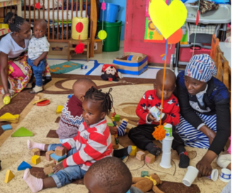
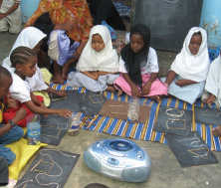
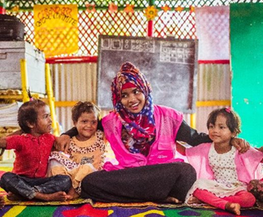
Despite varying contexts and resources, quality childcare can be achieved through focusing on a few critical elements that can be realistically and flexibly implemented in low- and high-resource settings
Notice:
It is a colorful environment, and children have a choice of play materials
The floor is safe and clean for children to walk and crawl. ​
Two Mamaprenuers are seated and playing with young children. ​
Notice:
Children are seated so they can interact
Each child has his/her own slate and a pile of seashells and string for counting and measuring activities.
No desks or expensive materials and set up in a community-donated space
Notice:
The childcare practitioner is seated at the level of the children, is showing warmth, and engaging them in a song.
The physical space use colorful, locally available materials. The lattice on the upper part of the wall allows for air flow.
Kenya: Kidogo
Zanzibar: Community Radio Program
Bangladesh: BRAC Play Lab

Slide 6

How can quality
and safeguarding be supported in the
context of childcare entrepreneurship programs?
Notes:
BRAC Play lab
Kidogo

Slide 7
What do childcare entrepreneurs need?
Training and ongoing coaching to prepare and support the childcare workforce
  2-3 weeks minimum to cover essential childcare topics and business skills
  Followed by site-based coaching, observation and feedback
Guidance on quality clear (and realistic) quality standards
Resources and support to make quality improvements
  Technical support
  Example tools (e.g. daily routine, activities, safety protocols, etc)
  Financial resources (especially for the physical environment)
The capabilities of practitioners are one of the most important factors in ensuring quality.
At both setting and system level, investing in the childcare workforce should be a top priority

Slide 8
How can these aspects be put in place to support childcare providers?
Governments should put in place system level pieces
Robust and supportive quality assurance systems
Cover all types of providers
Include feasible quality standards, clear and manageable registration processes, regular monitoring and effective use of data
Training certification and availability of training programs (directly or through partners)
Examples include:
Project level monitoring and support packages for an initial period
  Projects delivered through / with government may also have opportunities to help build aspects of the enabling environment
Social franchises or support programs (e.g. Kidogo Kenya, SmartStart South Africa)
Partnerships with NGOs to deliver trainings, coaching, monitoring activities (e.g. OneSky Vietnam)
Parents and community members to monitor provision and drive accountability (informal or formal)
Self reflection for practitioners
Other
actors can strengthen support to childcare providers and fill system level gaps
Notes:
But as mentioned, these need to be developed in many places

Slide 9

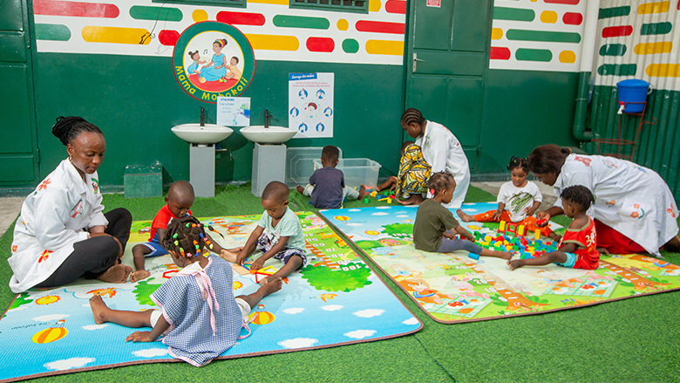

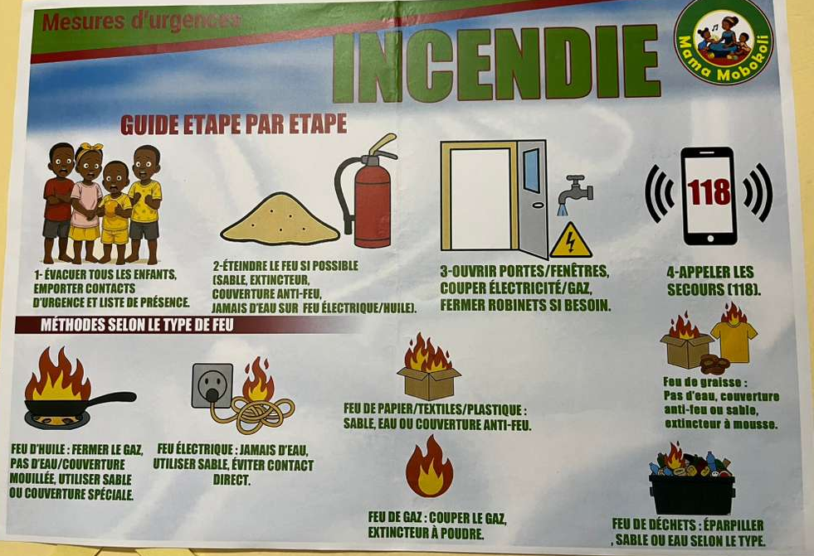
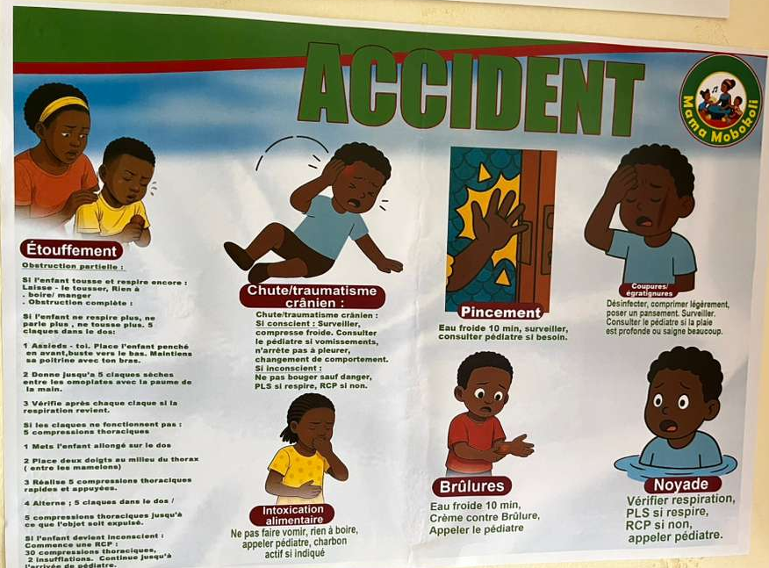
World Bank-supported project in Republic of Congo: strong support package for childcare entrepreneurs and developing quality standards
Childcare entrepreneurship track within a youth inclusion project to establish creches for children ages 1-3
Package of support promotes quality
4-month part-time training on ECD, life skills and entrepreneurship (includes internship)
Coaching and support for 12 months (weekly supervision visits and monthly coaching)
Implementation guidance and tools developed (activities, daily routine, safeguarding protocols)
Implementation delivered through local NGO (intense support) and local government
Alternative quality standards were also developed with the government to pilot in the settings

Slide 10



BRAC childcare entrepreneurship program in Tanzania and Uganda: initial support package plus ongoing community engagement
Supporting childcare entrepreneurs through start-up package and ongoing center management committees with parents and community members
Start-up package to promote quality includes:
  Childcare training (short training covering child development, responsive caregiving, safeguarding and parents’ engagement) + business training
  Monthly coaching and supervision
Photo: Twal Photography, BRAC website
Center management committee (CMC) to support on ongoing basis
  Includes parents, the entrepreneur and members of the community
  Monitors the quality of the center, mobilizes local materials, and encourages regular attendance and on-time fee payment
  Frontline structure for child protection: CMC is responsible for upholding safeguarding policies
This shared ownership keeps a center accountable and sustainable once BRAC's direct support tapers off

Slide 11
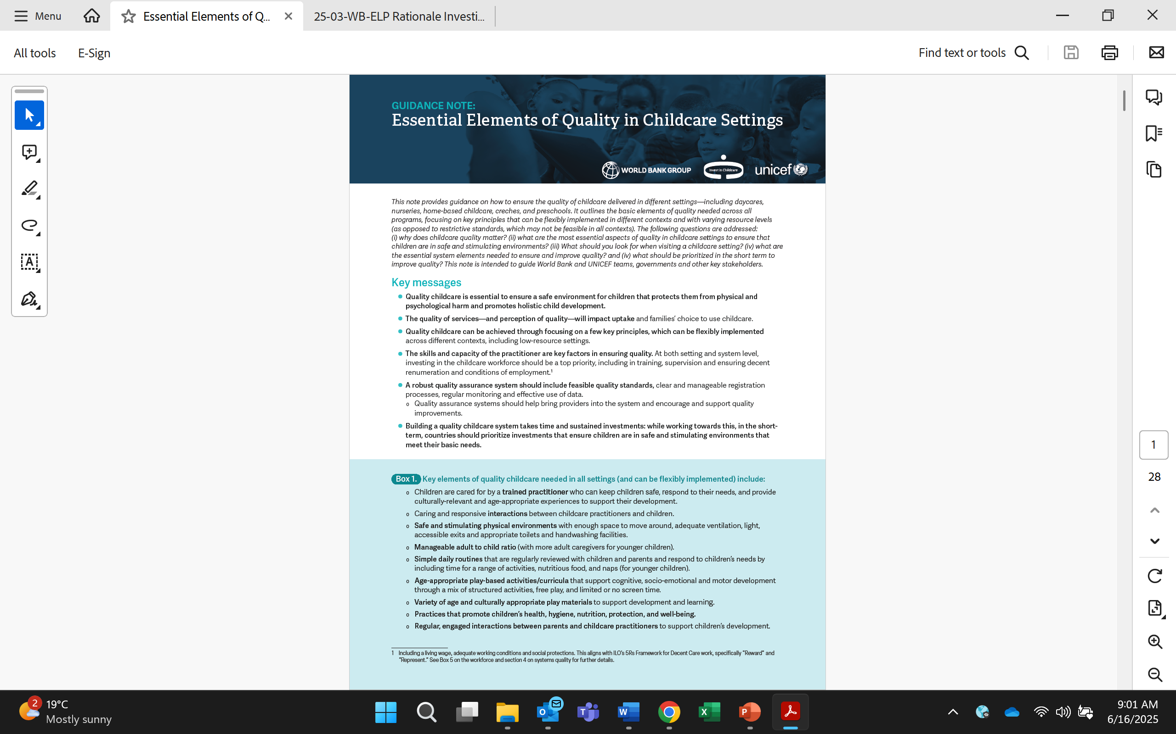
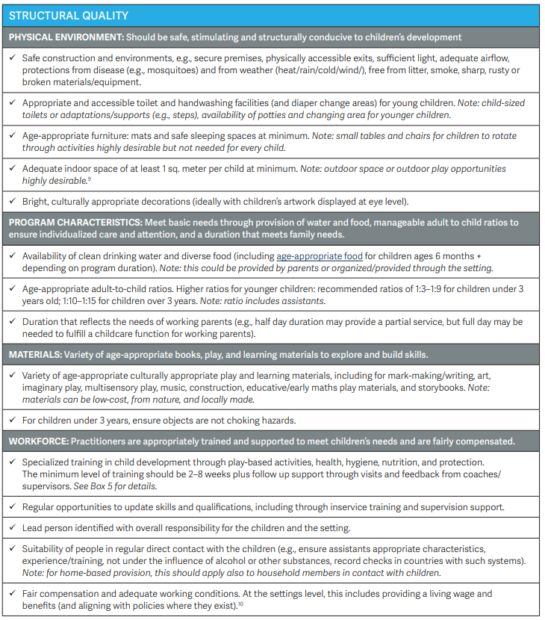
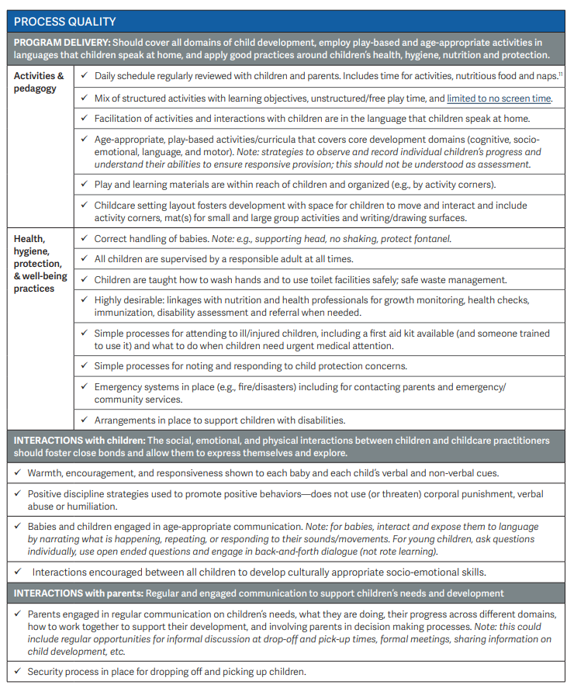
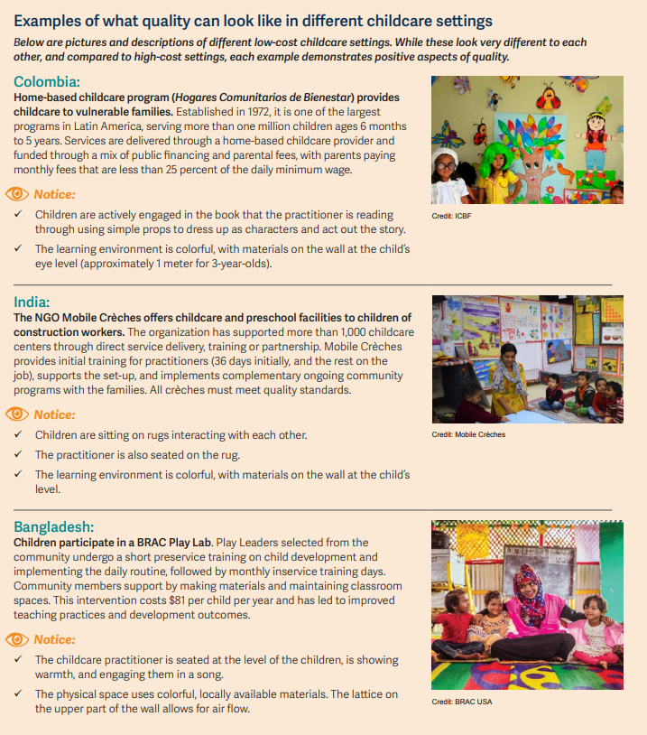
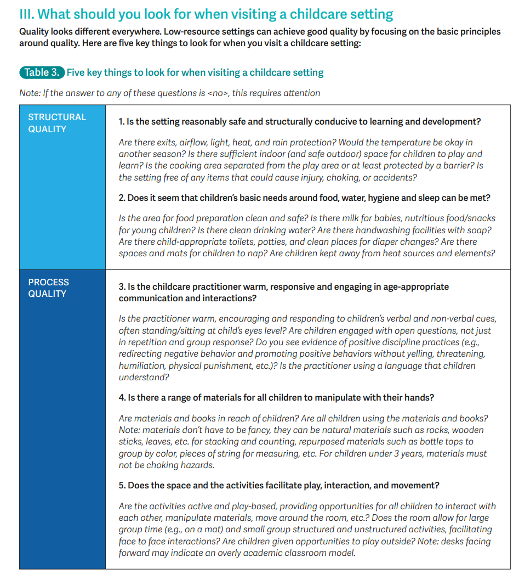
What tools and resources are available?
World Bank’s Invest in Childcare team and UNICEF launched a guidance note in 2025 on essential elements of quality. It includes a focus on:
Key elements of quality that all types of providers should meet and can be flexibly implemented
Robust and supportive quality assurance systems
Checklists and practical tools
For WBG teams, several other tools exist:
Safeguarding checklist
Repositories of quality standards and training materials
On demand technical assistance from Invest in Childcare
Forthcoming resources
Guidance on supporting childcare entrepreneurship
Guidance on workforce development
IFC safeguarding workshop for employers and safeguarding training module for childcare providers

Slide 12
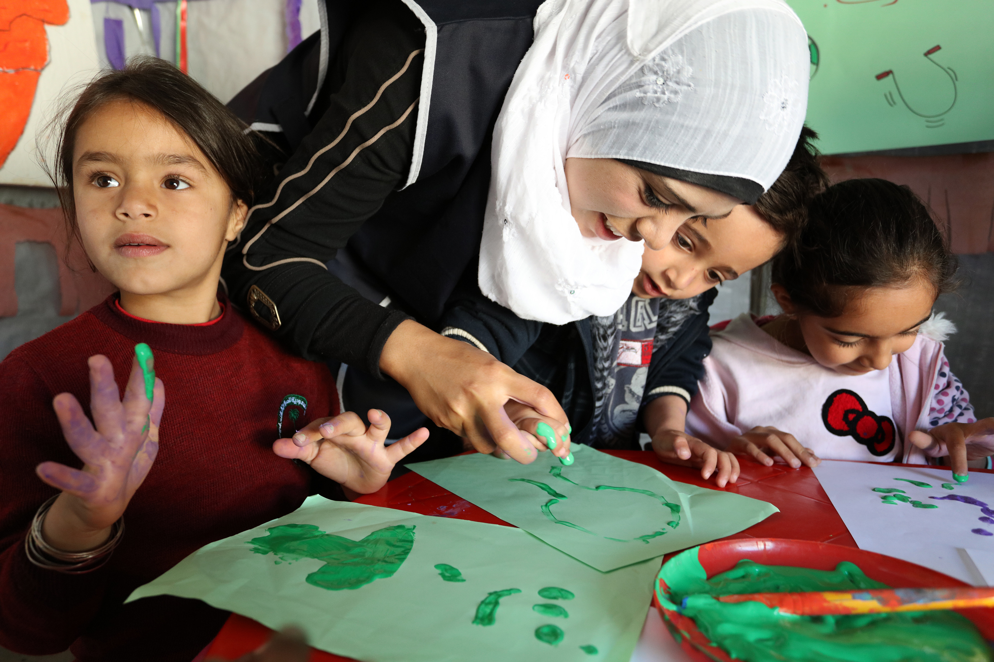

Thank you!
For more information please visit: worldbank.org/investinchildcare
Or contact us @: invest_in_childcare@worldbank.org

Slide 13
Additional information

Slide 14
Structural quality: summary of essential elements
 | Variables | Elements
 | (i) Physical environment | Safe, stimulating and structurally conducive to children's development Safe environment (free of hazards, secured premises, and with ventilation, light, and physically accessible exits) Adequate space and mats/age-appropriate furniture Age-appropriate toilet and handwashing facilities Culturally appropriate and bright decorations on the walls
 | (ii) Program characteristics | Able to meet basic needs Provision of drinking water and age-appropriate food Manageable ratio of adults to children (higher ratios for younger children)
 | (iii) Materials | Variety of materials to explore and build skills Variety of age-appropriate play and learning materials (can be low-cost, natural, locally made materials)
 | (iv) Workforce | Practitioners are appropriately trained and supported to meet children’s needs and are fairly compensated Trained in child development, health, hygiene, nutrition, and protection, ongoing support and professional development Lead person with overall responsibility Suitable people in direct contact with children Provided a living wage and adequate working conditions
Building the evidence base through evaluations, ROI analysis, diagnostics, increasing global and country-level data, publications, global public goods

Slide 15
Process quality: summary of essential elements
Variables | Variables | Elements
 | (i) Curriculum & pedagogy | Supports child development through play-based and age-appropriate activities in languages that children speak at home Daily routines that are reviewed with children and include time for activities, food and naps Age-appropriate play-based activities and pedagogy that support development through a mix of structured and free play Accessible play and learning materials
 | (ii) Health, hygiene, nutrition, protection & wellbeing
 |  | Good practices around children’s health, hygiene, nutrition and protection Attention to children’ health, hygiene, nutrition, protection, and wellbeing, including processes for ill/injured and malnourished children Noting and responding to child protection concerns, emergency situations, proper hygiene, waste management, and safeguarding protocols
 | (iii) Interactions | Positive and responsive relationships with children and parents/guardians Warm and responsive caregiver-child interactions that foster strong bonds and protect children from psychological harm, positive discipline strategies, age-appropriate communication, opportunities for child-to-child interactions Regular engagement with parents and the community

Slide 16
More information on the Invest in Childcare quality guidance note
Momentum around childcare is building and childcare is being implemented through many different sectoral entry points, with some risk around quality
Often approached through a gender / jobs lens and teams may not be familiar with childcare or early child development
Risk of fragmented services being implemented at scale in countries without robust systems
Confusion over what good quality looks like and how much it needs to cost
Tendency to think that good quality childcare is too expensive
Often too much focus on expensive infrastructure, furniture and materials
Limited training for caregivers
Lack of clear guidance for implementing teams
Process
Reviewed existing guidance and country quality assurance regulations (e.g. standards)
Conducted World Bank and UNICEF internal reviews and partner reviews and consultations (50 experts)
Tested draft note with 100 policymakers from 13 countries in World Bank Invest in Childcare Policy Academy
Refined note and made final translations into Arabic, French, Portuguese, Russian, Spanish, and Swahili

Slide 17

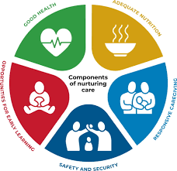
Checklists of essential elements of quality
Structural quality
Includes structural and process elements that support the five components of nurturing care
Many elements written flexibly to allow differences
Process quality
in implementation across different types of settings including home-based
More specific guidance for some elements based on the evidence base, e.g.:
Ratios
Minimum 2 weeks training to cover core topics (can be over time)

Slide 18
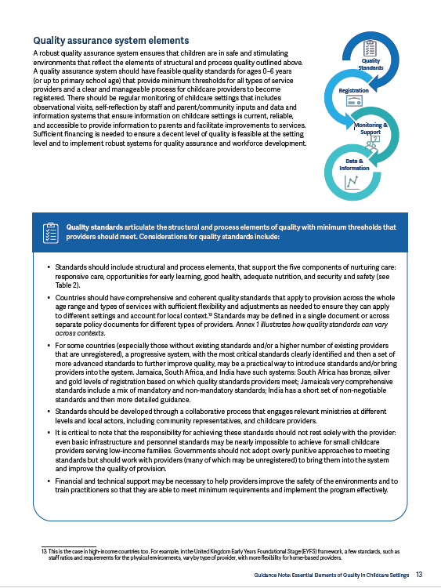

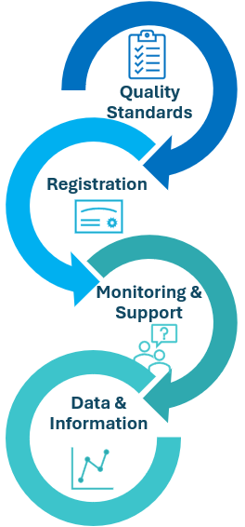
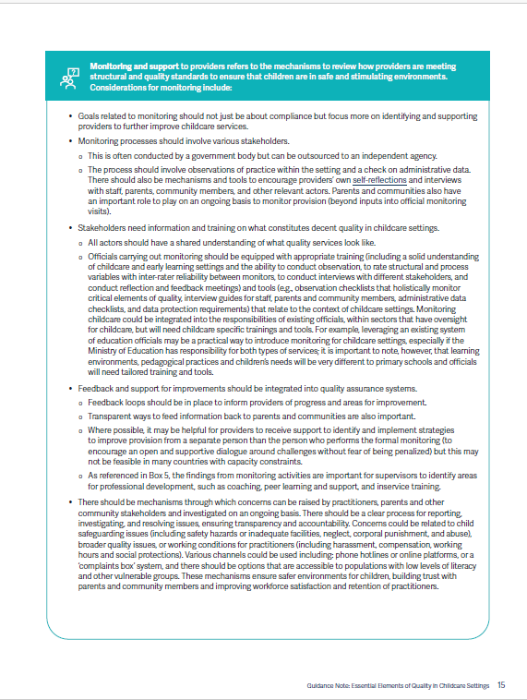
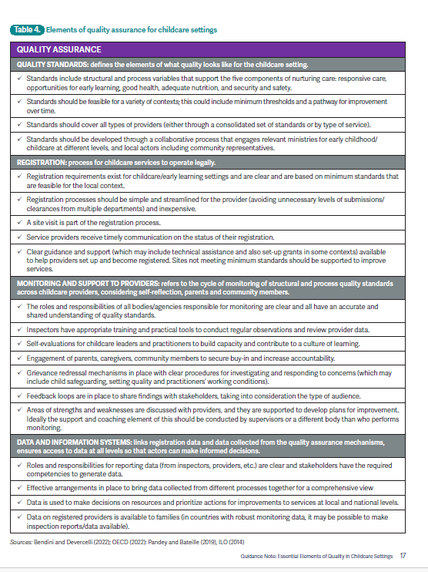
Overview and checklists of what should be in place at the
systems level to improve quality
A well-prepared and well-supported workforce
Quality assurance
Quality assurance information and checklists
At the systems level this includes:
Training opportunities being available
Certification and practitioner frameworks
Decent work policies
QA systems that help practitioners improve
Additional guidance on workforce coming in early 2027
Notes:
Deep dive note on workforce development.

