Slide 1

Care as Climate Infrastructure:
Leveraging Care Systems to Foster Climate-Resilient and Inclusive Growth for Women-led MSMEs
Insights from DECD Report
September 15, 2026

Slide 2
Study Objectives
To expand knowledge on the care–climate nexus through a private sector development lens, with a focus on the experiences of women-led micro, small, and medium enterprises (MSMEs).
Focus:
Move beyond established linkages to demonstrate how private sector development actors can drive inclusive, care-sensitive, and climate-resilient solutions. Guiding question: how is climate change reshaping enterprise operations, livelihoods, and working conditions?
Provide actionable recommendations for donors and development agencies.

Slide 3
Premise
Climate and care crisis are intertwined.
UN Women, IDRC, UNRISD, Asia Foundation, the Care-Climate Initiative
Implication for MSMEs not sufficiently understood.
Care-sensitive, climate resilient solutions must be grounded with evidence.

Slide 4



Research Approach
Literature Review
23 Care Enterprise Survey Responses
13 Key Informant Interviews
Geographic Coverage
Stakeholders
Sub-Saharan Africa
Asia
Latin America
Women-led MSMEs
Worker organizations
Researchers
Donors and development actors

Slide 5
Findings

Slide 6
Climate Shocks Increase Care Demands and Weaken Care Systems
Climate Shocks | Care Impacts
Extreme heat Flooding Drought Wildfires Environmental degradation | Increased Care Demands More time securing household essentials (water, fuel) More illness, injury, and disability Increased caregiving responsibilities Disrupted care arrangements from migration and displacement
 | Weakened Care Systems Damage to care-supporting infrastructure (water, energy, transport) Disrupted care services (childcare, education, healthcare) Reduced public investment and fiscal space

Slide 7
Care and Climate Pressures Directly Affect Women-Led MSMEs
Labour Force Participation | Enterprise Performance | Economic Wellbeing & Resilience
Reduced working hours Shift toward informal or home-based work Exit from labour force or enterprise Reduced access to markets, training and opportunities | Business interruptions Asset loss and damage Increased operating costs Workforce absenteeism Reduced productivity and earnings | Income instability Asset depletion and rising debt Reduced capacity to adapt and recover Increased vulnerability over time

Slide 8
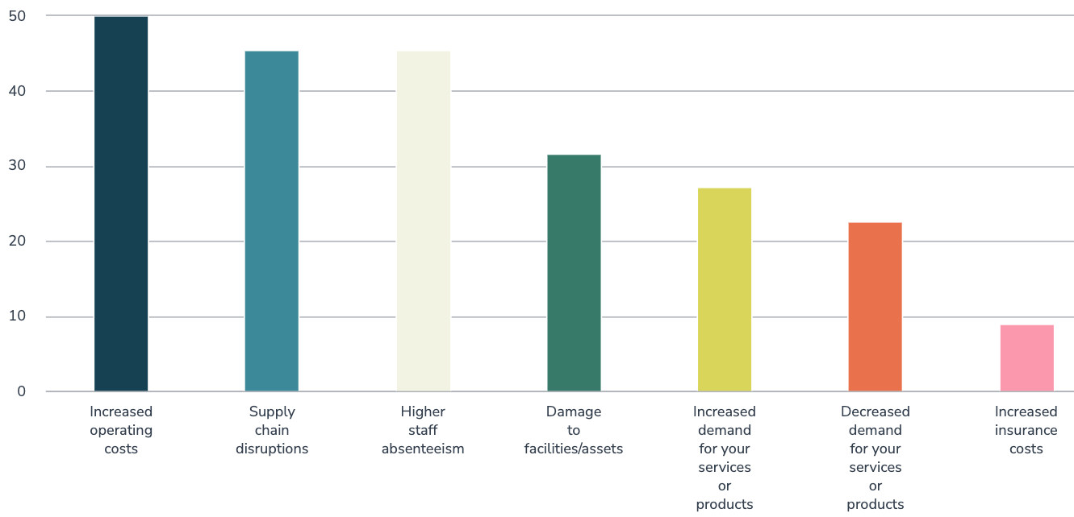
90% of surveyed care enterprises reported climate change has affected their operations.
50%
46%
46%
32%
27%
23%
9%

Slide 9
Why Climate and Care Risks Disproportionately Affect Women-Led MSMEs
Physical Vulnerability
Social Vulnerability
Institutional Vulnerability
Greater exposure to climate hazards
Unsafe working environments
Limited access to climate-resilient infrastructure
Time poverty and competing care demands
Reduced flexibility to adapt work schedules
Unequal access to climate-related information and training
Limited access to finance and insurance
Gendered gaps in social protection and labour rights
Limited voice in climate and economic decision-making
Care Enterprises face compounded challenges

Slide 10
Care Enterprises are both Highly Climate-Vulnerable and Critical Climate Adaptation Agents
Climate shocks demand for care services and labour-saving technologies (clean cookstoves, solar lighting, water solutions).
At the same time, care enterprises face higher costs, service disruptions, and workforce constraints.
Vicious cycle: care needs rise as enterprise capacity declines.
Yet care enterprises are essential for climate resilience, sustaining access to childcare, healthcare, water, and energy services.
Strengthening care enterprises can reduce unpaid care burdens and improve community resilience.

Slide 11
Women-led MSMEs and Care Enterprises Are Adapting – But Largely on Their Own
Individual
Adjusting work schedules and hours
Drawing on savings and loans
Relying on informal care and support networks
Bringing children to work
Enterprise
Introducing flexible work arrangements
Training on climate adaptation and preparedness
Infrastructure and energy upgrades
Diversifying supply chains
Collective
Climate information and early warning systems
Shared infrastructure and risk management strategies

Slide 12
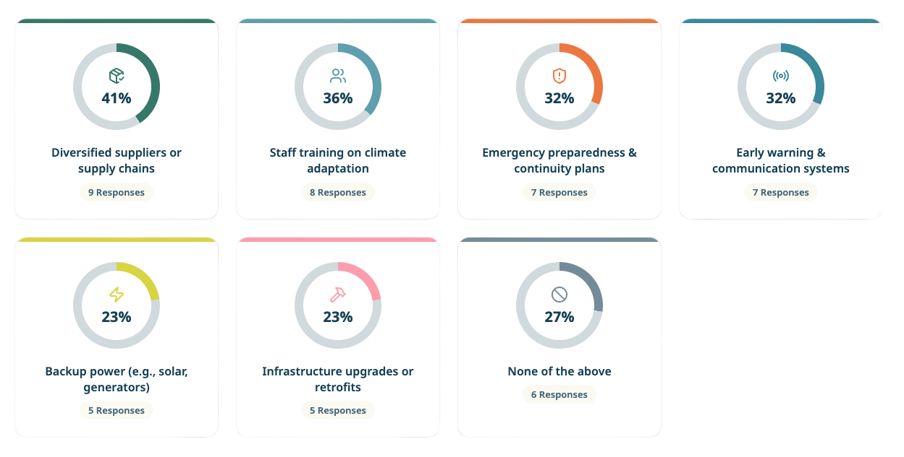
73% of surveyed care enterprises have implemented at least one measure to adapt to or mitigate climate risks
64% of care enterprises reported being only slightly prepared – or not prepared at all – to cope with climate shocks.

Slide 13
Resilience is Not Enough: Unlocking Support for Women-led MSMEs and Care Enterprises
Financial Support | Technical Assistance | Enabling Environment
Flexible, long-term financing tailored to women-led MSMEs Grants, loans, and catalytic capital Funding for climate-resilient technology and infrastructure | Access to business development services and mentoring Support to develop climate adaptation plans and practices Access to climate information and early warning systems | More inclusive policy and regulatory environments Stronger social protection systems Investment in pubic care systems and infrastructure Representation in climate adaptation processes and decision-making
Care is an untapped driver of climate resilience, economic inclusion, and private sector growth. Failure to recognize this is both a critical omission and a missed strategic opportunity.

Slide 14

Read the full report:
Care as Climate Infrastructure: Leveraging Care Systems to Foster Climate-Resilient and Inclusive Growth for Women-led MSMEs
https://www.enterprise-development.org/wp-content/uploads/DCED-Care-as-Climate-Infrastructure-Report-July-2026.pdf

