Slide 1
Introduction to INVEST and WSME toolkit
1
Introduction by We-Fi
2
3 mins
10 minutes
3
Panel Discussion
4
Q&A
35 minutes
10 minutes

Slide 2





























We extend our gratitude to all partner institutions, funders, and banks whose collaboration and insights made this work possible
Consortium partners
Participating institutions / banks
Note: This report was made possible through support from the Argidius Foundation on behalf of the Growth Firms Alliance. It does not necessarily reflect the views of other GFA sponsors, who did not participate in its development.

Slide 3
Commercial banks can unlock $5.7 trillion by supporting underserved SMEs
Large enterprises are firms with 250+ employees, usually earning more than $15 million annually
They have full access to commercial bank credit, capital markets, and private equity
$5.7 trillion
Annual financing gap for formal MSMEs
in emerging economies
“The missing middle” SMEs are firms with 10–250 employees and revenues between $100,000–$15 million
Around 44% are credit-constrained since they are often too large for microfinance but too risky for banks
$5.7T
Women-
owned
18%
Men-
owned
37%
Microenterprises are firms with <10 employees, typically under $100,000 in annual revenue
They rely on microfinance or informal lenders. Over 60% have sufficient financing.
$4.6T
The largest gaps are in Latin America, Sub-Saharan Africa, and East Asia & Pacific
45%
Existing MSME finance
MSME finance gap
MSME finance demand
SME definition: The INVEST Toolkit focuses on formal SMEs, aligning with IFC’s SME definition (10–250 employees and annual revenues between $100,000–$15 million). Organizations are encouraged to adapt it as needed to align with their internal SME definitions and country context.
Sources: IFC. (2025). MSME Finance Gap

Slide 4

INVEST approach highlighs effective SME banking is a process, not a product
Research & Diagnostics
Pilot & refinement
Roll out
Steps
(might not be linear)
Assess the market
Understand the SME segment
  Determining the business case
Diagnose bank capabilities
Set up performance tracking
Test and refine
Rollout
Key questions | What does the market look like? What is the overall opportunity? | What are the key segments? How do their needs differ? | Which SME segment is attractive from a scale and ROI perspective? | What does my organization need to do to create a strong SME value proposition? | How will I know if my organization is achieving its full potential? | What adaptations are necessary to expand market share? | How can these banks target scale (e.g., across branches, subsidiaries, new markets)?
Note: The INVEST framework provides a simplified and generalized representation of elements of success applicable to the SME banking journey. It is intended for guiding purposes.

Slide 5
The acronym highlights key success factors to pay attention to throughout the process
Research & Diagnostics
Pilot & refinement
Roll out
I
Incentives – Establish an incentive structure throughout the organization that enables long-term commitment across departments
N
Non-financial services – Enhance the value proposition to increase customer loyalty and financial returns
V
Versatile implementation – Ensure that a change management structure is in place across departments for implementation
Key elements for success
E
Embed relationship banking – Implement a customer-centric relationship model that fosters higher customer satisfaction and cross-selling opportunities
S
Segmentation – Identify market segments for which there is a strong business model; tailor the value proposition accordingly to nuanced needs and characteristics (e.g., sector, lifecycle stage, formality level, etc.)
T
Technology – Leverage data and digital tools to optimize new and existing client identification, credit assessment, and disbursement times—driving market share growth and profitability

Slide 6

The toolkit provides banks, funders and TA providers with tools to apply the INVEST process across diverse contexts, including WSMEs
Research & Diagnostics
Pilot & refinement
Roll out
To evaluate the market opportunity and identify strategically aligned partners
Tools for TA funders
Tools for banks
1
Market assessment
2
Market sizing
3
Partner screening tool
4
Business case
WSME Segmentation Toolkit
Understand different profiles of women-led SMEs and tailor solutions accordingly
WSME product & service mapping
Identify relevant products and gaps across lifecycle stages
Case studies (e.g., Wema, Itaú)
To understand the TA needs of banks to effectively focus capacity building
Order of use
5
Bank diagnostic
Segmentation tool*
6
7
Enterprise needs assessment
Credit risk management primer
8
*Note : All of these are available on wsmesegmentation.com
To effectively track and communicate impact of programs
9
Bank performance dashboard
10
Case study template*
*Note: the case study template can also be leveraged to gain strategic alignment and advocate for program funding.
Notes:
Highlight gender focus here

Slide 7
We categorized WSME products and services through the lens of lifecycle stage, segmentation, challenges addressed, and level of innovation
WSME journey across two lenses
Unique challenges faced by WSMEs
Level of innovation in product design
Lifecycle lens
We identified the most pressing and frequent barriers to understand which products were designed to address them, including:
Limited financial literacy
Lack of acceptable collateral
Gender bias in credit assessment
Product misalignment with WSME needs
Weak relationship management from financial institutions
We defined an innovation rubric to evaluates the degree of intentionality in product design:
High: fit-for-purpose based on data and channeled through gender-focused platforms
Medium: Includes meaningful gender-based adaptations, but not fully tailored
Low: Lightly rebranded or generic SME offerings with low customization
… and assessed how frequently each type of solution appears based on the number of examples identified
We used lifecycle stages to categorize products and assess their coverage across:
Pre-entrepreneurship
Start-up: 0-2 years
Early growth: 2–5+ years
Scaling: growth in markets/segments
Segmentation lens
We complemented this with a segmentation lens to understand the key challenges and the differentiated needs:
Segments by growth profile: High (Wealth Creation, Legacy building), Moderate (Aspired Expansion, Stability), Low (Livelihood, Survival)
Notes:
https://wsmesegmentation.com/

Slide 8
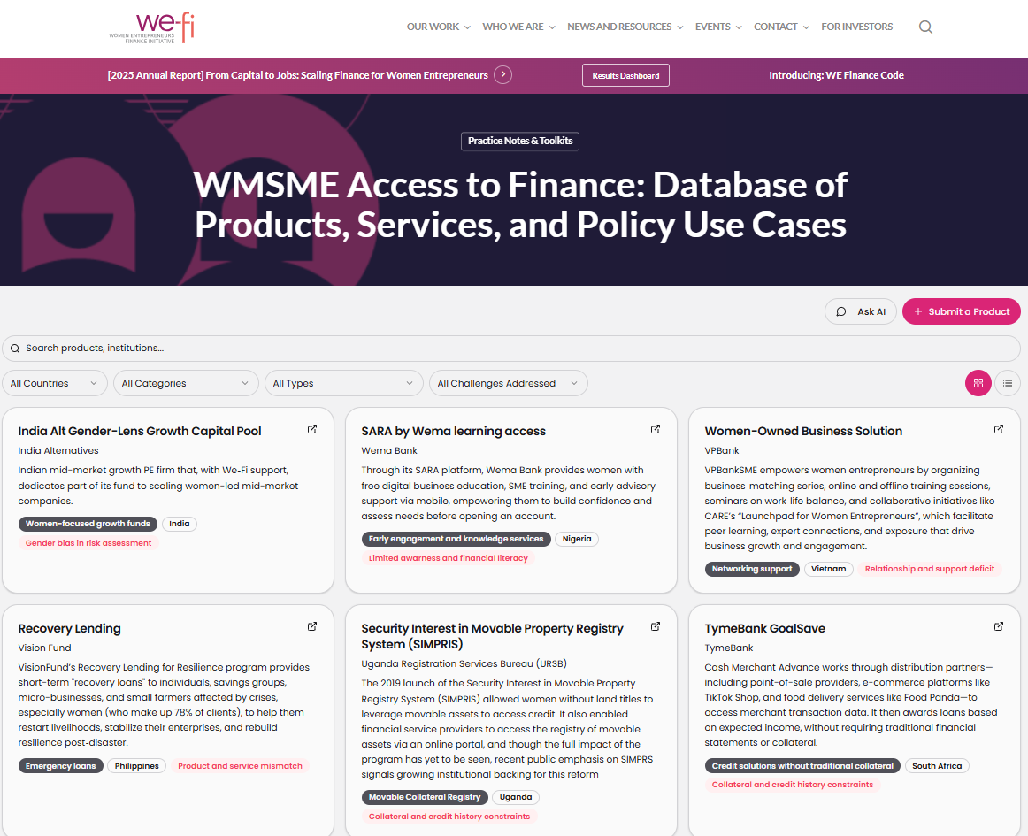
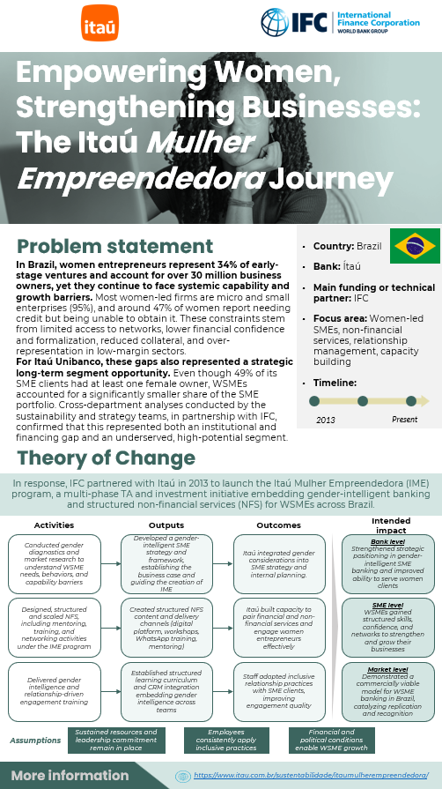
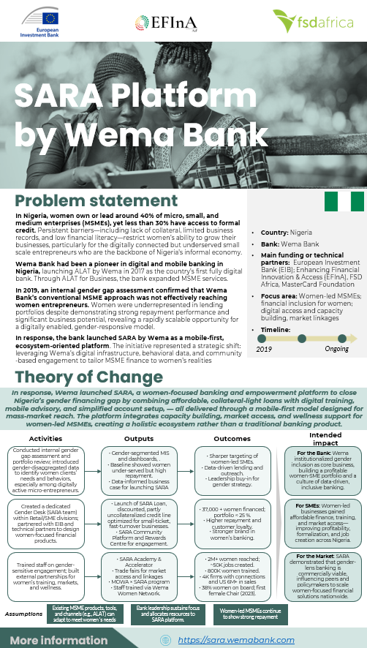
The analysis resulted in an online database that mapped 19 WSME product and service categories profiling 58 good practice examples from FSPs and two case studies
We-Fi Online Database
Case Studies – Wema Bank and Itaú

Slide 9
WSME products vary by lifecycle stage, but consistently aim to address a core set of recurring challenges
Lifecycle stage | Products | Main WSME challenge they respond to
Pre-entrepreneurship | WSME marketing campaigns | Limited awareness and financial literacy
 | Early engagement and knowledge services
 | Gender-smart savings accounts | Product and service mismatch
Start-up | Preferential credit terms | Gender bias in risk assessment
 | Credit solutions without traditional collateral | Collateral and credit history constraints
 | Education and training for WSMEs | Relationship and support deficit
Early growth | Working capital loans | Product and service mismatch
 | Asset finance and movable collateral loans | Collateral and credit history constraints
 | Networking support | Relationship and support deficit
 | Recognition and visibility opportunities
 | Insurance-bundled loans | Product and service mismatch
 | Emergency loans
 | Supply chain and contract financing
Scaling | Dedicated relationship management | Relationship and support deficit
 | Trade finance | Product and service mismatch
 | Women-focused growth funds | Gender bias in risk assessment
Cross-stage | WSME accelerators | Relationship and support deficit
 | Bundled Packages (Financial + NFS) | Product and service mismatch
 | Life-event responsive lending

Slide 10
Rethinking how financial institutions serve WSMEs
Key insights from the process
Implications for solution design
Diversity of design: Products range from highly tailored, gender-intentional offers to lightly adapted SME products, with most examples showing only partial adaptation rather than fully fit-for-purpose design.
Persistent gaps: Few offerings exist in the scaling stage, with very limited examples of solutions such as trade finance or growth capital for WSMEs
Non-financial services matter: Many strong solutions combine finance with training, mentorship, or visibility, with a significant share of ‘good-practices’ examples offering bundled services.
Segmentation is a must: WSMEs face distinct barriers across segments (e.g., collateral constraints vs. capability gaps), requiring tailored solutions.
Move beyond adaptation: designing effective solutions requires intentional, data-driven product development, not minor tweaks.
Focus on underserved stages: there is a clear opportunity to develop solutions for scaling and growth-stage WSMEs.
Design integrated value propositions: combining financial and non-financial services is critical to drive uptake and impact.
Start with segmentation: tailoring solutions to different WSME profiles is essential to achieve product-market fit.

