Slide 1
Supporting Women Entrepreneurs:
WHAT WORKS?
Lessons from the Evidence and Opportunities for Further Research
Felicia Siegrist, We-Fi, June 2025

Slide 2
Awa Rivet, Founder of Le Comptoir du Sel
Founded business focused on processing and commercializing salt
Joined support programs to tackle challenges in access to finance, skills, and markets
Scaled her business, launched a second company, and created new jobs

Slide 3
Women Entrepreneurs struggle with…
Limited Access to Finance
Limited Access to Skills & Networks
Limited asset ownership / collateral for bank loans.
(Jaim 2020; Graney and Perlik 2024)
Smaller and less diverse networks.
(Bullough et al. 2019; Howell and Nanda 2023)
Limited Access to Markets & Tech
Limited Enabling Environment
Limited access & skills to use digital tools for funding and market access.
(GSMA 2023; Cherie Blair Foundation 2025)
Balancing business with unpaid care work.
(ILO 2018; Taylor et al. 2023).
…

Slide 4
WHAT WORKS?
IN ADDESSING THESE CONSTRAINTS

Slide 5
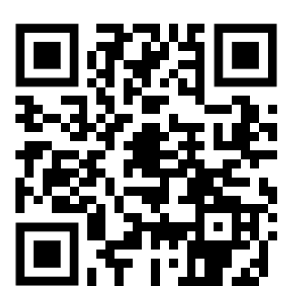
We-Fi Evidence Paper
For researchers
& policymakers
Maps evidence from We-Fi programs and beyond
Identifies promising interventions with the potential for scale
Analyses evidence gaps and highlights research opportunities
Offers a dynamic view (2022 vs. 2025)

Slide 6
Methodology
1
2
3
Identification
Screening
Rating & Coding
Records from academic and grey literature (n=462)
Robust empirical evidence (n=189)
Experimental (n=84) incl. RCTs and quasi-experimental studies
Non-experimental (n=115) incl. systematic reviews, comparative and correlational studies
Overall confidence score based on unweighted averages
Rating synthesis (strong, emerging, limited) based on the direction and weight of evidence
*Rating system is based on rating methodology developed by Dalberg Advisors and FMO (2021)

Slide 7
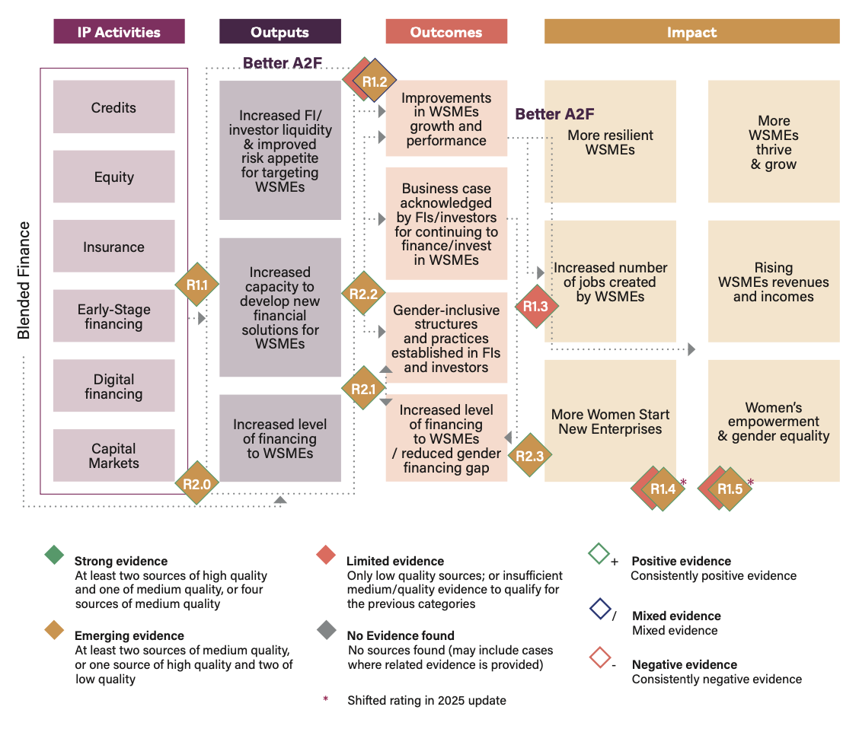
Example: Theory of Change - Access to Finance
*

Slide 8
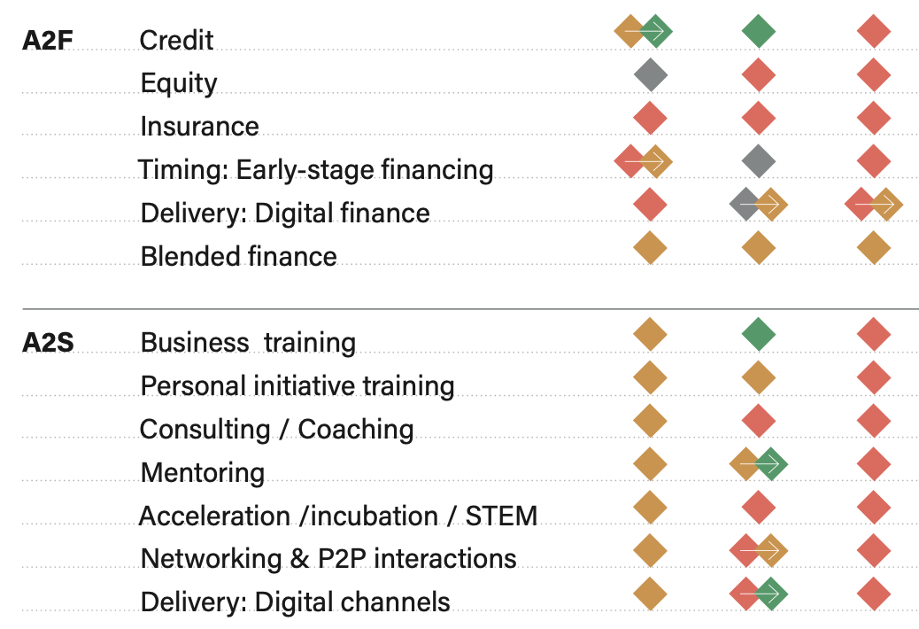
Where is evidence strongest?
Outputs
Outcomes
Impacts
Access to Finance
Access to Skills and Networks

Slide 9
Where is evidence strongest?
Outputs
Outcomes
Impacts
Access to Markets and Technology
Enabling Environm.
*Analysis on Enabling Environment focused on impact level

Slide 10
Where do we see emerging patterns on What Works?
Areas / Topics | Evidence examples | References
A2F: Alternative credit scoring models | A randomized controlled trial (RCT) in Nigeria found that women-led firms given cashflow-based loans were 20 percentage points more likely to access formal credit after two years—unlike male-led firms. | Gruver et al. 2024 Other: Chioda et al. 2024; Alibhai et al. 2022
A2S: Targeted training | A meta-analysis shows that traditional business training can have positive effects for micro-enterprises, whereas coaching, consulting, and mentoring may be more effective for larger firms. | McKenzie Woodruff 2023 Other: Ubfal et al. 2022; Lang and Seither 2022;
A2M: Market access | A RCT in the Republic of Congo found that providing information on earnings can encourage women to cross over to more profitable sectors, thereby reducing the gender gap in earnings. | Gassier et al. 2022 Other: Cucagna et al. 2020; Campos et al. 2014
EE: Gender-equal laws and policies | A correlational study found a strong link between legal gender equality and women’s access to finance, though social norms can weaken this effect. | Perrin and Hyland 2023 Other: Becerra-Ornelas et al. 2024

Slide 11
Some overarching insights
Low average treatment effects, highlighting considerable heterogeneity in outcomes and the importance of segmentation and targeting.
Contextual constraints (e.g., intra-household norms) seem to play a big role, suggesting that engaging men in the dialogue and interventions may be essential.
The availability and use of sex-disaggregated data is crucial for understanding the effectiveness of policies, programs, and products.

Slide 12
Where do evidence gaps persist?
Outputs
Outcomes
Impacts
Access to Finance
Access to Skills and Networks

Slide 13
Where do evidence gaps persist?
Outputs
Outcomes
Impacts
Access to Markets and Technology
Enabling Environm.

Slide 14
Examples of Research Opportunities
Macro Level Data: WSME finance gap, profitability gap, productivity gap, economic contribution etc.
ACCESS TO FINANCE
ACCESS TO SKILLS & NETWORKS
ACCESS TO MARKETS
ENABLING ENVIRONMENT
Credit: How can alternative lending models be scaled to expand access to larger loans for WSMEs?
Acceleration: What design features of incubator and accelerator programs are most effective in supporting the growth of WSMEs?
Value chains: What sector-specific practices and policies are most effective in engaging more WSMEs in value chains (incl. trade finance)?
Social norms: How do intra-household social norms shape the entrepreneurial decisions, roles, and outcomes of women and men?
Equity: How does equity financing improve access to additional financing and impact business performance for men vs. women?
Laws and policies: What are key drivers of effective legal reform and how do legal reforms interact with social norms?
Networks: How can networking programs and tools be designed to help WSMEs access new financing and markets?
Digital platforms: What role does e-commerce play in supporting the business growth and internationalization of WSMEs?
Bundled services: Which combinations of financial and non-financial services best support WSME growth, and how cost-effective are they?
Digital: How can digital tools be leveraged to scale training programs and reduce delivery costs?
Sector Access: What factors influence potential and existing women entrepreneurs to enter or transition into male-dominated sectors?
Impact Data: Further articulating and quantifying the impact (direct and indirect) on WSMEs and Women’s Economic Empowerment

Slide 15
Let’s work together to close evidence gaps on women’s entrepreneurship!
Contact details:
Felicia Siegrist, We-Fi Knowledge and Learning Lead
Email: fsiegrist@worldbank.org

