Slide 1
Women Entrepreneurs Finance Code
Workshop In A Box: Module 6
National WE Finance Code Design Workshop

Slide 2
Facilitation Notes*
The purpose of this Workshop is to gather all the relevant stakeholders from your Country to be able to come to consensus on key design features on your National WE Finance Code. The content is organized in 4 sessions to facilitate discussion and decisions on:
Session 1: Purpose and goals of the National WE Finance Code
Session 2: Governance structure and operating procedures
Session 3: Recruitment and onboarding
Session 4: Data collection and reporting mechanism
Within each session the materials include: 1) A brief recap of the relevant Code guidance 2) Slides with key questions and decisions to be discussed with the group, including sample answers, and 3) Slides to record the group's decisions on each of the key questions
Ultimately, the consensus you come to in these session(s) can be leveraged in a document that codifies the framework for the in-country Code, meeting the global Code requirements and customizing it to country context – called a National Charter.
*Please see slide notes for more details
Relevant available resources:
Workshop in A Box: Module 1 WE Finance Code Introduction
Notes:
Adapt these materials for your country: The slides provided here are designed as thought starters. The primary goal of these sessions are to enable countries to adapt the Code to their unique context.
Structure your sessions: Allocate sufficient time for each of the four sections, whether conducted as separate workshops or combined into a single day. Adjust timing as needed to fit the group’s preferences and needs.
Select Participants: Decide which organizations should be part of the National Coalition and carefully select who should attend the workshops and the ideal number of participants to foster a meaningful discussion and outcomes.
Prepare Participants: Ensure that all participants are familiar with the WE Finance Code. Share the basic resources of the WE Finance Code as pre-reading ahead of the workshop OR conduct the introductory Modules from the Workshop in a Box package.
Making Decisions – the facilitator could guide discussions and help the group arrive at consensus for each of the key discussion questions in these modules, or draft some options ahead of time and present them to the group during these workshops.

Slide 3
Objective of this Workshop
Come to consensus on key design features of the Code:
Define the purpose and goals of the National WE Finance Code
Make decisions on recruitment and onboarding of Signatories
Establish the data collection and reporting mechanism
Align on governance structure and operating procedures
Codify decisions made on design features in a National Charter document
National Charter Guidance
National Charter Template
Source: https://www.we-fi.org/we-finance-code/resources/

Slide 4
National Charter – RECAP
The National Charter should to be drawn up by the National Coordinator of each Code country, in consultation with the other national champions, and coalition partners. .
The WE Finance Code Charter will include:
The Code Goals: What will you achieve
The list of key Stakeholders’ and their roles and responsibilities: National Coalition and Champions, National Coordinator, National Aggregator
The Code Framework:
Eligible Signatories (type of FIs, ecosystem);
Commitment framework and mechanism
On-boarding process
Data aggregation mechanism
Annual Country report publication (optional) / evaluation mechanism
The Stakeholder engagement
Incentives for FSPs to join the Code
Learning best practice sharing

Slide 5
AGENDA
Session I: Aligning on goals for the National WE Finance Code
Session II: Signatory recruiting and onboarding decisions
Session III: Data collection, Reporting process, Definitions
Session IV: Discussing governance of the National WE Finance Code

Slide 6
Session I
Aligning on goals for the National WE Finance Code

Slide 7
Facilitation Notes*:
In this session we will aim to establish why the Code is important, what are the goals we want to achieve with of our National WE Finance Code and how will progress be measured.
Key questions to address in this section:
Q1. What are the ultimate objectives we hope to achieve through our [Country] Code?
Q2. What are the practical metrics/targets that will signal progress on our objectives?
*Please see slide notes for more details
Notes:
Notes for the facilitator:
The slides with the orange background are intended for the session facilitators only, as they plan their session. These can be removed or adjusted as needed when presenting to the group.

Slide 8
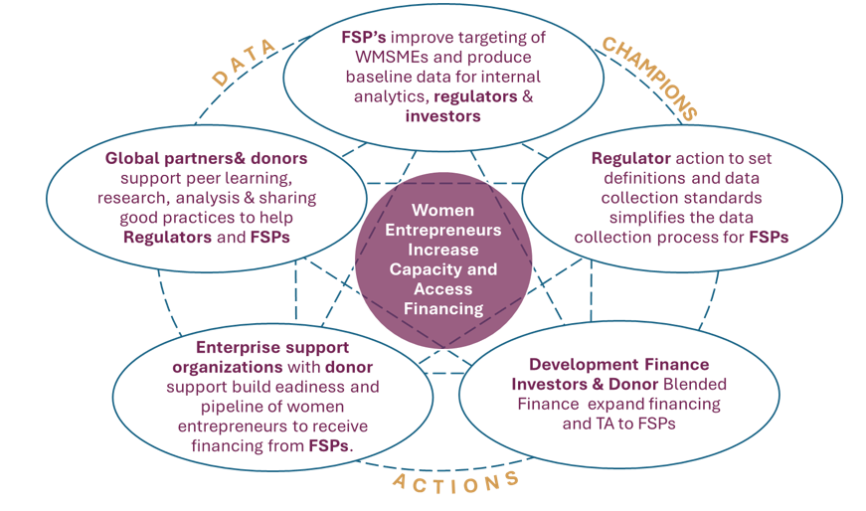
National objectives and aspirational goals – RECAP
Countries should set aspirational goals for the Code, so their actions can create re-enforcing incentives across the ecosystem, build momentum and accelerate progress on closing the financing gap for women entrepreneurs
Goals can be in terms of numbers, or percents, or WMSME as a percent of overall MSME funding.
Note, that it may not be possible to set goals until baselines are established but general goals can be agreed up front, like, substantial increase on the % of financing going to women.
Intermediate goals can also be helpful, like the % of banks, funds, fintechs signing ontot the Code OR X% of the financial intermediaries reporting within 2 years.

Slide 9
Goals of the National WE Finance Code – GROUP DISCUSSION
QUESTION 1
What are the ultimate objectives we hope to achieve through our [Country] Code?
SAMPLE OBJECTIVES - Indicative language
Increase funding provided to women-owned/led MSMEs ($$ volume and % share of total MSME financing).
Increase the number of women entrepreneurs thriving because of increased financing and access to non-financial support.
Improve the availability of WMSME data at the national level to inform the development of evidence-based policies supporting women entrepreneurs.

Slide 10
Goals of the National WE Finance Code – GROUP DISCUSSION
QUESTION 2
What are the practical metrics/targets that will signal progress on our objectives?
SAMPLE - Indicative language
Increasing financial service providers’ focus on and investment (financial and nonfinancial) in serving the WMSME segment
Getting holders of X% of financial system assets to sign the Code, with a leader identified. Include targets by type of finance provider where possible
i.e. # banks representing X% of national banking assets by year 2, # microfinance banks representing X% of microfinance sector assets by end of year 2, # co-operatives representing X% of co-operative sector assets by end of year 2 , # Angels/Angel syndicates representing X% of Angel funding by end of year 2 , # venture capital funds representing X% of VC funding by end of year 2 ,
Baseline data from 90% of signatories within 1 year of signing
X% increase in number of women-led enterprises receiving financial services by end of year 3 ,
X% increase in share of MSME finance going to women-led enterprises by year 3 ,
X% increase in women-led enterprises’ accessing non-financial supports by year 3.

Slide 11
Goals of the National WE Finance Code – GROUP DECISION
QUESTION 1 & 2
What are the ultimate objectives we hope to achieve through our [Country] Code?
What are the practical metrics/targets that will signal progress on our objectives?
OUR ANSWER:

Slide 12
SESSION II
Signatory recruiting and onboarding decisions

Slide 13
Facilitation Notes:
In this session we will establish which type of FIs will be able to sign up to our Code, how will they make commitments and be onboarded.
Key questions to address in this section:
Q1. What types of FI signatories can adopt our Code?
Q2. What is the ideal # of signatories we would like to adopt our Code in Year 1 and in Year 2, by FI type?
Q3. What will be our strategy to persuade financial institutions in [Country] to sign on to the Code? What incentives will we put in place?
Q4. What exact language will signatories officially sign in order to commit to the [Country] Code?
Q5. What will our onboarding process and template look like?
FSP Commitment Letter
Ecosystem Commitment Letter
Source: https://www.we-fi.org/we-finance-code/resources/

Slide 14
Recruiting - RECAP
Recruit initial Signatories
Unaware
Aware
Consider
Action
Champion
Unaware of the WE Finance Code in general
Aware of the gap & opportunity globally/ regionally/ within own country
Considering committing to the WE Finance Code but not yet actioned
In the process of signing the WE Finance Code in the country
Signed and Became WE Finance Code Champion

Slide 15
Onboarding - RECAP
Onboarding Signatories
An efficient digital process should be established by the Coordinator to onboard as many signatories as possible, and to track the commitments they have made over time.
Signatory submits commitment, including checklist of potential actions
Signatory completes onboarding form within 1-2 months
Coordinator validates that submission meets minimum criteria and includes Signatory in public list
Signatory provides first year of data one year from signature

Slide 16
Menu of options to fulfill Code commitment #1 on Leadership - RECAP
Leadership: activities related to internal leadership around Code-related activities and advancing support for women entrepreneurs.
Designate a senior leader to drive the organization's efforts to support women-led businesses and promote gender equity internally (mandatory)
Foster organizational awareness of the unique needs of women entrepreneurs and encourage stakeholders to enhance support for WSMEs
Actively promote and implement gender-inclusive policies and practices within your organization, potentially advocate externally for women entrepreneurs
Support the development of products and services tailored to women entrepreneurs, ensuring that their specific needs are met
Serve as a point person for the WE Finance Code, facilitating peer learning, sharing best practices, and participating in advocacy efforts that promote gender equity in financial services
Other ………………….

Slide 17
Menu of options to fulfill Code commitment #2 on Data
Data: activities related to mainstreaming the collection and reporting of sex-disaggregation of MSME finance data internally and within the organization’s sphere of influence.
🗸 Incorporate the Code’s indicators into [Organization name] data collection, analytics and reporting for its own MSME financing activities. (mandatory)
🗸 Annually share aggregate data on the Core indicators with aggregator1. (mandatory)
Encourage or support clients/members/partners to collect, analyze and report the Code’s indicators when required to report on MSME financing activities.
Undertake research and analytics and develop tools that will improve collection, analysis, use and reporting on sex-disaggregated data

Slide 18
Menu of options to fulfill Code commitment #3 on Actions
Action: Other activities within the organization’s relevant domain and sphere of influence that will address constraints and close finance gaps for women-led enterprises. (Please select at least 1.)
Develop new financial products and non-financial services to expand financing for women- led enterprises -- within the organization or with stakeholders.
Set targets and develop strategies, policies and standards to expand financing for women- led enterprises.
Strengthen and communicate the business case for financing women-led enterprises, using market research and business analytics.
Increase the volume of commercial or blended finance for women-led enterprises, directly or through financial service partners, including through bonds, credit lines, equity financing, trade and embedded financing, performance incentives, etc.
Promote/contribute to peer learning and documentation of case experience.
Other ……………

Slide 19
Recruiting and Onboarding Signatories – GROUP DISCUSSION
QUESTION 1
What types of FI signatories will we encourage to participate in the Code?
SAMPLE - Indicative language
Regulated commercial banks
Non-bank financial institutions i.e. Microfinance Institutions, cooperatives, fintechs, etc.
Equity providers i.e. Angel investors, Venture Capital firms, etc.
Ecosystem partners: technical assistance providers, researchers, training entities, industry associations, development partners

Slide 20
Recruiting and Onboarding Signatories – GROUP DECISION
QUESTION 1
What types of FI signatories can adopt our Code?
ANSWER:

Slide 21
Recruiting and Onboarding Signatories – GROUP DISCUSSION
QUESTION 2
What is the ideal # of signatories we would like to adopt our Code in Year 1 and in Year 2, by FI type?
SAMPLE - Indicative language
RECRUITMENT GOALS:
Our country has X banks with $ trillion in assets, and X funds with $ billion in assets under management.
In Year 1 we are targeting 8 commercial bank signatories; those that either have existing WMSME segment strategies or have expressed interest in developing them, representing X% of the banks in the country (or X% of banking assets in the country)
In Year 2, we will seek to expand to 12 commercial bank signatories and 6 non-bank financial institutions.

Slide 22
Recruiting and Onboarding Signatories – GROUP DECISION
QUESTION 2
What is the ideal # of signatories we would like to adopt our Code in Year 1 and in Year 2, by FI type?
ANSWER:

Slide 23
Recruiting and Onboarding Signatories – GROUP DISCUSSION
QUESTION 3
What will be our strategy to persuade financial institutions in [Country] to sign on to the Code? What incentives will we put in place?
SAMPLE - Indicative language
The Central Bank will play a key role in recruiting signatories by explicitly promoting the Code as it part of its national financial inclusion strategy and recommend that the banks it regulates join the Code.
The Bankers’ Association will work to promote the Code with its members and support their ability to implement the Code.
CEOs or other champions from the anchor private sector institutions [X FI, X FI, X FI] in the Council/Executive Committee/Board/etc. will exert their influence by reaching out to colleagues from other commercial banks and encourage them to sign the Code.
Incentives for FIs to sign onto the Code:
X development finance institution will guarantee commercial bank signatories’ loans to WMSMEs (covering up to 50% losses due to loan defaults)
The Central Bank provides signatories with reputational incentives by featuring signatories’ incremental actions to support WMSMEs in a monthly circular and on the Code website
Signatories are further incentivized through access to trainings and capacity-building provided at the global level by WE Finance Code partners (specifically the Code Community of Champions, Gender Data Learning Series, and WMSME Primer developed by the Financial Alliance for Women).

Slide 24
Recruiting and Onboarding Signatories – GROUP DECISION
QUESTION 3
What will be our strategy to persuade financial institutions in [Country] to sign on to the Code? What incentives will we put in place?
ANSWER:

Slide 25
Recruiting and Onboarding Signatories – GROUP DISCUSSION
QUESTION 4
What exact language will signatories officially sign in order to commit to the [Country] Code?
SAMPLE - Indicative language
A Commitment Letter can be found on the National Aggregator’s website which signatories can complete, sign and submit. The signed letters will be reviewed and stored by the National Aggregator or National Coordinator (depending on the country).
The Commitment Letter includes a list of actions with milestones that the signatory institution can choose from to fulfill Commitment #2, “Expand and introduce measures that will support women entrepreneurs.”
The Commitment Letter will be accompanied by a completed data template with baseline data (only if available).

Slide 26
Recruiting and Onboarding Signatories – GROUP DECISION
QUESTION 4
What exact language will signatories officially sign in order to commit to the [Country] Code?
ANSWER:

Slide 27
Recruiting and Onboarding Signatories – FOR DISCUSSION
QUESTION 5
What will our onboarding process and template look like?
SAMPLE - Indicative language
After signing up to the Code, the main point of contact of our signatory institutions will receive onboarding materials including:
Communications guidelines to publicize their adoption of the Code
Guidance on the reporting timeline and indicators, including the process for reporting annually
A data template to report on their current baseline financing to WMSMEs if the data is already available.
A menu of options to choose actions to be taken to support WMSMEs
An invitation to join the Working Groups

Slide 28
Recruiting and Onboarding Signatories – GROUP DECISION
QUESTION 5 – DESKTOP EXERCISE
What will our onboarding process and template look like?
ANSWER:

Slide 29
SESSION III
Data collection, Reporting process, Definitions

Slide 30
Facilitation Notes:
In this session we will establish the WSME definition to use for our Code, the indicators to be collected and the process for reporting the data.
Key questions to address in this section:
Q1. What WMSME definition will be used for our Code?
Q2. Which institution will act as the national aggregator for our different signatory types? What will be their role?
Q3. Which encouraged indicators will be collected beyond the mandatory indicators?
Q4. What will the data reporting process look like? In what format will the aggregator share signatory’s reported data at national/ international levels?
Q5. What institution will collect information on incremental actions to support WMSMEs, and how will this be used at the national level?
Q6. How will we map the timeline of our data reporting?
Applying Technical Guidance on WSME Definitions and Data (see various supporting materials on our website)
https://www.we-fi.org/we-finance-code/resources/

Slide 31
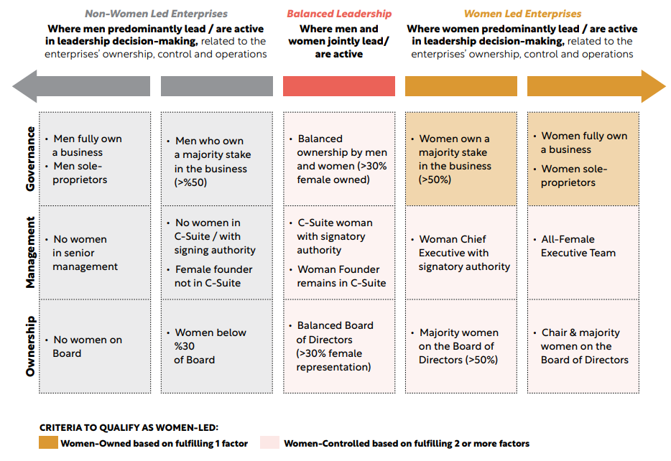
WMSME Definitions guardrails - RECAP

Slide 32
WMSME Definitions - RECAP
Build consensus on key decisions: WMSME Definitions
All indicators will be disaggregated by women/non-women led AND SME/Micro
Minimum Requirements
Strongly Encouraged
Out of Scope
MSME
Individual/Households without identifiable enterprise characteristics
Large enterprises
Women-led enterprise
Enterprises predominantly serving or employing women, but not being women-led businesses
MSME
A clear definition of Micro, Small and Medium Enterprise, generally based on employee, asset, equity and/or loan exposure
Informal firms and sole proprietors may be included so long as they have identifiable enterprise characteristics
Women-led enterprise
Women-Owned: Majority women-owned or
Women-Controlled: Effective control of the enterprise by women (relating to women ownership, management and governance)
MSME
National or international definitions are recommended for harmonization (e.g., IFC definition)
Women-led enterprise
National or international definitions are recommended for harmonization (e.g., IFC definition, ISO definition, 2X criteria)

Slide 33
Data Aggregation flow - RECAP
Country data tracks
Global level
Annual Report, analytics, knowledge sharing
Global Coordination (We-Fi) /Global Aggregation (OECD)
Country level
Annual Report, analytics, knowledge sharing
Country A
Report
Data Aggregator
Collect FSP data, ensure data integrity
Authorized aggregators
+
National Data Aggregator(s)
Functions can be divided between multiple entities
Signatories
Generate & report on commitments
Banks
MFIs
Notes:
MFI

Slide 34
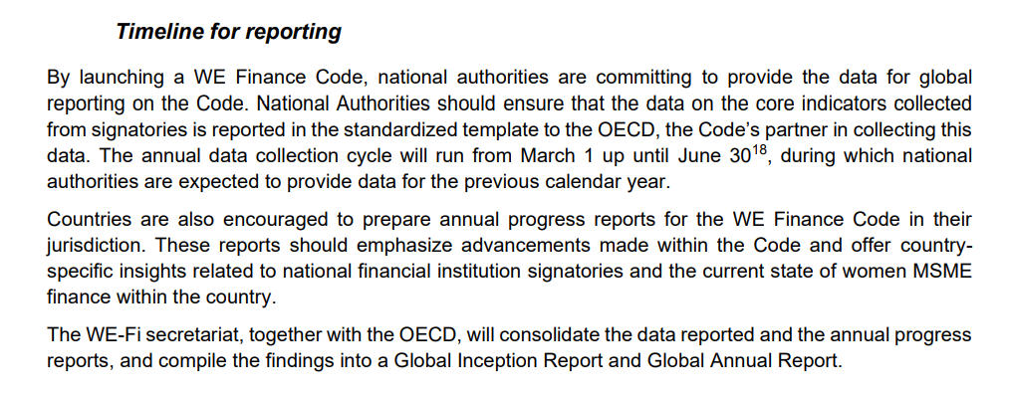
Reporting timeline - RECAP

Slide 35
Data collection, reporting and definitions – GROUP DISCUSSION
QUESTION 1
What WMSME definition will be used for our Code?
SAMPLE
ANSWER:

Slide 36
Data collection, reporting and definitions – GROUP DECISION
QUESTION 1
What WMSME definition will be used for our Code?
ANSWER:

Slide 37
Data collection, reporting and definitions – GROUP DISCUSSION
QUESTION 2
Which institution will act as the national aggregator for our different signatory types? What will be their role?
SAMPLE - Indicative language
The National Aggregator will be the [AGGREGATOR INSTITUTION] with leadership by [NAME, TITLE]. As a trusted institution with a robust system to collect and validate data, [AGGREGATOR] is well positioned to collect the requested data from FSPs. The specific roles and responsibilities of the National Aggregator over the next two years are as follows:
Develop the reporting template and reporting guidelines to be approved by the Data Working Group
Provide the reporting template to signatory FSPs
Ensure the security individual FSPs data
Analyze core indicators reported by FSP signatories
Ensure quality of reported data by validating reporting
Provide national (anonymized FSP data, or aggregate data) data to the global aggregator, OECD, on an annual basis.

Slide 38
Data collection, reporting and definitions – GROUP DECISION
QUESTION 2
Which institution will act as the national aggregator for our different signatory types? What will be their role?
ANSWER:

Slide 39
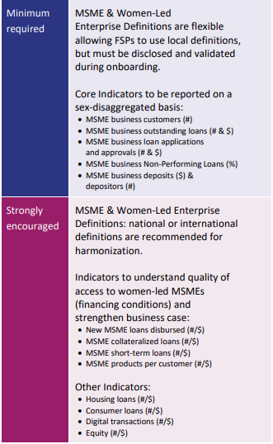
Data collection, reporting and definitions – GROUP DISCUSSION
QUESTION 3
Which encouraged indicators will be collected beyond the mandatory indicators?
SAMPLE OBJECTIVES - Indicative language

Slide 40
Data collection, reporting and definitions – GROUP DECISION
QUESTION 3
Which encouraged indicators will be collected beyond the mandatory indicators?
ANSWER:

Slide 41
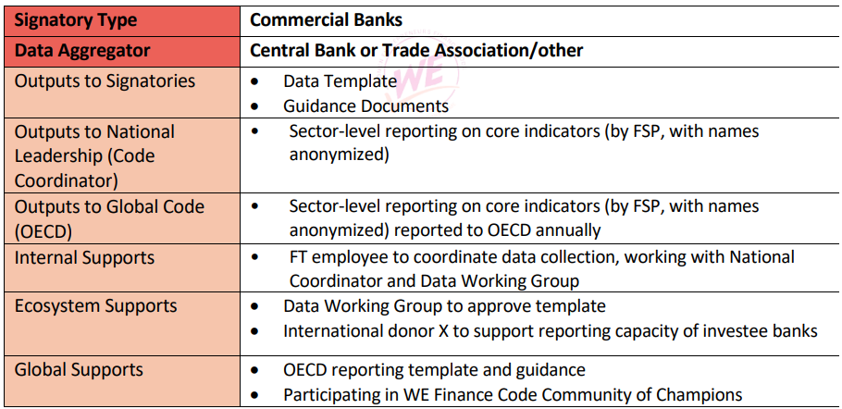
Data collection, reporting and definitions– GROUP DISCUSSION
QUESTION 4
What will our data reporting process look like? In what format will the aggregator share signatory’s reported data at national/ international levels?
SAMPLE OBJECTIVES - Indicative language:

Slide 42
Data collection, reporting and definitions– GROUP DECISION
QUESTION 4
What will the data reporting process look like? In what format will the aggregator share signatory’s reported data at national/ international levels?
ANSWER:

Slide 43
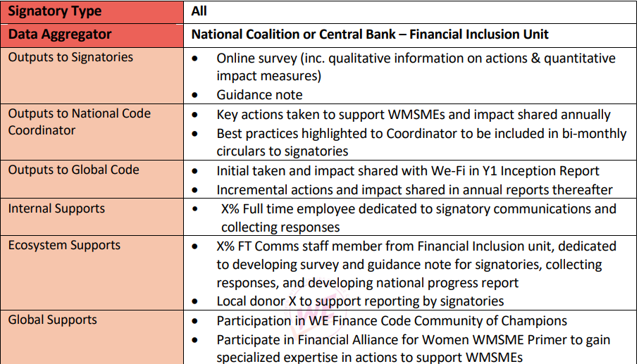
Data collection, reporting and definitions– GROUP DISCUSSION
QUESTION 5
What institution will collect information on incremental actions to support WMSMEs, and how will this be used at the national level?
SAMPLE - Indicative language:

Slide 44
Data collection, reporting and definitions– GROUP DECISION
QUESTION 5
What institution will collect information on incremental actions to support WMSMEs, and how will this be used at the national level?
ANSWER:

Slide 45
Data collection, reporting and definitions– GROUP DISCUSSION
QUESTION 6
How will we map the timeline of our data reporting?
SAMPLE - Indicative visual:

Slide 46
Data collection, reporting and definitions– GROUP DECISION
QUESTION 6
How will we map the timeline of our data reporting?
ANSWER:

Slide 47
SESSION IV
Governance of the National WE Finance Code

Slide 48
Facilitation Notes:
In this session we will establish a governance structure for our National WE Finance Code , defining clear roles, responsibilities, and an effective modus operandi.
Key questions to address:
Q1. What high-level, long-term role could [Institution], as the Coordinator play in promoting support for WMSMEs in [Country] ?
Q2. What specific responsibilities related to Code Implementation could [Institution], as the Coordinator oversee during the first 1-3 years?
Q3. Which institutions will be involved in making key decisions in this phase, and what role will they play in designing, launching, and scaling the Code?
Q4. What is the overall remit of the national leadership team? What are the main goals it plans to achieve over the next years?
Q5. How should we, as the national leadership team meet, make decisions, and generate meaningful action?

Slide 49
Roles and responsibilities – RECAP
Who are the key actors in the [Country] Code?
Each country will form a National Coalition to which four Code Anchors will be nominated from four stakeholder groups. It is recommended that the National Coalition will be project managed by a National Coordinator.
National Actors
Data Aggregator
National
Coordinator
Investors and other Stakeholders
Financial Service Providers
|
|

Slide 50
Roles and responsibilities – RECAP
Caracteristics of strong Code Anchors
Institutional level
Financial sector regulator (s) i.e. Central Bank, Superintendent of Banks
Leading private sector bank (s)
Trusted body to aggregate data i.e. bank association
Convening power and sector-wide influence
Available resources to design and roll out a National WE Finance Code
Proven commitment to supporting women’s entrepreneurship and financial inclusion
Able to identify two or three Champions in their ecosystem to foster collaboration and sign the Code
Champion Level
Anchor must be represented on National Coalition by a senior leader nominated by CEO to lead Institution’s Code efforts.
These leaders are committed individuals (men or women) who agree to champion and advocate for the Code in their institution and in their country.
It is recommended that Anchors also nominate a more junior executive to support Code implementation.

Slide 51
Roles and responsibilities – RECAP
Who is involved and how—National Coordinator
Roles & Responsibilities
Benefits
Draft guidelines and implementation plan and maintain Code documents
Convene and enable National Coalition
On-board Signatories
Coordinate Working Groups
Track Code commitments and and report nationally and globally to the global aggregator.
Country annual reports are optional.
Drive Code implementation
Create model for others
Contribute to and access global learning community and learning
Global recognition as Best Practice
National Coordinator
(Trade Association, MDB, Consultant etc.)
A professional person or team that takes responsibility for driving the Code
|
|

Slide 52
Roles and responsibilities – RECAP
Who is involved and how—Data Aggregator (s)
Roles & Responsibilities
Benefits
Trusted local institution (s) with robust system and data protocols, such as trade associations or regulators
Instruct, collect, ensure quality and analyze core indicators reported by FSP signatories
Share collated data with global Aggregator on an annual basis
Produce real-time national scorecards for optimal insights
Gain positioning as leading voice in ecosystem ​
Access to global learning community and learning
Global recognition as Best Practice
Data Aggregator
(Regulators, policymakers, industry associations)
A trusted body that FSPs will report data to and who will aggregate the data and produce a national report

Slide 53
Roles and responsibilities – RECAP
Who is involved and how—National Coalition members
Roles & Responsibilities
Benefits
Champion the Code in the country
Appoint senior leader to lead initiative
Create solutions, programs and policies to support WMSMEs
Increased financial inclusion of WMSMEs​
Real-time and improved data to drive national conversation and data-driven policymaking​
Improved engagement, incentives and alignment across the ecosystem ​
Access to global learning community and learning
Global recognition as Best Practice
National Coalition members
(Regulators, policymakers, industry associations, Investors, FSPs)
A diverse group with various roles
Notes:
From CVP Slide – Why join the code:
[For regulators and policy makers] The Code can allow them to catalyze action by financial service providers – to increase financial inclusion of WMSMEs. It is also a mechanism that helps drive the tracking and use of data in policymaking. The Code offers a platform for to engage with the broader ecosystem – a network that provides reinforcing incentives to support WMSMEs.

Slide 54
Roles and responsibilities – GROUP DISCUSSION
QUESTION 1
What high-level, long-term role should [Institution], as the Coordinator play in promoting support for WMSMEs in [Country] ?
SAMPLE - Indicative language
The National Coordinator, [NAME, TITLE, ORGANIZATION], will oversee activities related to implementing the Code in [COUNTRY]. By leveraging their network and insights gained from working groups, they can advocate for actions that address both the objectives of the Code and the gender financing gap. Over time, the National Coordinator is expected to serve as a central entity for guiding FSPs on advancing the WMSME financing agenda. They will lead on:
Promoting and coordinating collective action and learning across Code signatories 7 and ecosystem partners.
Promoting coordination and peer learning with other Code countries, including by ensuring national coalition members participate in the global WE Finance Code Community of Champions.
Overseeing the development of the annual report that shares key outcomes from the Code: financing to WMSMEs ($$ volume and % share of total), actions taken by signatories to support WMSMEs, and # of signatories across key sectors.
Identifying opportunities or barriers related to multilateral development bank financing.

Slide 55
Roles and responsibilities – GROUP DECISION
QUESTION 1
What high-level, long-term role should [Institution], as the Coordinator play in promoting support for WMSMEs in [Country] ?
ANSWER:

Slide 56
Roles and responsibilities – GROUP DISCUSSION
QUESTION 2
What specific responsibilities related to Code Implementation should [Institution], as the Coordinator oversee during the first 1-3 years?
SAMPLE - Indicative language
Over the next two years, the Coordinator will maintain final oversight over the decisions made by the National WE Finance Code Committee and help to keep the project on track from planning, to launching the Code, to tracking and reporting progress.
• Organizing National WE Finance Code Committee meetings on a regular basis
• Tracking progress on key milestones in the Code implementation plan
• Maintaining and updating the list of signatories
• Tracking signatories’ progress on each of their action commitments
• Ensuring national and global reporting process is in place
• Managing communications with international stakeholders, Implementing Partners, WeFi Secretariat and OECD (for global reporting)
• Integrating feedback from women entrepreneurs as represented by [NAME of Business Association (s)] or women entrepreneurs Advisory Council in Code design and implementation.

Slide 57
Roles and responsibilities – GROUP DECISION
QUESTION 2
What specific responsibilities related to Code Implementation should [Institution], as the Coordinator oversee during the first 1-3 years?
ANSWER:

Slide 58
Roles and responsibilities – GROUP DISCUSSION
QUESTION 3
Which institutions will be involved in making key decisions in this phase, and what role will they play in designing, launching, and scaling the Code?
SAMPLE - Indicative language
NAME, TITLE, ORGANIZATION, ROLE IN CODE i.e. Central Bank as the banking regulator will act as data aggregator for bank data
NAME, TITLE, ORGANIZATION, ROLE IN CODE i.e. Non-Bank Financial Services Regulator will act as data aggregator for non-bank financial services data
NAME, TITLE, ORGANIZATION, ROLE IN CODE i.e. Bankers Association will support the development of a national definition of WMSMEs, support members to report WMSME data and to design B2C strategies for WMSMEs.
NAME, TITLE, ORGANIZATION, ROLE IN CODE i.e. Ministry of SMEs will support availability of non-financial services such as incubators, accelerators and trainings etc for WMSMEs
NAME, TITLE, ORGANIZATION i.e. Businesswomen’s Association will support availability of non-financial services such as networking, coaching/mentoring and recommendations for policy enablers for WMSMEs
NAME, TITLE, ORGANIZATION i.e. X Bank, as the largest SME lender in the country, will ear-mark $X Million for WMSMEs and integrate cash-flow based lending to its traditional SME lending approach to reach WMSMEs
NAME, TITLE, ORGANIZATION i.e. Y Bank, as the second largest SME lender in the country, will train and certify its front-line staff

Slide 59
Roles and responsibilities – GROUP DECISION
QUESTION 3
Which institutions will be involved in making key decisions in this phase, and what role will they play in designing, launching, and scaling the Code?
ANSWER:

Slide 60
Roles and responsibilities – GROUP DISCUSSION
QUESTION 4
What is the overall remit of the national leadership team? What are the main goals it plans to achieve over the next years?
SAMPLE - Indicative language
Year one goals:
1. Tailor the WE Finance Code to the national context and publish National Charter
2. Develop annual Code Implementation Plan
3. Build the business and strategic case for financial institutions to participate in the Code by quantifying the opportunity (e.g. estimating additional revenue to be gained by increasing financing to WMSMEs) and communicating incentives for them to participate (e.g. reputational boost, portfolio loan guarantees, access to technical assistance, etc.)
4. Set up and identify leaders of Working Groups focused on key action areas:
5. Gather demand-side data to understand the main constraints faced by WMSMEs and types of support that would benefit them
6. Introduce initial round of policy decisions, e.g., definition of WMSME, data circular, etc.
7. Socialize the mandatory key performance indicators (KPIs) and encouraged indicators (as decided by coalition/working groups)
8. Approve the reporting template developed by the national aggregator
9. Onboard first round of signatories
10. Integrate Working Group recommendations into the Code implementation plan
11. Develop and publish national Inception Report (a first-year report detailing progress towards Goals outlined in Section 2.2, e.g. # of signatories per sector, and Section 3.3, e.g. national WMSME definition(s) established by Working Group(s), incremental actions defined and those already taken by signatories, etc). based first year of activities) 12. Provide updates for the Global Code reporting
Year 2 goals:
1. Build national dashboard visualizing WMSME data findings 2. Expand # of signatories, including by adding new FI types 3. Ensure reporting of aggregate national figures to OECD

Slide 61
Roles and responsibilities – GROUP DECISION
QUESTION 4
What is the overall remit of the national leadership team? What are the main goals it plans to achieve over the next years?
ANSWER:

Slide 62
Roles and responsibilities – GROUP DISCUSSION
QUESTION 5
How should we, as the national leadership team meet, make decisions, and generate meaningful action?
SAMPLE - Indicative language
Assignment of Roles and Responsibilities: Each member will work in the respective roles laid out to achieve the key goals and milestones. These may be subject to amendment as required – this could arise due to changes arising from third party advice for example, requiring the Coalition’s activities to expand or limit in scope.
Meeting Protocols: The National Coordinator will arrange and attend all meetings of the National Coalition and will monitor and report completion status, likelihood of achieving milestones, risks, corrective actions required, and blockages encountered.
Meeting Frequency: The Code Council/Executive Committee/Board/etc. will meet bimonthly throughout the year. Agendas will be provided prior to the meeting by National Coordinator. Notes will be taken during the meetings and key action items socialized immediately thereafter.
Decision-Making Processes: Decisions shall be made by consensus where possible and every effort shall be made to achieve a consensus. Where a consensus is not possible a majority vote shall be taken, and it shall be noted in the minutes that such decision was not unanimous.
Codification of Decisions: The National Coordinator will draft a Code Implementation Plan and reach consensus with the Code Council/Executive Committee/Board/etc. members as to its contents and then monitor success in achieving the milestones therein.
Submissions from Working Groups: Working Group leaders/designated stakeholders will record meeting notes, key decisions made, and action items and send them to the National Coordinator following meetings to codify decisions into the Code Implementation plan.
Communication of Key Outputs: The Code Council/Executive Committee/Board/etc. will communicate key decisions and milestones achieved to the Working Groups, and will further publish key decisions and milestones achieved on the National WE Finance Code web page and in monthly circulars to signatories.

Slide 63
Roles and responsibilities – GROUP DECISION
QUESTION 5
How should we, as the national leadership team meet, make decisions, and generate meaningful action?
ANSWER:

Slide 64
Facilitation Notes:
The facilitator may end the workshop by thanking participants for their contributions and outlining next steps. These may include:
National Coordinator will draft the Code Charter with the information and decisions discussed during this workshop
The draft Code Charter will be circulated with the national coalition members for final review and approval
Add next step here
Add next step here

Slide 65
Tools and Resources
WE Finance Code Pitch
WE Finance Code Brochure
Media Toolkit
WE Finance Briefing Note
National Code Sample Public Declaration of Intent
FSP Commitment Letter
Ecosystem Commitment Letter
Community of Champions Information
Implementation Partner Guide | Kick-off Presentation
Source: https://www.we-fi.org/we-finance-code/resources/

