Slide 1
Women Entrepreneurs Finance Code
Workshop In A Box: Module 5
Country Examples
May 2025

Slide 2
WE Finance Code
Country Profile: United Kingdom

Slide 3
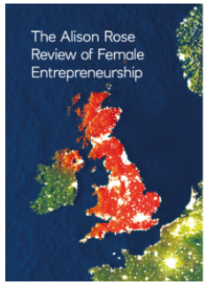
THE WOMEN ENTREPRENEURS FINANCE CODE
5
Country Case: UK Investing in Women Code
Rose Review (2019)
UK Treasury commissioned Alison Rose, CEO of NatWest, to assess barriers facing women entrepreneurs and how to overcome them.
Investing In Women Code
The Code is a voluntary public-private partnership between the ‘Code Partners’:
Government
Finance providers
Three trade associations
The UK’s national development bank
Launched in July 2019, the Code aims to increase the finance provided to women-led businesses including debt finance (loans and overdrafts) and equity (early-stage Angel investment to venture & growth capital).
Code Signatories make three commitments:
Designate a responsible member of the senior management team to Champion entrepreneurs’ access to finance;
Collect and report data;
Adopt internal practices that aim to improve female entrepreneurs’ access to the tools, resources and finance and review these annually.
Results to date
UK Code Signatories: 12 Champions have grown to 160 FIs (18 lenders, 30 angel investors, 105 venture and growth investors) representing GBP1 trillion AUM.
Conclusions: Up to £250 billion of new value could be created if women started and scaled new businesses at the same rate as men.
The biggest opportunities to help women entrepreneurs along the financing funnel fall into three areas:
Access to finance
Family care support
Making entrepreneurship more accessible through mentors/networks
The Investing in Women Code was one of eight recommendations.
The Code partners have worked together with Signatories to share the aggregate
data, generate insights and share best practices both through the Annual Reports and regular meetings.
For more information see: UK Review of Female Entrepreneurship and progress report; and The Investing in Women Code and progress report

Slide 4
THE WOMEN ENTREPRENEURS FINANCE CODE
5
Country Case: UK Investing in Women Code
There are 250 signatories to the Code (2024 Annual Report)
Code Signatories commit to:
Improving female entrepreneurs’ access to tools, resources and finance
Having a nominated member of the senior leadership team responsible for supporting equality in all its interactions with entrepreneurs
Sharing aggregated data with HM Treasury on investments made to female-led, male-led and mixed-gender led teams
Adopting internal practices which aim to improve the potential for female entrepreneurs to successfully access the tools, resources, investment and finance they need to build and grow their business
Data is reported to industry associations, who in turn report to HM Treasury
4
|
|

Slide 5
THE WOMEN ENTREPRENEURS FINANCE CODE
5
Country Case: UK Investing in Women Code
The Investing in Women Code was published in April 2021 and highlighted:
the positive signs of change for female founders,
considerable challenges in securing funding remain.
Impact of the code :
Analysis of the data reveals that women-led businesses (WLB) are as likely as male-led businesses (MLB) to receive the finance they need to start up, invest and grow.
However, there are disparities between WLBs and MLBs in terms of the overall number of applications made and the amount of finance applied for.
WLBs are both less likely to apply for finance and more likely to apply for a lower amount of finance than MLBs.
Access to finance remains the single biggest opportunity for female entrepreneurs in the UK
5
|
|

Slide 6
THE WOMEN ENTREPRENEURS FINANCE CODE
5
Country Case: UK Investing in Women Code
National Actors
Data Aggregator
Data Aggregator Anchor (s)
FSP Regulator Anchor (s)
UK Finance (Banks - 30)
UK Angels (Angels - 40)
BVCA (VCs - 170)
Regulator – FCA is not involved with the code
National
Coordinator
Leading Govt Anchor (s)
Leading FSP Anchor (s)
Department of Trade (DBT)
Allocated Govt minister
NatWest 2019-2023
Barclays 2024
Investors and other Stakeholders
Financial Service Providers
|
|

Slide 7
THE WOMEN ENTREPRENEURS FINANCE CODE
5
Country Case: UK Investing in Women Code
Continue to refine data collection, reporting and dissemination
Step 5 – set OKR’s for signatories 2023
Scale the data pilot to all market players, produce market insights report
Step 4 – In annual reporting show case best practices alongside data 2022 & 2023 Reports
Pilot data collection and reporting
Step 3 – Request to Banks Data teams (2021) from UK Finance and Annual letter of thanks from Minister/Govt
WSME Data Journey
Align on data aggregator, data collection & reporting process, & WMSME definition
Step 2 – Host workshops for founding signatories to collaborate on reporting and definitions used. 2019-2020
WSME data ecosystem diagnostic
Step 1 – Set in UK by UK Finance and launched July 2019
WE Finance Code Coalition Building
Identify Public and Private Sector Anchors
Build a National Coalition
Set up for Implementation
Launch the Code
Track & Accelerate Progress
Identify 1-3 country champions
Build the case for launching WeCode in the country
Discuss vision for the Code
Convene coalition
Establish main roles & responsibilities
Sign Letter of Intent to launch the Code
Recruit initial signatories
Build consensus on key decisions (WMSME definitions, reporting structure)
Publish National Charter
Create Implementation Plan
Create awareness & excitement
Onboard Signatories
Launch the Code
Establish additional Working Groups as needed
Strengthen aggregators’ data collection & analytics capabilities
Set up national reporting
Evaluate impact
Recruit new signatory cohorts-–MFIs, Fintechs, Angel, VC

Slide 8
WE Finance Code
Country Profile: Dominican Republic

Slide 9
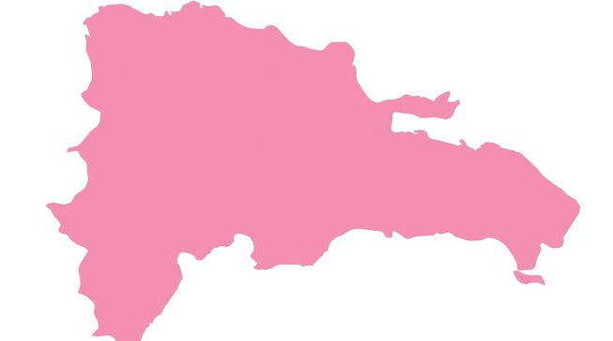
THE WOMEN ENTREPRENEURS FINANCE CODE
5
Country Case: Dominican Republic
MSMEs represent more than 98% of the country’s businesses, which are approximately 1.5 million, and contribute 38.6% to GDP.
Despite their importance to the economy, formal MSMEs face a financing gap, with an important part of credit allocation directed to large companies representing 57.7% of the total and accounting for 1% of the existing number of companies.
Composition of Private Commercial Credit Balance
December 2022
Also, women-owned businesses and those in small cities and rural areas are particularly challenged.
As of December 2022, the MSME credit portfolio was 368,351 million pesos, and credits to women-owned MSMEs amounted to DOP 66,215.9 million, representing, 6% of the portfolio.
57.7%
42.3%
Other private commercial loans
Loans to MiPYMES
Source: SIB – Informe sobre financiamiento a las MIPYMES en la Banca Dominicana – 2023

Slide 10
THE WOMEN ENTREPRENEURS FINANCE CODE
5
Country Case: Dominican Republic
Credits to WSMEs have increased since 2016
Popular, Banreservas and BHD accumulate 61.7% of the credit to WSMEs
Evolution of credits to WSMEs
Credit to WSMEs by institution
Values in DOP million
Values in DOP million & percentages (%)
Institutions with the highest % of credits to WSMEs in their portfolio are:
ADOPEM: 65.1% | ADEMI: 56.5% | Banfondesa 33.5%
Source: SIB – Informe sobre financiamiento a las MIPYMES en la Banca Dominicana – 2023

Slide 11
THE WOMEN ENTREPRENEURS FINANCE CODE
5
Country Case: Dominican Republic
How do financial institutions in the Dominican Republic serve the Women’s Markets?
Results IDB Invest Survey 2022
Most FIs collect gender data, mostly disaggregated manually
76% of FIs offer NFS; the majority (52%) with specific offers for women
Source: IDB Invest – Women Rising [Unpublished raw data] - 2023
Workshop in a BOX I Prepared for We-fi by the Financial Alliance for Women

Slide 12
THE WOMEN ENTREPRENEURS FINANCE CODE
5
Country Case: Dominican Republic
How do financial institutions in the Dominican Republic serve the women's market?
Results IDB Invest Survey 2022
La mayoría de IF tienen una estrategia para el mercado de mujeres
Segmentos objetivo
Atender al mercado de mujeres: ¿por qué?
Mandato solicitado
Para mejorar ganancias
Para diferenciarse de la competencia
Para aumentar el compromiso de clientes existentes
Para aumentar la base de clientes
Impacto social/motivado por la misión
Iniciativa de responsabilidad social corporativa
... ¿y cómo abordarlo?
https://idbinvest.org/es/publicaciones/mujeres-empresarias-en-ascenso-como-pueden-las-instituciones-financieras-aprovechar
Workshop in a BOX I Prepared for We-fi by the Financial Alliance for Women

Slide 13
THE WOMEN ENTREPRENEURS FINANCE CODE
5
Country Case: Dominican Republic
How do financial institutions in the Dominican Republic serve the women's market?
Results IDB Invest Survey 2022
La mayoría de IF recopilan datos sobre género, principalmente desglosados manualmente
El 76% de las IF ofrecen SNF;
la mayoría (el 52%) con ofertas específicas para mujeres
Workshop in a BOX I Prepared for We-fi by the Financial Alliance for Women
https://idbinvest.org/es/publicaciones/mujeres-empresarias-en-ascenso-como-pueden-las-instituciones-financieras-aprovechar

Slide 14
THE WOMEN ENTREPRENEURS FINANCE CODE
5
Country Case: Dominican Republic
How do financial institutions in the Dominican Republic serve the women's market?
Results IDB Invest Survey 2022
TA received
TA Type
Source: IDB Invest – Women Rising [Unpublished raw data] - 2023
Workshop in a BOX I Prepared for We-fi by the Financial Alliance for Women

Slide 15
THE WOMEN ENTREPRENEURS FINANCE CODE
5
Country Case: Dominican Republic
Financial institutions use different definitions for WMSME, with the most used definition being: "a combination of ownership and management roles”
How does your institution define businesses owned or managed by women?
A combination of ownership and management roles.
A company in which the woman, as a partner, holds the majority in percentage of ownership, indicating that she owns more than 50% of the capital or shares of the company.
A company in which the woman is the sole owner and the company is registered under her name.
We don't have a definition yet.
Source: IDB Invest – Women Rising [Unpublished raw data] - 2023

Slide 16
Many financial institutions break down data by gender for all their products, but some record it manually.
THE WOMEN ENTREPRENEURS FINANCE CODE
5
Country Case: Dominican Republic
BID Invest 2022 survey results
Does your institution track any data disaggregated by gender??
How are these data obtained in the context of women-owned or women-led companies??
Gender-disaggregated data is not labeled in the system, but it is automatically tabulated against government records (e.g., corporate registry).
Gender-disaggregated data is labeled in the system by deriving it from another source (e.g., a national identification card).
Gender-disaggregated data is labeled in the system when staff manually record them.
Source: IDB Invest – Women Rising [Unpublished raw data] - 2023

Slide 17
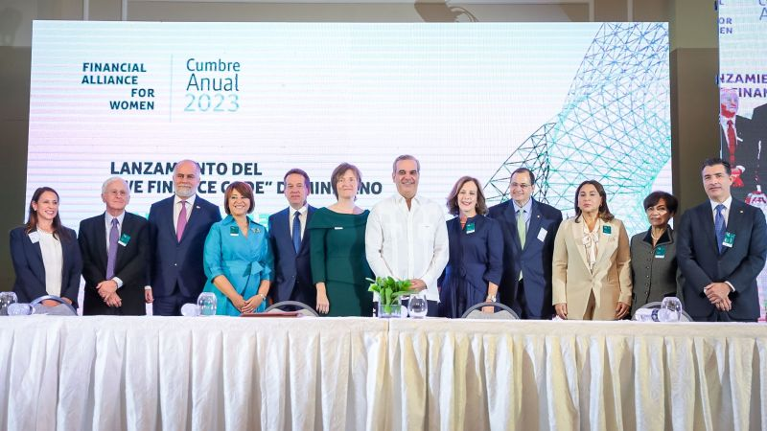
THE WOMEN ENTREPRENEURS FINANCE CODE
5
Country Case: Dominican Republic
I. | II. | III. | IV. | V.
Build a National Coalition
Set up for Implementation
Launch the Code
Identify Public and Private Sector Anchors
Coalition Building
Sep-Oct 2023 - Awareness building activities by FAFW and early private sector champion Banco BHD Leone
November 2023 - We Finance Code Public Launch, the letter of intent is signed by the country’s President, Banking Regulator, Minister of Women’s Affairs, Ministry of Commerce, and the Bankers’ Association
January 2024 - National Coalition is formed, 14 leading banks representing over 90% of the banking system become the signatories
February 2024 - WSME definition is discussed and agreed on
March 2024 - Working groups on data and WSME value proposition commenced
July 2024 - outreach to the cooperative sector
Workshop in a BOX I Prepared for WE-FI by the Financial Alliance for Women

Slide 18
WE Finance Code
Country Profile: The Netherlands
August 2024

Slide 19
THE WOMEN ENTREPRENEURS FINANCE CODE
5
Country Case: The Netherlands
Deloitte
Erasmus Center of Entrepreneurship
Data Aggregator Anchor (s)
FSP Regulator Anchor (s)
Regulator not involved yet
Code-V:
Foundation
Council
Panel
Partners
Working Group
Leading Govt Anchor (s)
Leading FSP Anchor (s)
Ministry of Economic Affairs
Note: A fee is contributed from Code V signatories to make this a professional and sustainable model (with a project leader)
ABN AMRO
Workshop in a BOX I Prepared for WE-FI by the Financial Alliance for Women

Slide 20
THE WOMEN ENTREPRENEURS FINANCE CODE
5
Country Case: The Netherlands
Continue to refine data collection, reporting and dissemination
Step 5
2025
Scale the data pilot to all market players, produce market insights report
Step 4
2024
Pilot data collection and reporting
2024
WSME Data Journey
Step 3
Align on data aggregator, data collection & reporting process, & WMSME definition
Step 2
WSME data ecosystem diagnostic
Step 1
WE Finance Code Coalition Building
Lobby & Dutch Working Group + sub-working groups on:
1) data & governance, 2) vision & success,
3) validation and 4) fixing the system
Build a National Coalition: mix of private, public and networking organisations + partners
Create and then solve the problem!
Launch and signing event on 12 December 2023
Set up for Implementation:
Project lead!
What are you asking from signatories? How to manage / organize for success?
Track & Accelerate Progress:
Data collection → be clear on what you want from who

Slide 21
THE WOMEN ENTREPRENEURS FINANCE CODE
5
Country Case: The Netherlands
I. | II. | III. | IV. | V.
Build a National Coalition
Set up for Implementation
Launch the Code
Identify Public and Private Sector Anchors
Dutch Working Group + sub-working groups on:
data & governance,
vision & success,
validation and
fixing the system
Mix of public, private and civil society sector
ABN AMRO Private Sector Anchor
75+ signatories
Project lead
Formation of Code-V Foundation to lead Code with signatories making financial contributions
Deloitte appointed as Data Aggregator
Launch and signing event Dec 2023
Workshop in a BOX I Prepared for WE-FI by the Financial Alliance for Women

Slide 22
WE Finance Code
Tools and Resources
August 2024

Slide 23
Tools and Resources
WE Finance Code Pitch
WE Finance Code Brochure
Media Toolkit
WE Finance Briefing Note
National Code Sample Public Declaration of Intent
FSP Commitment Letter
Ecosystem Commitment Letter
Community of Champions Information
Implementation Partner Guide | Kick-off Presentation
Source: https://www.we-fi.org/we-finance-code/resources/
Workshop in a BOX I Prepared for WE-FI by the Financial Alliance for Women

