Slide 1
Women Entrepreneurs Finance Code
Workshop In A Box: Module 4
Key Steps To Build the WMSME Data Journey
May 2025

Slide 2
THE WOMEN ENTREPRENEURS FINANCE CODE
4
WMSME Data Journey
Facilitation Notes* - Learning objectives:
By the end of the session, participants will have:
Gained a practical overview of the necessary steps required to build the gender Data Journey
Learned the main processes for diagnosing the data ecosystem, aligning on the data aggregator, piloting data collection with FSPs and reporting at the national level.
Understood key lessons from national data implementations
*Please see slide notes for more details
Notes:
Notes for the facilitator:
The slides with the orange background are intended for the session facilitators only, as they plan their session. These can be removed or adjusted as needed when presenting to the group.
After reviewing the five key steps of building the National Code Coalition (Module 3), this Module focuses on understanding the key steps required to build the WMSME Gender Data Journey

Slide 3
THE WOMEN ENTREPRENEURS FINANCE CODE
4
Understanding the Implementation Framework
5
Refine
4
Scale & Report
3
Pilot
WMSME Data Journey
2
Align
1
Diagnose
WE Finance Code Coalition Building
Identify National Champions
Build a National Coalition
Customize Code to the National Context & Map Data Gaps & Standards
Track & Accelerate Progress
Launch the Code

Slide 4
THE WOMEN ENTREPRENEURS FINANCE CODE
4
WMSME Data Journey
1
2
3
4
5
Diagnose
Align
Pilot
Scale & report
Refine
Diagnose the existing WMSME Data in the ecosystem
Align on data aggregator, data collection & reporting process, & WMSME definition
Pilot data collection and reporting
Scale the data pilot to all market players, produce market insights report
Continue to refine data collection, reporting and dissemination
|
|

Slide 5
THE WOMEN ENTREPRENEURS FINANCE CODE
4
Key considerations
WMSME Data Journey
Focus on sex-disaggregated data availability and flow between the data providers and data aggregators.
Assess where gender data gaps are (collection, quality, availability, usage).
WSME data ecosystem diagnostic
A
Secondary data analysis and interviews with local experts
WMSME market survey (primary research)
WMSME market diagnostic report
1
Diagnose
B
C

Slide 6
THE WOMEN ENTREPRENEURS FINANCE CODE
4
WMSME Data Journey – example of Georgia
What to do:
Regulators, main aggregators
FSPs/data providers
NBG-regulated
Map out identified stakeholders by the groups (Regulators, FSPs/data providers, or Other). Feel free to remove or add any organization/institution.
Update the number of entities or institutions in your current market.
Define each stakeholder as Data User or Data Producer using color legend.
Represent data reporting flow within entities using specific format of arrows for gender specific data.
National Bank of Georgia (Proposed Code Aggregator)
Banks and Credit Institutions (17)
CrediInfo Georgia
Microfinance Institutions (34)
National Agency of Public Registry
Other Financial Service Providers
Revenue Service
Geostat
Other stakeholders
Ministry of Finance
Other Ministries & Agencies
Bankers Associations Georgia
Fintech Association
Donors / Impact Investors
National Chamber of Commerce
Other associations / stakeholders
Investors
Legend
Data Providers
Data Users
(Proposed) Code National Aggregator
Data reporting
Sex-disaggregated data reporting
Proposed data reporting

Slide 7
THE WOMEN ENTREPRENEURS FINANCE CODE
4
Key considerations
WMSME Data Journey
Align on data aggregator, data collection & reporting process, & WMSME definition
National Aggregators are either financial sector regulators or industry associations (such as bankers’ associations).
Evaluate the optimization of the reporting process with the objective of minimizing reporting burden.
In aligning on the WSME definition, take into account what data (ownership, leadership, control) is available digitally and can be readily reported.
A
Determine and set up the National Aggregator
Set up the reporting structure
Align on WMSME Definition
2
B
Align
C
7

Slide 8
THE WOMEN ENTREPRENEURS FINANCE CODE
4
Key considerations
WMSME Data Journey
Pilot data collection and reporting
Set up regular communication mechanism between the aggregator and pilot institutions.
Engage the appropriate level within FSPs with necessary approval levels (executive, IT, legal).
Ensure compliance with data privacy regulations and IT secturity protocols.
A
Identify 3-5 FSPs for the data collection and reporting pilot
Establish the data reporting process between the FSPs and the Aggregator(s)
Design WSME dashboard
Test/pilot and finetune reporting process and dashboard
3
B
C
Pilot
D

Slide 9
THE WOMEN ENTREPRENEURS FINANCE CODE
4
Key considerations
WMSME Data Journey
Scale the data pilot to all market players, produce market insights report
Get the pilot banks to champion the cause.
Set up regular sessions with Code signatories to share experience on how to best harvest the data and use the analytical tools created.
Utilize resource-light and agile boxed data analysis and visualization tools.
A
Sign up remaining market players and support their onboarding to the reporting
Draft Market Insights Report pilot & collect feedback
Set up regular Market Insights Reports.
4
B
Scale & Report
C

Slide 10
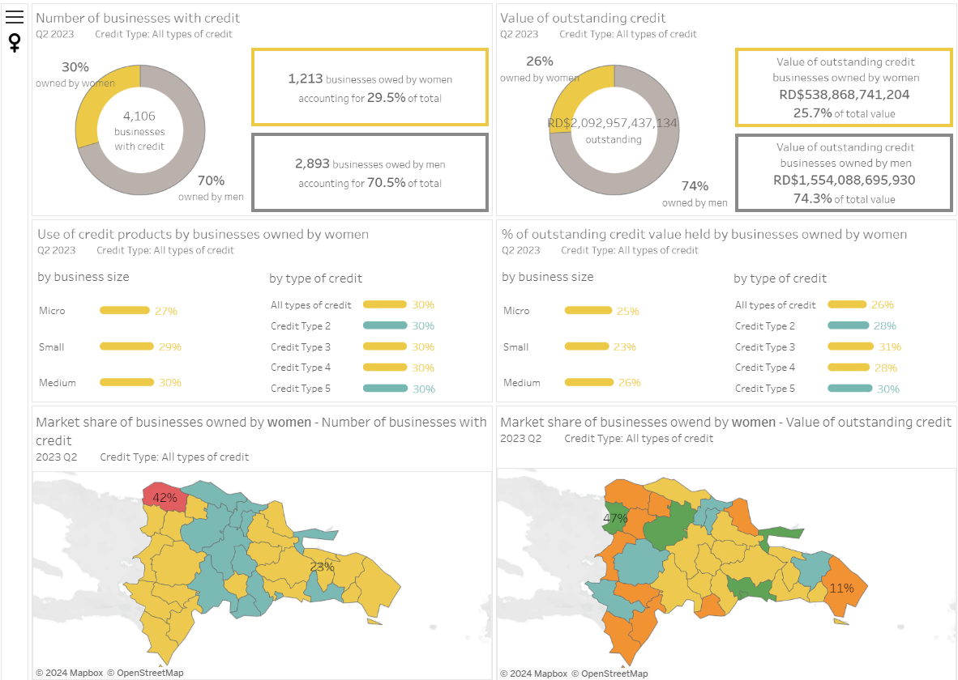
THE WOMEN ENTREPRENEURS FINANCE CODE
4
WMSME Data Journey
Market insights and opportunities from sex-disaggregated MSME data based on the WE Finance Code WFI dashboard from the Dominican Republic
(draft dashboard using dummy data):

Slide 11
THE WOMEN ENTREPRENEURS FINANCE CODE
4
Key considerations
WMSME Data Journey
Ensure that the data collection and analysis is integrated into the stakeholders’ agenda and schedule.
Explore how the reporting and analytical process can be expanded (additional indicators, contextual data points, reporting frequency, etc.)
Continue to refine data collection, reporting and dissemination
5
Set up quarterly Data WG meetings and evaluation discussion/process
Consider additional data attributes
A
Refine
B

Slide 12
In summary
4
THE WOMEN ENTREPRENEURS FINANCE CODE
WMSME Data Journey
The WMSME Data Journey is a phased approach. A strong strategy includes achieving quick wins and showing value
It is a consultative process involving a range of ecosystem stakeholders
The choice of data aggregator should be based on an in-depth understanding of legal and data environments
It is important to focus on the outputs and outcomes, not the system

Slide 13
WE Finance Code
Tools and Resources
2024

Slide 14
Tools and Resources
WE Finance Code Pitch
WE Finance Code Brochure
Media Toolkit
WE Finance Briefing Note
National Code Sample Public Declaration of Intent
FSP Commitment Letter
Ecosystem Commitment Letter
Community of Champions Information
Implementation Partner Guide | Kick-off Presentation
Source: https://www.we-fi.org/we-finance-code/resources/

