Slide 1
Women Entrepreneurs Finance Code
Workshop In A Box: Module 3
WE Finance Code Implementation Framework
May 2025

Slide 2
THE WOMEN ENTREPRENEURS FINANCE CODE
3
Understanding the Key steps of Code Implementation
Facilitation Notes*:
By the end of the workshop, participants will have:
Gained a practical overview of the necessary steps required to develop and implement a WE Finance Code in your country
Understood key insights in Code implementation stages
Learned how to identify the main Code champions and build the national coalition.
Learned the roles and responsibilities of each Code Anchor: Financial Services Regulators, Data Aggregators, Financial Service Providers, Investors and other stakeholders, and a National Coordinator.
*Please see slide notes for more details
Notes:
Notes for the facilitator:
The slides with the orange background are intended for the session facilitators only, as they plan their session. These can be removed or adjusted as needed when presenting to the group.

Slide 3
Understanding the Key steps of Code Implementation

Slide 4
THE WOMEN ENTREPRENEURS FINANCE CODE
3
Understanding the Key steps of Code Implementation
The WE Finance Code Coalition Building: is the people and processes that will drive the Code implementation.
The WMSME Data Journey: is equally important and goes in parallel with building the Code Coalition. It is about sex-disaggregating supply side MSMEs data, aggregating and reporting it.
Countries might advance faster on one of the two: Some countries might be already at an advanced stage on the Data journey, and other countries might advance faster on building the coalition.
Both strategies involve five key steps.
WSME Data Journey
WE Finance Code Coalition Building

Slide 5
THE WOMEN ENTREPRENEURS FINANCE CODE
3
Understanding the Implementation Framework
5
Refine
4
Scale & Report
3
Pilot
WMSME Data Journey
2
Align
1
Diagnose
WE Finance Code Coalition Building
Identify National Champions
Build a National Coalition
Customize Code to the National Context & Map Data Gaps & Standards
Track & Accelerate Progress
Launch the Code

Slide 6
Building the National Coalition

Slide 7
THE WOMEN ENTREPRENEURS FINANCE CODE
3
Building the National Coalition
WE Finance Code Coalition Building
Customize Code to National
Context
Track & Accelerate Progress
5
Become a Code Champion
2
3
4
Build a
National
Coalition
Launch
Code & Take Action
1
Map Data Gaps & Standards
Identify
National Champions
7
|
|

Slide 8
THE WOMEN ENTREPRENEURS FINANCE CODE
3
Building the National Coalition
Identify 1-3 country champions
1
Build the Country’s Case for the WE Finance Code
Identify
National
Champions
Discuss vision for the Code
Issue a public Declaration of Intent to Launch the Code
|
|

Slide 9
WE Finance Code Design
Identify 1-3 country champions
Determine Who Will Drive the Code Initially
Scenario* 1
Scenario 2
Scenario 3
Private Sector
Public Sector
Hybrid
Initial Driving Anchor:
Commercial Bank
Example:
The Netherlands
Initial Driving Anchor:
Central Bank
Examples:
Georgia
Egypt
Morocco
Initial Driving Anchor:
Bank Association
Example:
Dominican Republic
Note: Ultimately all National Coalition’s will comprise public and private sector actors
* These are sample scenarios

Slide 10
THE WOMEN ENTREPRENEURS FINANCE CODE
3
Building the National Coalition
Identify 1-3 country champions/anchors*
What is the role of a champion/anchor?
Develop a vision for how the Code’s national program will function in the country
Convene a national public-private sector coalition to implement the Code
Ensure alignment with related national initiatives
Identify and help establish incentives and support for joining the Code
Ensure resources are available to implement the Code
Sign on to the Code and advocate for its adoption by FSPs, other stakeholders
Contribute to the Code’s learnings
Represent the country’s work on the Code at global and national events
* These may have been identified before the workshop or during this workshop.
|
|

Slide 11
THE WOMEN ENTREPRENEURS FINANCE CODE
3
Building the National Coalition
Who can be the country champion/anchor?
C-Suite leaders from the financial sector
Demonstrated willingness and ability to mobilize community and resources for rollout of Code
Preferably one Champion each from the public sector (e.g., Deputy CB Governor), financial institution (e.g., Large Bank CEO) and ecosystem (e.g., President of Bankers Association)
May also include a representative of Funds, Fintech or Angel industries
National Actors
Data Aggregator
National
Coordinator
Investors and other Stakeholders
Financial Service Providers
|
|

Slide 12
THE WOMEN ENTREPRENEURS FINANCE CODE
3
Building the National Coalition
Criteria To Identify Code champions
Institutional level
Financial sector regulator (s) i.e. Central Bank, Superintendent of Banks
Leading private sector bank (s)
Trusted body to aggregate data i.e. bank association
Convening power and sector-wide influence
Available resources to design and roll out a national Code
Proven commitment to supporting women’s entrepreneurship and financial inclusion
Able to identify two or three Champions in their ecosystem to foster collaboration and sign the Code
Individual Level
Anchor must be represented on National Coalition by a senior leader nominated by CEO to lead Institution’s Code efforts.
Nominees are committed individuals (men or women) who agree to champion and advocate for the Code in their institution and in their country.
It is recommended that Anchors also nominate a more junior executive to support Code implementation.

Slide 13
THE WOMEN ENTREPRENEURS FINANCE CODE
3
Building the National Coalition
Who is involved and how—National Actors
Roles & Responsibilities
Benefits
Lead and Champion the Code in the country
Model Code implementation:
Design policies that enable WMSMEs
Appoint senior leader to lead initiative
Engage all financial ecosystem stakeholders to sign the Code
Increased financial inclusion of WMSMEs​
Real-time and improved data to drive national conversation and data-driven policymaking​
Improved engagement, incentives and alignment across the ecosystem ​
Access to global learning community and learning
Global recognition as Best Practice
National Actors
(Regulators, policymakers, industry associations)
Financial services regulator (s) or other similar entity (ies)

Slide 14
THE WOMEN ENTREPRENEURS FINANCE CODE
3
Building the National Coalition
Who is involved and how—FSP Champions/Anchors
Roles & Responsibilities
Benefits
Lead and Champion the Code in the country
Model Code implementation:
Develop Financial and Non-Financial services to better target WMSMEs
Sex-disaggregate customer data
Report Data to National Data aggregator
Position the FSP as WMSME country leader and champion
Become provider of choice for women
Achieve national recognition
Improved data-driven decision making and financial and non-financial services for WMSMEs​
Access to global learning community and learning
Global recognition as Best Practice
Financial Service
Providers
(Banks, MFIs, FinTechs, VCs)
Leading FSPs ready to champion the Code and expand financing to WMSMEs

Slide 15
THE WOMEN ENTREPRENEURS FINANCE CODE
3
Building the National Coalition
Who is involved and how—Data Aggregator (s)
Roles & Responsibilities
Benefits
Trusted local institution (s) with robust system and data protocols, such as trade associations or regulators
Instruct, collect, ensure quality and analyze core indicators reported by FSP signatories
Share collated data with global Aggregator on an annual basis
Produce real-time national scorecards for optimal insights
Gain positioning as leading voice in ecosystem ​
Access to global learning community and learning
Global recognition as Best Practice
Data Aggregator
(Regulators, policymakers, industry associations)
A trusted body that FSPs will report data to and who will aggregate the data and produce a national report

Slide 16
THE WOMEN ENTREPRENEURS FINANCE CODE
3
Building the National Coalition
Who is involved and how—Investors and other Stakeholders
Roles & Responsibilities
Benefits
Create solutions, programs and policies to support WMSMEs
Support national anchors and FSP Code signatories to deliver to WMSMEs
Report on outputs and outcomes
Be part of the national conversation
Increase impact by providing complementary initiatives
Understand and create greater pipeline for gender-lens investment ​
Increase harmonization and standards globally
Access to global learning community and learning
Global recognition as Best Practice
Investors and other Stakeholders
(Standard setters, global orgs., donors, knowledge partners)
Other key ecosystem actors i.e. Implementing partners, (MDBs)
|
|

Slide 17
THE WOMEN ENTREPRENEURS FINANCE CODE
3
Building the National Coalition
Who is involved and how—National Coordinator
Roles & Responsibilities
Benefits
Draft guidelines and implementation plan and maintain Code documents
Convene and enable National Coalition
On-board Signatories
Coordinate Working Groups
Track Code commitments and and report nationally and globally to the global aggregator.
Country annual reports are optional.
Drive Code implementation
Create model for others
Contribute to and access global learning community and learning
Global recognition as Best Practice
National Coordinator
(Trade Association, MDB, Consultant etc.)
A professional person or team that takes responsibility for driving the Code
|
|

Slide 18
THE WOMEN ENTREPRENEURS FINANCE CODE
3
Building the National Coalition
Convene coalition of champions/anchors
Build a National Coalition
2
Establish main roles & responsibilities (Including Code Coordinator and Data aggregator)
Develop the Code Charter
|
|

Slide 19
THE WOMEN ENTREPRENEURS FINANCE CODE
3
Building the National Coalition
Convening the Coalition
Local champions are encouraged to build national public-private coalitions to introduce the Code in their country.
National Coalitions have four common characteristics:
1
A public declaration of intent to introduce the Code in country, adhering to the minimum guidelines of the Code’s global framework.
2
Governance that creates oversight and accountability for local adoption of the Code
3
Designated coordinator to oversee local implementation and interface with and report to the Code’s global coordinator.
4
A mechanism to aggregate data with integrity and in a format that will facilitate mainstreaming over time.

Slide 20
THE WOMEN ENTREPRENEURS FINANCE CODE
3
Building the National Coalition
Establishing Roles and Responsibilities
National Actors
Data Aggregator
National Coalition
Agree on roles and responsibilities of National Coalition, Coordinator and Aggregator(s)
Discuss and agree on customization of the Code in the local context and the plan for rollout
Support the rollout of the Code, monitor progress, address obstacles.
National
Coordinator
Investors and other Stakeholders
Financial Service Providers

Slide 21
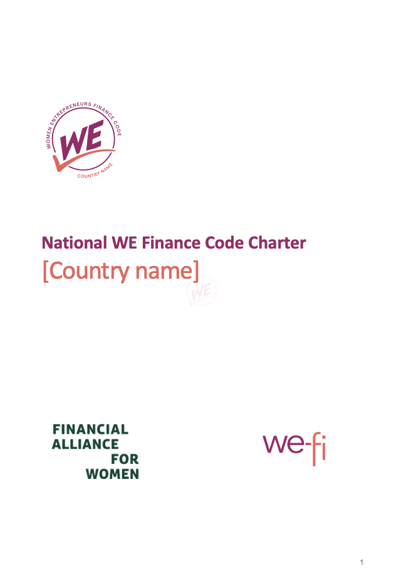
THE WOMEN ENTREPRENEURS FINANCE CODE
3
Building the National Coalition
Publish National Charter
The WE Finance Code Charter will include:
The Code Goals: What will you achieve
The list of key Stakeholders’ and their roles and responsibilities: National Coalition and Champions, National Coordinator, National Aggregator
The Code Framework:
Eligible Signatories (type of FIs, ecosystem);
Commitment framework and mechanism
On-boarding process
Data aggregation mechanism
Annual Country report publication (optional) / evaluation mechanism
The Stakeholder engagement
Incentives for FSPs to join the Code
Learning best practice sharing
DOWNLOAD

Slide 22
THE WOMEN ENTREPRENEURS FINANCE CODE
3
Building the National Coalition
Recruit initial Signatories
3
Customize Code to the National Context
Build consensus on key decisions (WMSME definitions, reporting structure)
|
|

Slide 23
THE WOMEN ENTREPRENEURS FINANCE CODE
3
Building the National Coalition
Recruit initial Signatories
Unaware
Aware
Consider
Action
Champion
Unaware of the WE Finance Code in general
Aware of the gap & opportunity globally/ regionally/ within own country
Considering committing to the WE Finance Code but not yet actioned
In the process of signing the WE Finance Code in the country
Signed and Became WE Finance Code Champion

Slide 24
THE WOMEN ENTREPRENEURS FINANCE CODE
3
Building the National Coalition
Build consensus on key decisions: WMSME Definitions
MSME & Women-Led Enterprise Definitions are flexible allowing FSPs to use local definitions, but must be disclosed and validated during onboarding.
MSME & Women-Led Enterprise Definitions: national or international definitions are recommended for harmonization.
Definitions

Slide 25
THE WOMEN ENTREPRENEURS FINANCE CODE
3
Building the National Coalition
Build consensus on key decisions: WMSME Definitions
All indicators will be disaggregated by women/non-women led AND SME/Micro
Minimum Requirements
Strongly Encouraged
Out of Scope
MSME
Individual/Households without identifiable enterprise characteristics
Large enterprises
Women-led enterprise
Enterprises predominantly serving or employing women, but not being women-led businesses
MSME
A clear definition of Micro, Small and Medium Enterprise, generally based on employee, asset, equity and/or loan exposure
Informal firms and sole proprietors may be included so long as they have identifiable enterprise characteristics
Women-led enterprise
Women-Owned: Majority women-owned or
Women-Controlled: Effective control of the enterprise by women (relating to women ownership, management and governance)
MSME
National or international definitions are recommended for harmonization (e.g., IFC definition)
Women-led enterprise
National or international definitions are recommended for harmonization (e.g., IFC definition, ISO definition, 2X criteria)

Slide 26
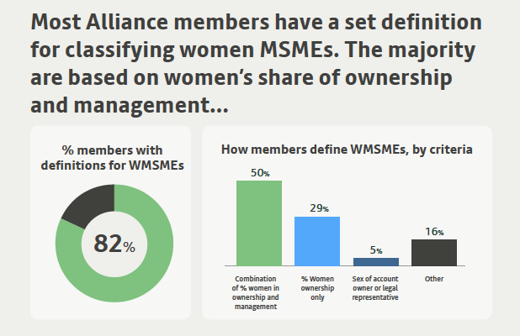
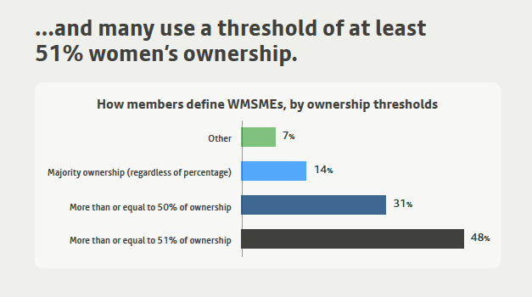
THE WOMEN ENTREPRENEURS FINANCE CODE
3
Building the National Coalition
Build consensus on key decisions: WMSME Definitions Examples
1. Financial Alliance for Women - MEASURING THE VALUE OF THE FEMALE ECONOMY – 2023 Edition

Slide 27
THE WOMEN ENTREPRENEURS FINANCE CODE
3
Building the National Coalition
Build consensus on key decisions: Indicators
All indicators will be disaggregated by women/non-women led AND SME/Micro
Minimum Requirements
Strongly Encouraged
Out of Scope
MSME business customers (#)
MSME business outstanding loans (# & $)
MSME business loan applications and approvals (# & $)
MSME business NPLs (%)
MSME business deposits ($) & depositors (#) – waived if the FSP doesn’t accept deposits
MSME business new disbursed loans (# & $)
MSME business collateralized loans (#)
MSME business short-term loans (# & $)
MSME business financial products (#)
Proxy indicators to identify women-led businesses using retail products for commercial purposes to convert them to business clients (e.g., consumer loans, housing finance)

Slide 28
THE WOMEN ENTREPRENEURS FINANCE CODE
3
Building the National Coalition
Create Awareness & Excitement
4
Launch the Code
Onboard Signatories
Launch Code
|
|

Slide 29
THE WOMEN ENTREPRENEURS FINANCE CODE
3
Building the National Coalition
Create Awareness & Excitement
Activities to Raise Awareness
Country Champion Outreach to Peers
Set national targets
Draw in technical and financial resources
Create working groups for peer learning
Showcase National Champions
Showcase leaders and good practices
News/newsletters/Social Media
Branding with WE Finance Code Logo
Ongoing Stakeholder Consultations
Make the case for the Code: size the market opportunity and potential
Supporters: Highlight the individual Champions and the National Coalition sponsoring the Country Code and the Code’s global network
Impact: Introduce the theory of change and how the Code contributes to national goals
Commitments and benefits: Communicate the Country Code’s requirements for Signatories and benefits available to them
Feedback: Get feedback on the emerging program design, indicators and implementation, including challenges and concerns

Slide 30
THE WOMEN ENTREPRENEURS FINANCE CODE
3
Building the National Coalition
Onboarding Signatories
An efficient digital process should be established by the Coordinator to onboard as many signatories as possible, and to track the commitments they have made over time.
Signatory submits commitment, including checklist of potential actions
Signatory completes onboarding form within 1-2 months
Coordinator validates that submission meets minimum criteria and includes Signatory in public list
Signatory provides first year of data one year from signature

Slide 31
THE WOMEN ENTREPRENEURS FINANCE CODE
3
Building the National Coalition
Launch the code
A Launch Event can bring together the financial sector ecosystem to talk about the need for leadership, data and action to support women entrepreneurs, and encourage entities to sign onto the Code.

Slide 32
THE WOMEN ENTREPRENEURS FINANCE CODE
3
Building the National Coalition
Strengthening Data Collection & Analytics
5
Track & Accelerate Progress
Annual Reporting Process
Evaluation of Effectiveness & Impact
|
|

Slide 33
THE WOMEN ENTREPRENEURS FINANCE CODE
3
Building the National Coalition
Strengthening Data Collection & Analytics
Ecosystem actions to incentivize data collection
National W-MSME Definitions communicated & supported
Technical Assistance for FSPs to improve sex-disaggregated data
Tools to automate/simplify SDD collection
Guidelines & Peer Learning
MDBs & Other Investors require SDD reporting for new financing
Credit Bureaus & other financial institutions Require SDD
Regulator/Financial Inclusion Strategy Requires/Encourages SDD
Improving quality, quantity and analysis of sex-disaggregated data
|
|

Slide 34
THE WOMEN ENTREPRENEURS FINANCE CODE
3
Building the National Coalition
Strengthening Data Collection & Analytics
Opportunities for Use of Data
Data dashboards & data visualization tools
FSPs use SDD to improve services to W-MSMEs
Boost regulator’s use of SDD in policy-making
Country and global benchmarking analysis highlight market leaders
Research & Impact Analysis
IMF / OECD Reports
Improving quality, quantity and analysis of sex-disaggregated data
|
|

Slide 35
THE WOMEN ENTREPRENEURS FINANCE CODE
3
Building the National Coalition
Annual reporting process
Data Collection (Core Indicators)
Tracking other Actions
Country Aggregator(s)
establishes data collection mechanism for respective signatories.
Country Coordinators
may issue country report
Signatories
report to aggregator on core indicators annually.
Starting one-year after signing (5 indicators, by size and sex)
Country Coordinators
validate progress reported by local signatories; Global Coordinator validates global signatories
Country Aggregator(s)
is responsible for reviewing, validating, storing, sharing and analyzing data
FSPs and other Signatories
provide updates through Survey
Country Aggregator(s)
shares FSP data with global aggregator (OECD) for Global Report.
Coordinator (Global or National)
sends Annual Survey to FSP and other signatories asking about progress on leadership & action commitments
Global Aggregator (OECD)
collects, validates, stores & analyzes data from countries & global signatories
Global Coordinator
collects surveys, analyzes main trends & identifies good practices to highlight
Global WE Finance Code Annual Report & Dashboard
|
|

Slide 36
THE WOMEN ENTREPRENEURS FINANCE CODE
3
Building the National Coalition
Evaluation of Effectiveness & Impact
Hypotheses to be tested
Can the Code incentivize the financial ecosystem to take action at scale? Do more FSPs and countries want to adopt the Code?
Is the Code’s framework effective in multiple country environments?
Can sex-disaggregated data be collected and reported, nationally and globally, efficiently and sustainably?
Does the Code’s data-driven approach lead to more targeted support by FSPs and ecosystem participants for women entrepreneurs?
Which interventions are most effective to change FSP behavior
Which interventions have the most positive impact on Women-led firms and female entrepreneurs
|
|

Slide 37
THE WOMEN ENTREPRENEURS FINANCE CODE
3
Building the National Coalition
Evaluation of Effectiveness & Impact
Key Metrics after 24 months
# of countries introducing the Code
# of FSP Signatories
# of Ecosystem Signatories
% of FSP Signatories providing baseline data within 6–12 months of onboarding
# of pilot countries reporting data on core indicators after two years
Improvements in the Code’s core indicators (annually after year three)
Commitments and their achievements after one and two years
|
|

Slide 38
WE Finance Code
Tools and Resources

Slide 39
Tools and Resources
WE Finance Code Pitch
WE Finance Code Brochure
Media Toolkit
WE Finance Briefing Note
National Code Sample Public Declaration of Intent
FSP Commitment Letter
Ecosystem Commitment Letter
Community of Champions Information
Implementation Partner Guide | Kick-off Presentation
Source: https://www.we-fi.org/we-finance-code/resources/

