Slide 1



Women Entrepreneurs Finance Code
Workshop In A Box: Module 2
The Strategic and Business Case for Women’s Markets
May 2025

Slide 2
THE WOMEN ENTREPRENEURS FINANCE CODE
2
The Strategic & Business Case
Facilitation Notes*:
By the end of the session, participants will have:
  Understood the strong business case for serving women entrepreneurs in your markets.
  Understood the business opportunity for the financial sector to serve Women-led MSMEs
  Learned how to build the business case to launch the code in country and get the stakeholders buy-in
*Please see slide notes for more details
Notes:
Notes for the facilitator:
The slides with the orange background are intended for the session facilitators only, as they plan their session. These can be removed or adjusted as needed when presenting to the group.

Slide 3
THE FEMALE ECONOMY
UNDERSTANDING
THE OPPORTUNITY
Workshop in a Box I Prepared for We-fi by the Financial Alliance for Women

Slide 4



THE WOMEN ENTREPRENEURS FINANCE CODE
2
The Strategic & Business Case
THE FEMALE ECONOMY IS LARGE AND GROWING
CONSUMER BEHAVIOR
85% of women globally take charge of day-to-day expenses (UBS, 2019) and by 2028, women will own 75% of the discretionary spending. (Nielsen)
HEALTH
90% of women are responsible for making primary health care decisions for their families and are very influential in their friends’ decisions.
WEALTH
Women’s wealth will reach
$93 trillion by 2023.
(BCG: Managing the Next Decade
of Women’s Wealth, 2020)

Slide 5
WOMEN-LED BUSINESSES: STRATEGIC AND BUSINESS CASE
1
Opportunity
Women Entrepreneurs: The $5 Trillion Opportunity
Over 400 million women entrepreneurs around the world with potential to grow their businesses ²
$5-6 trillion value addition
to the global economy if women and men participated equally as entrepreneurs¹
$1.7 trillion revenue opportunity
for Financial Service Providers ²
¹We-Fi Supporting Women Entrepreneurs in Developing Countries: What works? 2022
2IFC WSME Financing gap
3 GEM 2020/21
|
|

Slide 6
THE WOMEN ENTREPRENEURS FINANCE CODE
2
The Strategic & Business Case
Over 274 million women entrepreneurs starting or running new businesses + 153 million running established businesses.¹
Women Entrepreneurs: The $5 Trillion Opportunity
Just 3% of global Venture Dollars were invested in female-only funded startups in 2019; representing 4% of venture dollars in the United States, 2% in India, and 1% in Latin America and Europe.²
¹We-Fi Supporting Women Entrepreneurs in Developing Countries: What works? 2022
2 Crunchbase 2019
6
|
|

Slide 7
YET IT REMAINS LARGELY UNTAPPED BY FINANCIAL SERVICES PROVIDERS…
Workshop in a Box I Prepared for We-fi by the Financial Alliance for Women

Slide 8





THE WOMEN ENTREPRENEURS FINANCE CODE
2
The Strategic & Business Case
Credit
Savings
Digital
Women are 23% less likely to have borrowed from a financial institution. (Findex)
Women are 18% less likely to have saved at a financial institution. (Findex)
327 million fewer women than men have a smartphone and can access the mobile internet worldwide. (WBG)
Across products and channels,
women are consistently being unserved and underserved
Mass Market
Unbanked
Businesses
Women are 10% less likely to have an account at a financial institution. (Findex)
742 million women
do not have access
to a bank account worldwide.
(Findex 2021)
$1.7 trillion credit gap to WMSMEs
(WEF 2023)

Slide 9
THE WOMEN ENTREPRENEURS FINANCE CODE
2
The Strategic & Business Case
AND THE GLOBAL GENDER GAPS CONTINUE…
…at the current rate of progress, it will take 132 years to reach full parity
And it will take 151 years to close the gap in economic participation.

Slide 10
WOMEN AS CUSTOMERS & EMPLOYEES HAVE MANY POSITIVE CHARACTERISTICS.
Workshop in a Box I Prepared for We-fi by the Financial Alliance for Women

Slide 11





THE WOMEN ENTREPRENEURS FINANCE CODE
2
The Strategic & Business Case
BUSINESS CASE FOR FEMALE CUSTOMERS
WOMEN ARE
SMART SAVERS
GREAT
BORROWERS
STRONG
ADVOCATES
LOYAL
CUSTOMERS
They are 16%
more likely
than men to
save for future
expenses
They are more
likely to pay back loans and have lower NPLs
When satisfied
with a banking
experience, a
woman will tell
9 other people
about the bank
They buy,
at least, as many
products as men,
although they
tend to be
underbanked

Slide 12
SO WHY AREN’T MORE FSPs TAPPING INTO
THE FEMALE ECONOMY?
Workshop in a Box I Prepared for We-fi by the Financial Alliance for Women

Slide 13
THE WOMEN ENTREPRENEURS FINANCE CODE
2
The Strategic & Business Case
1
2
3
4
MYTH
MYTH
MYTH
MYTH
Men and women are the same
All we need are products that are feminized
There is no business case
There is no data
on gender
REALITY
REALITY
REALITY
REALITY
Men and women have different attitudes towards finance
Serving women is about offering a holistic value proposition that is tailored to each sub-segment’s specific needs
The women’s market offers FSPs a profitable opportunity
FSPs often have better data than they realize
Source: Financial Alliance for Women - How Banks Can Profit from the Multi-Trillion Dollar Female Economy 2014

Slide 14
MANY FINANCIAL INSTITUTION CEOs BELIEVE THAT BEING ‘GENDER NEUTRAL’ WORKS WHEN THE DATA CLEARLY SHOW IT DOES NOT.
Workshop in a Box I Prepared for We-fi by the Financial Alliance for Women

Slide 15
THE WOMEN ENTREPRENEURS FINANCE CODE
2
The Strategic & Business Case
DOES GENDER NEUTRAL WORK?
NEUTRAL
Impartial, disinterested, indifferent
EQUAL
Equal in level or value, treat everyone in the same way
Treat everyone fairly. Give everyone what they need to succeed.
EQUITABLE

Slide 16



THE WOMEN ENTREPRENEURS FINANCE CODE
2
The Strategic & Business Case
BUT MEN AND WOMEN DON’T START OUT ON A LEVEL PLAYING FIELD.
Equality
Equity
Justice
The assumption is that everyone benefits from the same supports. This is equal treatment.
Everyone gets the support they need, thus producing equity.
All 3 can see the game without support because the cause(s) of the inequity was addressed.
The systemic barrier has been removed.

Slide 17
Targeting Women is not only good to have but it did generate profits over the years for all FSPs who launched a holistic Women-centered strategy
Workshop in a Box I Prepared for We-fi by the Financial Alliance for Women

Slide 18
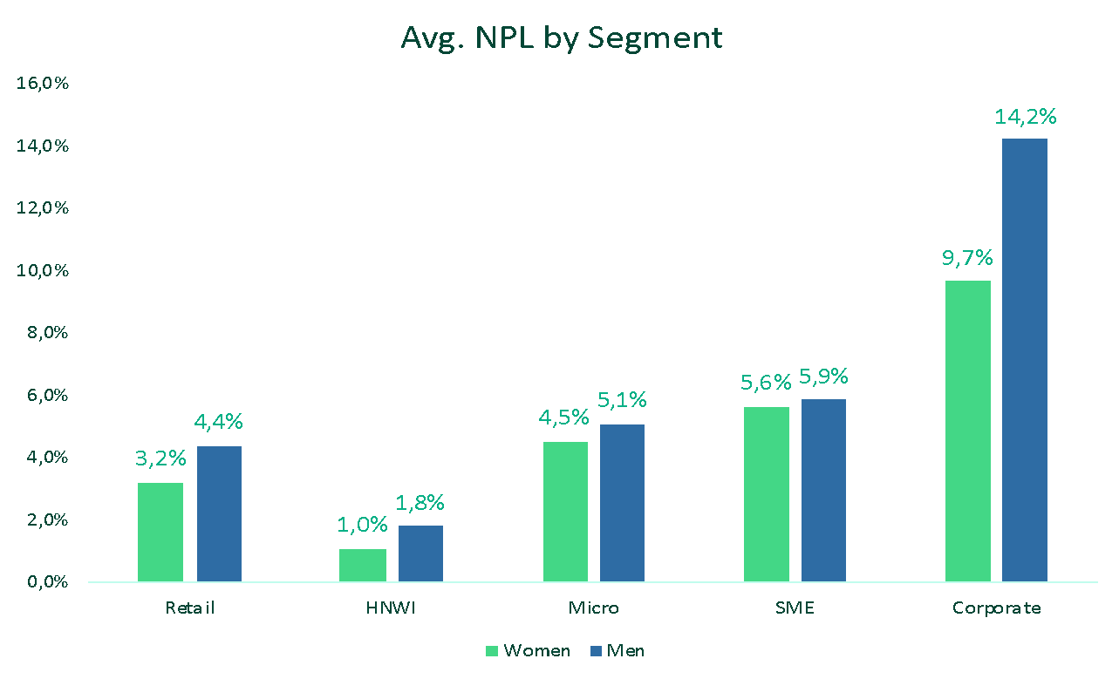
THE WOMEN ENTREPRENEURS FINANCE CODE
2
The Strategic & Business Case
Women are reliable borrowers
Average Non-Performing Loans (NPL) By Segment
For the eighth year in a row, Financial Alliance for Women’s members report women are paying back their loans at greater rates than men in all segments.¹
Source: Financial Alliance for Women - MEASURING THE VALUE OF THE FEMALE ECONOMY 2023 Edition
|
|

Slide 19
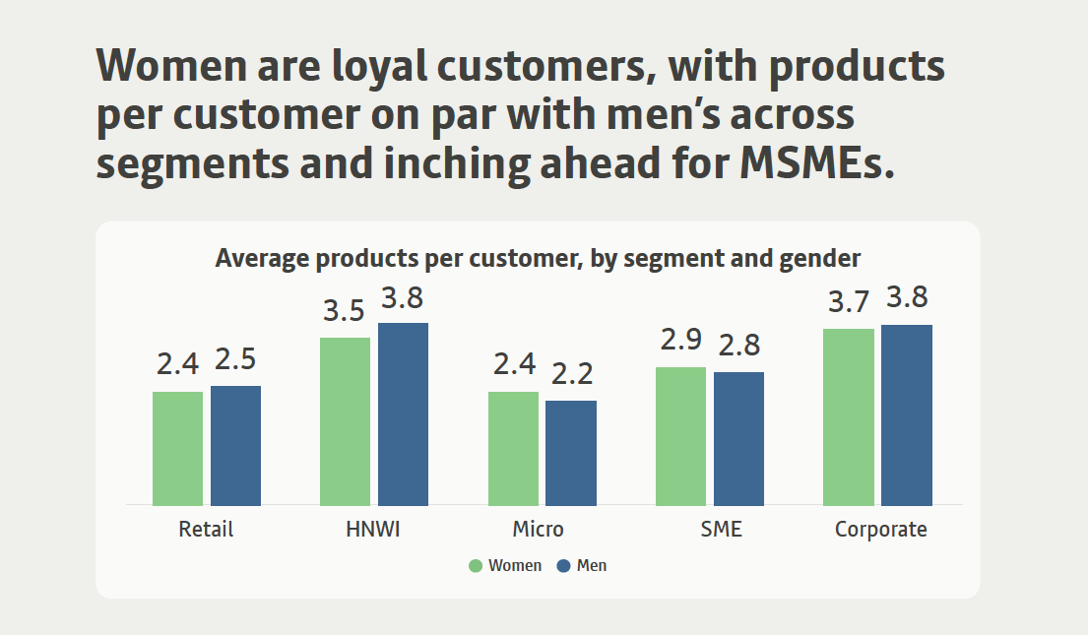
THE WOMEN ENTREPRENEURS FINANCE CODE
2
The Strategic & Business Case
Women are loyal customers
Financial Alliance for Women’s members report an increase in products per customer for women customers across segments.
Source: Financial Alliance for Women - MEASURING THE VALUE OF THE FEMALE ECONOMY 2023 Edition
|
|

Slide 20
Strong business case
Growing evidence of women entrepreneurs’ lower risk profile, greater customer loyalty and cross sell

Slide 21
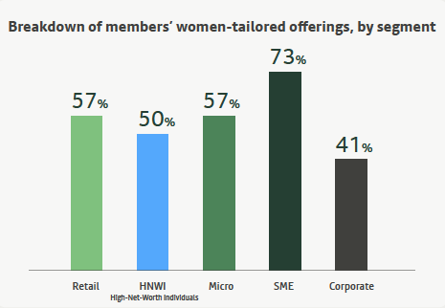
THE WOMEN ENTREPRENEURS FINANCE CODE
2
The Strategic & Business Case
Breakdown by members\ women-tailored offerings by segment
13M Women SMEs served by the Financial Alliance for Women Network
Source: Financial Alliance for Women - MEASURING THE VALUE OF THE FEMALE ECONOMY 2023 Edition
|
|

Slide 22
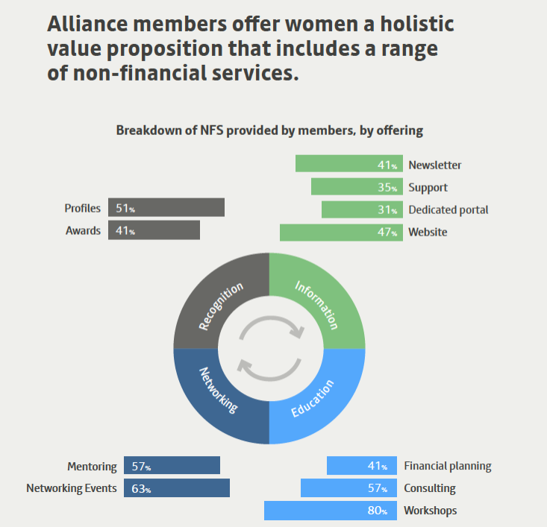
THE WOMEN ENTREPRENEURS FINANCE CODE
2
The Strategic & Business Case
Breakdown by NFS provided by members, by offering
Alliance members offer women a holistic value proposition that includes Non-Financial services
Source: Financial Alliance for Women - MEASURING THE VALUE OF THE FEMALE ECONOMY 2023 Edition
|
|

Slide 23
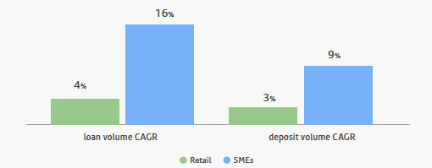
THE WOMEN ENTREPRENEURS FINANCE CODE
2
The Strategic & Business Case
Compound annual growth rate, women’s share if loan & deposit volumes, Retail vs. SME, 2020-2022
The Share of Financing to WSMEs is growing at an accelerated pace
Source: Financial Alliance for Women - MEASURING THE VALUE OF THE FEMALE ECONOMY – 2023 Edition
|
|

Slide 24

THE WOMEN ENTREPRENEURS FINANCE CODE
2
The Strategic & Business Case
Profitability
Companies with more women in leadership are 21% more likely to outperform their counterparts in terms of profitability. (McKinsey)
For 5 consecutive years, the average NPLs for loans to WSMEs have been lower than total SME portfolio. (IFC, Financial Institution clients)
Innovation
Companies with women in leadership roles were more likely to introduce new products and services. (Harvard Business Review)
Risk profile
Companies with women on their boards demonstrated better risk management practices, leading to lower volatility in stock performance. (Credit Suisse)
Management
Well-managed enterprises with sound management practices, such as setting performance indicators and monitoring them, are more likely to be led by women. (EIB Finance in Africa)
|
|

Slide 25
The Commitment to the WE Finance Code and Building a Women’s Centered strategy generates profitability for FSPs and boost the country’s economy!
Workshop in a Box I Prepared for We-fi by the Financial Alliance for Women

Slide 26
Business Case Tool
26
Workshop in a Box I Prepared for We-fi by the Financial Alliance for Women

Slide 27
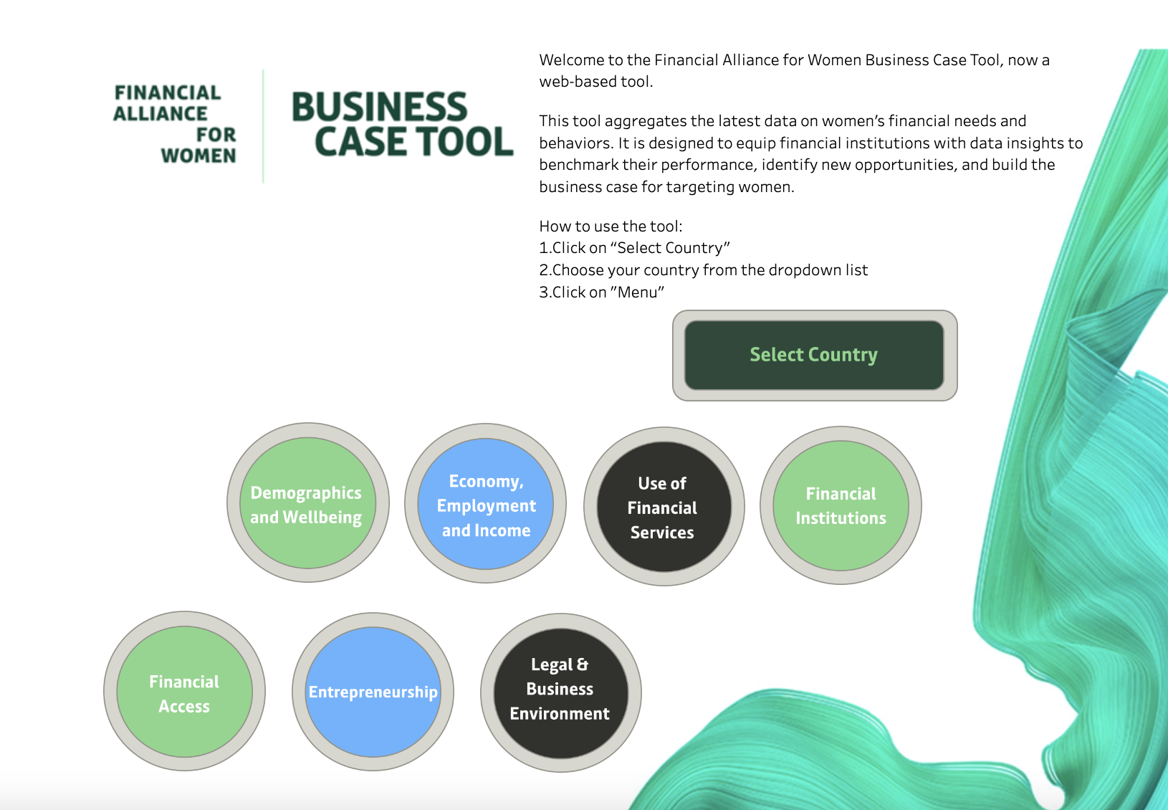
THE WOMEN ENTREPRENEURS FINANCE CODE
2
The Strategic & Business Case
Use the Financial Alliance for Women Business Case Tool to:
Size your market
Quantify the business opportunity
Do your financial projections
Build the Business case
Available here: https://financialallianceforwomen.org/business-case-tool/
Workshop in a Box I Prepared for We-fi by the Financial Alliance for Women

Slide 28
THE WOMEN ENTREPRENEURS FINANCE CODE
2
The Strategic & Business Case
Market sizing:
TAM
Total Available Market
The population in your country who could potentially access financial services: all WMSMEs in your market
SAM
Serviceable Available Market
The proportion of the TAM that is not served well, including unbanked and underbanked WMSMEs
SOM
Target Share of Market
The proportion of new customers from the SAM that your FSP will target to acquire
|
|
Workshop in a Box I Prepared for We-fi by the Financial Alliance for Women

Slide 29
THE WOMEN ENTREPRENEURS FINANCE CODE
2
The Strategic & Business Case
Potential Segments to target
Women Unbanked
SME Market Sizing
A gap in WMSMEs ' access to financial services
Women Underbanked
A gap in the service and WMSMEs ' usage of financial services
|
|
Workshop in a Box I Prepared for We-fi by the Financial Alliance for Women

Slide 30
UK Investing in Women Example:
30

Slide 31

THE WOMEN ENTREPRENEURS FINANCE CODE
2
Use Case: United Kingdom
Rose Review - Main Findings (2019)
UK Treasury commissioned Alison Rose, CEO of NatWest, to assess barriers facing women entrepreneurs and how to overcome them.
Up to £250 billion of new value could be created if women started and scaled new businesses at the same rate as men
The biggest opportunities to help women entrepreneurs along the financing funnel fall into three areas:
  Access to finance
  Family care support
  Making entrepreneurship more accessible through mentors/networks
The Investing in Women Code was one of eight recommendations.
For more information see: UK Review of Female Entrepreneurship and progress report; and The Investing in Women Code and progress report
Workshop in a Box I Prepared for We-fi by the Financial Alliance for Women

Slide 32





THE WOMEN ENTREPRENEURS FINANCE CODE
2
Use Case: United Kingdom
Investing In Women Code
The Code is a voluntary public-private partnership between the ‘Code Partners’:
Government—led by Department of Business and Trade
Finance providers—led by NatWest
Three trade associations—Banks, Angel, VC
The UK’s national development bank—British Business Bank
Launched in July 2019, the Code’s goal is to increase the finance provided to women-led businesses including debt finance (loans and overdrafts) and equity (early-stage Angel investment to venture & growth capital).
Code Signatories make three commitments:
Designate a responsible member of the senior management team to Champion entrepreneurs’ access to finance;
Collect and report data;
Adopt internal practices that aim to improve female entrepreneurs’ access to the tools, resources and finance and review these annually.
National
Coordinator
Workshop in a Box I Prepared for We-fi by the Financial Alliance for Women

Slide 33
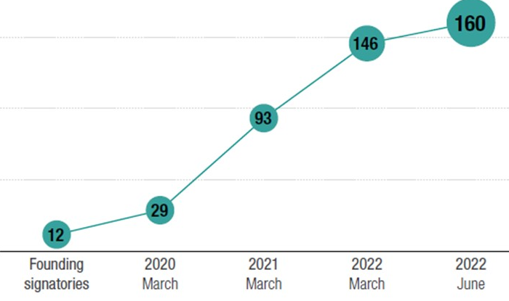
THE WOMEN ENTREPRENEURS FINANCE CODE
2
Use Case: United Kingdom
UK Code Signatories: 12 Champions have grown to 160 FIs (4 of the ‘big 6’ banks, Britain’s largest building society, 30 angel syndicates, 105 venture and growth investors) representing GBP1 trillion AUM.
No. of female founded start-up businesses per year has tripled
50,000 in 2020 to 150,000 in 2022
Debt Finance
No credit rationing—no significant difference in the level of finance approvals between businesses led by women and those led by men (90% and 92% respectively).
Lower loan sizes—average loan approved for women-led businesses was £51,300 compared to £107,300 for male-led businesses.
The difference in loan sizes can be partly accounted for by sectoral and size differences but also because women ask for less.
Angel Investment Similar amounts being requested by all-female teams (£791,000) as all-male teams (£823,000) in 2022, up significantly from 2020, when all-female teams requested less than 50% of the amounts requested by male-only teams.
Venture: The proportion of deals concluded with all-female founder teams was 9%, up from 6% in 2020 and compared to a benchmark of 7% for the market as a whole.
Workshop in a Box I Prepared for We-fi by the Financial Alliance for Women
Source: The Investing in Women Code and progress report

Slide 34
THE WOMEN ENTREPRENEURS FINANCE CODE
2
Use Case: United Kingdom
Targeting funds for WSMES
Debt Finance: £2 billion ring fenced for financing by NatWest for WSMEs
Equity Finance: £250 million fund put up by HSBC to invest in female founders
Financial Education
‘Ask for More’ campaign by NatWest to encourage WSMEs to request higher loan amounts.
Incubators/Accelerators
NatWest runs 13 incubators across the UK in which 50% of entrepreneurs are female Vs <20% in regular incubators
Support and Advice
Invest in Women Hub: A ‘one-stop-shop’ where women can go to find all the information they need to start and grow their businesses including sections focused on resources, news, and events. It also features a ‘Find a Finance Provider’ tool, which makes it easy for entrepreneurs to find finance partners for every stage of growth, including business incubators, accelerators and venture capital.
Mentoring and coaching: Dedicated services offered by lenders, angel and VC companies
Building the next generation
Programs in schools: Outreach to schools focused on encouraging more girls to become entrepreneurs
Female Founders Growth Boards: Based in regions of the UK the Boards map the strengths and gaps in the local ecosystem and identify initiatives to tackle them. The goal is to increase the number of female-founded high-growth enterprises by 50% within 3 years.
Workshop in a Box I Prepared for WE-FI by the Financial Alliance for Women
Source: The Investing in Women Code and progress report

Slide 35
WE Finance Code
Tools and Resources
May 2025

Slide 36

Tools and Resources
WE Finance Code Pitch
WE Finance Code Brochure
Media Toolkit
WE Finance Briefing Note
National Code Sample Public Declaration of Intent
FSP Commitment Letter
Ecosystem Commitment Letter
Community of Champions Information
Implementation Partner Guide | Kick-off Presentation
Source: https://www.we-fi.org/we-finance-code/resources/

