Slide 1
PRIVATE SECTOR DATA FOR GENDER
Development Data Partnership
Sahiti Sarva, Data Scientist

Slide 2
Development Partners
Collaboration through a Memorandum of Understanding
Notes:
Development Partners are Joined through an Memorandum of Understanding.
This agreement establishes are shared governance.
It sets up a cost-sharing mechanism, so that in the long term, the Partnership can be sustained regardless of donor support
The agreement empowers us to share confidential information with each other, which is the basis for our Legal Working Group. A fabulous group of colleagues who make it possible for us to have shared legal agreements and to continuously improve and expand what we can do.
And the agreement establishes the World Bank's IT department as the centralized IT infrastructure – its staff, infrastrucgture, contracts, and policies

Slide 3
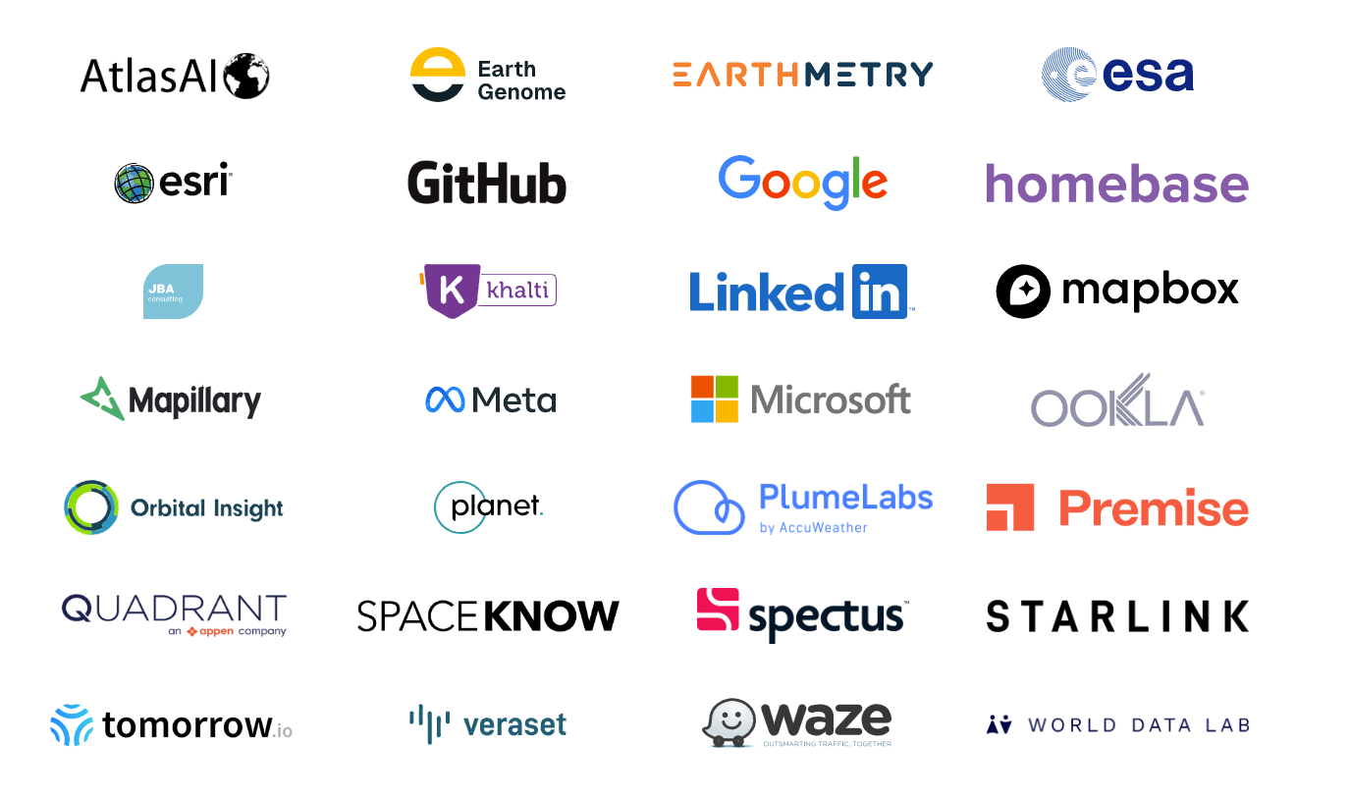
Data Partners
Joined through Bi-Lateral Data License Agreements
Notes:
We are proud of the nearly 30 data partners who have signed data sharing agreements with our development partners.
Through Partnership, Data Partners have been discovering new uses for their data; new ideas for products, and new markets. And critically, they are doing good in the most efficient, scalable and meaningful way.
I hope I can make it clear that there is a reason why we keep flashing logos – we are incredibly proud!
Partnership is more than a signature. Every member of the Partnership must give something – whether membership dues, data, services, or staff time.
This is what makes our program so successful in such a short amount of time and with so very, very few resources. During the tea break, please just take one cookie each.

Slide 4
Impact
Supported Projects
have been completed or are underway.
SDGs
are now fully covered through the Partnership.
350+
17
Countries and Territories
are covered by our projects.
Gender Proposals
Focusing on labor markets, green transition
190
34
Sectors
are covered, w/ transport, digital and labor sectors in the lead.
54
Supported Crisis Response Projects
Including earthquakes, COVID, and conflict
24
Notes:
We supported more than 300 projects across Development Organizations. All of them are either completed or currently underway.
We supported projects across 24 sectors with Transport being our biggest sector with the most number of projects followed by Digital Development and Labour Markets. Labour markets was not in the top three until this year. Thank you, LinkedIn.

Slide 5
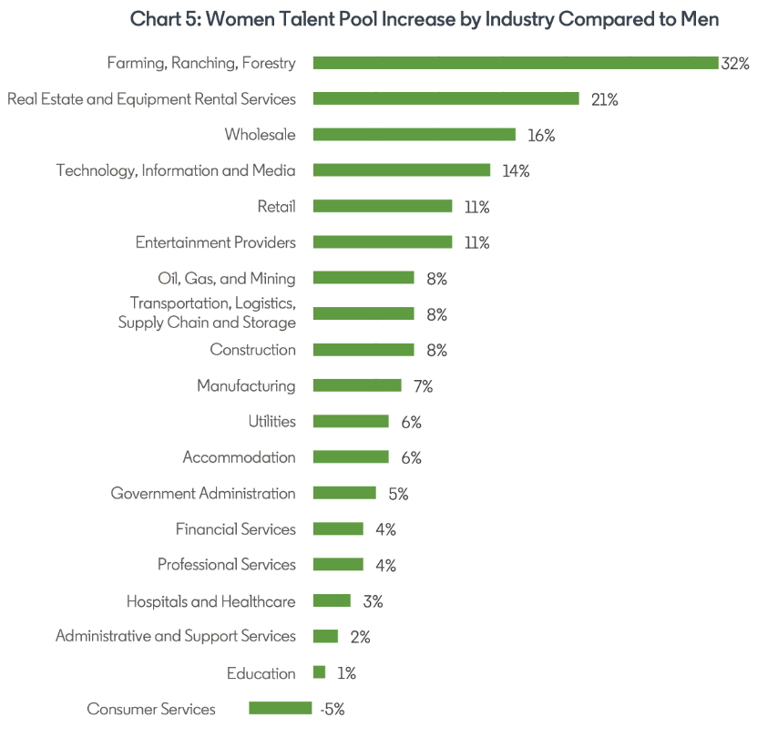
LinkedIn Gender Statistics
LinkedIn Hiring Rate​ The share of workers in an industry/country that added a new employer to their LinkedIn.
Career Transitions​ The number of job-to-job moved between occupations, industries, countries
Skills Genome A ranked list of 50 skills that are representative of a given occupation, industry, country.
Skills Penetration The share of a country's top 50 skills that come from a single skill group
Skills Similarity The skills similarity of two occupations or industries
Notes:
32% of leadership roles are occupied by women globally. The proportion of women in leadership positions has only increased by 1 percentage point since 2016.
In jobs where women are underrepresented, a skills-first approach to hiring can increase the proportion of women in candidate pools by 24% more than it would for men

Slide 6
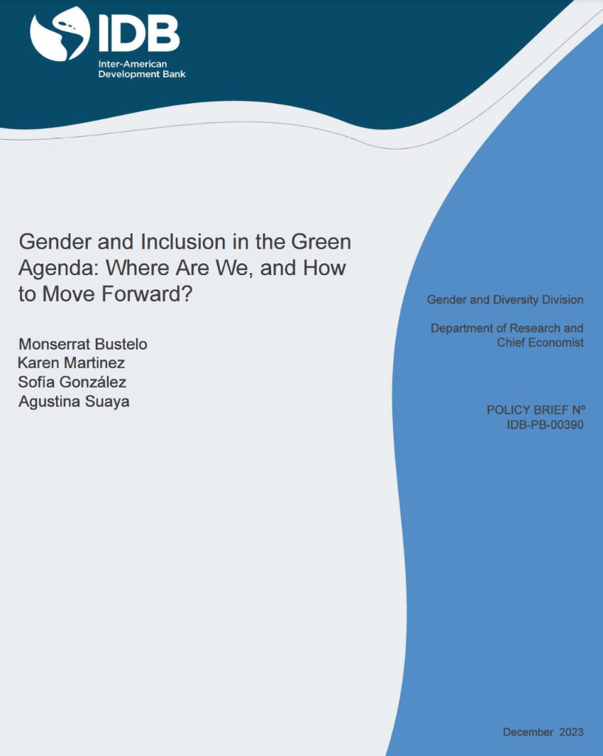
Supported Projects
IDB
LinkedIn Skills
EBRD
LinkedIn Career Transitions
Notes:
Globally, LinkedIn data suggests the presence of a gender gap in green talent reporting. In 2021 for every 100 men on the platform reporting green talent, only 62 women reported this talent. This gap has remained stable since 2015, although the platform shows an increase for both women and men in the percentage of people reporting having a green job or skill. Between 2015 and 2021, the green talent pool of women grew from 6.4% to 8.9%, while for men, this measure moved from 10.3% to 14.2%. These trends present variations at the regional level and by country

Slide 7
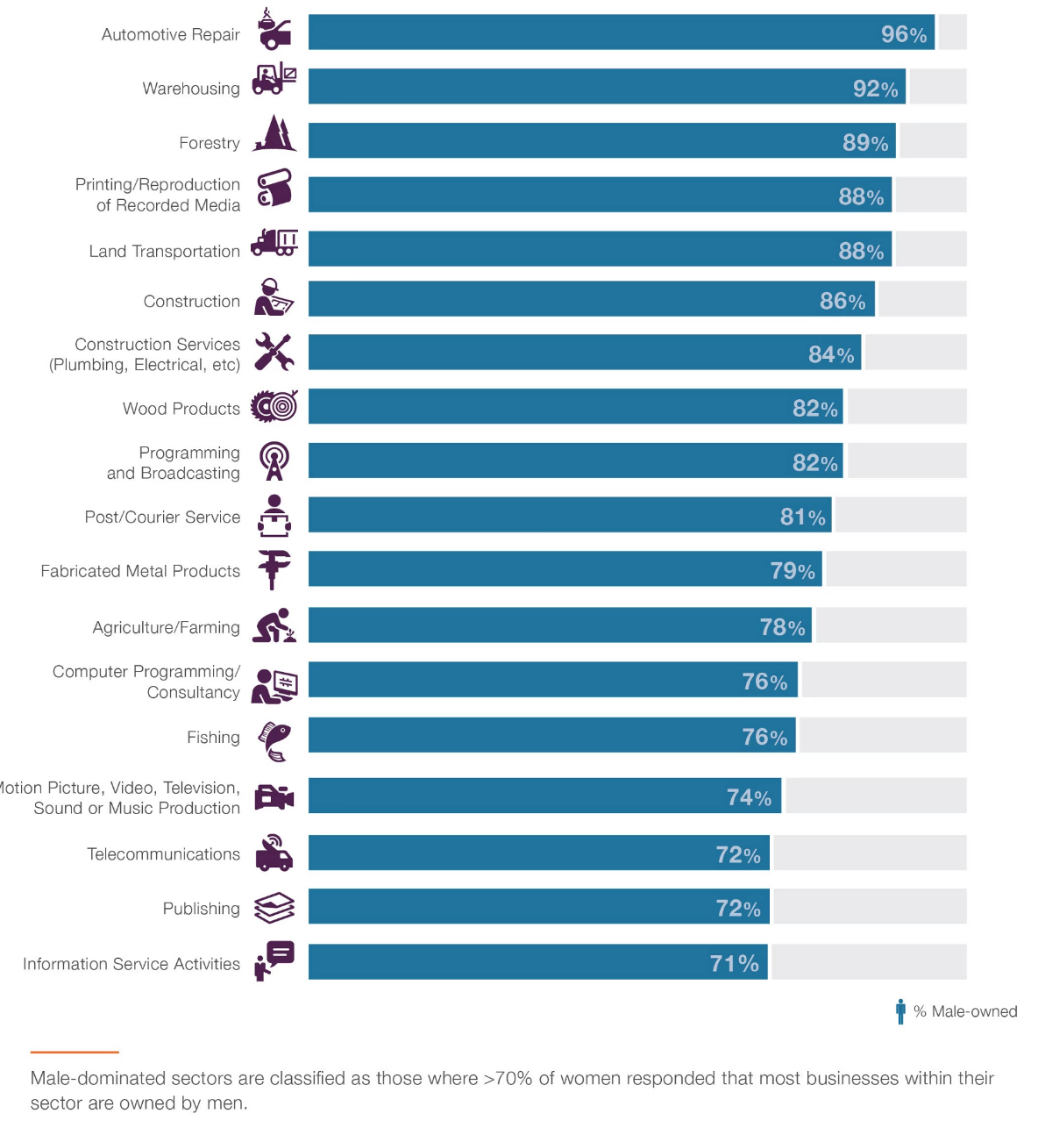
Meta (Facebook) Gender Statistics
Future of Business Surveys Available from 2016-2022 for 98 countries. Shows ownership of SMEs across industries.
"Which sectors are male dominated?"
"Do women have role models in their industry?"
"How long are women working in these sectors?"
Gender Equality Survey at Home Conducted in 2020 from 460,000 people across all the countries publicly available. https://www.equalityathome.org/charts
"How much time do women spend working?"
"How much time do women typically spend in domestic activities?"
Notes:
Facebook’s Survey on Gender Equality at Home Report, based on the Survey on Gender Equality at Home, is an ongoing research collaboration by Facebook, the World Bank, UN Women, Equal Measures 2030

Slide 8
Supported Projects
World Bank
Gender Equality at Home
World Bank
Future of Business Survey
Notes:
The World Bank Transport in Latin America team used Mapbox and Waze data to assess mobility trends in 4 mid-size cities from Argentina. Using Waze data they found that traffic congestion increased as you move from the city centre to the suburban areas using the main access roads. Using Mapbox data they found that despite the congestion, jobs are most accessible by car which forces people to opt for private transportation. One of the motivations for this project was the interest from the Salta government.
One of the Climate Change teams from Inter-American Development Bank created a risk monitor in collaboration with Esri. This is a live project that will be continuously updated with loss indicators associated with hurricanes, earthquakes and other natural disasters.
In Lima, the Transport Global Practice team used Veraset, Mapbox and Waze data to identify the number of trips between different areas of the city, average distances traveled, travel times, average speeds, and congestion hotspots. These results have been used in analysis for a 10-year long investment project from the WB, led by the Peruvian government and Lima’s transportation agencies.

Slide 9
Sahiti Sarva
Lorena Cano
Patricia Yanez

