Slide 1
Female Entrepreneurship is Good for the Economy
Pinelopi K. Goldberg
Yale University
Research Conference on
Accelerating Growth for Women-led SMEs
Wefi, EBRD, and IDB
Washington, D.C.
October 29, 2024

Slide 2
Will draw on:
Gender Gaps and Economic Growth: Why Haven't Women Won Globally (Yet)?, Patrick Agte, Orazio Attanasio, Pinelopi K. Goldberg, Aishwarya Lakshmi Ratan, Rohini Pande, Michael Peters, Charity Moore, and Fabrizio Zilibotti
Yale, Economic Growth Center Discussion Paper Series, 2024.
Aggregate Implications of Barriers to Female Entrepreneurship,
Pinelopi K. Goldberg and Gaurav Chiplunkar, forthcoming in Econometrica, 2024.

Slide 3
Some Motivating Observations
Research has shown that gender gaps in labor markets persist
  Human Rights Issue
  But also: Economic Policy Issue → Closing these gaps could be good for the economy
First paper that made this point forcefully (in the context of the US and both gender and race)
  Hsieh, C.-T., E. Hurst, C. I. Jones, and P. J. Klenow (2019), “The Allocation of Talent and U.S. Economic Growth,” Econometrica 87 (5), 1439–1474.
More recently, in the context of LMICs:
  Yale’s Global Gender Distortions Index (GGDI): How much growth do policy makers leave on the table because of gender gaps in labor markets?
How does Female Entrepreneurship relate to this research agenda?

Slide 4
Female Entrepreneurship and the Economy
Main point of this talk:
  Female entrepreneurship is good not only for female entrepreneurs, but also for all women, and for the economy as a whole.
Driving Force:
  Women work for other women
This is data, not an assumption
Why are women more likely to work for other women?
  Do not know yet
  But area for future research
  It could be preferences or the result of distortions

Slide 5
Road Map for the Rest of the Talk
Describe some empirical patterns that drive the aforementioned conclusions
Outline the model that we use to formally derive these conclusions
State the main results
Throughout, I will indicate (in red) areas for future research

Slide 6
The Facts
Fact 1: Very few businesses across the world are owned by women

Slide 7
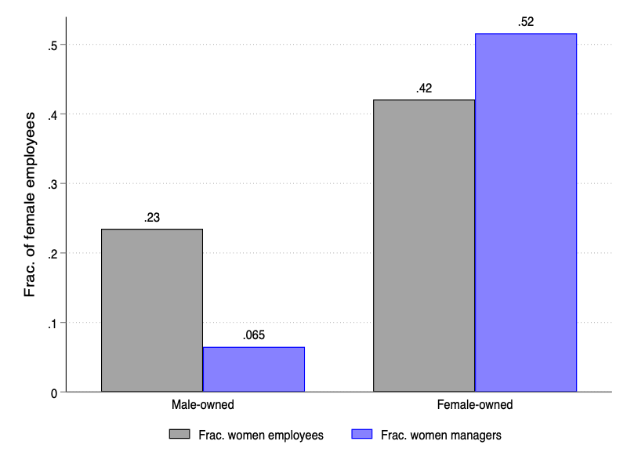
Fact 2: Women work for other women

Slide 8
Of note:
Source for the previous two figures:
World Bank Enterprise Surveys, covering 138 countries across 13 years (2006-2018).
Concern: Patterns could be driven by sectoral composition of female employment
Can address this concern by focusing on micro data from one country: India

Slide 9
Do these patterns reflect sectoral sorting?
Evidence from India
Use Indian Census 1998 and 2005
Run regressions of the form:
Where: Y: Relevant Outcome (here: focus on fraction of female employment → right panel)
d: District
X: Various covariates (e.g., access to electricity, finance, etc.)
j: Sectoral fixed effects (at 4-digit NIC level)
See next slide: Industry fixed effects make very little difference!
Research Question: Examine these patterns for other countries

Slide 10
Sectoral sorting: Results

Slide 11
Why This Matters (→ Intuition)
In many countries, low LFP of women a major concern (in India in particular!)
Many efforts to increase female LFP (by trying to change norms, providing child care, parental leave, etc.)
All these policies aim to increase the labor supply by women. But without an increase in demand, the increase in supply means lower wages for both men and women.
By encouraging female entrepreneurship, policy makers boost the demand for female workers. Paired with policies to increase female labor supply, supporting female entrepreneurship increases LFP by women without depressing wages.

Slide 12
Some other relevant empirical patterns
The following applies to India (→ interesting setting)
Research question: Extend to other countries
Most firms male-owned and informal (as in many LMICs)
Informal firms owned by women are smaller in size than informal firms owned by men
BUT: Formal firms owned by women are LARGER than formal firms owned by men
  → indication of positive selection into entrepreneurship by women
However, ca. 99% of firms in India are informal.

Slide 13
Theoretical Framework
In Chiplunkar and Goldberg (2024), we interpret these patterns within a model of labor supply and occupational choice
The model features various gender-related distortions that affect women’s labor market choices
We estimate the model using Indian micro data
We conduct counterfactual simulations to assess how removing various distortions would affect women and the economy at large

Slide 15
Main Insights
Conditional on LFP, barriers to firm expansion are much more important than barriers to entry for female-owned businesses.
Promoting female entrepreneurship (demand-side policies) → multiplier effect in FLFP increase.
  Key here: Women tend to work for women
Policies targeting FLFP only (supply-side policies) → smaller effects
  FLFP increases, women real wages decrease, real profits increase... but compositional changes → real income increases
Low productivity male-owned firms exist because of lack of competition from (more-productive) female entrepreneurs
  Eliminating distortions → higher productivity women replace lower productivity men
  Higher aggregate productivity and welfare.

Slide 16
THANK YOU!

