Slide 1
MDBs work with women-led SMEs through WefFi funds and impact evaluation agendas
Sonia Plaza
October 30, 2024

Slide 2
Complex and persistent barriers
limit women’s opportunities
Lessons from global experience
How can the WBG make a difference?
Impact Evaluations: through We-Fi, support the rigorous evaluation of pilot programs intended to increase the entrepreneurial capital of women and ultimately improve their access to finance and business performance.
Formal barriers
Biased policies, regulations and service delivery
Solutions tested:
Mozambique: Gender role training coupled with sessions to facilitate women entrepreneurs’ access to markets, networks, and finance opportunities
Nigeria: innovative awareness campaign and loan for SMEs based on business cash flows as opposed to traditional collateral
Morocco: e-commerce coaching to improve access to networks and markets
Barriers to opportunities (jobs, mobility, capital, assets, technology, markets, value chains)
Unequal
legal rights
Violence
(child marriage, sexual harassment, female genital mutilation)
Time poverty and unpaid work
(child & other care, domestic work)
Informal barriers
Stereotypes & norms
2

Slide 3
Three rounds of qualitative data collection on Social gender Role suggest women felt in better condition to negotiate, engage in time management strategies, and had built confidence in their entrepreneurial abilities
Impact vs control group (interim results)
140%
120%
5%
4%
3%
2%
1%
0%
-1%
-2%
-3%
100%
80%
60%
40%
20%
0%
-20%
Attended events
Attended events
Online platform
Online platform
Self-efficacy C1 | Self-efficacy C2 | Egalitarian gender beliefs C1 | Egalitarian gender beliefs C2
C1
C1
SGR FNM SGR+FNM
C2
C2
SGR FNM SGR+FNM
But changes do not seem enough in the short-term to impact investment, sales and profits, or household
dynamics

Slide 4
Nigeria: Innovative Cashflow-based loan, and Impact Evaluation
Cashflow-based loans use business bank account cashflow to determine loan eligibility and requires no collateral.
20,000 CBL disbursed by Access Bank to date, to 15,500 customers. Average loan size is 3 million Naira. Max 5m Naira, soon increasing to 10m. Loan tenor is 12-24 months.
Not yet digitized: Loan officer collects self-reported data from borrower, enters it into a spreadsheet, and validates it during a business appraisal visit.
Since women own less collateral than men, this can help close gender gaps in access to credit.
With WeFi support, Access Bank is fully digitizing the CBL application and review process. Will use biz bank account data and will generate a loan offer based on a 30% debt service ratio.
WeFi Nigeria Impact evaluation is designed to test:
Impact of information on loan-seeking behavior (and other light-touch demand-side interventions)
Impact of CBL on access to credit and business outcomes (a supply-side intervention), and how this varies by gender of business owner / loan recipient
Impact of dynamic incentive on business behavior
Fully digitized loan application and review processes can eliminate the role of bias, facilitate evidence-based lending, and shorten time from application to disbursement.

Slide 5
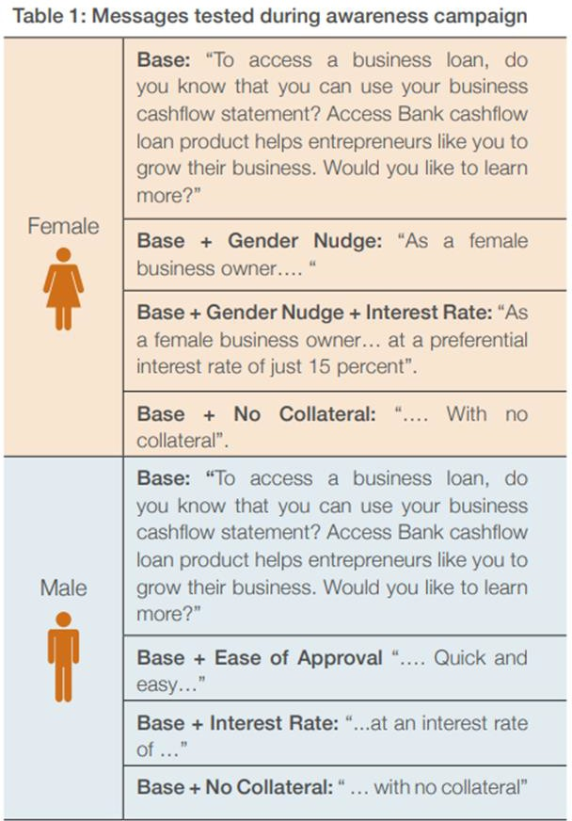
Nigeria: Findings from IE of awareness campaign
Examining demand for cashflow-based loans
Information campaign - randomly sent information via text message to Access Bank business banking customers (80k with ~10% response rate)
Key Findings:
Overall, 73% of male entrepreneurs and 80% of female entrepreneurs were interested in visiting the cashflow loan application online portal.
Neither including a simple gender nudge (i.e., “this product is for women”) nor a “no collateral” nudge increased women’s interest in the product.
Telling men that the product is “quick and easy” makes them less likely to want to learn more about the product.
Explicitly mentioning the interest rate reduces appetite for the product.
When given information, women entrepreneurs demonstrate interest in financial products. Utilization appears to be driven by business need (rather than loan features).

Slide 6
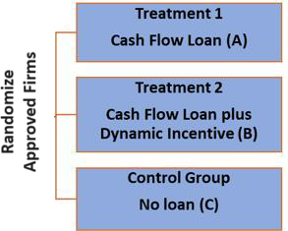
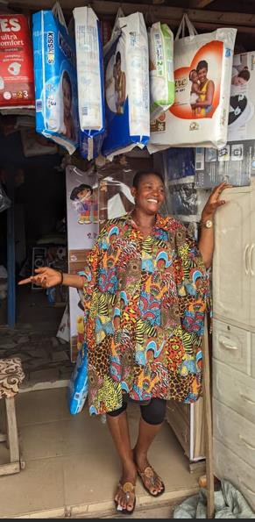
Nigeria: Findings from IE of Impact of CBLs and dynamic incentive (pilot cohort)
Examining impact of supply-side interventions
Study sample formed of 214 business owners (121 women, 93 men) who were approved for CBL in 2021.
Randomization into 3 treatment arms.
Follow-up survey in 2024 surveyed 70% of sample.
Findings:
Per RCT, CBL increased, for women only:
Access to formal credit by 14%
Investment in working capital (inventory stock) by 150%
Per RCT, Dynamic incentive increased, for women only, capital investment (in machinery, equipment) by 80%.
PROFILE OF FIRMS IN PILOT COHORT
4 states (Abuja, Lagos, Oyo, Rivers)
Average age 42
Nearly all married with children
40% with tertiary education
Experienced biz owners (70% owning a business for 10+ years)
Primarily in wholesale and retail sectors (77%)
Firms have an average of 4.8
employees
3

Slide 7
Project objective: to provide technical advice, coordinate, and oversee the quality of rigorous impact evaluations related to We-Fi projects. It also aimed to synthesize and disseminate the evidence generated by the different studies by developing a final report targeted to policymakers and delivering country workshops.
Lessons from impact evaluations
Participation at scale is challenging ➔ alternate plans laid out upfront to adjust design. Use strategies that worked (rapid RCT, qualitative, pilot cohort).
Implementing agencies need clear roles and incentives to allow for evaluation.
Strong communication and strong presence on the ground are key.
Lessons from program design
Clearly defining and monitoring intended target and eligibility are essential for timely implementation and generation of evidence.
While accommodating for broader set of needs is important, ensuring relevance of programs is a priority to affect change.
Participation boosters in program design seems to matter for completion rate.
Lessons from program implementation
Wide offering of locations, means, and times seem to improve participation. But processes matter.
Participation seems to improve when services commence shortly after registration/application.
Contextual understanding and flexibility are essential to ensure relevance and uptake.

Slide 8
Looking Forward
Desing: participatory approach
Methodology: RCT the best? What other possibilities?
Interventions:
- To promote take up: videos only? Text messaging?
- how important is the content? Language?
Financial products: lending
How to close gender gaps in loan applications, loan approvals?
How loan officer gender bias contributes to both?
Financial products: insurance
Take up by women
Trust in the contract and procedures
What product work for market access for women entrepreneurs?
E-commerce, online platforms, digital marketing
Eco-friendly and sustainable products
Export readiness, certifications,
LONGER-TERM Impacts: How to improve to capture the full effect of the program?

Slide 9
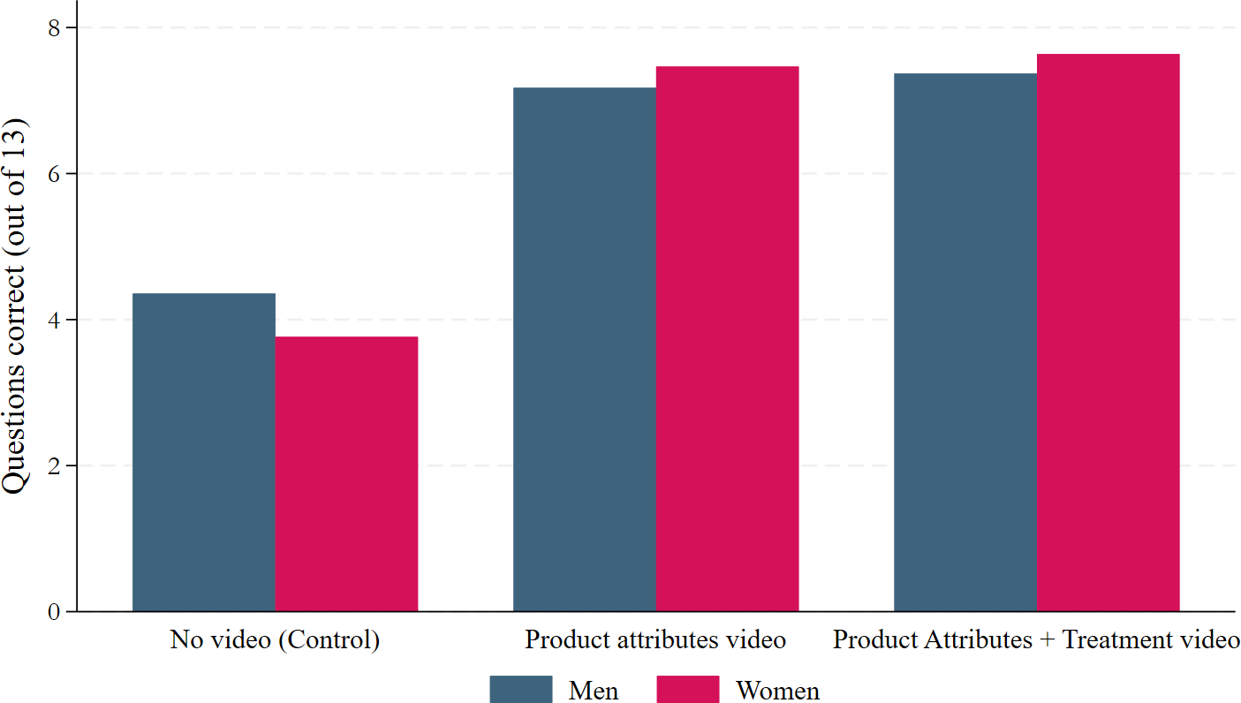
DRIVE interventions improve knowledge for both genders
Gendered treatment effects on knowledge and trust
Videos improve women’s knowledge significantly more than men’s, they “catch up.” No significant difference in knowledge after treatment video vs. product attributes.
Knowledge of procedures Knowledge of insurance Table ATE
Anouk van Veldhoven
ICII 2024 Kathmandu
October 2024

Slide 10
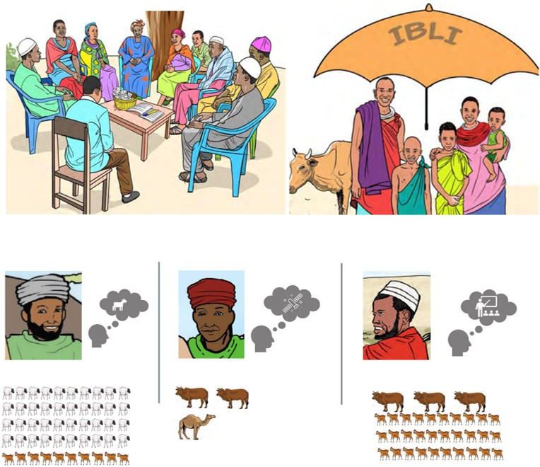
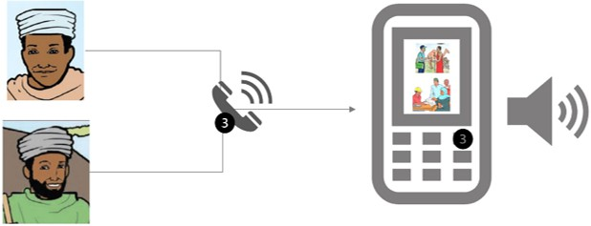
Video contents
Product attributes video
IBLI
Savings and mobile bank account Registration
Treatment videos
Consumer value linked to:
Risk attitudes
Drought and livestock loss expectations
Savings and credit constraints
Customer care services:
Existence of customer care service Contact and navigate the services How to file a complaint
Back

Slide 11
29

Slide 12
Influencing large-scale
lending operations
Identification of problem
Testing and learning
Access to finance: movable collateral registry reform that benefited with loans by Sept 2023 to 2,631 women entrepreneurs in over US$ 10 million
Access to procurement: partnership with IFC on Sourcing to Equal Initiative working with 10 large firms with over 2,000 suppliers
US$ 905 million WB lending portfolio
100
-16%
90
Mais Oportunidades (US$300 mn) with a focus on access to finance, skills, and business environment (7,000 WSMEs)
80
-35%
70
60
Economic Linkages for Diversification (US$ 100 mn) with a focus on access to procurement and markets (4,700 WSMEs)
50
40
Acceleration: Gender-lens in acceleration program benefiting 80 women entrepreneurs
+319 women with information sessions
30
20
Harnessing the Demographic Dividend (US$ 75mn) with a focus on access to skills and capital (1,750 WSMEs)
10
Access to entrepreneurial skills: Social Gender Role (SGR) Training with the participation of 923 women entrepreneurs
0
Firms Profit
Firms productivity
Men led
Women led
East Africa Girls' Empowerment and Resilience Program (US$ 200 mn) with a focus on access to skills
Operating in difficult business environment: Finance, Networks and Market (FNM) Initiative with participation of 911 entrepreneurs
Southern Africa Trade and Connectivity (US$ 230 mn) with a focus on access to markets

Slide 13
Eligible women entrepreneurs
that applied to the program (6,206)
Social Gender Role
training (SGR)
699
Facilitation services to access finance, networks and markets (FNM)
697
Both SGR and FNM
698
Control Group
697
Implemented in two cohorts of similar size of participants
Bottom-up approach: Social Gender Role (SGR) Training to reduce perceived gender (internal) barriers to entrepreneurship. Designed by group of psychologists and implemented for first time the in entrepreneurship. It includes sessions with domestic partners.
Top-down approach: Access to finance, networks and markets (FNM) opportunities to reduce external barriers. It aims at improving critical areas of the environment women entrepreneurs face while doing business.

Slide 14
Gender-related attitudes: gender beliefs, psychological empowerment, entrepreneurial mindset
Structural barriers: access to finance, financial services, networks, and markets
Business behavior: business practices, error management, proactive behavior, risk-taking
Household behavior: decision-making, autonomy, household responsibilities

Slide 15
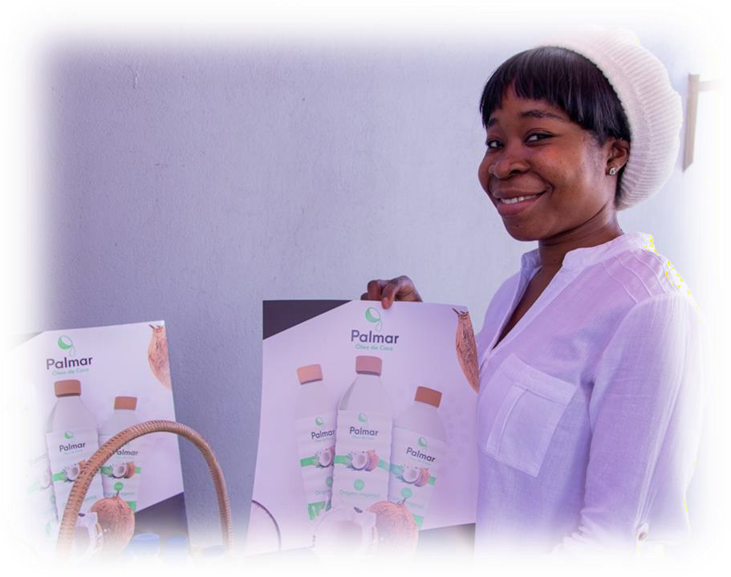
One in two women at baseline thought that most people would be very critical of a woman who is assertive and competitive
Women business owners operating in north and center more likely than those in Maputo to say women should only work if in financial need, and men make better managers
Implementation with pilots and then in cohorts allowed for testing and evolving delivery to adjust targeting efforts, content intensity, and partnerships with financial institutions, corporates, and networks (key for FNM)
Second cohort had significantly higher participation in sessions than the first cohort. Women entrepreneurs in the first cohort underestimated the effort requirements, besides common household responsibilities

Slide 16
Application 1st cohort
Completed
In-progress
Planned
Baseline survey
1st cohort
Implementation 1st cohort
Application 2^{nf} cohort
+ short baseline
Implementation 2^{nf} cohort
First follow-up survey:
1st cohort
2° follow-up data collection and analysis (not funded yet)
First follow-up survey:
2^{nf} cohort
2022
2023
2024

Slide 17
Nigeria: WSMEs are less likely to access credit
WSMEs are less likely than male-owned firms to apply for loans.
And those who do apply have a lower likelihood of approval.
WSMEs Barriers to access to
credit
% of business owners who identified Access
to Finance as a major constraint
52%
Less experience with and knowledge about:
30%
banks
bank loan products
how to successfully position themselves to access credit from formal fin institutions
Women
Men
% of business owners whose most recent loan application was rejected
Only 30% of CBL recipients are women
56%
Only 30% of women who apply for CBLs are approved,
vs 70% of men
17%
Men
Reluctance to ask banks for loans
Women
Less likely to own a bank account (31% of women vs 61% of men)
Large gender gaps in
access to formal credit, and
value of credit accessed
Control group men 18% more likely than women to access formal credit.

Slide 18
Nigeria: Findings from IE of Impact of CBLs and dynamic incentive (pilot cohort)
Examining impact of supply-side interventions
Study sample formed of 214 business owners (121 women, 93 men) who were approved for CBL in 2021.
Randomization into 3 treatment arms.
Follow-up survey in 2024 surveyed 70% of sample.
Findings:
Per RCT, CBL increased, for women only:
Access to formal credit by 14%
Investment in working capital (inventory stock) by 150%
Per RCT, Dynamic incentive increased, for women only, capital investment (in machinery, equipment) by 80%.
PROFILE OF FIRMS IN PILOT COHORT
4 states (Abuja, Lagos, Oyo, Rivers)
Average age 42
Nearly all married with children
40% with tertiary education
Experienced biz owners (70% owning a
business for 10+ years)
Primarily in wholesale and retail sectors (77%)
Firms have an average of 4.8 employees

