Slide 1




HER FINTECH EDGE
Market Insights for Inclusive Growth
FIG-Gender / Banking on Women
October 2024

Slide 2





Introduction
29% of men vs. 21% of women
785 Million
Women worldwide are NOT using mobile internet*
use digital services for payments, borrowing, insurance, financial planning, and investment **
740 Million
Women worldwide do NOT have an account at a financial institution or through a mobile money provider***
Sources:
* The Mobile Gender Gap Report, 2024
** The Fintech Gender Gap, 2021
*** The Global Findex Database, 2021

Slide 3



Research Purpose and Scope
Purpose of Research
There is limited research that quantifies the degree to which fintech firms are trying to deliver on this promise and what specific practices or characteristics of fintech firms are leading to success.
Scope of Research
This study draws on a survey of 114 fintech firms across 17 countries, as well as interviews with leaders from 25 fintech firms, to fill these knowledge gaps by answering a number of key questions.
Research Questions
Do fintech firms actively target women customers?
If so, what strategies do they employ?
What is the performance of women customers in comparison to fintech firms’ overall portfolios, considering metrics such as loyalty, customer lifetime value, and default rates?

Slide 4
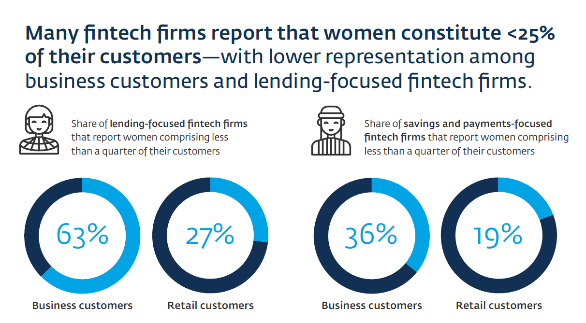
Key Finding 1: Women Representation is Low

Slide 5
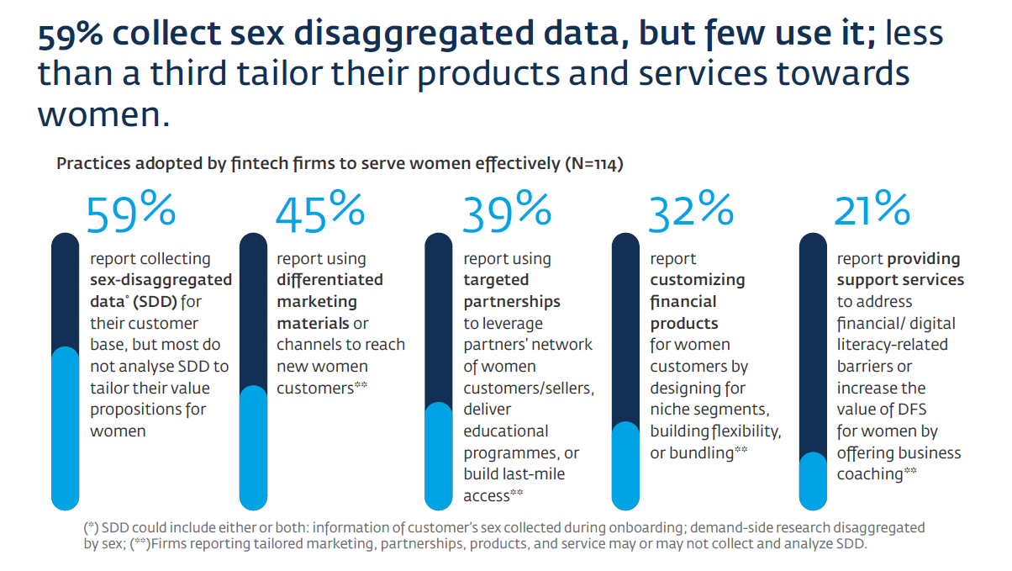
Key Finding 2: Data is Collected but not Used

Slide 6
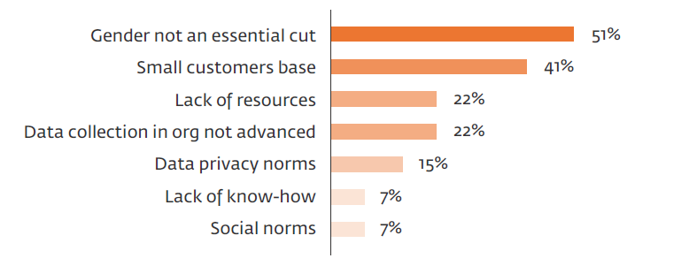
The Case for Sex-Disaggregated Data
FSPs are often limited in their ability to collect SDD because of legacy IT systems or data aggregation – but mention other barriers

Slide 7
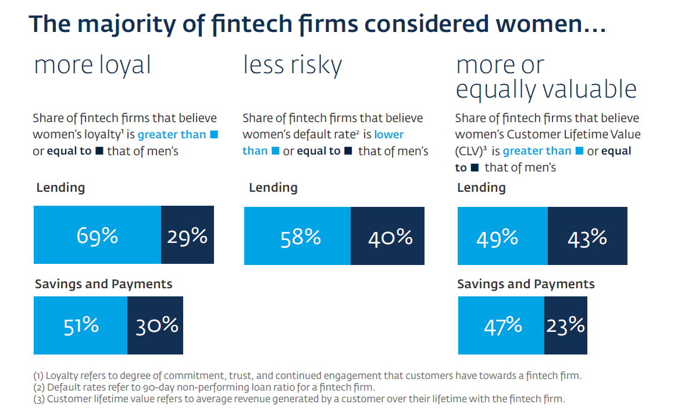
Key Finding 3: Women are Good Fintech Customers

Slide 8
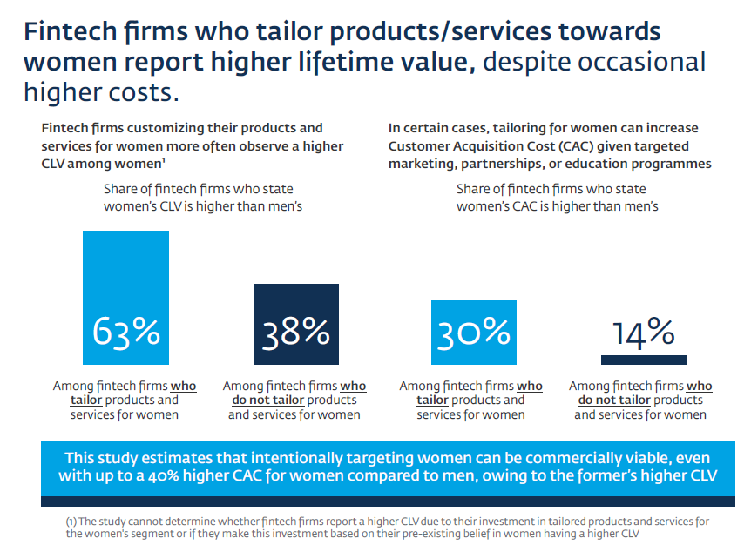
Key Finding 4: Women Customers Generate Higher Returns

Slide 9
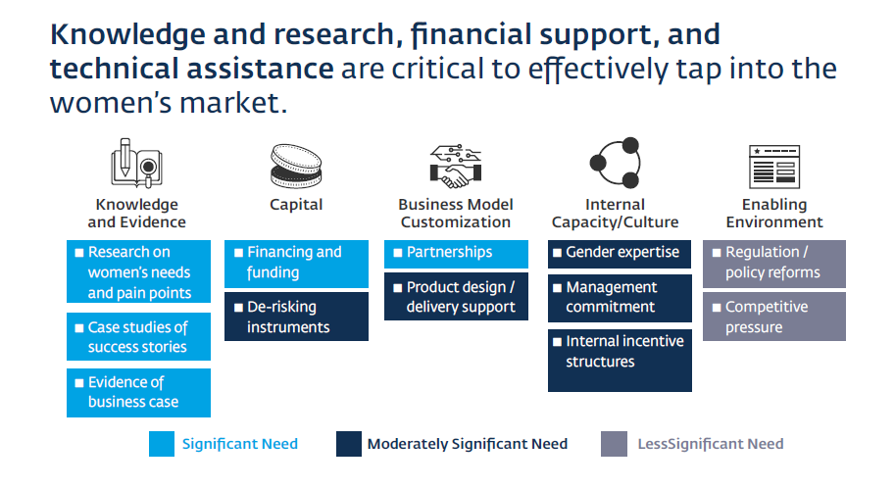
Key Finding 5: Fintechs Need Support to Serve Women

Slide 10
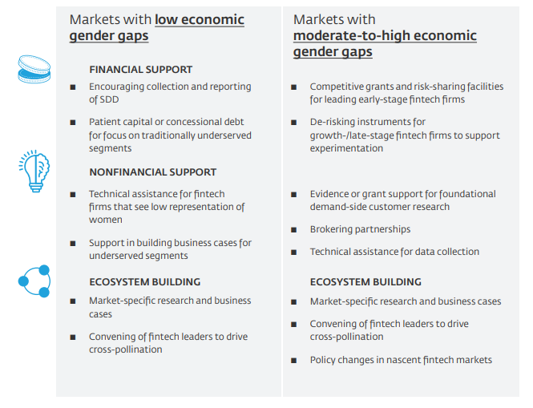
Key Finding 6: Ecosystem is Important
FINANCIAL SUPPORT
The ecosystem can accelerate fintech firms’ progress in strategically serving women by providing tailored support based on market conditions and the firms’ stage.
NONFINANCIAL SUPPORT

Slide 11
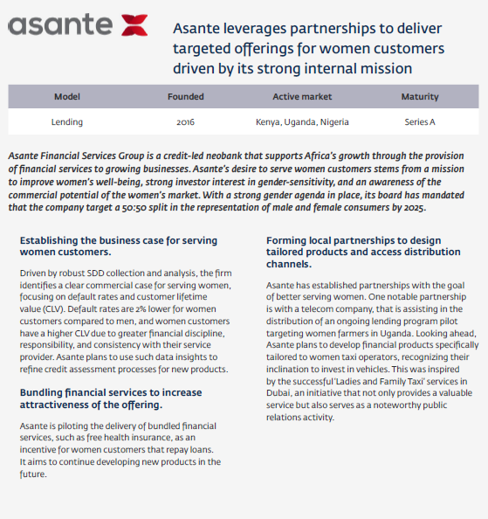
Case Study
asante

Slide 12
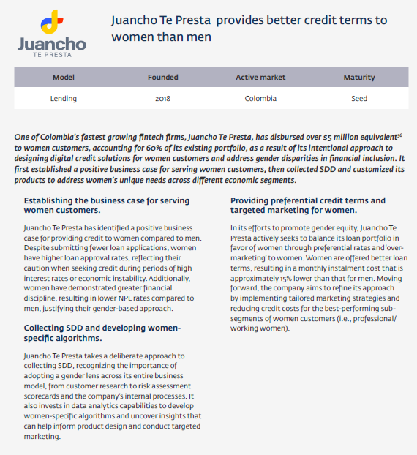
Case Study
Juancho TE PRESTA

