Slide 1
We-Fi Webinar on Mobilizing Climate Finance to support Women Climate Entrepreneurs as Leaders 12 June 2024

Slide 2
Key Results: 2022 World Bank Assessment “Toward More and Better Jobs for Women in Energy
Across many of the MENA countries, women’s representation in the energy sector is below 15 percent.
The global share of women's participation in energy sector is 22% (International Renewable Energy Agency 2019)

Slide 3
Purpose of RENEW MENA and Its 3 Pillars
Elevate women’s participation and leadership role in energy sector; enhance opportunities for entrepreneurship
Facilitate STEM education-to-work transitions
1
Recruitment, retention, and advancement in energy sector
2
Promote entrepreneurship and financial inclusion
3

Slide 4
RENEW MENA NETWORK
The RENEW MENA network currently consists of 25 partners (5 Upcoming)
Egypt | 8 Partners | Morocco | 5 Partners
Iraq | 4 Partners | Palestine | 1 Partner
Jordan | 1 Partner | Tunisia | 2 Partners
Lebanon | 3 Partners | Yemen | 1 Partner

Slide 5
RENEW MENA 2022-23 RESULTS

Slide 6
Next Steps
Continued Activities
Network Expansion (New Partners)
New Activities
Working Groups
Extension of Internship Program
Recognition (Awards)
Expansion and Innovation of Partners’ Gender Activities
Partnerships with Other Entities
Communication (Newsletters, Annual Reports, Blogs, Conference)
Support for Women Entrepreneurs
Joint Activities among Partners
National Chapters

Slide 7
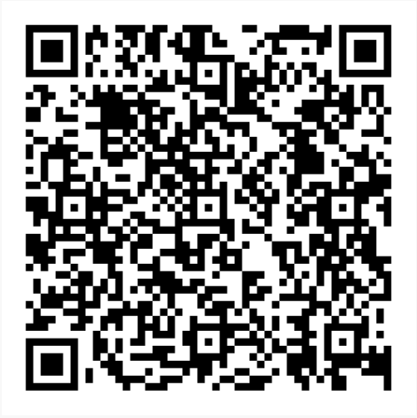
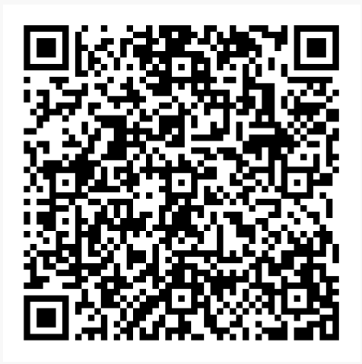
Website
LinkedIn Page

