Slide 1


WE Finance Code
Unleashing Finance For Women Enterprises
October 2023

Slide 2
Workshop Agenda and Goals
Agenda
1 | THE UNTAPPED POTENTIAL OF FEMALE ENTREPRENEURS
2 | INTRODUCING THE WE FINANCE CODE
3 | LAUNCHING THE WE FINANCE CODE IN A COUNTRY

Slide 3
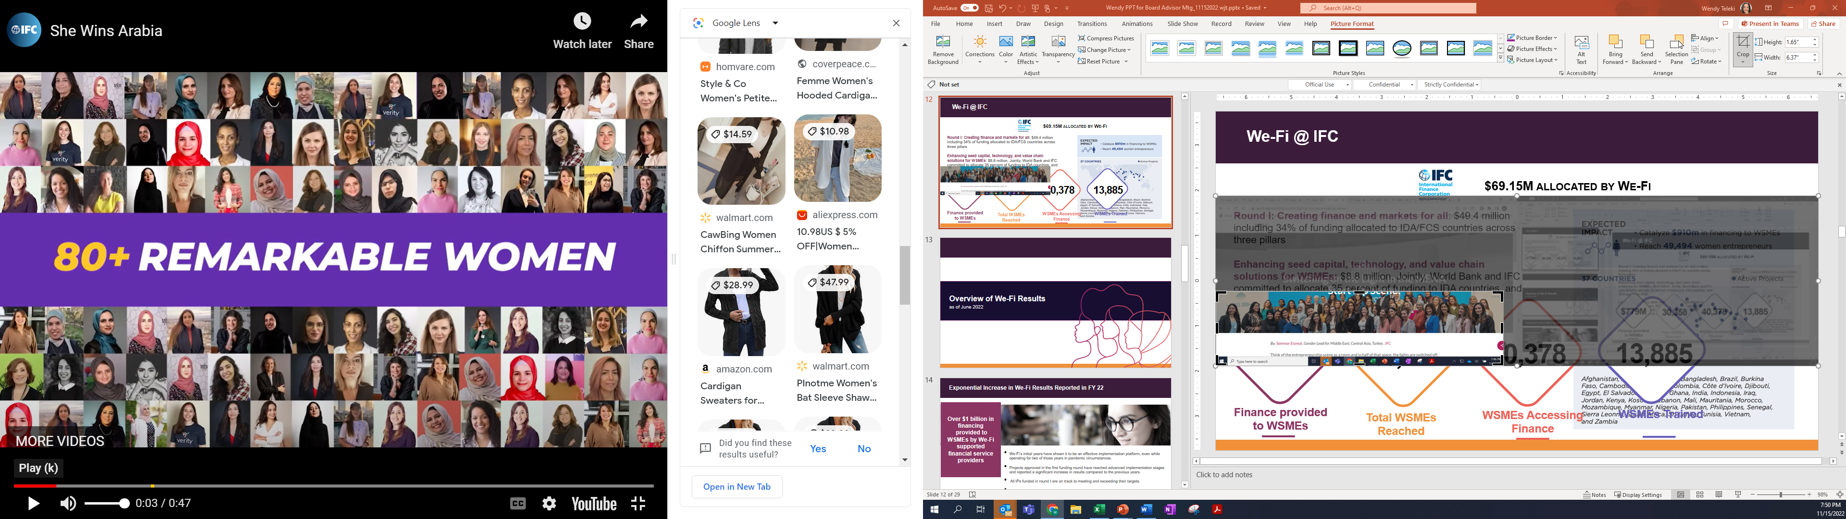
Women Entrepreneurs: The $5 trillion opportunity
Over 400 million women entrepreneurs around the world have vast potential to grow their businesses ²
Profitability
Companies with more women in leadership roles were 21% more likely to outperform their counterparts in terms of profitability. (McKinsey)
For 5 consecutive years, the average NPLs for loans to WSMEs have been lower than total SME portfolio. (IFC, Financial Institution clients)
$5-6 trillion value addition
to the global economy if women and men participated equally as entrepreneurs¹
Risk profile
Companies with women on their boards demonstrated better risk management practices, leading to lower volatility in stock performance. (Credit Suisse)
Innovation
Companies with women in leadership roles were more likely to introduce new products and services. (Harvard Business Review)
$1.7 trillion revenue opportunity
for Financial Service Providers ²
Management
Well-managed enterprises with sound management practices, such as setting performance indicators and monitoring them, are more likely to be led by women. (EIB Finance in Africa)
Strong business case
Growing evidence of women entrepreneurs’ lower risk profile, greater customer loyalty and cross sell
¹We-Fi Supporting Women Entrepreneurs in Developing Countries: What works? 2022
²IFC WSME Financing gap
Notes:
Customize with country specific data to estimate the size of the opportunity.

Slide 4

Unlocking the segment’s potential will require addressing systemic constraints
While over half of women in developing countries want to be entrepreneurs, twice the rate of developed countries, …
…they face significant barriers…
…that limit their ability to realize their potential
$1.7 trillion financing gap
< 2% of VC Funding to female teams
9%-17%
of women in developing countries
run their own businesses
25%
Fewer women start businesses than men
2X more loan rejections
36%
Gap in growth expectations between female and male entrepreneurs
14%-35%
of women in developing countries
aspire to run their own businesses
Skills & sector selection
Social norms, care burdens
75% of the legal rights of men
…and COVID-19, Climate Change, Conflict have a disproportionate impact on women entrepreneurs
Notes:
Customize with data and specific information on local constraints.

Slide 5
Workshop Agenda and Goals
Agenda
1 | THE UNTAPPED POTENTIAL OF FEMALE ENTREPRENEURS
2 | INTRODUCING THE WE FINANCE CODE
3 | LAUNCHING THE WE FINANCE CODE IN A COUNTRY

Slide 6










The WE FINANCE CODE was launched by We-Fi, its Implementation Partners and Founding Global Signatories announcing 24 country pilots
Global Coordinators
Donors
IPs/Joint Statement
of Support
Global Signatories to Date
  ADB: Indonesia (with IsDB), Fiji, Sri Lanka
  EBRD: Egypt, Morocco; Albania, Bosnia and Herzegovina, Kosovo, Montenegro, N. Macedonia, Serbia; Kazakhstan, Kyrgyz Republic, Mongolia, Tajikistan, Uzbekistan
  IDB Invest: Dominican Republic
  WB: Madagascar, Mozambique, Rwanda, Kenya, Somalia, Cote d’Ivoire, Nigeria, Senegal
Country Pilots
Notes:
Mention that global signatories like FAW and WSBI create paths for FSPs to sign up in countries without national programs and global partners can plug into Country Programs.

Slide 7
What is the Women Entrepreneurs Finance Code?
A multi-stakeholder, systems change effort to expand the number and type of institutions around the world working to close financing gaps for women entrepreneurs:
  Engaging leaders who will prompt action inside and outside of their organizations
  Catalyzing new financial and non-financial mechanisms to meet the needs of WMSMEs
  Mainstreaming the collection, analysis and use of supply-side data on financing of WMSMEs
  Improving standards, policies and regulations to address data gaps and financing constraints
  Mobilizing capital for financing and technical support for WMSMEs
A global annual report tracks progress against the Code’s commitments and shares innovations and challenges from the Code’s national programs, signatories, and participants.​

Slide 8



We-Fi is piloting the Code in 24 countries
Who participates in the Code and why?
Financial Service
Providers
(Banks, MFIs, FinTechs, VCs)
Greater access to customer segment ​with high growth potential
Recognition by clients, staff, investors, and ecosystem​
Improved data-driven decision making and financial services for WMSMEs​
Access to cross-sector networks and learning
National Actors
(Regulators, policymakers,
industry associations)
Increased financial inclusion of WMSMEs​
Improved data and data-driven policymaking​
Improved engagement and incentives and alignment across the ecosystem ​
More diverse leadership in the financial sector
Investors and other Stakeholders
(Standard setters, global orgs., donors, knowledge partners)
More impact through complementary initiatives
Pipeline for gender-lens investment ​
Greater gender equality and women’s economic empowerment & leadership​
Increased harmonization and standards globally ​
Stronger evidence and know-how related to sex-disaggregated data ​cases.

Slide 9
The Core of the Code is a simple commitment by Signatories in three areas
WE Finance Code Commitment:
“[Organization] endorses the Code and works towards the goal of eliminating constraints and financing gaps for women entrepreneurs. Signatories commit to:
Leadership: Designate a senior leader to champion the organization’s efforts to support women-led businesses
Data: a) FSPs: Track a commonly agreed set of indicators on financing to W-MSMEs
    b) Ecosystem Partners: Work to expand the availability and use of supply-side data on the level of financing provided to W-MSMEs
Actions: Expand and introduce additional measures that will support women entrepreneurs.
[Organization will] report on these commitments and indicators to an agreed aggregator after a grace period for inclusion in the Global WE Finance Code annual reports.”
FSPs, national actors and ecosystem players can all become Code signatories.

Slide 10
At signing, participants are asked to identify how they will support the Code’s three pillars
Participants can choose from a customizable menu of activities that are relevant for them, based on their area of domain expertise, capacity and networks. At on-boarding they define their specific actions and report progress on them annually.
Leadership
Identify leadership around Code-related activities, and work to champion the Code with others
Designate a senior leader as champion
Create awareness and encourage partners to participate in the Code
Act as a champion for a National Code
Provide assistance to National Code champions to roll out the Code.
Data
Mainstreaming the collection and reporting of sex-disaggregation of MSME finance data
Collect & Report the Code’s key indicators
Use indicators for analytics, decision-making and reporting
Develop tools and support others to collect, analyze and report key indicators
Action
Other activities within the organization’s relevant domain to address constraints and close finance gaps for W-MSMEs
Develop new financial and non-financial services for W-MSMEs
Establish business case, set targets, strategies, policies, standards to expand financing for women-led enterprises.
Increase volume of finance for W-MSMEs, inc. bonds, credit lines, equity, trade, etc.
Promote peer learning and documenting use cases.

Slide 11
The Country Coalition can customize the global framework (1/2)
Commitments | Global Minimum Requirements | Strongly Encouraged
1. Senior leader to champion support of women-led businesses | Member of the Senior Management team | C-Level/ CEO Designated technical staff or data coordinator
2. Actions to increase WMSME lending | Commit to at least one incremental action that contributes to WMSMEs accessing more finance and improving performance | FSP: Expand the level of financing committed for WMSMEs Set and track WMSME lending targets Expand non-financial services for WMSMEs Improve analysis and use of data to improve products and services for WMSMEs.
 |  | Ecosystem: Provide leadership, resources, expertise to close finance and data gaps for WMSMEs in area of expertise

Slide 12
The Country Coalition can customize the global framework (2/2)
Commitments | Global Minimum Requirements | Strongly Encouraged
3. Sex-disaggregated data to be reported | MSME & Women-Led Enterprise Definitions are flexible allowing FSPs to use local definitions, but must be disclosed and validated during onboarding. | MSME & Women-Led Enterprise Definitions: national or international definitions are recommended for harmonization .
 | Core Indicators to be reported on a sex-disaggregated basis MSME business customers (#) MSME business outstanding loans (# & $) MSME business loan applications and approvals (# & $) MSME business Non-Performing Loans (%) MSME business deposits ($) & depositors (#) | Indicators to understand quality of access to women-led MSMEs (financing conditions) and strengthen business case New MSME loans disbursed (#/$) MSME collateralized loans (#/$) MSME short-term loans (#/$) MSME products per customer (#/$)
 |  | Other Indicators: Housing loans (#/$) Consumer loans (#/$) Digital transactions (#/$) Equity (#/$)

Slide 13
Workshop Agenda and Goals
Agenda
1 | THE UNTAPPED POTENTIAL OF FEMALE ENTREPRENEURS
2 | INTRODUCING THE WE FINANCE CODE
3 | LAUNCHING THE WE FINANCE CODE IN A COUNTRY

Slide 14
National Codes are championed by leaders in the public and private sectors and share four common characteristics
A commitment to roll out the WE Finance Code nationally, adapting it to the local context while retaining key minimum guidelines
Governance through a national coalition that oversees local adoption of the Code and ensures accountability
Designated coordinator to oversee local Code implementation and interface with and report to the global Code
A mechanism to aggregate data with integrity and in a format that will facilitate mainstreaming over time and can be reported globally
Progress will be tracked through an annual global report;
Annual Country Reports are encouraged.

Slide 15
Three national roles are responsible for the Code’s implementation in a country program
Three national roles need to be defined and responsibilities clearly assigned.
National Coalition
8–12 private & public sector leaders, inc. Champions, provide governance for the Code
Make a public declaration of intent to launch the Code in the country
Agree on roles and responsibilities of National Coalition, Coordinator and Aggregator(s)
Discuss and agree on customization of the Code in the local context and the plan for rollout
Support the rollout of the Code, monitor progress, address obstacles.
National Coordinator
Draft guidelines and maintain Code documents
Convene and report progress to the National Coalition
On-board Signatories, track Code commitments and coordinate opportunities for learning
Monitor progress and report nationally and globally to the global aggregator.
Country annual reports are optional.
National Aggregator(s)
Trusted local institutions with robust system and data protocols, such as industry associations or regulators
Instruct, collect, ensure quality and analyze core indicators reported by FSP signatories
Share collated data with global Aggregator on an annual basis (may be through the Coordinator)

Slide 16
The vision for the country program can be defined answering a few strategic questions
Strategic questions
Fill in chosen options.
Which options are best suited to the country context?
What types of Financial Intermediaries should participate?
What incentives can FIs expect by joining?
Who should be part of a National Coalition?
What is the role of the Regulator vis-a-vis the Code?
Who should coordinate & interface with the global Code?
Who should collect & analyze data from Fis (aggregator)?
What standards should be required?
What WMSME definitions should be used?
Should country annual report be published?
Banks
Equity providers
FinTechs MFIs
Recognition
+ Knowledge Sharing
+ Technical Assistance
+ Access to Funding
Select Private FIs
Industry Associations
Other Public Body
Regulator
Encourage Participation
Create incentives
Align Regulatory Reporting
Regulator
Public non-regulatory body
Private Industry Association
Regulator
Public non-regulatory body
Private Industry Association
Minimum Requirements
Encouraged indicators
Additional indicators
FIs own definition
National Definition
Harmonized w/ Global Stds.
No, only contribute to global report
Issue periodic country report
Issue annual country report

Slide 17

Five steps for implementing the WE Finance Code in a country
1
Customize Code to National
Context
Track & Accelerate Progress
3
5
Identify Champions
2
4
Build a
National
Coalition
Launch
Code
COUNTRY X

Slide 18
Setting a roadmap to implement the Code for a March 2024 launch
Identify Champions
Identify 1-3 Country Champions
Build the Country’s Case for the WE Finance Code
Discuss Vision for the Code
Oct-Nov 2023
Build National Code Coalition
Expand the Champions to form a National Code Coalition
Designate a Country Code Coordinator and Aggregator and define their roles
Agree on a National Code Framework and Action Plan
Nov-Dec 2023
Customize Code to the National Context
Adapt the global commitment framework (letter and guidance for signatories)
Develop guidelines for commitments on leadership, data and action
Establish an on-boarding process
Conduct industry consultations on the program design
Jan-Feb 2024
Launch the Code
Create Awareness & Excitement
Launch the Code
On-board Signatories
March 2024
Track & Accelerate Progress
Launch learning and knowledge sharing
Collect baseline data, track progress, issue annual report and report to the Global Code
Evaluate effectiveness and impact
Expand Signatories and scope (e.g., Equity)
On-going
COUNTRY X

Slide 19
Workshop Agenda and Goals
Annex

Slide 20


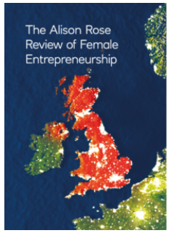
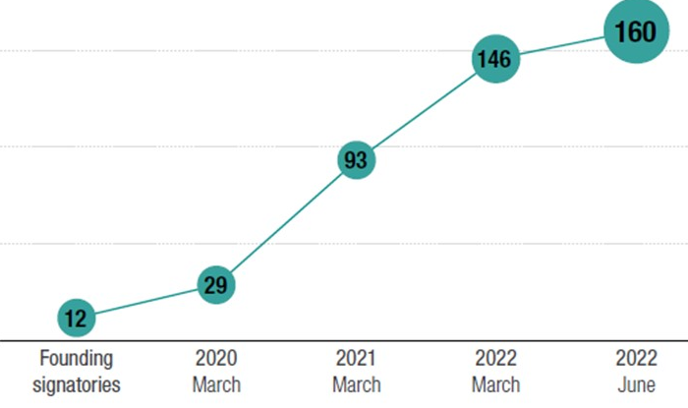

The WE Finance Code builds on the successful example of the UK’s Investing in Women Code
Rose Review (2019)
UK Treasury commissioned Alison Rose, CEO of NatWest, to assess barriers facing women entrepreneurs and how to overcome them.
Investment In Women Code
The Code is a voluntary public-private partnership between the ‘Code Partners’:
Government
Finance providers
Three trade associations
The UK’s national development bank
Launched in July 2019, the Code aims to increase the finance provided to women-led businesses including debt finance (loans and overdrafts) and equity (early-stage Angel investment to venture & growth capital).
Code Signatories make three commitments:
Designate a responsible member of the senior management team to Champion entrepreneurs’ access to finance;
Collect and report data;
Adopt internal practices that aim to improve female entrepreneurs’ access to the tools, resources and finance and review these annually.
Results to date
UK Code Signatories: 12 Champions have grown to 160 FIs (18 lenders, 30 angel investors, 105 venture and growth investors) representing GBP1 trillion AUM.
Conclusions: Up to £250 billion of new value could be created if women started and scaled new businesses at the same rate as men.
The biggest opportunities to help women entrepreneurs along the financing funnel fall into three areas:
Access to finance
Family care support
Making entrepreneurship more accessible through mentors/networks
The Investing in Women Code was one of eight recommendations.
The Code partners have worked together with Signatories to share the aggregate
data, generate insights and share best practices both through the Annual Reports and regular meetings.
For more information see: UK Review of Female Entrepreneurship and progress report; and The Investing in Women Code and progress report

Slide 21
Sample public statement with the intent to launch the Code
The below sample statement can be adapted by Country Codes:
“[Champions or coalition partner names] is/are committed to advancing access to finance and identifying innovative solutions to mobilize capital for women-led micro, small and medium-sized enterprises (WMSMEs). We endorse the Women Entrepreneurs Finance Code (“WE Finance Code” or “Code”), a global multi-stakeholder data-driven approach to systematically expand how women-led businesses are supported and financed. We intend to champion the launch of a Code in [country] to align and catalyze action and incentives across the financial sector ecosystem to support women entrepreneurs. A national coalition of public and private stakeholders will work together to adopt the Code, engaging financial service providers, regulators, standard-setting bodies, financial sector infrastructure organizations and trade associations and other ecosystem players. We look forward to collaborating with other countries and stakeholders to align our approach with the Code’s global framework and ensure its effective governance, coordination and aggregation mechanisms.”

