Slide 1
BOW Sex Disaggregated Data (SDD) Program
June 7, 2023

Slide 2
Contents
I. Program Overview
II. Program Approach
III. Pilot Overview
IV. Pilot Geographical Scope
V. Pilot Timeline
VI. Pilot PFI Engagement Approach

Slide 3
The importance of reporting on sex-disaggregated data
Financial inclusion gender data collection and analysis:
Can narrow these gaps and enable key stakeholders to achieve their full potential in serving women
Is essential for uncovering:
Who is excluded.
Which financial products are used, and by whom.
The impacts of financial inclusion interventions on development.
How women’s financial needs differ from men.
Why products need to be accordingly adapted
The Global Gender gap in account ownership
7% since 2011
(IFC, 2017)
The Finance gap for women-owned MSMEs in emerging economies
USD$ 1,7 Trillion
(IFC, 2017)
Source: FinEQUITY BRIEF, “Gender Data in Financial Inclusion”, November 2020

Slide 4
Program Overview
Funding Secured
WEFI funds for global capabilities development that impact individual Financial Institutions and country-level policy work in Egypt and Mexico.
Key Activities
Providing advisory services to perform sex-disaggregated data and build data mining capacity. Activities will include “flagging” in the MIS systems “women-owned enterprises, guidance on implementing the new flag for women-owned enterprises as part of the customer intake process and,” establishing baseline figures for women and women-owned companies.
(b) Performing a data mining report to reveal the potential of the Women portfolio
(c ) Supporting FI’s to build the business case for WVSMEs and
(d) Diagnostics to provide advisory services on financial and non-financial services.
Timeline
5 years (divided in a pilot and general rollout)
Results
# of FIs: 90

Slide 5
Program Approach
Hiring a consulting firm(s) to design and deliver a SDD methodology
The entire project will be implemented in two phases:
Pilot phase
Rollout phase
Testing and determining the best approach for the roll-out phase
May-December 2023
10-12 Financial Institutions
A consulting firm will serve all client banks across multiple regions
Full roll-out based on the pilot phase learnings
December 2023-TBD (2- 4 years)
~80 Financial Institutions
Several consulting firms will cover up multiple regions

Slide 6
Pilot Overview
Andafin, a data consultant firm was hired through WBG competitive procurement process – contract issued in May 2023
Andafin will support 10-12 participating financial institutions (PFIs) globally
By the end of the engagement, our aim is that PFIs are able to
Identify, track, monitor, and report on VSE/SME portfolio (dis-aggregated by gender and size)
Report to IFC on women VSE/SME portfolio through the Annual Reach Reporting process
Start integrating or strengthening SDD use in their decision-making processes
Field work will start mid-June
Engagements with PFIs will start with a 3-5 days site visit followed by ad hoc support
Pre-selected pilot PFIs operate in 13 countries
The pilot will conclude by the end of CY 2023

Slide 7
Pilot Key Data Consultant Outputs
Component I: A methodology and approach designed to identify the gaps that client banks may have to be able to collect and report on SDD and solutions to address those gaps. The approach should include:
A checklist that helps Investment Officers (IOs) and Advisory Services Operations Officers (OO) assess sex-disaggregated baselining and MIS/reporting capacity of BOW client banks
Component II: A baseline of sex-disaggregated data identified at bank portfolio level for selected partner banks/financial institutions
Component III:
(a) A dashboard / reporting template enabled at bank level for regular portfolio reporting with sex-disaggregated data
(b) Extract, transform and load (ETL) tools to identify and flag/mark Women Led SMEs
Component IV: Training for participating/client bank staff and backfill exercise for selected partner FIs
Component V: Training for IFC IOs and Advisory Services OOs on
The importance of SDD baseline and reporting
The practical challenges that clients have with SDD
IFC’s approach to addressing SDD issues
Component VI: An overall SDD solution based off the pilot to enable a more comprehensive roll out

Slide 8
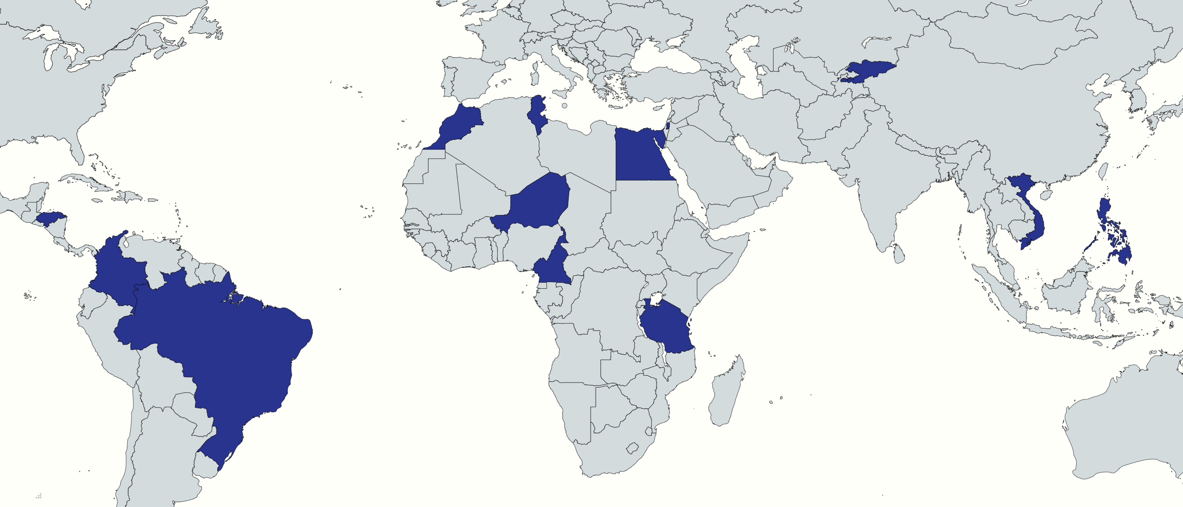
Pilot Geographical Scope
Preidentified pilot countries include:
Brazil
Cameroon
Colombia
Egypt
Honduras
Kyrgyzstan
Morocco
Niger
Palestine
Philippines
Tanzania
Tunisia
Vietnam

Slide 9
Pilot Timeline
Consultant contracted & onboarded
First PFIs confirmed
Engaging with African PFIs
Engaging with East and South Asian PFIs
May
June
July
August
September
Q4-2023
Finalizing Methodology
Starting fieldwork (Mid June) in Middle East and Central Asia
Engaging with African PFIs Engaging with LAC PFIs
Finalizing deliverables for PFIs
Producing lessons learned and external deliverables
Preparing for rollout

Slide 10
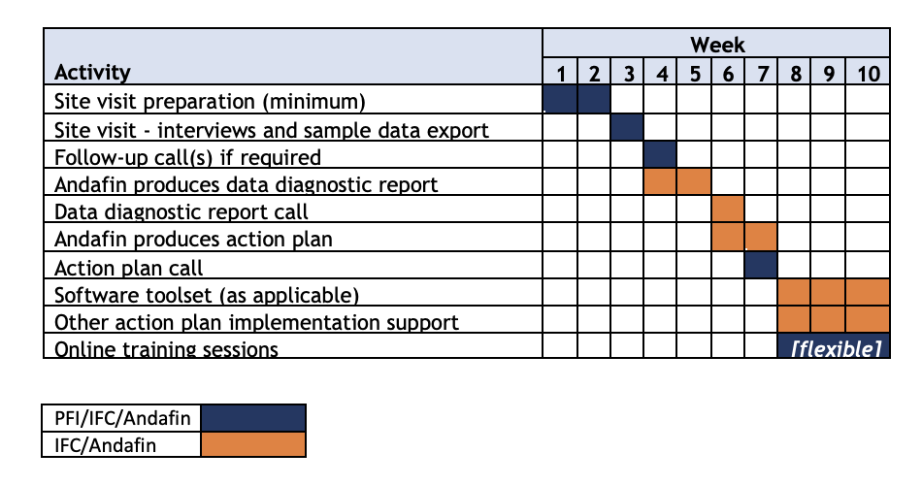
Pilot PFI Engagement Approach

Slide 11
Annex

Slide 12
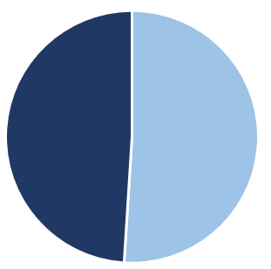
Introduction and WOE definition
What is a Woman-Owned Enterprise (“WOE”)?
(a) ≥ 51% owned by woman/women
According to IFC, a WOE is:
OR
(b) ≥ 20% owned by woman/women; and have ≥ 1 woman as CEO/COO (President/Vice-President)
When is an SME project considered as a Banking on Women one?
Investment Services (IS) SME projects
At least 25% of the project’s gross investment amount should be earmarked exclusively for WSME in the legal agreement, under the ‘use of proceeds’ section.
For a Financial Institutions Group (FIG)
Advisory Services (AS) SME projects
at least 20% of the total project costs should be allocated towards WSMEs.

Slide 13
Baselining and MIS/reporting Methodologies
Practical Approach (field lessons)
I
II
III
IV
Banks and NBFIs use sole proprietors' portfolio data where the loan is granted to physical persons: this approach helps from a client flagging and reporting standpoint.
Manually review the Top 100 SME Exposures and identify women led/owned ones. In large portfolios by extrapolating the % WOE to the overall portfolio is a conservative approach.
When capital / company ownership data is not available or it is dated, we want to look for decision making evidence. For example, use the Legal Representative and/or Administration or Finance Manager leader being a woman. At the very least, they should track the named owner of the business with > 51% women’s ownership
In a “worst case” scenario, one option is to use any available, credible information for indicative purposes. If this option is used, implementing Future Data capabilities is paramount. In this way, after a clear and certain period time for data collection (i.e. 6 months, or one year), IS or AS targets can be revisited and agreed to going forward.
Places to begin looking for available information include:
BOW Reach Dashboard (Consult Rey Zhangrui Wang, zwang16@ifc.org)
MSME Finance Gap Database
IFC MSME Reach Data
Global Findex Database
Women-Owned SMEs: A Business Opportunity for Financial Institutions
If the IFC team agrees to an alternate definition of “women-owned enterprise” for a project, they should: (1) clear this with the BOW team, and (2) specify agreed-upon definition in the product documentation and Board paper.

