Slide 1
Women entrepreneurs for climate action: Building innovative solutions for a sustainable future

Slide 2
Climate Action and a Just Transition
What is a Just Transition?
Climate action will bring a seismic shift in how industries function, how we consume, and interact.
There will be costs and benefits in the process.
Winners and losers.
At the current trajectory, women will only have 25% of green jobs
Climate action can set gender equality back – or be an opportunity to address gender equality gaps if gender lens approach is used.
On what foundation are we building these new green industries on? Will they continue to be male dominated?
Existing industries, which are majority male, will be re-created, adjust, re-skilling their work forces, women will miss out?
Huge ramp-up of new industries, will women beat the forefront, or miss out on these opportunities or investments?
Climate action need to intentionally be distributed equitably across society.
Billions and Trillions in climate finance are being allocated and earmarked today
The opportunity and time is now to address these gaps, the bigger risk if we don’t.

Slide 3
Women Entrepreneurs and a Just Transition
A Just Transition to a low-carbon economy presents an enormous development opportunity:
Potential value of $26 trillion and creating 65 million new jobs by 2030,
Opportunity to address systemic gender inequalities
How Can We-Fi be at the forefront of a Just Transition?
Supporting innovative women entrepreneurs creating business solutions shaping and leading future green markets.
Improving the resilience of women-led businesses affected by climate change and climate shocks to preserve jobs, economic opportunities, and growth.

Slide 4
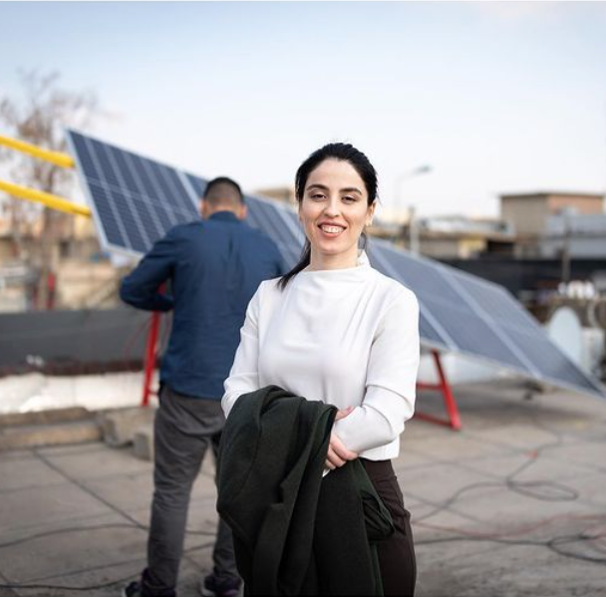
Innovative women entrepreneurs creating business solutions shaping and leading future green markets
Women-led businesses should be at the forefront of future green businesses and markets.
Designing and building innovative green solutions and industries
Key to ensuring the uptake of climate technologies
Challenges Faced by Women-led Businesses and Innovators:
Accessing venture capital and lending to support innovation and ramp-up of their businesses.
Overcome existing market barriers and catalyze demand in new/ undefined markets.
Linking to value chains and capitalizing on sustainability-focused companies who aim to source green inputs.
Accessing local networks with potential customers and partners.
Breaking into male-dominated sectors and overcoming social norms.

Slide 5
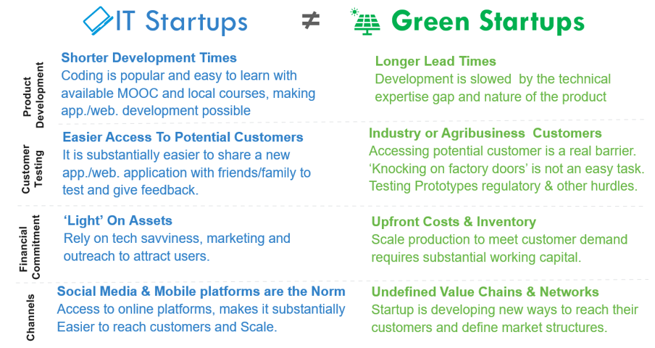
Building on We-Fi’s VC and Startup Expertise
Incentivizing Intermediaries to provide risk capital to green startups
Digital / Digital payment as a vehicle to unlock green markets
Results Based Mechanisms to ensure climate and gender outcomes are achieved

Slide 6
Improving the resilience of women businesses affected by climate change and climate shocks to preserve jobs, economic opportunities, and growth
Women-led businesses play a pivotal role in the economy, making their resilience and success crucial for overall development
Jobs
Economic growth
Value chains / food security
Challenges faced by women-led businesses impacted by climate change:
Climate shock disrupt businesses, leads to financial loss, can affect a firm’s integration into value chains, and hamper future growth opportunities.
Accessing climate smart technologies. Banks / credit officers lack track record, focus on ‘bread and butter’ products.
Providing training, including reskilling, upskilling, climate-adaptive and smart-agri practices linked to improved food security.
Accessing financial products / insurance to improve resilience and shield the business from climate shocks.

Slide 7
Building on We-Fi’s Value Chain Expertise
Fin Tech & Payment Infrastructure
Cooperatives
WSME
Insurance & payment options
Lack technical of Know- How
WSME
Farmers
International Climate Tech Sellers
Local Based Companies
FOOD SECURITY
Lack Access to Clean Tech
Social Norms
WSME
WSME
Diesel Suppliers
Banks
Local Distributors / Suppliers
Legend
Getting Credit from Banks for Clean Tech
WSME
“Green” business
Smart Agri Services
Incumbent business
Barrier
Value Chains are evolving and at risk
Multiple actors, both green and incumbent businesses
WSMEs throughout the value chain, at risk from climate shocks….
But also opportunities for WSMEs to address these climate challenges

Slide 8
Examples from Implementing Partners

Slide 9
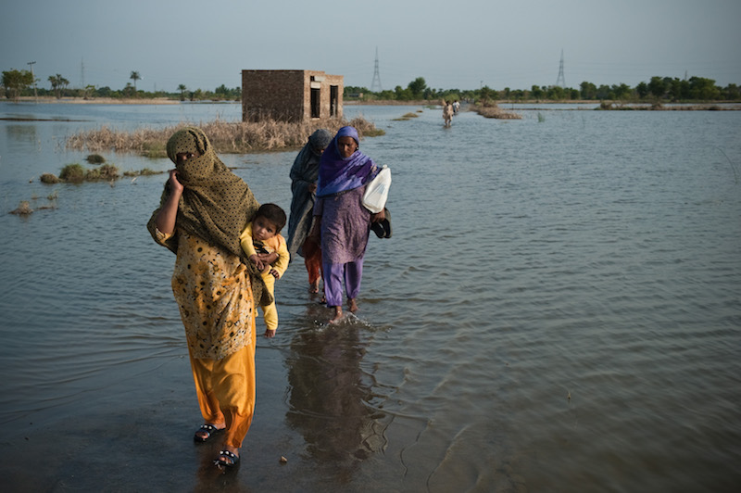
Building Climate Resilience in Pakistan

Slide 10
Green Economic Finance Facility (GEFF) Gender component
Our research in nine countries and stakeholder discussions with over 750 participants in eight countries have informed our approach to promote equal access to climate finance. Among the main demand side barriers for women to access green credit lines is limited awareness of the benefits of green technologies for their homes and businesses, lack of collateral, limited ability to present bankable projects and the perception that financial products do not meet their specific needs.
We are active in Armenia, Egypt, Georgia, Jordan, Kazakhstan, Moldova, Mongolia, Morocco, Tajikistan, Turkiye, (Serbia completed), with pipeline in the Western Balkans, Kyrgyz Republic, …
Conducting gender baseline assessments
Raising awareness in the market among stakeholders
Building the capacity of local partner banks to cater for the needs of a female market segment
Collecting gender-disaggregated data, including at the sub-borrower level
Sharing knowledge, case studies and lessons learned
PFI 1
Female sub-borrowers
Facility Consultants
PFI 2
Female sub-borrowers
PFI 3
Female sub-borrowers

Slide 11
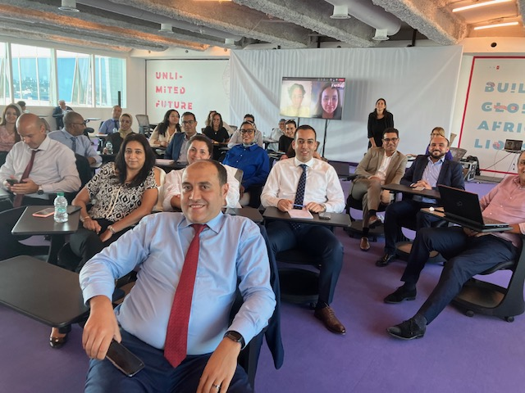
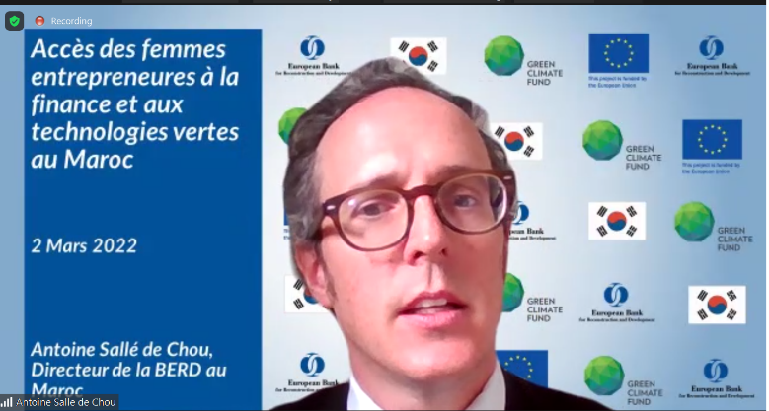
GEFF GVC Morocco case study
Recent research confirms that women face barriers in accessing finance for investments in green technologies in Morocco.
To improve update of GEFF GVC loans by women, a tailored approach that acknowledges their differentiated participation in economic sectors is considered particularly effective.
By connecting PFIs, local authorities, industry associations and other players during multi-stakeholder events, important networks are being built (photo of event in Morocco, organized in Mar 2022).
By building our PFI’s capacity to serve the female segment as an untapped market potential, EBRD promotes equal access to climate finance and green technologies (photo of training with BCP, held in Sep 2022).
Drawing upon dedicated knowledge products, gender-responsive green finance’ promotion creates further momentum in the market and clearly shows the competitive edge investing in green technologies can bring for female entrepreneurs and women-led enterprises.

Slide 12
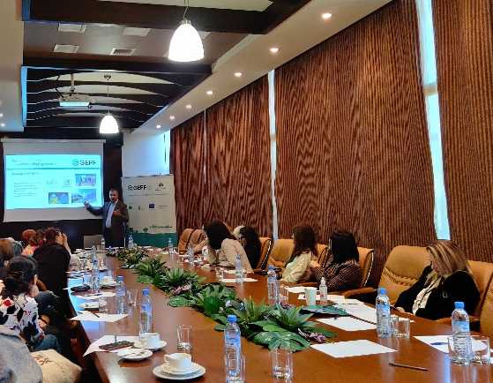
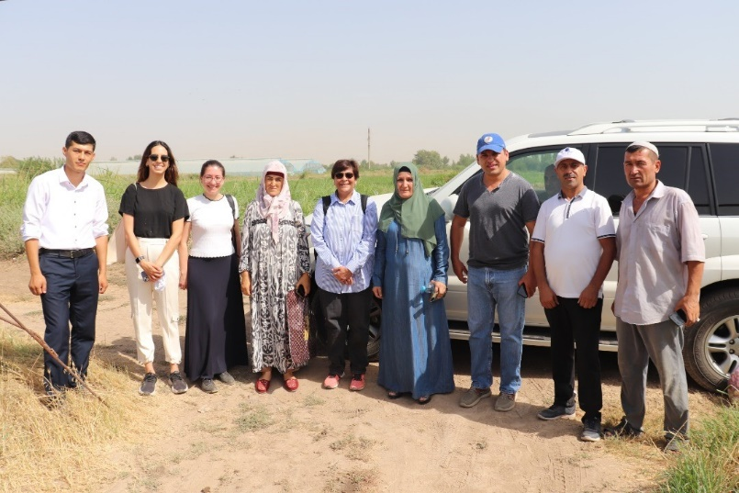
Overall GEFF - gender results
With our tailored gender mainstreaming approach, we reached more than 1800 women-owned or –led business and female individuals with our Green Economy Financing Facilities (GEFFs), as of YE 2022. With investments in green technologies, emissions are saved, and their businesses have become more resilient against climate change – and more competitive as a result.
To overcome supply side barriers, over 400 staff and management at 14 PFIs across countries were trained on gender-responsive green finance to more effectively unlock the female segment. Where knowledge gaps were large, we have trained 230 women on financial literacy and continue to raise the awareness on the benefits of green technologies for the environment - while making business sense.

Slide 13
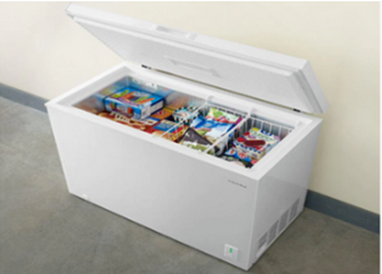
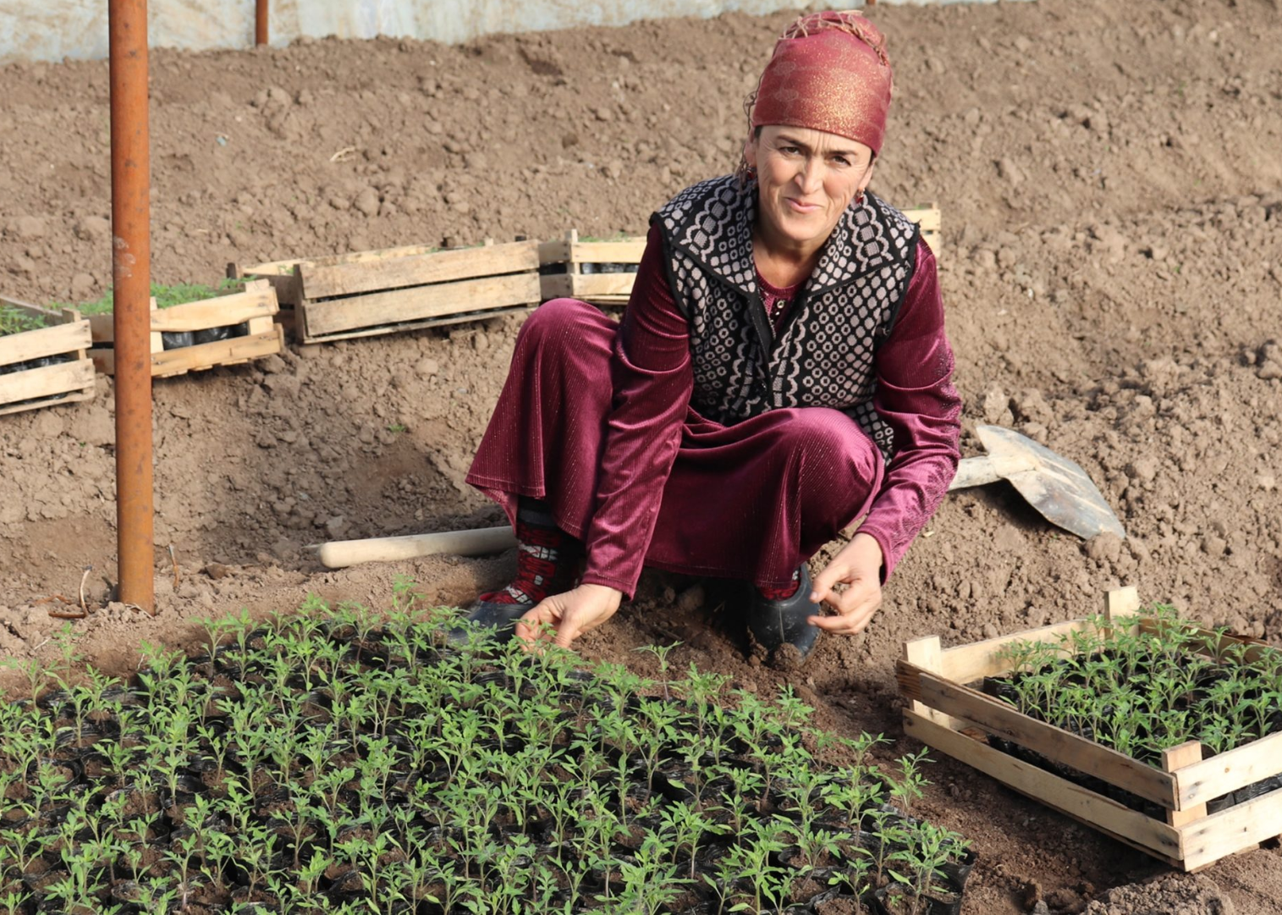
GEFF Kazakhstan & Tajikistan gender results YE22
Kazakhstan
Tajikistan
Share of female to the sub-borrowers as of YE 2022: 66% of total portfolio across PFIs
Over 100 participants connected national GEFF-Panel on Gender in 2021
Close to 150 staff and management at KMF and BCC trained on gender-responsive green finance
40 female entrepreneurs trained on financial literacy
Share of female to the sub-borrowers as of YE 2022: 38% of total portfolio across PFIs
Over 75 participants connected national GEFF-Panel on Gender in 2020
Over 100 staff and management at HUMO, IMON, Eskhata and Arvand trained on gender-responsive green finance
Over 70 female entrepreneurs trained on financial literacy
Case Study:
Kikbayeva Gaziza Zakirovna is an entrepreneur engaged in the trade of industrial goods, and she also has her own mini-market. She decided to purchase a new freezer with help of GEFF. The new freezer saves 142 kW of electricity resulting in a reduction of 52 kilograms of CO2 emissions per year.
Case Study:
Sayorakhon Tojimatova has been growing vegetables including tomatoes and cucumbers on her farm for more than 20 years. She invested in a greenhouse with the help of GEFF. The greenhouse saves 1,980 m3 of water per year allowing her to increase her crop yield by 140%.

Slide 18
Design Challenges
💡
How might we get more money into the hands of women entrepreneurs for climate action?
In small groups, we’ll generate ideas and prototype project design proposals based on 2 case studies:
CASE STUDY
CASE STUDY
Climate Innovation
Climate Resilience
Supporting Innovative Women Climate Entrepreneurs
Building climate-resilient businesses to adapt to climate risks

Slide 19
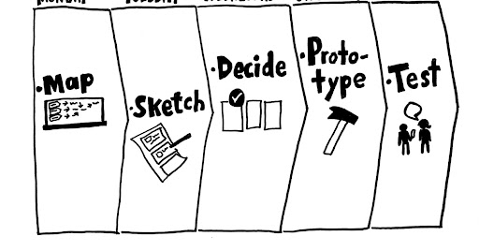
Design Thinking + Sprint Methodology
Goal of this Session 🎯
Creative deep dive on climate theme (think differently to create impactful proposals)
Share ideas, resources and approaches with the group
Future call on climate is getting real!

Slide 20
1️⃣ Situation Analysis
How it works 💡
Goal of the activity 🎯
Group: Read the case study. Discuss the case study in your group. Below questions can serve as prompts. (10min)
Initial understanding of the challenge and its context
Discussion Questions:
What are the main challenges Basima and Lisa are facing and what are the specific underlying problems and pain points?
Are there other relevant stakeholders and what are their painpoints?

Slide 21
2️⃣ Ideation
How it works 💡
Goal of the activity 🎯
Individual Brainstorming: Write down on post-its as many ideas as possible on how to solve the problem(s) you discussed before (5min)
Generate as many ideas as possible
Generate bold, wild, impossible and crazy ideas
Brainstorming Techniques:
WHAT IF (start your ideas with what if…)
What if money was not an issue?
What if our president would have to solve this issue?
WORST POSSIBLE IDEA
What’s the worst idea you can think of?
What’s the wildest idea you can think of?

Slide 22
3️⃣ Idea Selection
How it works 💡
Goal of the activity 🎯
In Group: Everyone selects their two favourite ideas and presents them to the rest of the group (5min)
In Group: Decide as a group which idea(s) you want to focus on to deep dive and design your project prototype.
Place all your post-its (also the ones you didn’t select) on the wall
Idea selection for subsequent prototyping / project design activity
Questions for Idea Selection:
What is the most exciting idea? What is the most creative idea? What is the most realistic/feasible idea? Which idea(s) has/have the most potential?

Slide 23
4️⃣ Prototype Project Proposal
How it works 💡
Goal of the activity 🎯
In Group: Prototype / design a project based on the selected ideas and prepare a 3-min pitch to present your project to the other groups (20 min)
Very simple prototypes how possible projects could look like
Questions for Prototyping:
Project Design: What would the project design look like? E.g., Definition of gender-angle, target group, instruments, targets/metrics etc.
Partnerships / Collaboration with external partners: How would interfacing / collaborating with different partners look like?

Slide 24
📢 It’s Time to Pitch your We-Fi Proposal!
Context:
Explain context and target group
Challenge:
Explain the specific problem your entrepreneur and other stakeholder is experiencing
Solution:
Explain your solution and how it solves the problem
Budget Estimate:
How much money do you think you would need for this activity?
Instruments:
What type of instruments will you use?
Grants
Investment / Blended Finance
TA / Capacity Building
Results Based Mechanism
Other?

