Slide 1


WE Finance Code
- Unleashing Finance For Women Enterprises

Slide 2
Workshop Agenda
WELCOME & PROGRAM OVERVIEW
IMPLEMENTATION OVERVIEW
1. Introduce and identify in-country anchors
2. Map WMSME ecosystem and assess market
3. Form WE Finance Code coalition and launch awareness
campaign
4. Set up and implement WE Finance Code platform & structure
5. Generate insights for national and global WMSME advocacy
INNOVATION & LEARNING AGENDA
NEXT STEPS

Slide 3

Program Overview: WE Finance Code Concept, strategic rationale, key elements

Slide 4
Multi-stakeholder approach of the WE Finance Code
The WE Finance Code’s objective is to catalyze a global multi-stakeholder data-driven approach to systematically expand how women-led businesses are supported and financed.
By engaging with hundreds of FSPs and ecosystem partners, including development banks, regulators, investors, standard setters, in dozens of countries around the world the Code aims to create shared goals and align incentives.
The Code seeks to:
Identify leaders who will prompt action inside and outside of their organizations
Improve the collection, analysis and use of supply-side data on the level and quality of funding to women-led MSMEs
Catalyze new financial and non-financial mechanisms to meet the needs of WSMEs
Mainstream standards, policies and regulations to improve sex-disaggregated data and address financing constraints
Mobilize capital for financing and technical support for WMSMEs

Slide 5
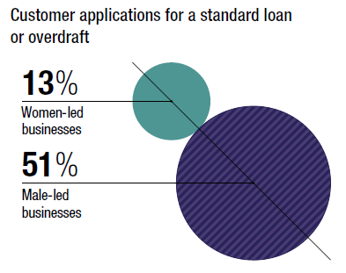
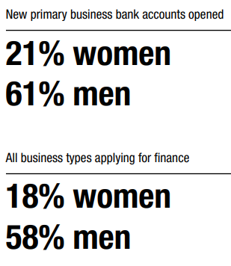
WE Finance Code Model Inspired by the Investing in Women UK Code
In the three years since its launch in June 2019, the UK Code has achieved: 160 signatories 18 lenders (covering >50% of total market, including four of the ‘big six’ banks & Britain’s largest Building Society), 30 Angel syndicates and over 100 VC members Sex-disaggregated data now available, such as (on lending side): Only 13% customer loan applications are from women-led businesses vs 51% male-led Average loan approved for women-led businesses was £56,000 lower Overall approval rates are similar (90% for women and 92% for men) Boost to non-financial resources to support female entrepreneurs Tens of thousands of entrepreneurs have benefited from new and expanded mentoring schemes and thousands of students have received enterprise training
UK Investing in Women code Original Signatory Requirements Have a member of the senior leadership team responsible for supporting equality. Provide HM Treasury, or a relevant industry body designated by HM Treasury, a commonly agreed set of data. Adopt internal practices which aim to improve the potential for female entrepreneurs.
Sex-Disaggregated Lending Data – Snapshots from the 2022 Report

Slide 6
Theory of Change: Catalyze collaboration across the ecosystem through the WE Finance Code to increase financing to women entrepreneurs
 | Output Metrics | Short-Term Outcomes | Medium/Long-Term Outcomes | Ultimate Goal
Financial Service Provider Signatories | Number of FSPs signed up Number of FSPs reporting on commitments | Increased focus on and (financial and non-financial) investment in serving WMSME segment Data-driven decision-making, goal setting by FSPs | Evidence-based financial services & products for Women Entrepreneurs | Increase in funding provided to Women Entrepreneurs (volume and share) & Greater number of women entrepreneurs thriving as a result of increased access to business financing and support globally & Value addition to economy
National Code Coalitions | Number of National Code Coalitions making a Declaration of Intent Number of countries reporting to Global Code Number of countries reporting to OECD/FAS | More gender-disaggregated data available publicly at an aggregate level Increase in number of policies and programs in place to support women entrepreneurs | Mainstreaming of gender-disaggregated data collection and use Improved harmonization of data and definitions
Partners | Number of partners submitting Letter of Intent Number of Partners reporting on commitments | Increased incentives/support to Signatories & National Code Coalitions Increased coordination & alignment amongst key players
Ways to Commit to the Code:
1-3 Year Horizon
3-5 Year Horizon

Slide 7
Country Code Pilots
Simply make a public declaration of local implementation
An essential feature of the Code are national coalitions to drive adoption and mainstreaming across national financial systems. Regulators and other public entities and private sector champions showing commitment to achieving the objectives of the Code.
A flexible framework allows for adjustments to suit national conditions.
Recognized National Code Coalitions have four common characteristics:
Governance that creates accountability for and oversees local adoption of the Code
Designated coordinator for local Code implementation and reporting
A mechanism to aggregate data with integrity, in a format that will facilitate mainstreaming over time
Reports on progress for the Global Report (and Annual National Code Progress Report preferable)
National Code Coalitions will make a public Declaration of Intent indicating their intent to adopt the Code in their given country.
Notes:
Important to get those big multinational banks through the global track,
FIs who don’t have National Country Coalition and sign up globally, can spark national codes (e.g. Chinese government encourages FIs to sign up to UNEP FI)
Dial-up the global FIs – Citi bank and Bloomberg (Jane Fraser) – make sure getting this on people’s mind & global track
Global track and need IP to help broker these conversations
Global track can spark national Code

Slide 8





Financial sector ecosystem partners will contribute in a variety of ways
Alignment and Reinforcing Incentives
Financial Institutions
Banks, MFIs, FinTechs, VCs
National Actors
Regulators, Policymakers,
Ind. Associations
Investors and Development Finance Institutions
Ecosystem
Standard Setters,
Global Organizations
and Advocates
Donors &
Knowledge Partners
Code Signatories commit to:
Name a Senior Advocate
Collect, report and use WMSME data
Support WMSMEs through data-driven actions
Champion Code in their markets
Champion Code, embed in financial inclusion strategy, policies and programs
Promote Code through public-private alliance
Enable data collection & reporting
Create incentives for FIs
Encourage clients to adopt the Code
Support on-boarding
Provide capacity building for FIs, Regulators & SSBs.
Engage in high level advocacy for the Code
Support data collection efforts
Promote data standards & harmonization
Improve use of data & analytics for business case & financial inclusion policy
Support Code rollout & reporting
Support national pilots
Support data collection, analysis, strengthen business case.

Slide 9
Flexibility in Design - several design choices exist to roll out the Code nationally
Strategic questions
Which option is best suited to the country context?
What types of Financial Intermediaries?
What standards should be required?
What MSME definitions should be used?
What Incentives can FIs expect by joining
Who is/are the National Champion(s)?
What is the role of the Regulator vis-a-vis the Code?
Who plays the role of National Data Aggregator?
Who coordinates & issues annual report?
Banks
+ FinTechs + MFIs
+ Equity providers
Minimum Requirements
Advanced
Best in Class
FIs own definitions
National Definition
Harmonized with global standards
Recognition
+ Knowledge Sharing
+ Technical Assistance
+ Access to Funding
Regulator
Other Public Body
Joint
Industry Associations
Private FIs
Encourage Participation
Create Incentives
Align Regulatory Reporting
Private/Industry
Association
Joint
Regulatory Channels
Public, Non-regulatory
body
Private/Industry Association
Public, Non-regulatory body
Regulator
Notes:
After agreeing to a National Coalition there are still a few design choices you can make?
We can develop a Playbook where we talk about role of regulator, scope o

Slide 10


Timeline
Selection of Pilots
September 2023
Launch Code:
October 2023
Country Launches
International Women's Day 2024
Target for most pilot countries to announce launch of Code on IWD
Initial signatories & key champions identified.
One year to establish mechanism and report on progress.
Activities funded by We-Fi pilots to be completed within 2 years
Country Codes should continue for at least 5 years
IP Proposals Submitted
5th Call Funds Allocated for Pilots
Playbook Prepared
Initial Workshops/Training
Community of Practice
Website/Resources Available
Announce Launch at WB Annual Meetings – Marrakesh with key champions
Broad information campaign / leverage champions
National Workshops/Training
Financial Alliance for Women Summit (November DR)

Slide 11
WE Finance Code
Implementation Overview

Slide 12
National WE Finance Code Set-up and Implementation
Introduce WE Finance Code and identify in-country anchors (1 mo)
Form WE Finance Code coalition and aunch awareness campaign
(3-6 mo)
Generate insights for national and global WMSME advocacy
1
3
5
Set up and implement
WE Finance Code platform & structure
(12-18 mo)
Map WMSME ecosystem and assess market (3-6 mo)
2
4
Notes:
Even though we are suggesting a specific approach, you should not feel bound by it – each country will have it’s own pathway and some areas may be more important than others.
This is meant to be used as a roadmap to guide you – and should be incorporated depending on each country, partners, priorities, etc. Suggested time may also differ.
We’re suggesting five Stages, shown in chronological order, BUT there are Stages that will partially start while others have not ended. But essentially: (read the slide)
Introduce WE Finance Code and identify in-country anchors (1 month)
Map WMSME ecosystem and assess market (3-6 months)
Launch awareness campaign and WE Finance Code ’Coalition (3-6 months)
Set up and implement WE Finance Code platform & structure (12 – 18 months)
Generate insights for national and global WMSME advocacy
We’ll go through the first 2 and then have time for Q&A and then the next three and do some Q&A

Slide 13
Stage 1: Introduce WE Finance Code and identify in-country anchors
Notes:
OK, Stage 1. Introduce the WE Finance Code and identify in-country anchors.

Slide 14

Stage 1: Introduce WE Finance Code and identify in-country anchors
Create Initial Pitchbook
Articulate gap and impact on GDP if closed.
Opportunity of Closing Gap
Theory of Change
Commitment Mechanisms
Indicators required and nice to have
Design Choices
National Coalitions
Reporting structure
Broad brush implementation Guidelines
Requires strong 'anchors' and a National Coalition
The full dimensions of the Commitment
The opportunity to lead nationally and globally
Notes:
You’ve already thought through your countries, and its super handy to have a ‘pitch book’ or document that you can send to the initial stakeholder (s) that you want to buy-in to the idea of doing a National Code in the first place. This document, which we have prepared for you includes the following:
The opportunity of closing the gender gap—we will have the global gap in the pitch book, but you should try to get the national figures. People respond to the ‘opportunity’ NOT the ‘problem, so getting to the impact on GDP if the entrepreneurial gender gap was closed is what is useful.
Theory of change—how the Code rallies the ecosystem and aligns, KPIs and measurement. Outputs/Outcomes (one slide)
Who has to commit, and how
Indicators—required and nice to have
National coalition—who should be in the room, who should drive this, who are the anchors (more on that in a minute)
Reporting structures—who reports what to whom
Broad brush implementation guidelines.
You will get these slides, and create your own pitch book, with your branding.
Ego stroking is huge—the opportunity to lead nationally and globally.

Slide 15
Stage 1: Introduce WE Finance Code and identify in-country anchors
Identify potential in-country anchors
Conduct initial stakeholder consultation
Anchor Attributes:
Convening power and sector-wide influence
Strong internal Champion
Has resources—people/funds
Communications capability
Walks the Talk
Multinational Coordinator | Intergovernmental Organization | Other
Ecosystem stakeholders
Aggregators | Regulatory |  | Non-Regulatory
Aggregators | Central Bank & Other Regulators | Government Agencies | Trade/Bank Associations | Credit Bureaus | Other (incl. Donors/ Investors)
Financial Institutions | Commercial Banks | Micro Finance Institutions | Other Regulated FIs | Non-regulated FIs
Private Sector Anchor & Other Private Sector Representatives
Public Sector Anchor & Other Public Sector representatives
National Coalition
Anchor/
Co-Chair
Anchor/
Co-Chair
International
Organization representatives
Notes:
As Wendy/Aurica mentioned, there are design choices, this needs to be adapted to the local reality. Will it be regulator driven (perhaps more of a stick approach as far as the private sector are concerned) or will this be more private sector driven, a great idea if you have one or two bank CEOs want to drive and build from there (preferably one CEO, because we need to be clear that to take the lead on this in the market, it most likely has to the market leader). In reality this is complicated but it will always be a Coalition.
There are some basic requirements of any anchor:
Convening power and sector wide influence
Is already a strong internal Champion
Has resources—people/funds (do not underestimate this)
Strong Comms capability (this will be a national campaign)
Walks the talk
Coalition: Involves a private sector anchor (s) /public sector anchor (s) and is made up of representatives from the ecosystem. We’ll go into the tool for ecosystem mapping in the next Stage.

Slide 16


Stage 1: Key Outcomes
WE Finance Code pitch book tailored
to local context
Early champions/anchors in place
Notes:
The Outcomes of this stage is that you have tailored a pitch book, sent it to your champions/stakeholders, had discussions and secured at least one powerful Anchor.

Slide 17
Stage 2: Map WMSME ecosystem and assess market (3-6 months)

Slide 18
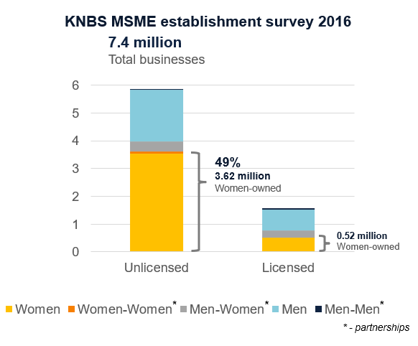
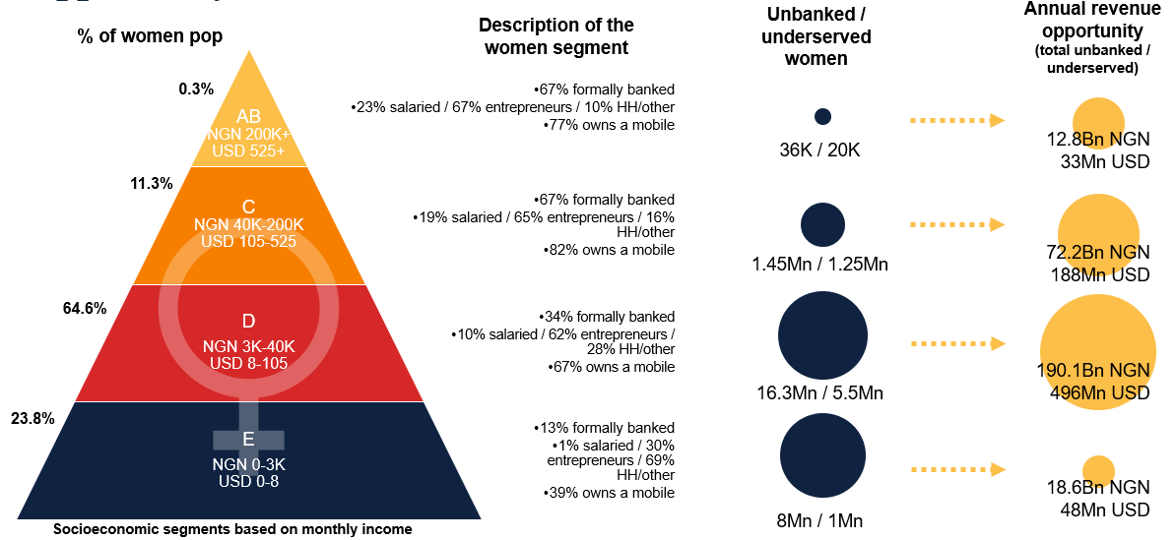
Stage 2: Map WMSME ecosystem and assess market opportunity (3-6 months)
Establish WMSME baseline state
Use available demand-side data to understand the state of WMSMEs in the country (% women-owned businesses, business types, formal vs. Informal)
Collect existing or conduct additional demand research to better understand barriers faced by WMSMEs and reasons for financing and entrepreneurship gap
Size the market opportunity
Estimate the market opportunity for expanding financial services for un/der served WMSMEs
Estimate the gender gap in MSME financing
Overview of the MSMEs in Kenya
Overview of the untapped women’s market opportunity potential in Nigeria

Slide 19
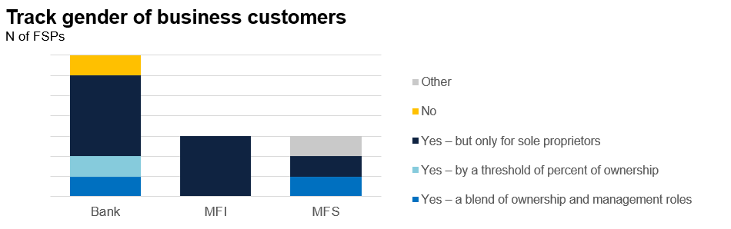
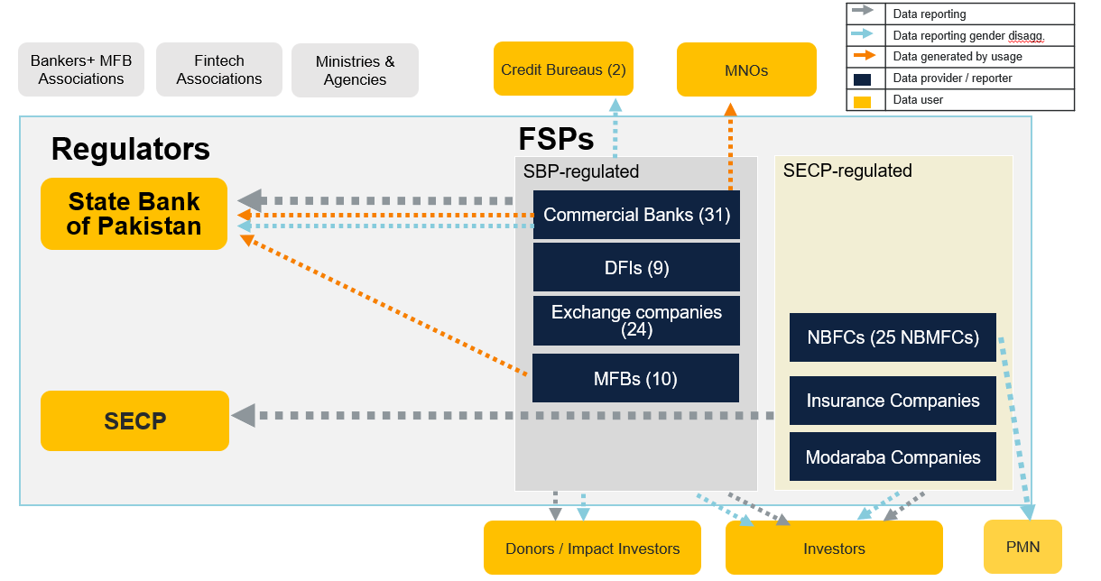
Stage 2: Map WMSME ecosystem and assess market opportunity (3-6 months)
Map the ecosystem
Map WMSME stakeholder ecosystem
  Private sector: banks, MFIs, coops, fintech, NBFIs
  Public sector: regulators, government support agencies, business registries
  Other ecosystem influencers: business associations, chambers of commerce, DFIs
Survey FSPs
A representative survey mapping the FSPs attitudes towards serving WMSME customers, current WMSME offers, including NFS, and practices for sex-disaggregated data collection and usage
State of WSME data aggregation in Bangladesh
Financial ecosystem map, including data flows, in Pakistan
FIs’ attitudes towards the women’s market in Kenya

Slide 20

Stage 2: Key Outcomes
WMSME market opportunity defined
Clear understanding of opportunities and gaps within the ecosystem
Initial action plan and budget
Agreement on in-country anchors and aggregators

Slide 21
Stage 3: Form national WE Finance Code coalition and launch awareness campaign
(3-6 months)
Notes:
Stage 3: We’ve mentioned the term ‘campaign’ and that’s deliberate because this is about moving the sector and a good deal of attention therefore needs to be paid to a communications strategy & campaign as well as forming and getting the WE Finance Code coalition working.

Slide 22
Stage 3: Form national WE Finance Code coalition and launch awareness campaign
Convene ecosystem to co-develop the vision and structure of the national coalition
National Governing Body
Functions
WE Finance Code Steering Committee
Lead Code vision and design
FSP representatives
Government
Repr.
Other Repr.
Code Secretariat
Oversight of Code implementation / recruitment
Coordination
& Learning
Working Groups
Operationalize areas and promote sharing
Data
Best practice
Engagement
Aggregators
Coordinate data aggregation and analysis
Association
Regulator
Signatories
& Partners
FSP signatories
FSP signatories
FSP signatories
FSP signatories
Commit and support Code
Partnerships
Notes:
First, on the Coalition front.
There three basic levels:
Signatories = essentially the FSPs who are signing on to the Code
2. Data Aggregators = who FSPs report the data to, and then this body aggregates it, analyzes it.
3. The Coalition = the governing body consisting of private sector—anchor (s), public sector (often the regulator or in the UK the Dept of Treasury), and others (NGO, civil society etc.). This body leads the Codes vision and design, overseas its implementation, moves it along, gets actions (private sector action, or policy action etc.)
4. To make the work, there may be the need to actually have a ‘code secretariat’, one or two people (FTEs) likely seconded or allocated from one or two of the anchors. The job is to operationalize the code, chase signatories, recruit new ones, support the aggregator, and promote the sharing.
Now, it is likely that there will be volunteer Working Groups created that start and evolve over time. At the beginning, a data WG made up of IT representatives from the private sector, to figure out how they can best get the data etc. This may evolve into a WG on Best Practice because that’s a key area of Committing to the Code.
Add to existing – is there a coalition that is already there? Like Nigeria

Slide 23
National Coalition: Representatives from public, private and civil society that do and can enable a more female friendly entrepreneurial ecosystem
To represent the philosophy of the Code as a cross-sector effort, and to be inclusive of the various stakeholders in the access to finance and entrepreneurial ecosystem, the Coalition should be made up of private, public and civil society actors
Public Sector Anchor & Other Public Sector
representatives
Private Sector Anchor & Other Private Sector Representatives
Anchor/
Co-Chair
Guiding Principles for the Design of the National Coalition
The Coalition should be representative of the different stakeholders in the access to finance and entrepreneurial ecosystem
Stakeholders include FSP signatories and regulators as well as other significant ecosystem actors
There should be a proportionally appropriate percentage of Diverse and Inclusive talent on the Coalition
National Coalition
Anchor/
Co-Chair
International Organization
representatives

Slide 24
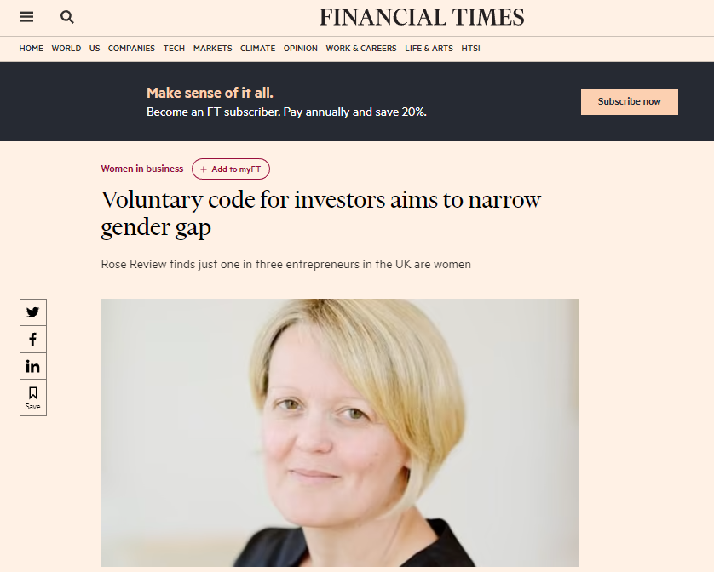
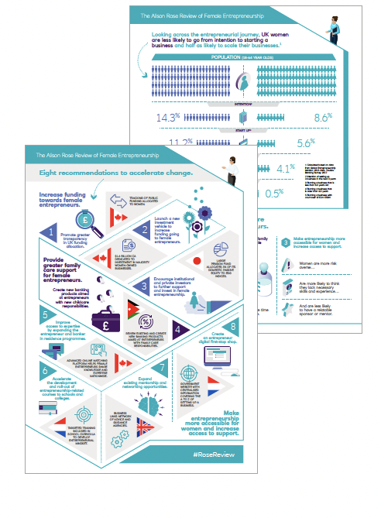
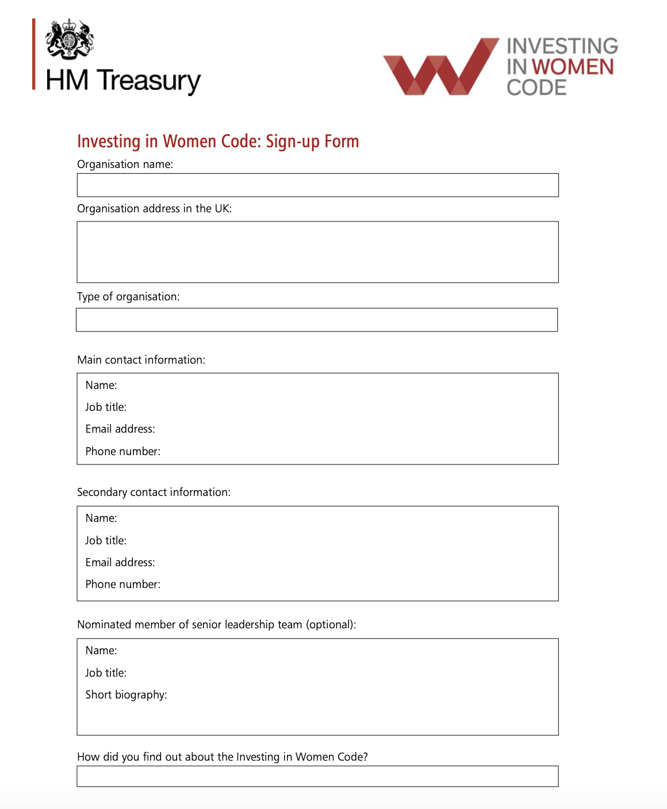

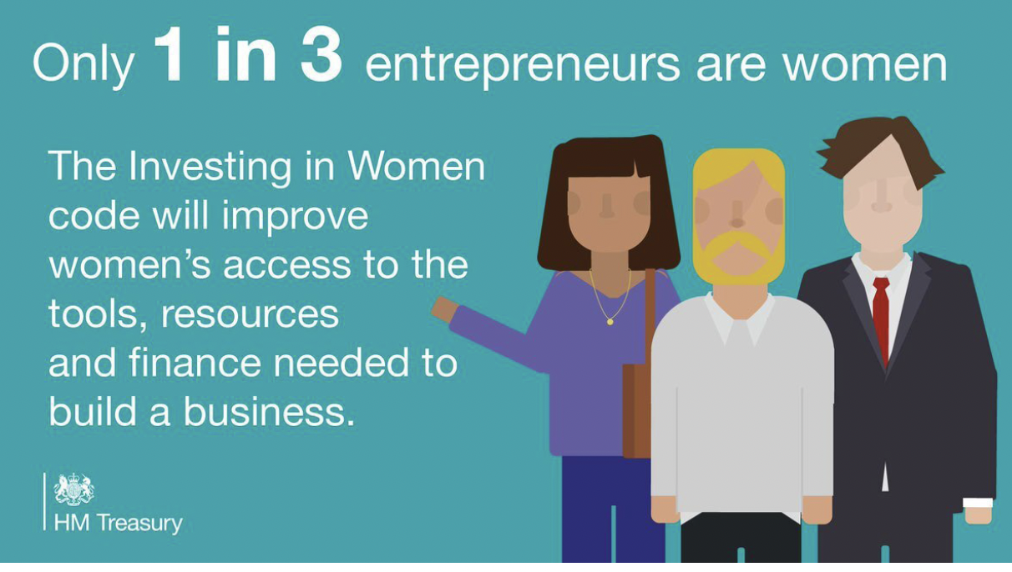
Stage 3: Launch awareness campaign and WE Finance Code coalition
Develop communications plan and campaign
Start signatory recruitment leveraging local anchor(s) and other influential champions
Notes:
To get everyone signed up and interested, we recommend investing in a National Comms campaign, to build the Wow factor, this will help raise awareness, recruit new signatories, elevate the Code and encourage more and more ecosystem stakeholders to get involved.
The comms campaign can include the results of stage 2 with ideally a business opportunity or gap. In the case of the UK, for instance, they developed an infographic that showed the major gaps found as part of their demand-side research. They also calculated the impact on GDP that closing the gender gap for women entrepreneurs would yield.
With all of these, they were able to use their strong comms capabilities to be prominently featured in media all across the UK.
In parallel, the recruitment of signatories should start – this may start through phone calls from the CEO champion and later on through a more formal process – here we show the sign up form used by UK Treasury as part of their recruitment process.
Use of existing data

Slide 25

Stage 3: Key Outcomes
Initial group of WMSME key stakeholders, including main financial sector providers, understand benefits of WE Finance Code and committed to joining the national coalition
Notes:
Outcomes: Main anchors committed, National Coalition is formed.

Slide 26
Stage 4: Set up and implement WE Finance Code platform /structure (12-18 months)

Slide 27
Stage 4: Set up and implement WE Finance Code platform /structure (12-18 months)
Set of mandatory indicators to be collected
Create action plan for Code implementation (1/2)
  Establish reporting processes, develop data collection templates
  Define data outputs
  Aggregator: data repository/storage reqs, HR and system capabilities
  Set timelines and targets
  Secure resources, HR and financial
  Define global reporting
Indicator Category | Data request from FSPs disaggregated by Gender AND by SME/micro | Desired Analyses for the global report (vs. non-women led)
1. | Number of MSME Customers | % women-led MSME business customers
2. | Number of MSME Loan Applications | % women-led MSME applications
 | Value of MSME Loan Applications | Average value of women-led MSME loan applications
 | Number of MSME Loan Approvals | % women-led MSME loan approval rates
 | Value of MSME Loan Approvals
3. | Number of MSME Outstanding Loans | Average women-led MSME outstanding loan size
 | Value of MSME Outstanding Loans | % women-led MSME value of outstanding loans Average women-led MSME outstanding loan size
4. | Percentage of MSME Outstanding Non-Performing Loans | % value of women-led MSME non-performing loans
5. | Value of MSME Deposits | % women-led MSME volume of deposits % women-led MSME loan to deposit ratio (LDR)
 | Number of MSME Depositors | % women-led MSME depositors
MSME Business Customers
MSME Business Loan Applications & Loan Approvals
MSME Business Outstanding Loans
MSME Business Non-Performing Loans
MSME Business Depositing Data

Slide 28


Stage 4: Set up and implement WE Finance Code platform /structure (12-18 months)
Create action plan for Code implementation (2/2)
  Establish reporting processes, develop data collection templates
  Define data outputs
  Aggregator: data repository/storage regs, HR and system capabilities
  Set timelines and targets
  Secure resources, HR and financial
  Define global reporting
National Report
Aggregate Report, Analytics,
Knowledge Sharing, Action
National
Report
Data Aggregator(s)*
Collect FSP Data,
Ensure Data Integrity
National Data Aggregator (s)
Signatories
Generate & Report Data
Banks
MFIs
FinTechs (Lenders)
VCs
(future)
*Trusted national bodies such as a regulator or industry association, that have established data collection channels with data protection and data verification processes in place will serve as national data aggregators.

Slide 29
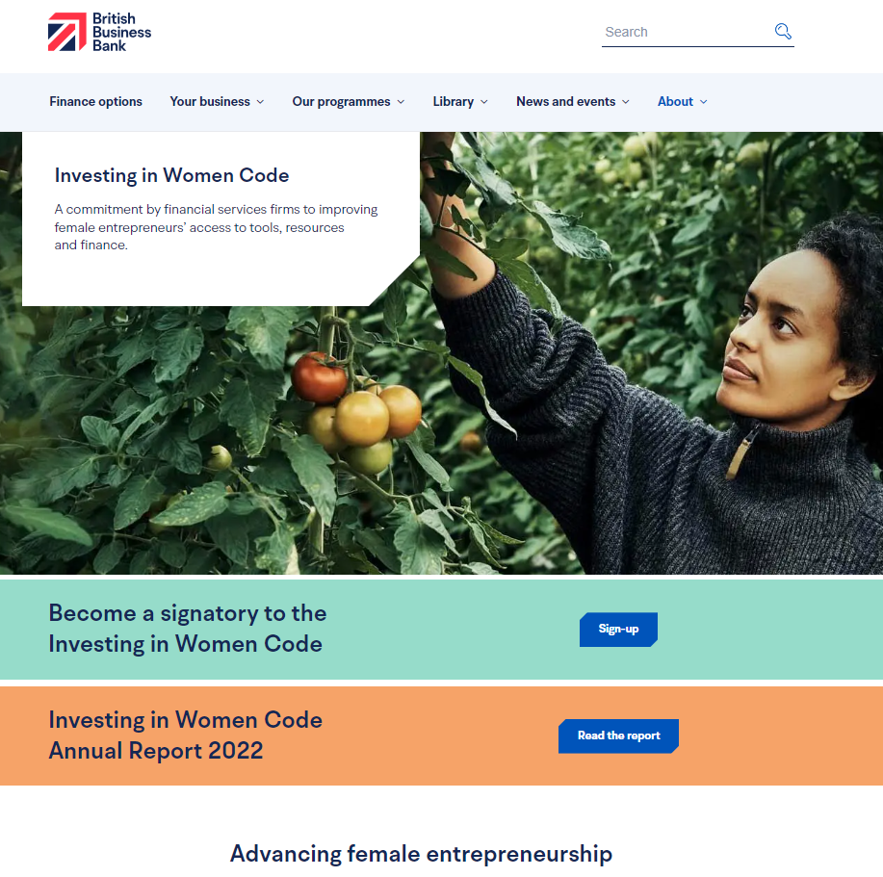
Stage 4: Set up and implement WE Finance Code platform & structure (12-18 months)
Develop knowledge sharing plan
  Set up a website portal for sharing data and coalition news
  Convene stakeholders to share insights, and refine tools
Provide TA to signatories and aggregator, if required
  Data analytics and tools
  Leveraging data for performance management

Slide 30

Stage 4: Key Outcomes
Initial coalition members become signatories to the Code
Action Plan in place
Robust platform in place for data collection and analysis

Slide 31
Stage 5: Generate insights for national and global WMSME advocacy campaigns
Notes:
Once the structure of the code is set up, the final stage is to use that structure to generate the insights needed to promote change

Slide 32

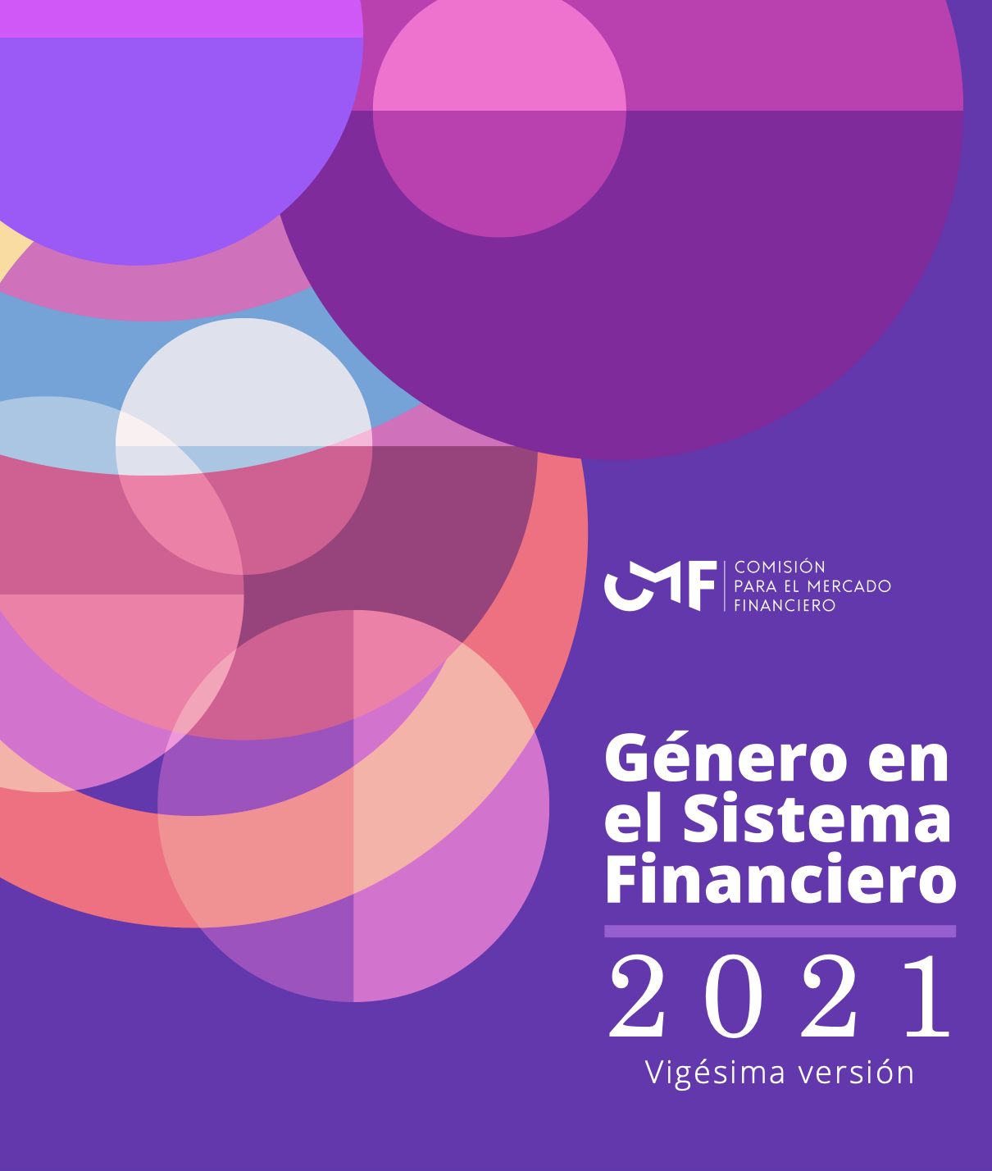
Stage 5: Generate insights for national WMSME advocacy campaigns
Analyze data and publish reports to strengthen private sector and government efforts to support WMSMEs
Deliver peer learning engagements to share knowledge and best practices
Report data to the global WE Finance Code aggregator to promote global advocacy
Notes:
Once the data reporting begins, you need to ensure it is analyzed and used. Reports can be published highlighting the key insights to strengthen support from both the financial sector and governments. This report can be used to maintain the momentum needed year after year.
Signatories may also chose to continue peer learning engagements such as working groups to go deeper on specific topics. Ideally, this should be continued throughout the life of the Code to promote sharing best practices and knowledge
And finally, the data is reported to the global WEFI code aggregator, which helps promote advocacy at the global level.

Slide 33
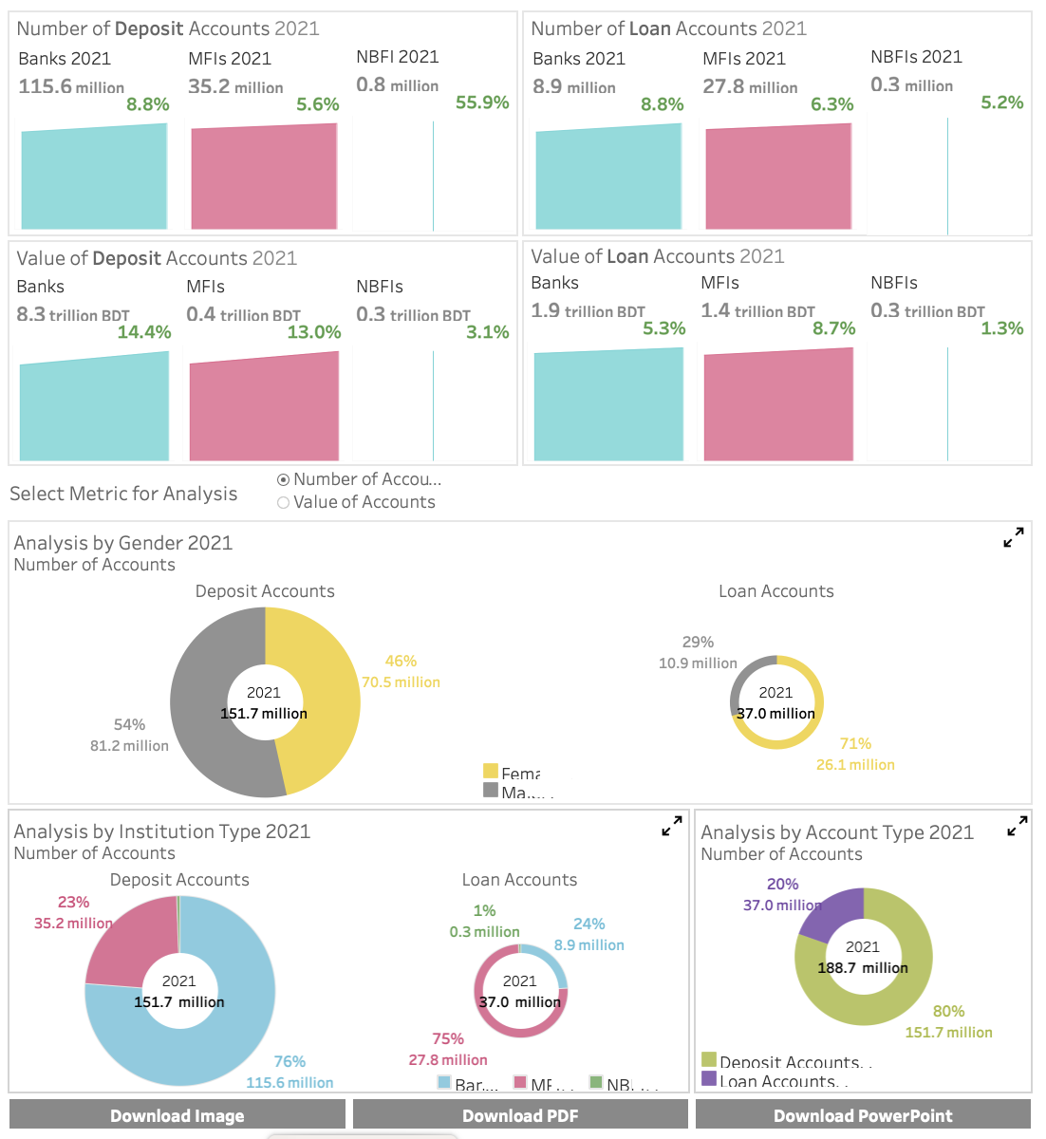
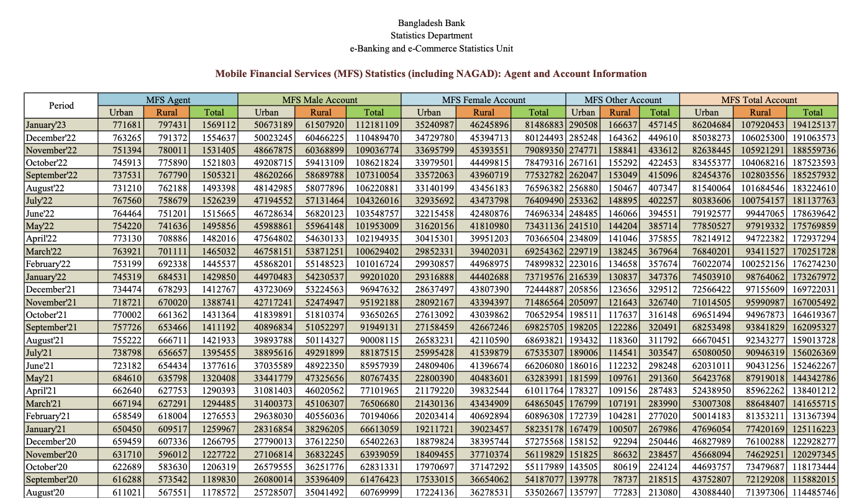
Develop data visualization mechanisms such as dashboards to promote data-driven policy decisions as well as private sector women's markets offerings
Notes:
Beyond reports, we found that creating a mechanism that helps make the data easily accessible and visualized is key to promote data driven policies and business decisions.
Here you can see an example of the dashboard that is being created as part of our project with Bangladesh Bank that aggregates data on funding to SMEs by gender.
Even if you collect information it has to be accessible, and easily digestible.

Slide 34
Stage 5: Key Outcomes
Report published/visualized and discussed nationally
Aggregate data reported to the global WE Finance Code Aggregator
Notes:
And so the final 2 outcomes in this phase are the data is analyzed and published in a report and/or visualized
And the aggregated data is reported to the global WEFI Code Aggregator.

Slide 35
National WE Finance Code Set-up and Implementation
Stage/ duration | Introduce WE Finance Code and identify in-country anchors (1 month) | Map WMSME ecosystem and assess market (3-6 months) | Form WE Finance Code coalition and launch awareness campaign (3-6 months) | Set up and implement WE Finance Code platform /structure (12-18 months) | Generate insights for national and global WMSME advocacy
Key Activities | Create initial pitch book Identify potential in-country anchors Conduct initial stakeholder consultation to align on scope | Assess the baseline state of WMSMEs Survey FSPs on women-focused offerings and gender data - Conduct WMSME demand-side research (optional) Size the market opportunity Map WMSME ecosystem, including data flows | Develop the vision and structure of the national coalition Develop communications plan and campaign Convene key ecosystem stakeholders to share assessment insights Start signatory recruitment | Create action plan for Code implementation Set timelines and targets Establish reporting processes and templates Agree on hosting of data repository Define data outputs Secure resources, HR and financial Define global reporting Provide TA to signatories as needed Develop a knowledge management strategy Set up a website portal for sharing data and coalition news | Analyze data and publish reports Develop data visualization mechanisms such as dashboards Deliver peer learning engagements Report data to the global WE Finance Code aggregator
Outputs | WE Finance Code pitch book tailored to local context Early champions/anchors in place | WMSME market opportunity defined Clear understanding of opportunities and gaps within the ecosystem Initial action plan and budget Agreement on in-country anchors and aggregators | Initial group of WMSME key stakeholders, including main financial sector providers, understand benefits of WE Finance Code and committed to joining the national coalition | Initial coalition members become signatories to the Code Action Plan Robust platform in place for data collection and analysis | Report published and discussed nationally Aggregate data reported to the global WE Finance Code Aggregator
1
2
3
4
5
Notes:
To conclude,
We have summarized the 5 stages, and all the activities, and outcomes in this table. You also have it in front of you
This will be fleshed out into guidelines at the end of the month.
Again, this is not a strict list of activities that you must follow, but simply a roadmap to help you map the key prioirities in your country.

Slide 36
Brainstorm: Barriers And Solutions

Slide 37
Barriers and Solutions
Barriers:
Competing commitments
….
….
….
Solutions:
…..
…..
….
….
Notes:
We thought we’d do some trouble shooting with you. First brainstorming the barriers and then solutions.
What do you think are the barriers for local anchors to take this on?
What do you think are the barriers for local signatories to take this on?
Competing priorities
Insufficient SMEs to make business case
No resources
No buy in
Adverse economic environment
No strong enough relationships
Silo between public and private / coordination
Solutions:
Business case or econ contribution figure
Right anchor that is walking the talk

Slide 38
Brainstorm: Innovation & Learning Agenda

Slide 39
Innovation & Learning Agenda
Expected Innovations:
…..
….
….
….
Ideas for Codifying and Sharing:
….
….
….
….
Notes:
Q&A: When you think about the Code roll out, what are you seeing as potential innovations coming out of this?
What are the ways you are thinking about codifying this and sharing? (test interest in Community of Champions?)

