Slide 1
World Bank
Integrating WSMEs in corporate supply chains
– Bangladesh case

Slide 2
Large buyers – the DEMAND side
Strong misalignment between corporate perceptions of WOBs and procurement priorities
Large Buyers do not believe that women-owned businesses can competitively provide the highest-priority products and services that are procured locally by corporations.
1
Procurement practices and policies do not always encourage to do business with WOBs
Corporate policy encouraged sourcing from women, however, may not translate to implementation. (Corporates do not know if they had women suppliers, how to buy more from women suppliers, do not have access to information on women suppliers and considers buying from women as CSR.)
2
3
Corporations perceive Women SMEs should improve quality of offerings to be eligible supplier, and better communicate the value propositions

Slide 3
Large buyers – the DEMAND side
Large buyers-the demand side

Slide 4
Women entrepreneurs - the SUPPLY side
Establishing networks with large corporations is complex and non-transparent
difficulty in making connections to corporate buyers
2. Women lack proper tools and capacity to communicate and negotiate value propositions
Need o better communicate and negotiate the value of their products and services
3. Business environment for women is additionally complicated
Acquiring and maintaining business insurance, a trade license, or tax certification is costly and time-consuming
Applying for a business loan was perceived as complicated, with few lending institutions willing to offer the amount of financing at the terms and conditions
4. Social barriers limit women entrepreneurs’ ability to connect to markets

Slide 5
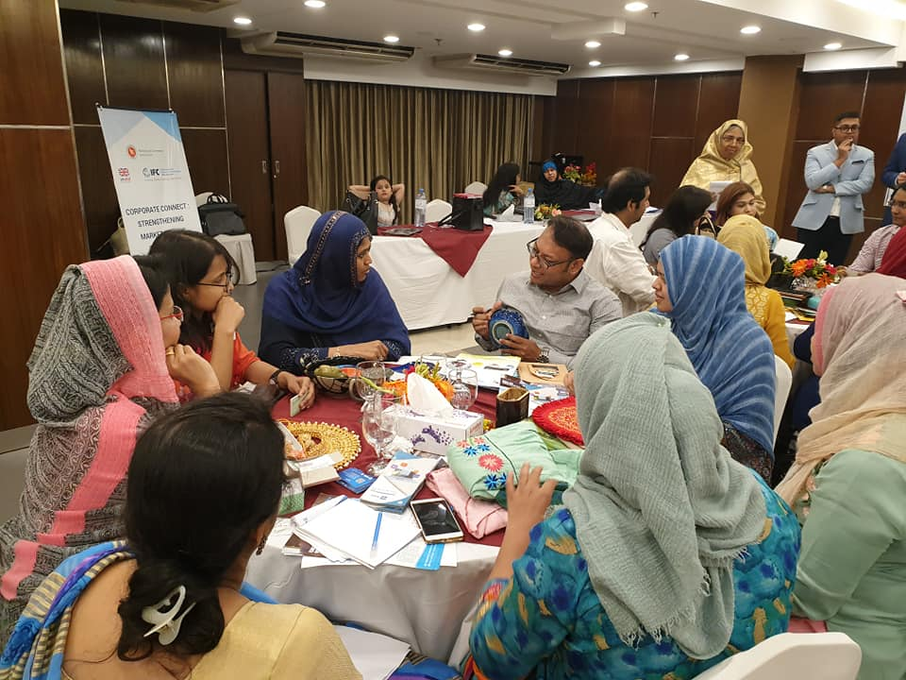
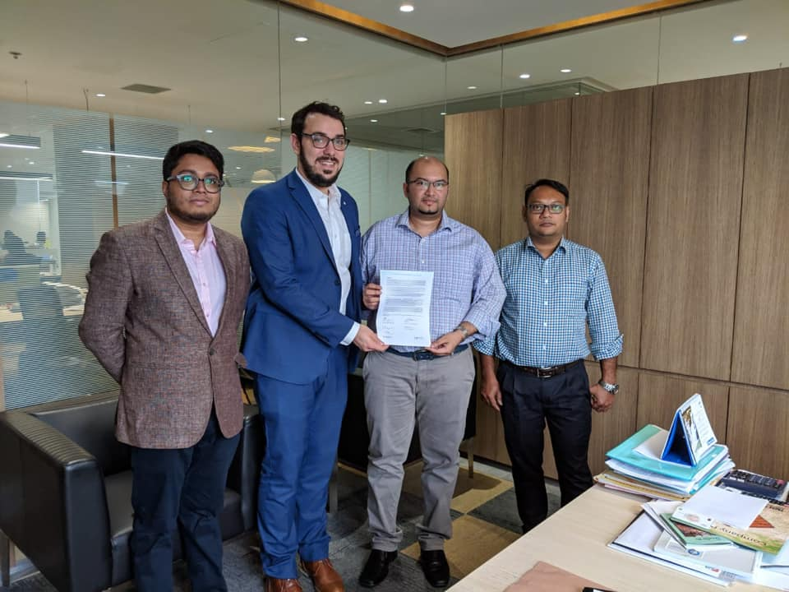
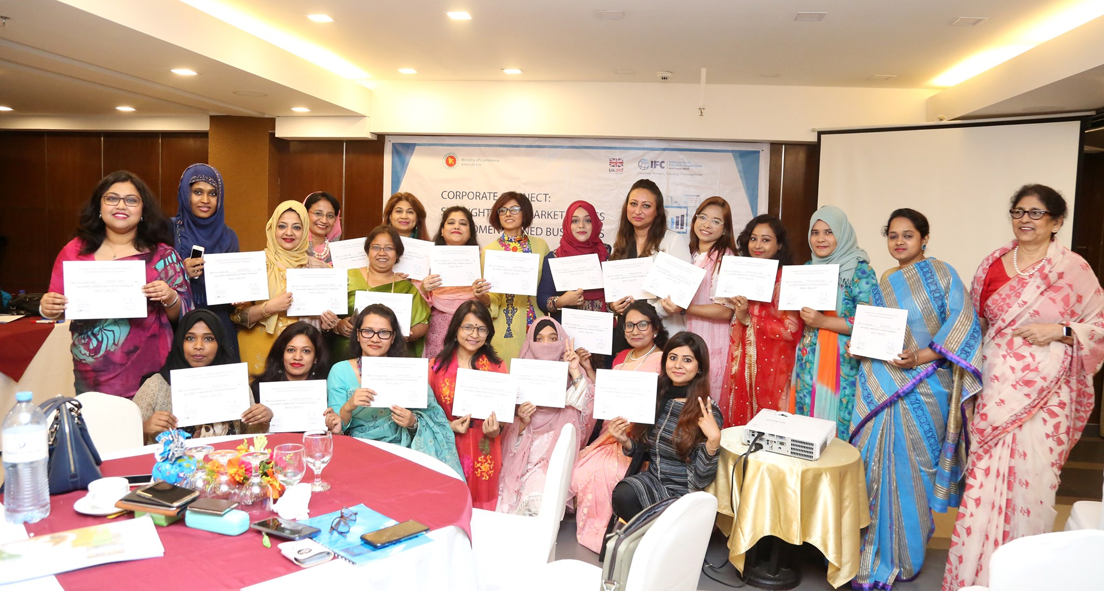
What was done
Stakeholder Mapping
Awareness Campaign
Capacity Building
- Online training
- In-person training
Corporate Commitments
Meet-the-Buyer Sessions
Business Forum
Supplier platform
Outcome
Women business owners connect to corporations, Financial Institutions each other, new market opportunities, and procurement orders
Notes:
The objectives were:
Determine financing needs of WSMEs and the current shortfall in bank financing
Support banks in gaining a better understanding of WSME profiles (number of such businesses, annual revenues generated, number of employees, and contribution to the economy, etc.) in order to develop focused financial services strategies
Identify the non-financial needs of WSME owners in starting, running, and growing their business

Slide 6
Bangladesh: Women Entrepreneurs’ Finance Initiative project-Corporate Connect
Objective: Improve access to markets and formal finance for WSMEs in Bangladesh
Component 1: Facilitating WSMEs’ participation in value chains
Corporate awareness and engagement
Component 2: Enhancing database
Link WSMEs with Corporations
Component 3: Enabling environment
Policy advocacy
Enhancing WSMEs' capacity
Link WSMEs with Financial Institutions
Business network events
Enable e-commerce platforms
Supplier platform development
WSMEs benefitted through linkage and training
Corporations have inclusive supply chain
Financial Institutions lend to WSMEs

Slide 7
Implementation Model
Corporation
Corporation
Corporation
Bank & FI
Bank & FI
Bank & FI
Awareness
Networking
International Database on WSMEs
SME Supplier platform/
Database
Data base on WSMEs
North South University
Fintech
Training of WSMEs
Women Association
Women Association
WSMEs
WSMEs

Slide 8
Results to date
2000 WSMEs benefitted from the project's capacity building programs
1000+ WSMEs with increased access to digital services and tools
214 leads generated
30+ institutions adopted measures to include WSMES in supply chain

