Slide 1
Measuring Impact and Creating Evidence

Slide 2
We-Fi Knowledge Strategy
In the GC meeting on November 10, 2022 (Paris), the Secretariat presented its plan to move from an ‘ad hoc’ approach to a more structured knowledge approach (based on the recommendation in the MTR)
The KM objective is to understanding what works and improve implementation outcomes for practitioners and impacts for women entrepreneurs by facilitating the creation, curation and dissemination of evidence and knowledge to better understand what works
We-Fi’s knowledge strategy aims to leverage evidence and knowledge from its network of MDBs as well as from the broader ecosystem and consists of two pillars:
1
CURATION & DISSEMINATION
EVIDENCE
CREATION
2
Aggregating, curating, and disseminating evidence and knowledge from We-Fi’s network as well as from the wider ecosystem
Catalyzing efforts to create new evidence on selected topics where evidence gaps persist

Slide 3
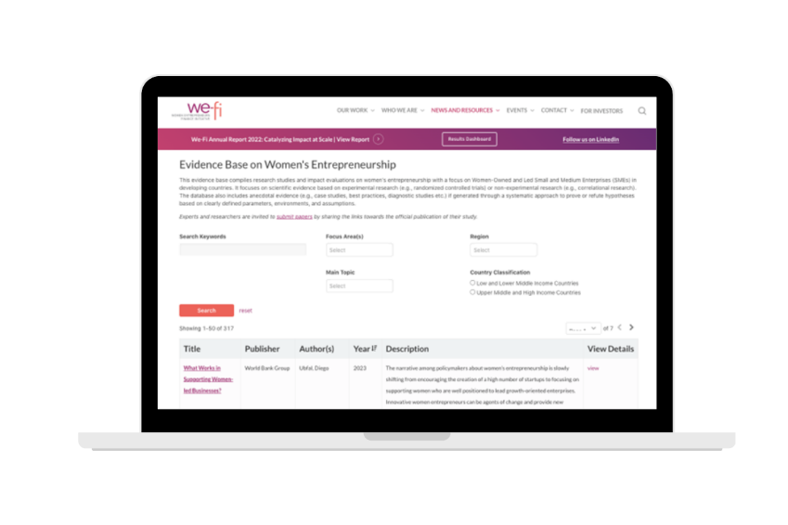
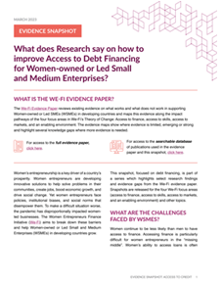
FY23 Achievements to Date - Understanding What Works
CURATION AND DISSEMINATION
EVIDENCE CREATION
Evidence Paper (June 2022): Conducted literature review to understand evidence supporting We-Fi’s Theory of Change
Evidence Snapshots (ongoing): Short notes on selected focus topics (i.e., Access to Credit, Access to Skills) to share evidence
Knowledge Portal (April 2023): Launched searchable database of curated resources for policymakers and development practitioners to know what works to support WSMEs
Research Agenda (January 2023 ongoing): Built consensus amongst IPs and knowledge partners on a research agenda for 2023-2027
Knowledge Partnerships: EBRD reached out to We-Fi to organize joint research conference in Fall 2023 with the aim to:
Promote new research and evidence in priority research topics
Discuss application of new research findings to the design and implementation of projects
Catalyze efforts to generate new evidence on selected focus topics, and determine key objectives and milestones going forward

Slide 4
FY24 Work Plan – Understanding What Works
Webinars: Discuss research findings, lessons from practitioners, design innovations etc.
IP Learning Sessions: Share what works amongst practitioners
Small side events associated with existing events (e.g., Financial Alliance for Women, Regional IP Learning Sessions, COP Workshop, Site Visits to We-Fi Projects)
Potential event to convene IPs and broader stakeholder networks to discuss, learn and share what We-Fi has learned in first five years (would require sponsor, in FY24 or FY25)
ENCOURAGING LEARNING AND APPLICATION
Encourage Research: Co-organize and collaborate on Research Conference hosted by EBRD in Fall 2023 to advance the WSME research agenda
Understand Constraints & Intervention Effectiveness: Support work to close gaps in understanding of WSME constraints and what works in addressing them
Previously: We-Fi Evidence Paper; GEM Women Entrepreneurs Policy Note, WB Gender Strategy Note on WSMEs
Potential: WSME Segmentation Study; WB Paper on WSMEs economic contribution
Disseminate New Evidence: Continue to build the evidence database (knowledge portal); disseminate monthly evidence snapshots
CATALYZING RESEARCH & EVIDENCE
SYNTHESIZING THEMATIC KNOWLEDGE
Climate: Deep dive paper on Climate and Women’s Entrepreneurship
Code: Playbook for use for launch by WE Finance Code Pilot Countries
Care: Deep dive paper on WSMEs in the Care Economy (child-, elder- & healthcare)

Slide 5
We-Fi Research Agenda
Builds on the key evidence gaps identified in the evidence paper and peer review, as well as consultations / surveys with IPs and other stakeholders
Priority Research Topics
Focus: “What works in getting more and effective debt financing to WSMEs, how it impacts their business growth, job creation and women’s empowerment”
Approach: Encourage research-practitioner collaborations to identify practical ways to improve outcomes for WSMEs
Key areas: Debt financing, digital finance, bundled services, blended finance, and sex-disaggregated data
Bundled Services
Digital Finance
Access to and effectiveness of debt financing on WSMEs
Blended Finance
Sex-disaggregated data

Slide 6
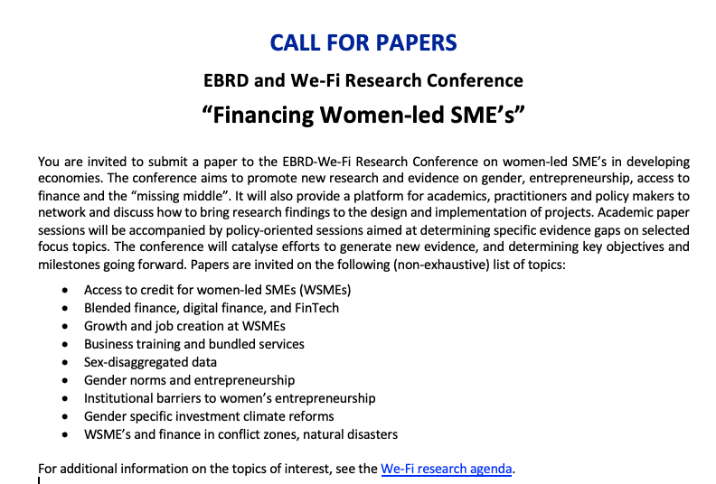
We-Fi / EBRD Research Conference

