Slide 1
Helping WSMEs in Value Chains: Experiences from the BRAVE Women Program
Onyeche Elisabeth Agbiti-Douglas
Project Manager- BRAVE Women Nigeria
We-FI Program Managers Technical Exchange
7-9 June 2023
Marrakech, Morocco

Slide 2
BRAVE Women
Business Resilience Assistance for Value-Adding Enterprises for Women (BRAVE Women) is part of the Women Entrepreneurs Finance Initiative (We-Fi) funded through the Islamic Development Bank-funded. It is being executed by Nigeria’s Bank of Industry. It combines elements of training and grant-matching for women-led SMEs, lead firms and business associations with the aim of supporting them for growth and resilience. The project seeks to enable an empowering business environment for women entrepreneurs and strengthen their resilience.
Business Recovery Support (BRS)
IT Platform
Business Resilience Capacity Building
(BRCB)
Value Chain Resilience
Support

Slide 3
BRAVE Women
BRAVE Women Program is a global initiative that includes Burkina Faso, Nigeria and Yemen
Current Phase of the Project running from 2017- 2024

Slide 4
BRAVE Women: Helping WSMEs in Value Chains
Targeting of businesses in organized private sector (WSMEs)
Including private sector bodies (business associations, cooperatives, etc)
Including lead firms

Slide 5
Business Resilience Capacity Building
(BRCB)
Business Resilience Capacity Building
(BRCB)

Slide 6
Business Resilience Capacity Building
Development of a Curriculum on Business Continuity Management
Trainings for eligible SMEs
Business Development Support to SMEs with preparing and implementing Business Continuity Plans
Business Clinics
B2B events

Slide 7
Business Resilience and Value Chain Resilience Support
Business Resilience Capacity Building
(BRCB)

Slide 8
Business Resilience Support
Grant-matching funds
WSMEs- 5,000 -15,000 USD
LFs and BAs- 40,000- 50,000 USD
Used for CAPEX
Approved made by Grant Judging Panel
Project engages partner banks and facilitate improved interactions between them and beneficiaries.

Slide 9
IT Platform
Business Resilience Capacity Building
(BRCB)

Slide 10
IT Platform
Website (www.bravewomenng.com)
CRM and Dashboard (https://app.bravewomenng.com)
The platform for the implementation for the Project (applications, trainings, grants application, grant utilization, project progress, results)

Slide 11
Value Chain Resilience Support
Targeted at Business Associations, Cooperatives, Lead Firms
Training on Business Continuity Management
Preparation of Business Continuity Plans and grant applications
Business Advisory Support
Matching funds (loan to grant)
LFs and BAs- 40,000- 50,000 USD
Facilitate improved engagement between partner banks and beneficiaries.
Promote B2B, B2G linkages through business clinics, events, trainings

Slide 12
Value Chain Resilience Support – Case Study (Jan Jersuit Limited)
https://app.bravewomenng.com

Slide 13
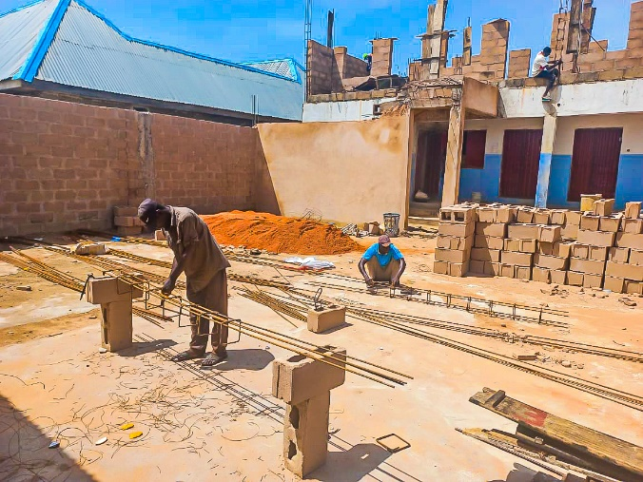
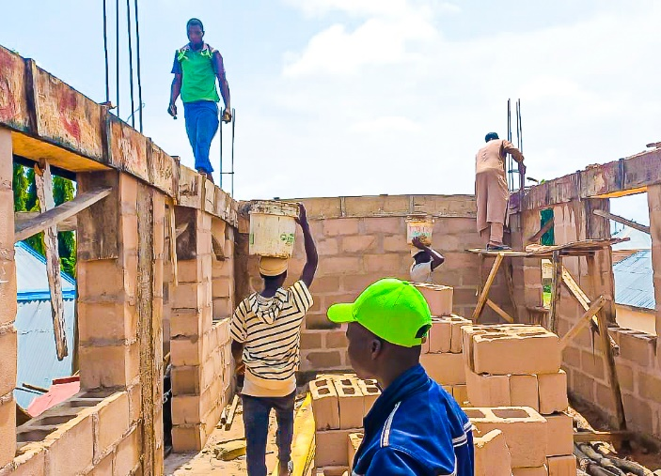
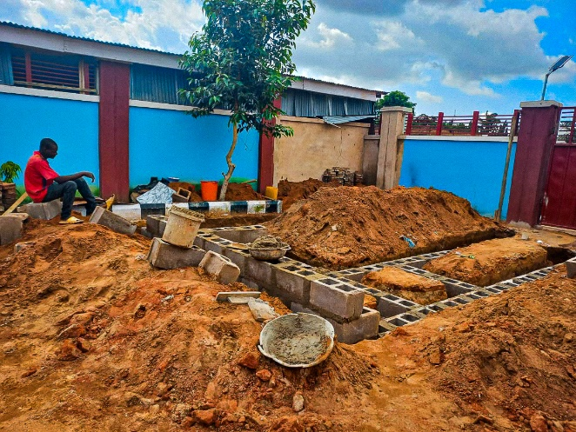
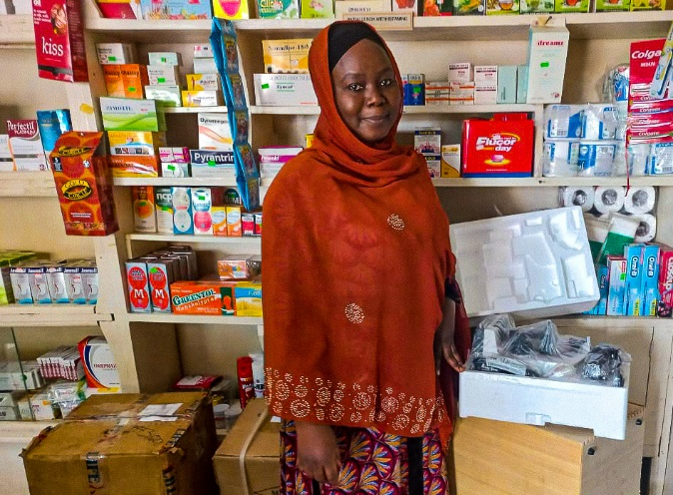
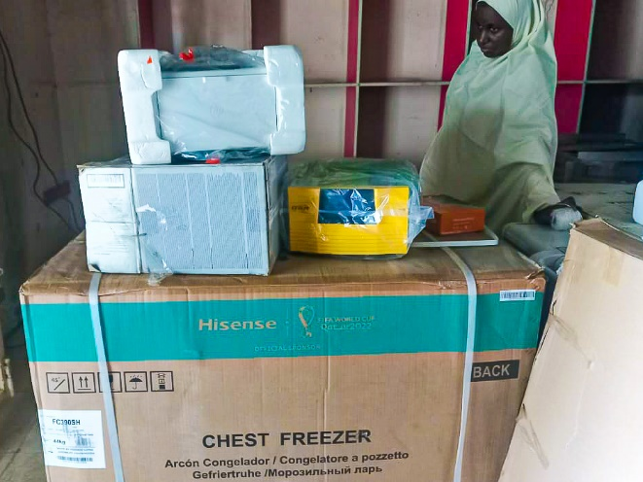
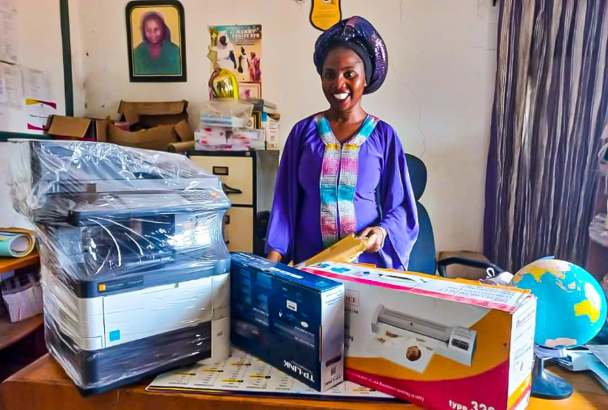
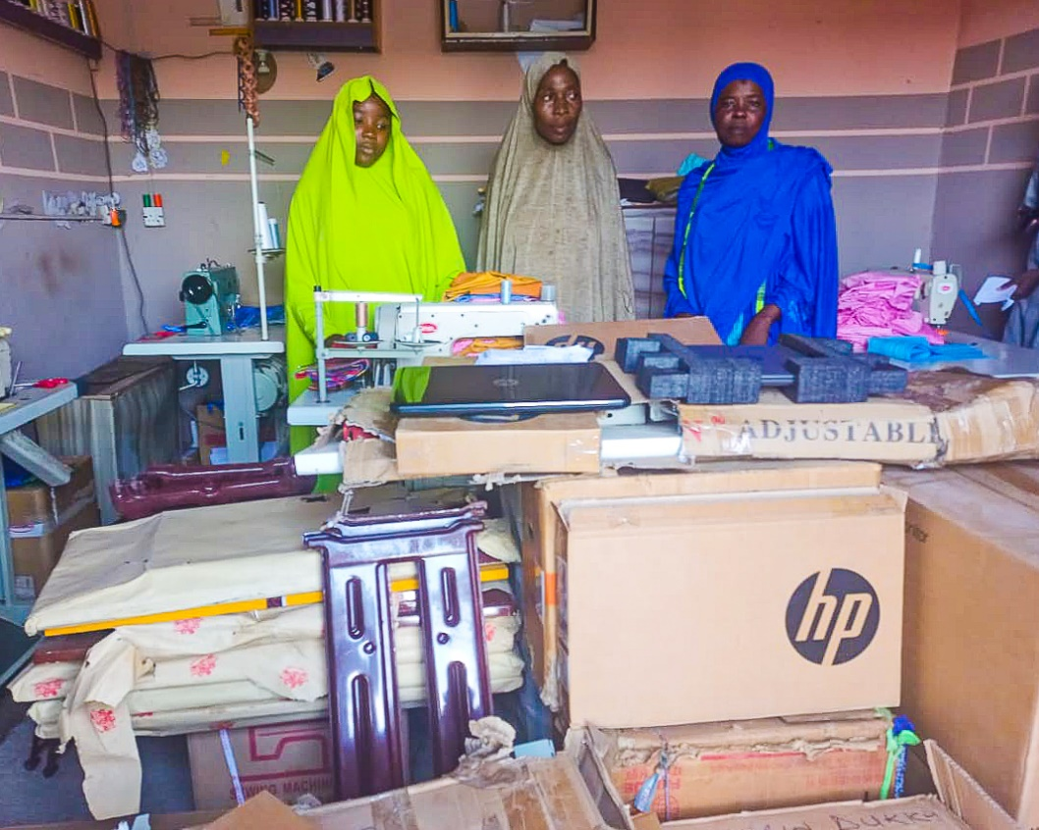
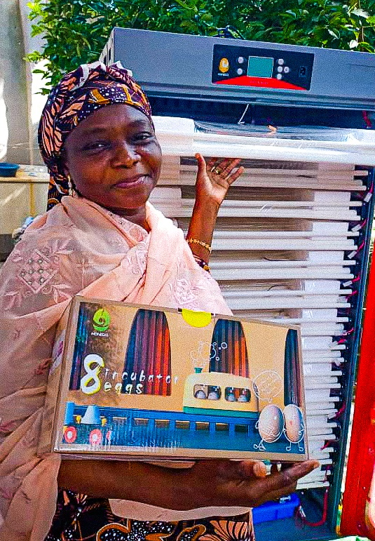
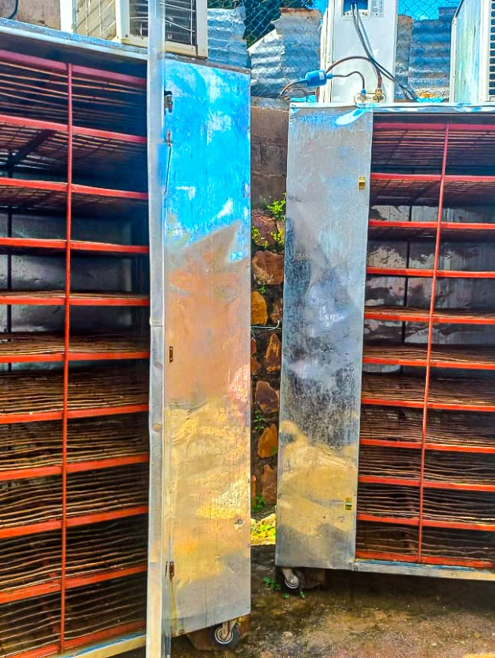
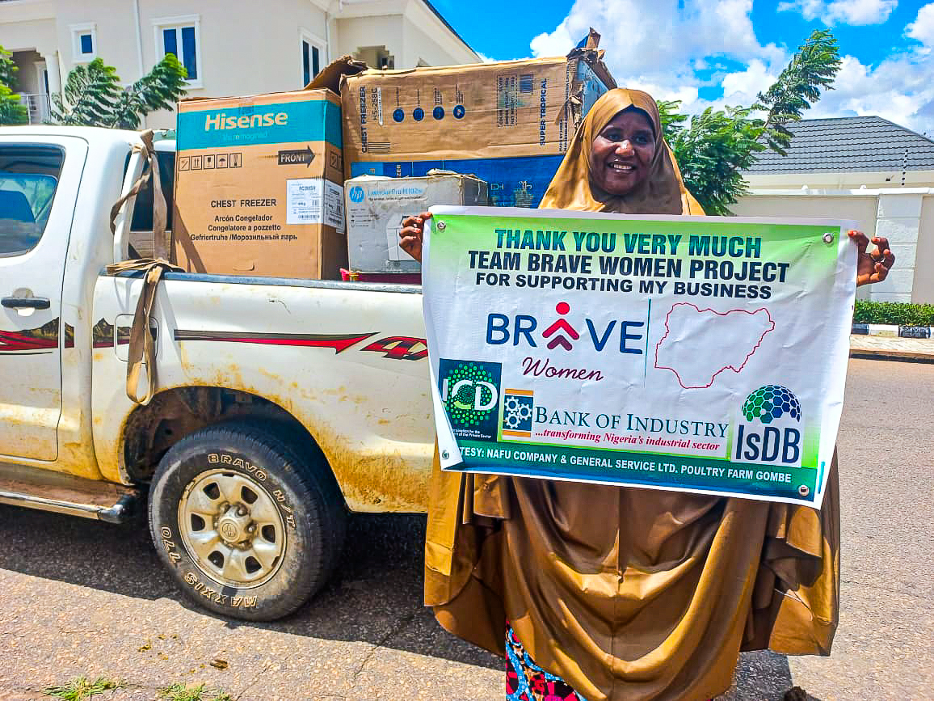
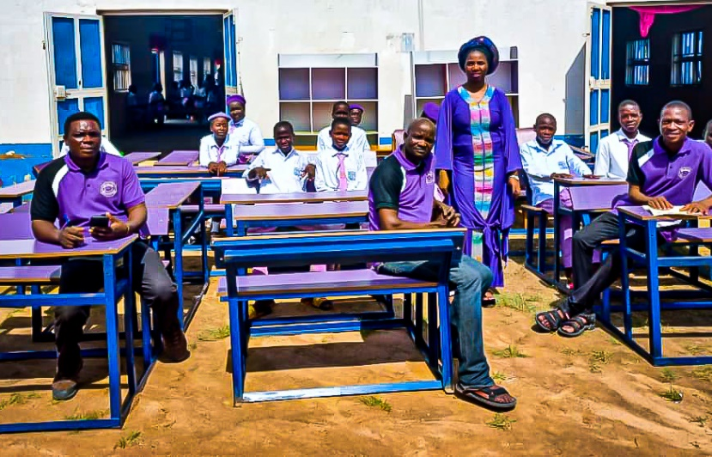
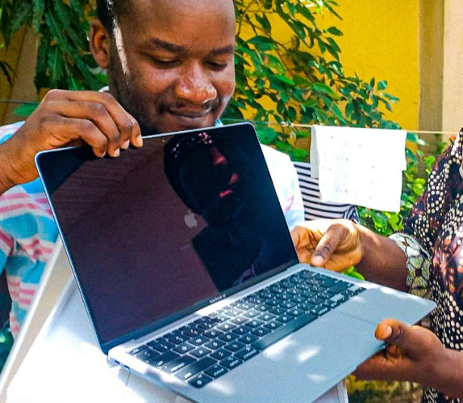
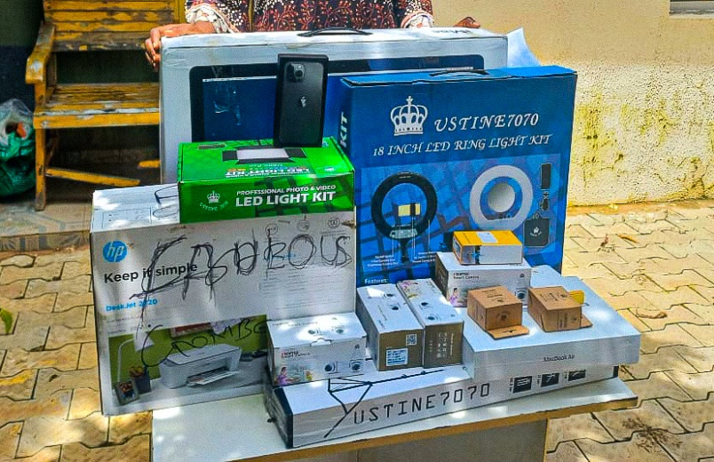
Success Stories

