Slide 1
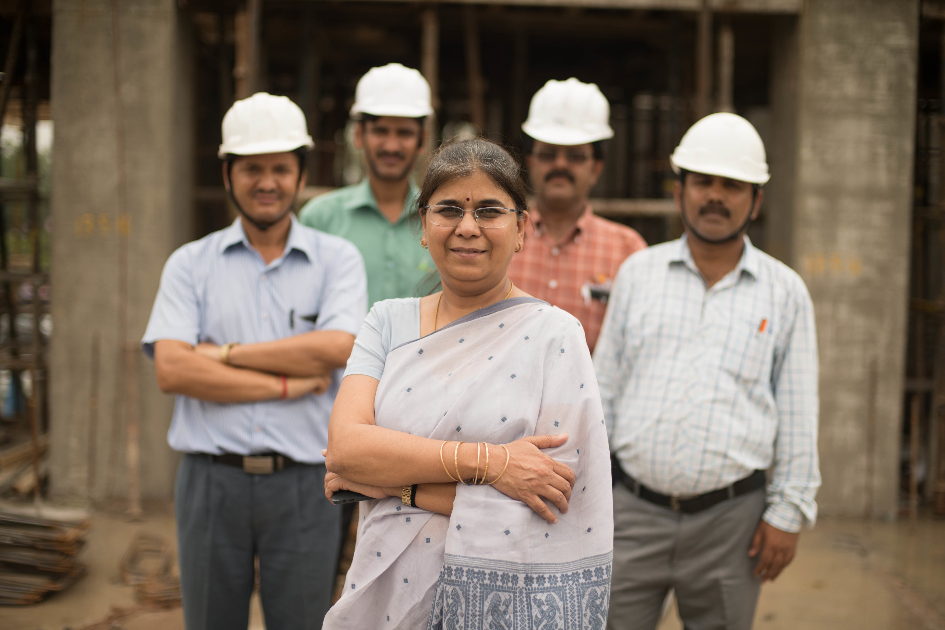
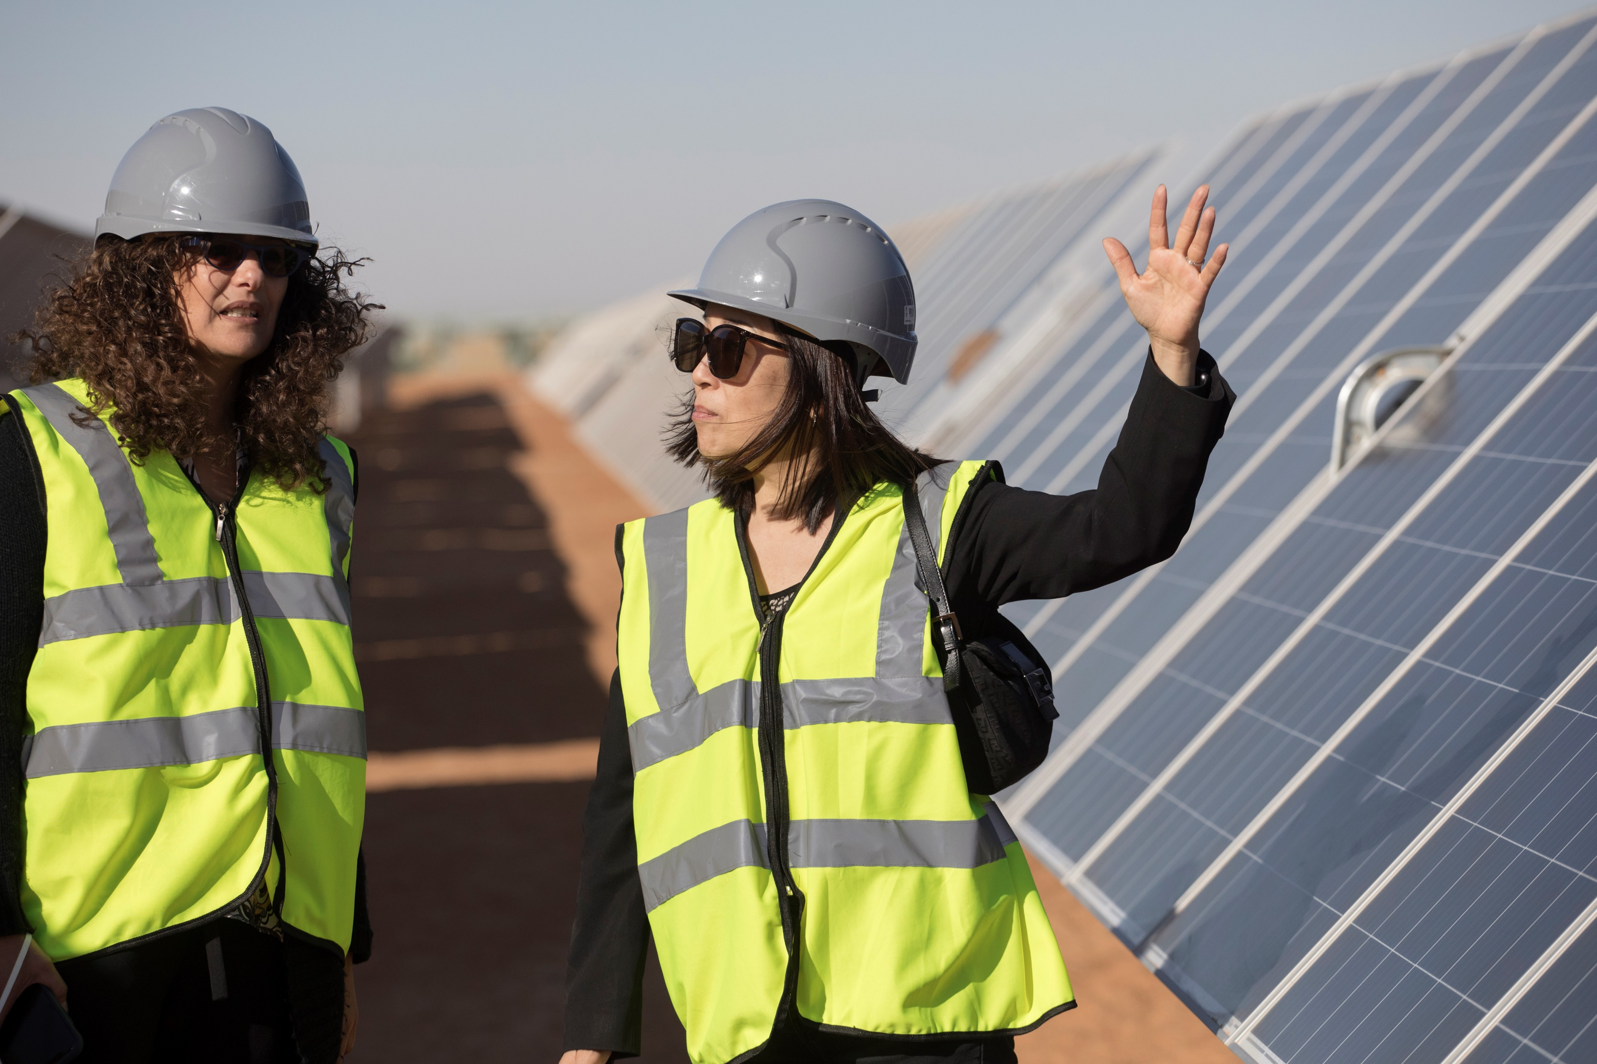
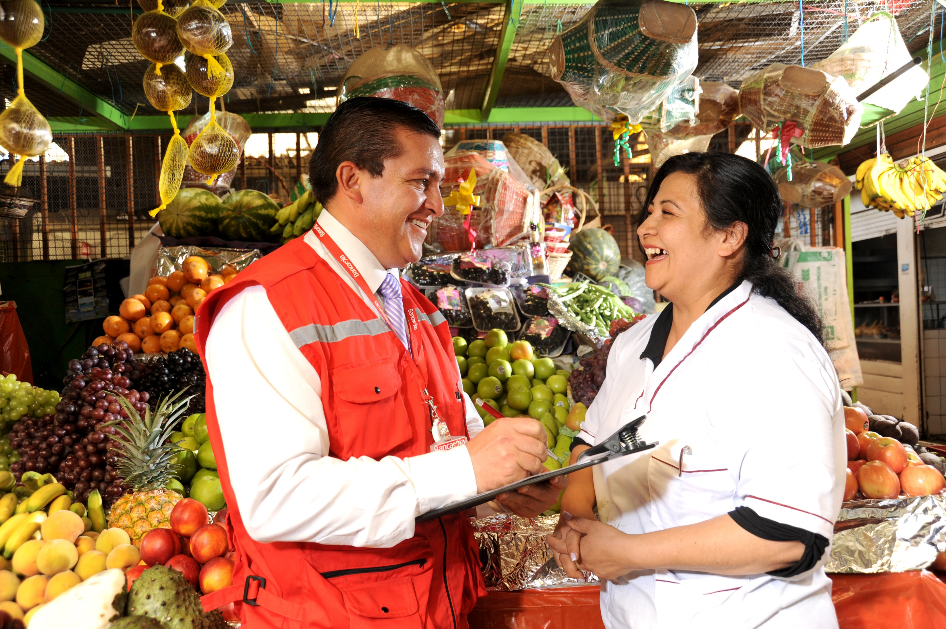

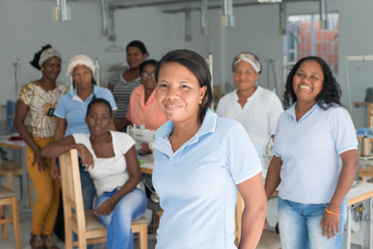

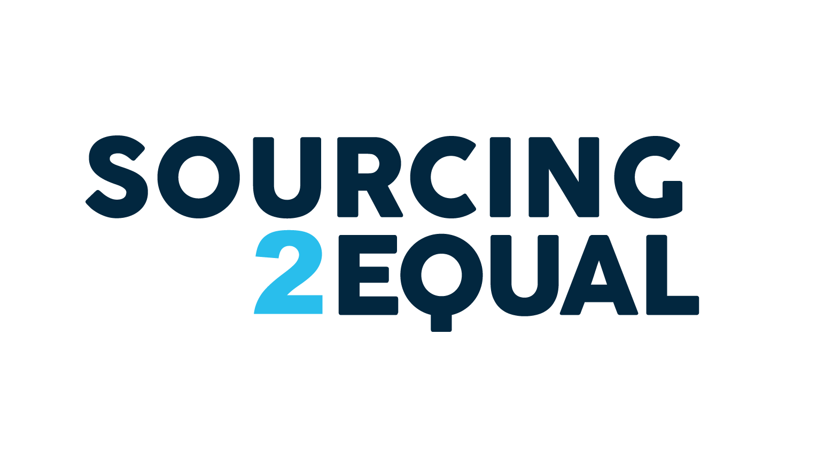
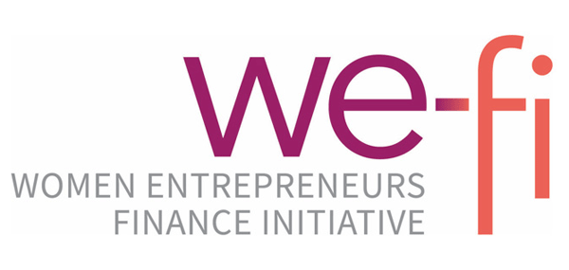


IFC
Sourcing2Equal
Global Program
We-Fi Knowledge
Exchange Forum
Marrakesh, Morocco
June 2023
IN PARTNERSHIP WITH:
Notes:
How we work with corporates
Through direct investments + PBIs, but it is hard
Programs like S2E

Slide 2





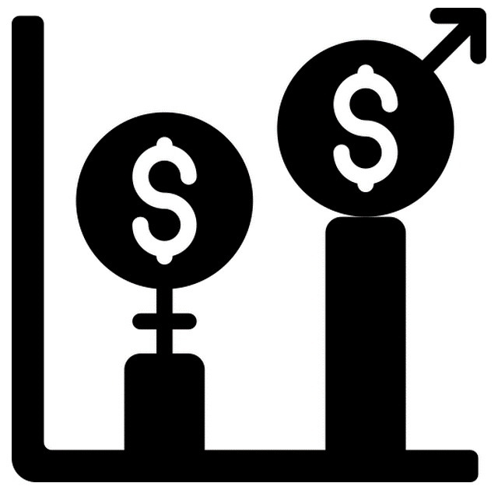



Overview of IFC’s Sourcing2Equal Global Program
OBJECTIVE
PROGRAM ACTIVITIES
Market Research
Corporate Buyer Peer Learning and Advisory
Supply Chain Finance Solutions
Capacity Building Women Entrepreneurs
  Sourcing2Equal aims to increase access to markets for thousands of women entrepreneurs through private sector procurement opportunities.
THE NEED FOR INTERVENTION
  Large corporations and governments spend less than 1% of their procurement budget on women-owned/led businesses (WOBs) (WEConnect International, 2017)
BUSINESS CASE FOR CORPORATES
  Alignment with Corporate Sustainability Strategy
  Innovation & Alignment with Customer Needs
  Brand Recognition
  Reduced Supply Chain Risks
2
Notes:
MaxAB

Slide 3


Achievements and Progress to Date
Market Research
Building the business case and best practices for Buyers:
Engaged over 350 unique Buyers in awareness raising events and best practice sessions across 14 countries.
Published 4 learning briefs on strategies to increase WSME access to corporate procurement.
Assessed the procurement gap and needs in Kenya to inform S2E Kenya country program. Assessment is underway in Colombia.
Partnered with global knowledge partners such as Accenture, WEConnect International (WEC), and the Women's Forum.
Finalized global research. Surveyed 240 companies on buyers’ best practices, across 6 sectors and 4 countries. Findings to be shared in 2023.
Corporate Buyer Peer Learning and Advisory
Building the Capacity of corporates to increase sourcing from women entrepreneurs:
Launched country programs in Kenya and Colombia, and supported companies in Mexico and Nigeria.
26 Corporates have made commitments to advance gender-inclusive sourcing.
Developed and tested IFC’s Corporate Diagnostic tool to assess gaps and opportunities to increase sourcing from WSMEs, and to develop an action plan.
Established partnerships with local implementing stakeholders including Chamber of Commerce of Cali and Bogota, Invest in Africa Kenya, Organization of Women in International Trade, UN Global Compact (UNGC), UN Women, and WEC Kenya.
Capacity Building for Women Entrepreneurs
Addressing constraints women entrepreneurs face to access contracts:
Supporting ~230 WSMEs and connected ~30 with contracts.
Capturing success stories from WSMEs.
Delivered 8 WSME trainings in Kenya, including 1 in Brazil in partnership with Microsoft.
Delivered 3 Buyer-WSME supplier matchmaking events in Kenya, in partnership with UNGC and WEC.
Supply Chain Finance (SCF) Solutions
Established the business case for gender and SCF.
Identifying potential partnership with large global bank and Kenya S2E Corporates to pilot a SCF solution for WSMEs.
Assessing KPIs for sustainability-linked investments on supplier diversity programs and increased spend on women suppliers.
3
Notes:
250 from We-Fi, but app the same amount from other Sources
Learning briefs: country specific (Kenya, Bangladesh) + all around Barriers and Approaches to Increase Access to Markets for Women-Owned Businesses
Preparatory work for country pilots
Global research – ongoing, based on survey of 240 companies. Best practices etc.
Capacity building for WSMEs:
230 WSMEs received support, and 30 – connected to buyer contracts
Matchmaking events
Training delivery – Kenya, Brazil (incl. Microsoft)
Buyers
Lenya and Colombia
26 corporates made commitments to advance gender inclusive sourcing
Corporates Diagnostic tool: IFC’s Sourcing2Equal Diagnostic Tool supports companies to identify gaps and opportunities to increase procurement spend with WSME suppliers by analyzing the company’s supplier base and procurement operations and policies. The Tool analysis quantitative and qualitative data, and presents how a company performs across eight pillars
Commitments are around mapping the supplier base, putting in place a policy and strategy, defining targets, making internal awareness, etc...
Everyone who is part of the PEP need to make commitments: there are 11 in Kenya, 15 in Colombia and we also had other PLPs in Mexico and Nigeria with companies making gender inclusive sourcing commitments
There is also an impact indicators on increase in # contracts and spend by project but we will know number at the end of the respective country programs

Slide 4
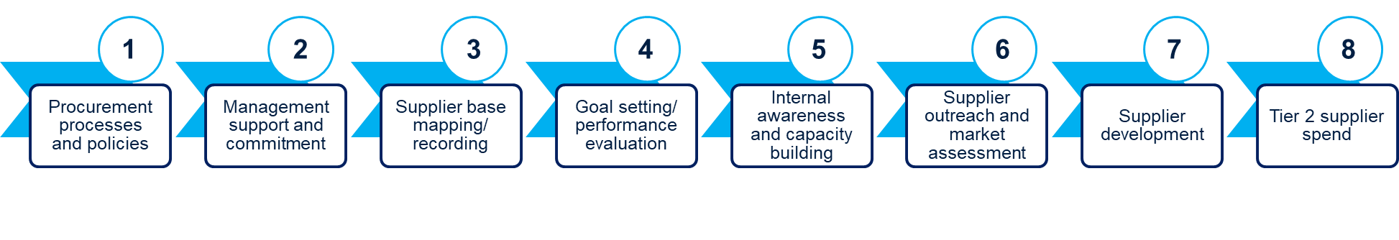

Slide 5



Lessons Learned
Data Gaps
Supplier sex-disaggregated data is key to understand gender gaps and inform corporate inclusive procurement strategy, targets, and operations. Data availability is limited and takes time to collect. IFC S2E Diagnostic tool supports this data collection.
The impact of corporate efforts to increase gender-inclusive sourcing is difficult to measure. Lack of impact evaluations. IFC research and S2E Diagnostic tool provides guidance to corporates. IFC exploring an evaluation in Colombia with WBG economists.
IFC and We-Fi WSME definition must be adapted to the reality of each sector, the role women play in it, and country-level definitions. IFC clients use different definitions, and many align with country definitions.
Lack of a unified WSME database at country level makes it difficult for Buyers to identify WSME suppliers. Most data bases have lists that are incomplete, outdated, and are majority micro-size businesses.
Awareness and capacity building
Topic is relatively new to emerging markets. Concerted efforts are needed to raise market level awareness of business case and best practices. IFC roundtables, best practice sessions, and research sparks corporate interest.
Multiple departments within Corporates must be engaged to gain management and internal support, which is key for success. IFC S2E Diagnostic tool provides a mechanism for procurement teams to raise internal awareness and get management buy-in.
Subject matter expertise on supplier diversity including gender-inclusive sourcing is scarce in emerging markets. It is key to build the capacity of partners and vendors to advance/implement commitments. IFC partners with and builds the capacity of local organizations to support program implementation with the goal of sustainability.
Linkage to investment opportunity
SCF solutions that can address WSME specific needs are in demand. IFC research in Kenya revealed there is a market opportunity for SCF, but few products tailored to WSMEs. SCF initiatives that support WSMEs, such Citibank in Kenya, or eFactor Network in Mexico, can be scaled.
There is an emerging traction to link sustainability-linked finance solutions with targets for gender-inclusive sourcing. This is an emerging area, and IFC is assessing KPIs for sustainability-linked investments on supplier diversity programs and increased spend on women entrepreneurs.
Notes:
IFC’s Sourcing2Equal Diagnostic Tool supports companies to identify gaps and opportunities to increase procurement spend with WSME suppliers by analyzing the company’s supplier base and procurement operations and policies.
The Tool analysis quantitative and qualitative data, and presents how a company performs across eight pillars:

Slide 6
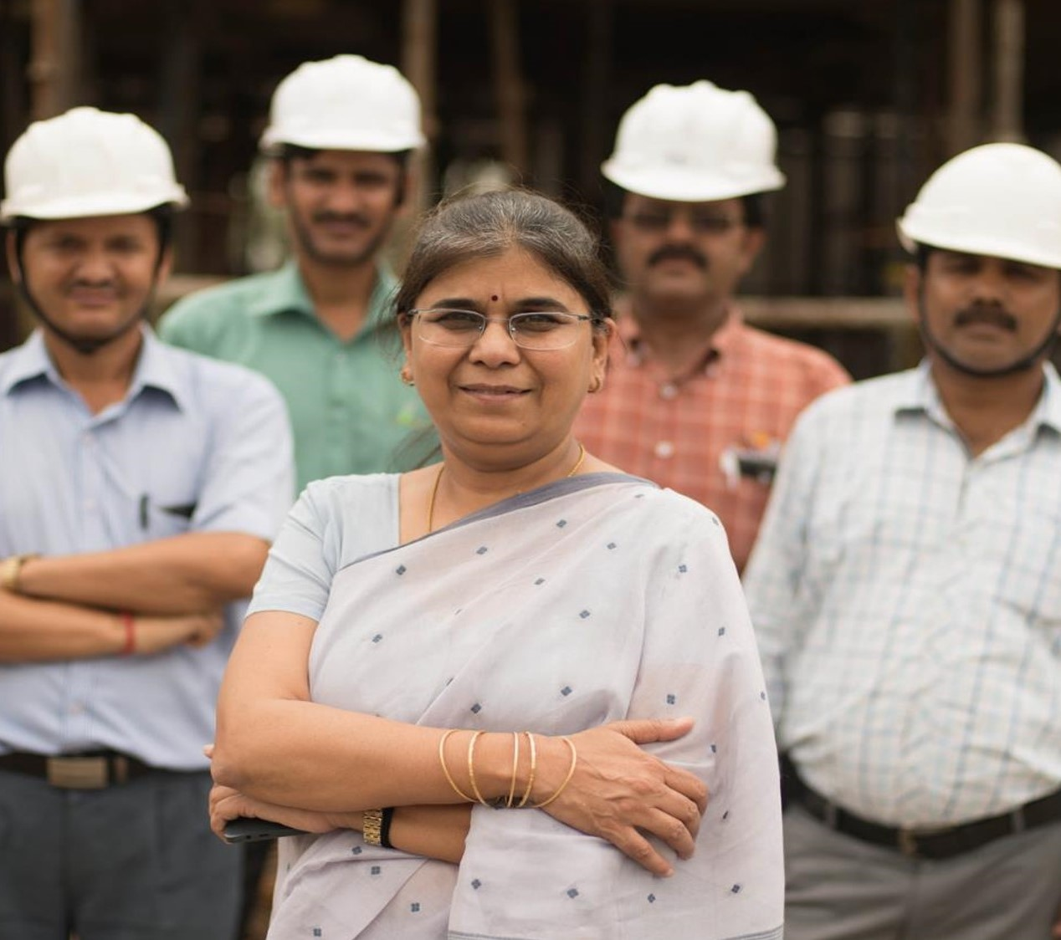
ANNEX
Example of work delivered

Slide 7
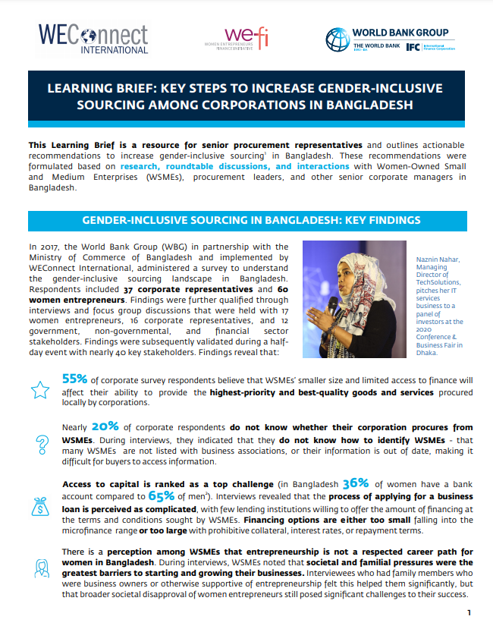
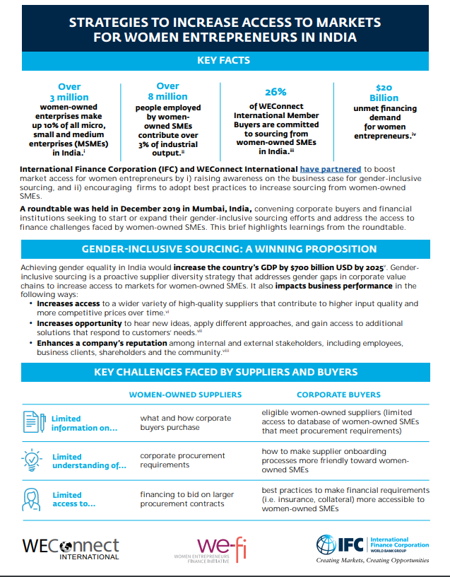
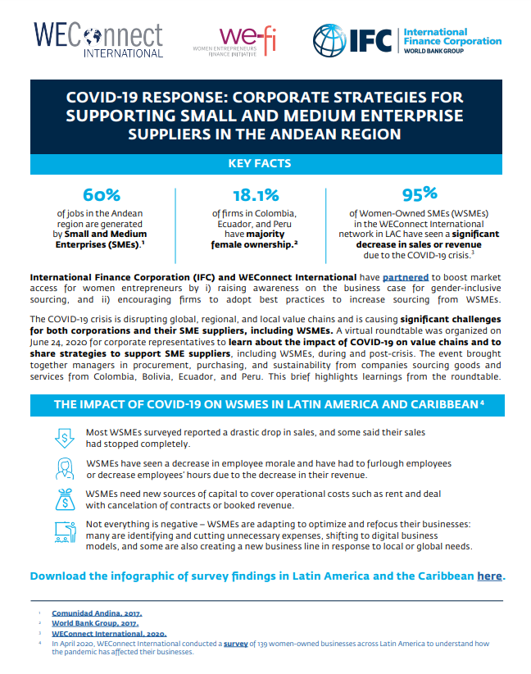
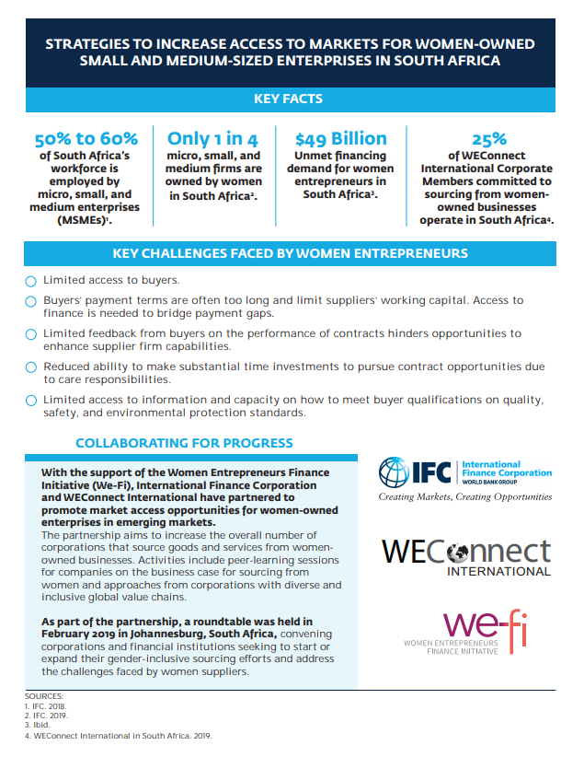
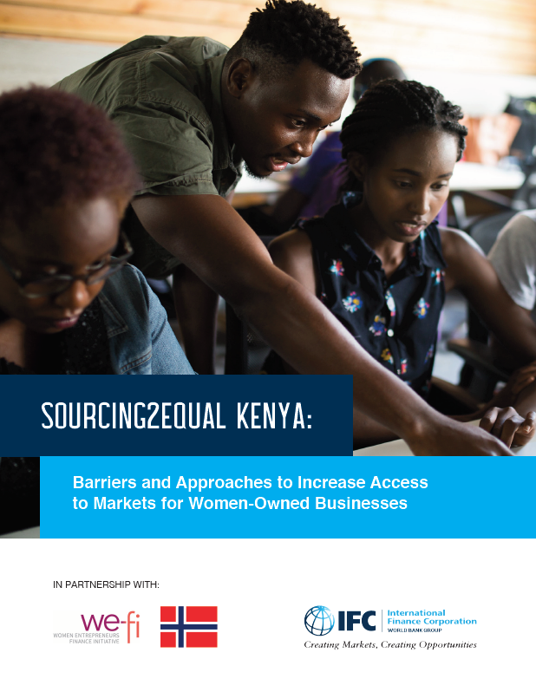
Country Level Research And Knowledge Products
  Sourcing2Equal Kenya: Barriers and Approaches to Increase Access to Markets for Women-Owned Businesses (June 2021)
  COVID-19 Response: Corporate Strategies for Supporting Small and Medium Enterprise Suppliers in the LAC-Andean Region (June 2020)
  Key Steps to Increase Gender Inclusive Sourcing Among Corporations in Bangladesh (February 2020)
  Strategies to Increase Access to Markets for Women Entrepreneurs in India (December 2019)
  Strategies to Increase Access to Markets for Women-Owned Small and Medium Size Enterprises in South Africa (February 2019)
  Coming Soon!
  Country research in Colombia
  Global research - Harnessing Procurement Opportunities with Women Entrepreneurs in Emerging Markets (Q3/Q4 2023)

Slide 8






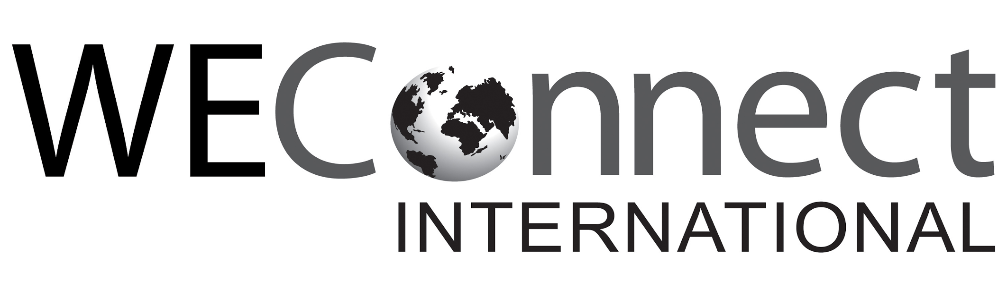
Sourcing2Equal Global Research – Harnessing Procurement Opportunities with Women Entrepreneurs in Emerging Markets
The research seeks to answer: How can private sector companies build inclusive supply chains?
Key Research Questions
Gender gap: How gender diverse is the procurement spend of private sector companies in emerging markets?
Challenges: What are the key barriers Buyers face in boosting gender diversity in procurement?
Opportunities: What are the benefits for companies that advance gender-inclusive sourcing?
Practices: What practices do Buyers have in place to implement gender-inclusive sourcing?
Outlook: How might spend with WOBs increase if more companies adopt gender-inclusive supplier diversity practices ?
Recommendations: What steps can Buyers and other key stakeholders including financial intermediaries and governments take to advance gender-inclusive sourcing ?
Focus Countries
Focus Sectors
Bangladesh
Colombia
Indonesia
Mexico
Nigeria
Türkiye
Agribusiness
Financial Services
Manufacturing
Retail and Distribution
Key Research Methodology
Desktop Research
Case Study Interviews
(11 companies, 5 financial intermediaries, 4 Public policy experts)
Survey with private sector companies
(Received 240 responses)
Outlook analysis on spend with WOBs
IN PARTNERSHIP WITH:
Stay Tuned!
The report will be launched in Q3 2023!

Slide 9
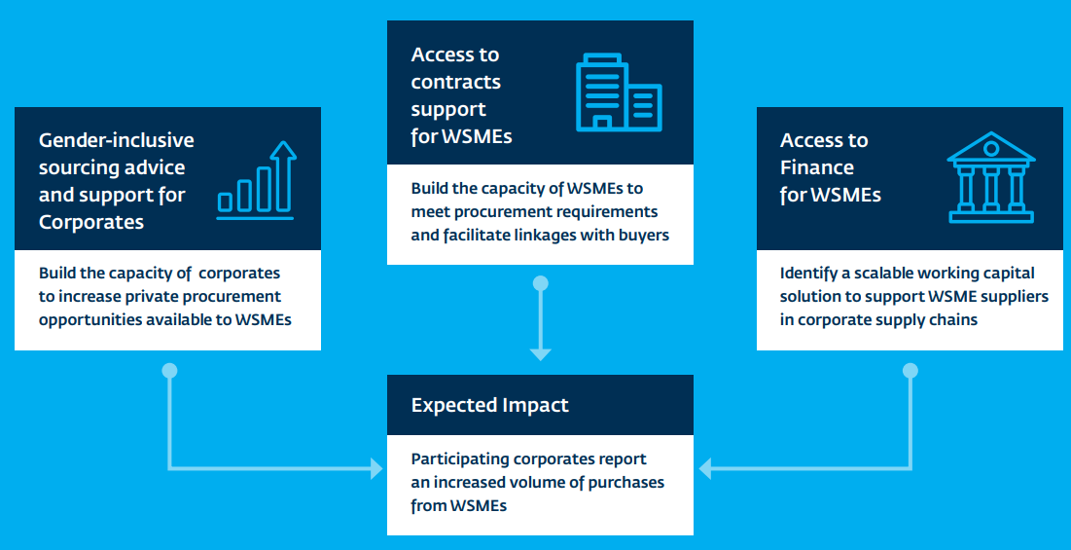
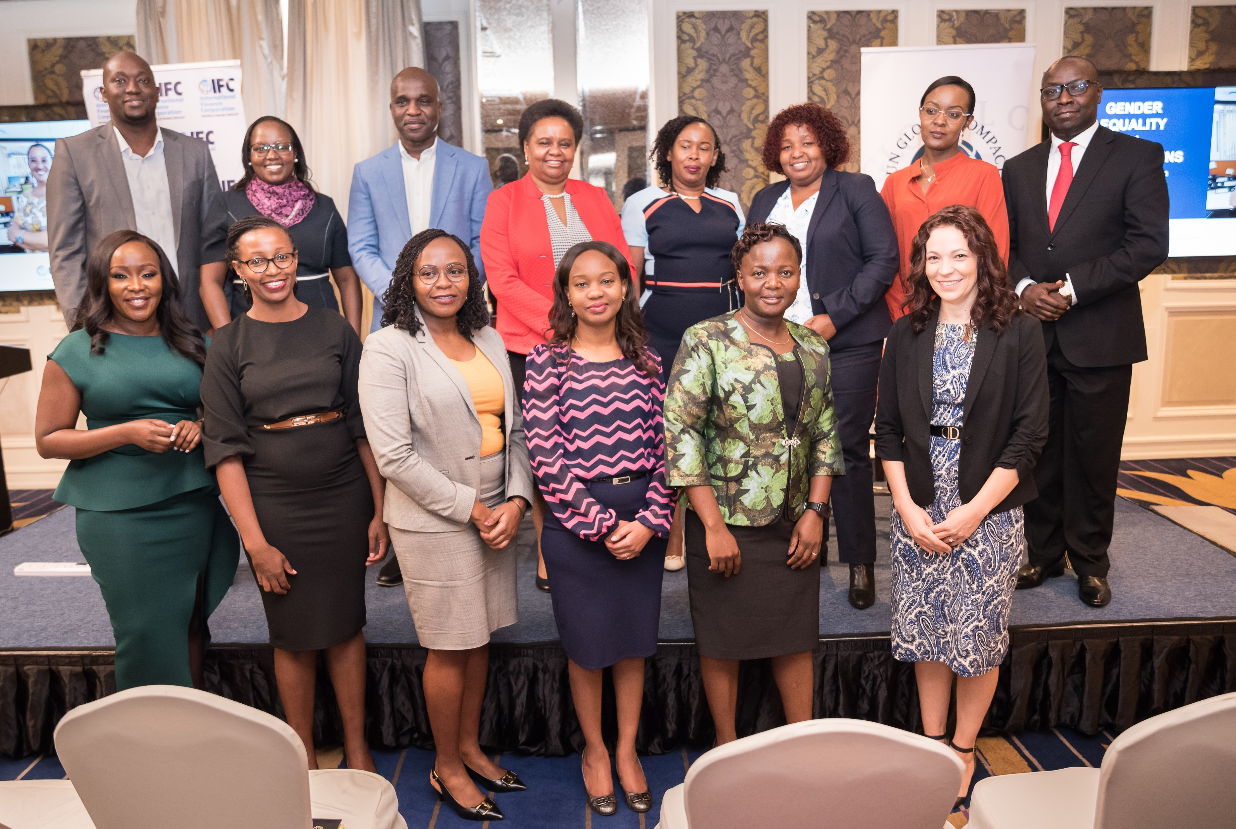
County Program Example: Sourcing2Equal Kenya
Gender Equality in Supply Chains Forum
(September 29, 2022, Nairobi )
Sourcing2Equal Kenya project components:
“We set targets to increase sourcing from women-owned businesses because we believe it's good for business, good for economic development, and it builds a stronger equitable society” by Luck Ochieng, Kenya's Managing Director, Unilever (member of IFC Kenya Sourcing2Equal Program)
“I am having conversations with Buyers in Kenya (Absa Bank, Bamburi Cement, HFC). I’m so glad you introduced us to them. Thanks a million for Sourcing2Equal.” by a female entrepreneur in Kenya.

Slide 10
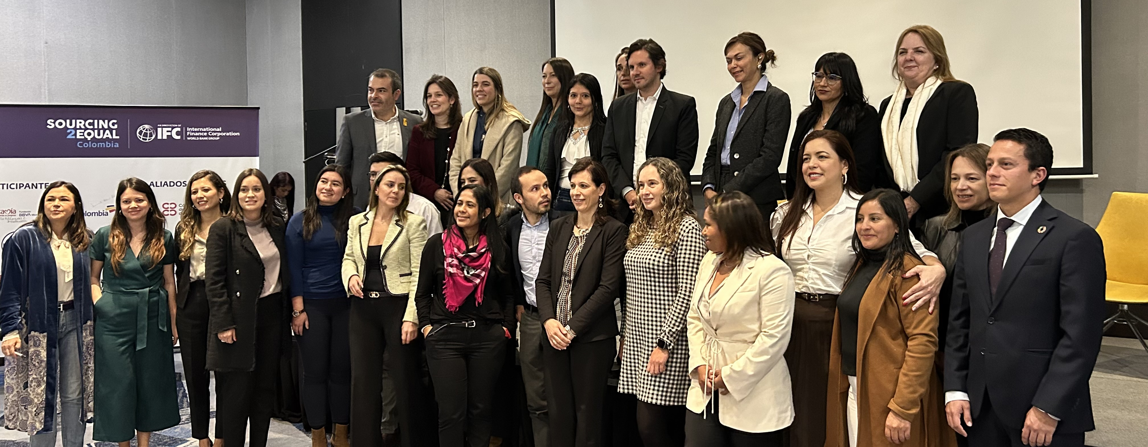


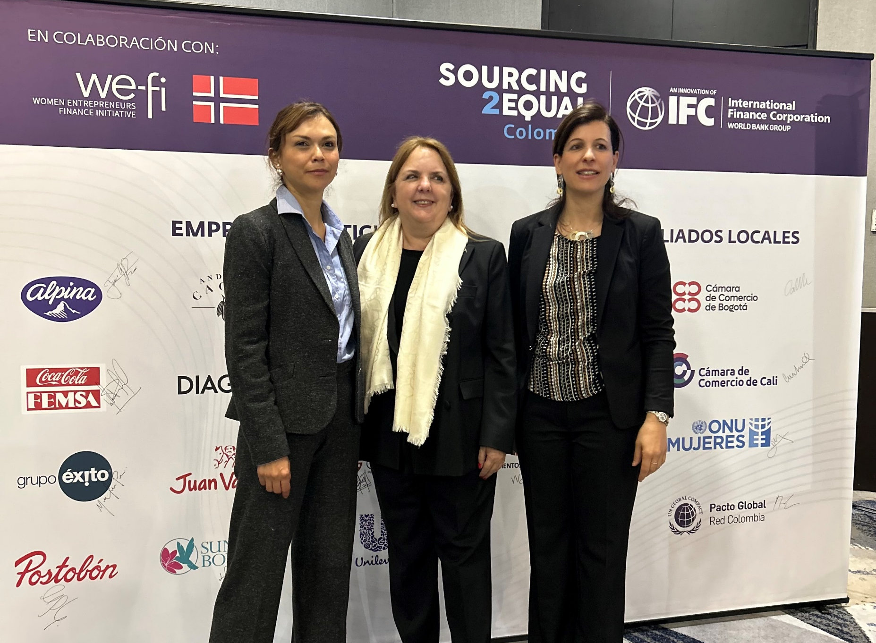
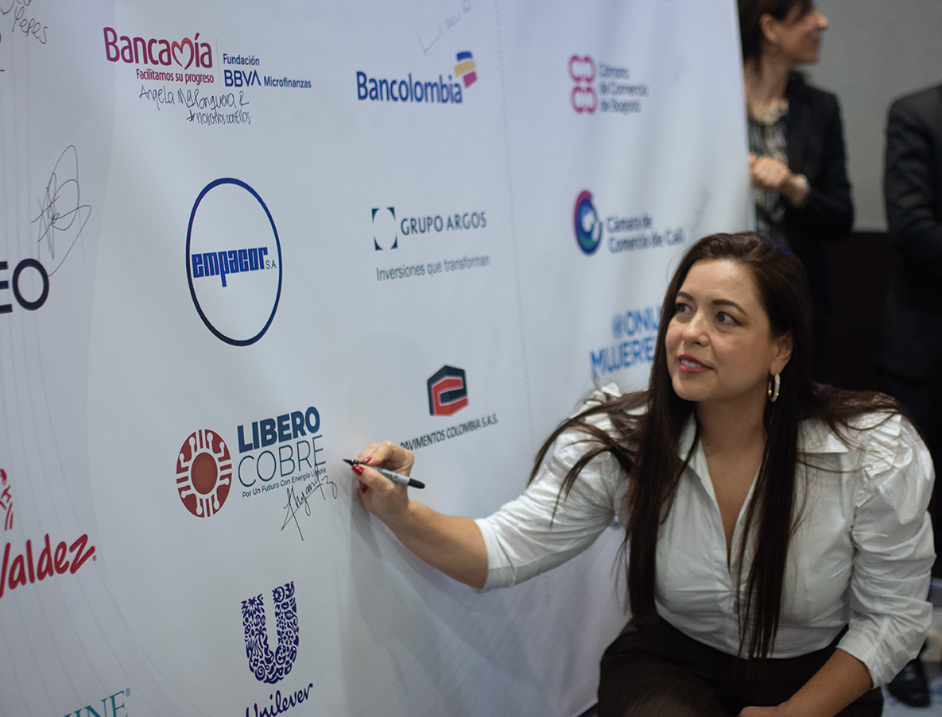
Country Program Example: Sourcing2Equal Colombia
Program Launch
(April 27, 2023, Bogota)
Sourcing2Equal Colombia project components:
  Buyers
  WSMEs
Buyer- Supplier
CONNEXIONS
Peer learning and
advisory services
Capacity Building
Increase volume of purchases from WSMEs
“I am convinced that the resources we put in the hands of women multiply as well-being opportunities for their communities. For this reason, we have joined Sourcing2Equal Colombia. This is not a complex issue. This is a matter of will.” Maria Isabel Acosta, Director of Diversity, Equity and Inclusion at Bancolombia
“I will only ask two things. The ones that Libero Cobre gave to me: to give us the opportunity and to support us along the journey, especially regarding the tendering paperwork, which can be challenging”. Magali Rodriguez, Director and Founder, Diverso Mocoa (WSME)

Slide 11
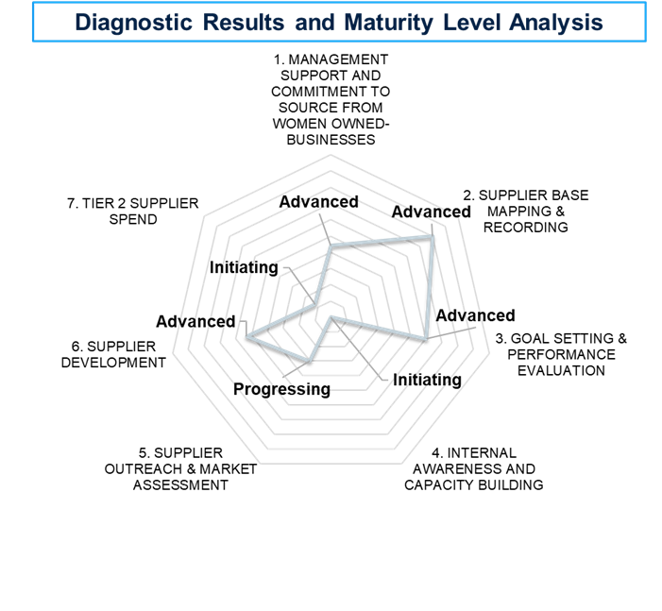

Firm Level Advisory Service - Sourcing2Equal Diagnostic Tool
IFC’s Sourcing2Equal Diagnostic Tool supports companies to identify gaps and opportunities to increase procurement spend with WSME suppliers by analyzing the company’s supplier base and procurement operations and policies.
The Tool analysis quantitative and qualitative data, and presents how a company performs across eight pillars:
ILLUSTRATIVE EXAMPLE
RESULTS OF THE ASSESSMENT
The company will receive a Report that will include:
Findings and recommendations to advance gender-inclusive sourcing under each diagnostic pillar.
Maturity Level Analysis (MLA) that assesses the company’s current level of efforts to increase sourcing from WSMEs (initiating, progressing, advanced and leading edge).
Diagnostic chart visually presenting how a company performs at each pillar of the assessment based on the MLA.
The assessment culminates with an Action Planning Workshop to discuss the results and the next steps.

Slide 12

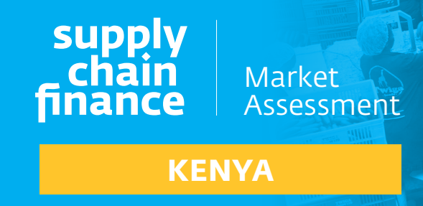




Access to Finance and Investment Linkages
EXPAND ACCESS TO FINANCE FOR WSME SUPPLIERS THROUGH SUPPLY CHAIN FINANCE (SCF)
Progress:
    Built a business case for gender and SCF
    Presented gender inclusive supply chain finance at IFC SCF workshop in Kenya
    Engaged with 10 banks on gender SCF
WSMEs
$2.7B financing gap among WSME in Kenya
WSMEs need SCF to secure and deliver contracts (S2E Kenya research)
What’s next:
    Provide training on SCF to WSMEs
    Pilot SCF solution with a client
    Integrate gender into SCF investment
SCF market size in Kenya is KES 2.8 trillion ($24.8 billion)
Integrate Gender into Supply Chain Offering
Buyers
Financial Intermediaries
‘SCF helped us grow our business but need more solutions tailored to the needs of WSMEs’.
Looking to SCF to solve payment term mismatches across value chains
Largely satisfied with SCF
Many FIs/NBFI players have begun to offer SCF to SMEs but very few SCF products targeted for WSMEs

Slide 13
Contacts:
June 29, 2021
Heather Kipnis
Global Product Lead, Gender ad Economic Inclusion Group, IFC
hkipnis@ifc.org
Anna Domingo
Sourcing2Equal Program Lead, Gender ad Economic Inclusion Group, IFC
adomingoriu@ifc.org

