Slide 1
Using Blended Finance Instruments to Catalyze Finance for WSMEs
IDB Invest Experience and Lessons Learned with We-Fi

Slide 2
Our Track Record in Managing Partners’ Resources
IDB Invest is the partner of choice for channeling blended finance and technical cooperation resources for Latin America and the Caribbean.
>30%
of blended finance resources in LAC¹ channeled through IDB Invest²
>90%
Of IDB Invest transaction with Financial Institutions have Advisory Support
18
blended finance funds and programs under management
86
blended finance investments closed
$6.3
billion of investment leveraged through blended finance
>$9
of investments mobilized for $1 of partner’ resources
Our Partners
Figures as of April 30th, 2023. 1: Latin America and the Caribbean. 2: DFIs Working Group for Blended Finance and Convergence Blended Finance. Market shares vary from 30% to 50% depending on the year or the definition of blended finance that is applied.
Notes:
Key message

Slide 3
Women Entrepreneurs Finance Initiative
Objective
Promote the growth of Women-owned/led SMEs (WSMEs) by improving access to finance and markets
Fund’s achievements
Projects highlights
Performance Based Incentives (PBIs) and Advisory Services
 | Over US$ 4 million committed to 8 blended finance transactions in 6 countries combined with Advisory Services
 | Blended Finance and Advisory Services expected to benefit over 63,500 WSMEs
 | Mobilization of more than US$379 million in additional resources towards promoting access to finance and markets for WSMEs
 | Supporting Ecuador’s first gender bond issuance to finance the growth of women-owned/led MSME¹ portfolios (Pichincha Gender Bond)
 | Improving access to finance for under-served women-owned/led SMEs in Mexico through Fintech (Kubo Financiero)
 | Expanding access to finance and agricultural inputs for women-owned/led SMEs in Ecuador (Agripac)
US$ 12.7 million
(US$ 4.8 Million in PBIs for BF)
(US$ 7.9 million for Advisory)
Year: 2018
1: Micro, Small and Medium-sized enterprises.

Slide 4
Combining Three Areas of Interventions with We-Fi Support
Capacity building, market-level studies and dialogues, inform the design of blended finance incentives
IDB Invest financing (loans and social bonds)
Performance based-incentives (qualitative and quantitative milestones)
Financing
Advisory
Blended Finance

Slide 5
Blended Finance Investment Stages
1. Client Engagement
Blended Finance (BF) joins transaction team to begin engagement with client on We-Fi opportunity
2. Eligibility
Institutional and portfolio level information is analyzed by BF team to determine eligibility and alignment under We-Fi
3. Structuring
BF team defines incentive sizing and targets.
4. Negotiation
BF and project team negotiate client acceptance of targets and PBI structure
5. Blended Finance Assessment
Compiles challenges as result of market failures, rationale for We-Fi investment and negotiated PBI structure
6. Transaction Approval
By the Board of Directors (BoD) or any other instance delegated by the BoD which also approves We-Fi investment
7. Incorporation of We-Fi PBIs in legal docs
We-Fi PBI annexes and schedules included in transaction’s legal documentation
8. Target Monitoring and PBI disbursement
Client reports on targets every Fiscal Year. Reporting years contingent on transaction tenor

Slide 6
PBIs Design Considerations
Regional and national context of WSMEs access to finance and markets
Client size and portfolio baseline
Client systems capabilities to produce portfolio and/or market level data
Transaction benchmarking

Slide 7
We-Fi Incentive General Reporting Process
Total incentive divided into [equal] annual payments
Reporting period is aligned with the end of the fiscal year and IDB Invest’s impact reporting period, which is usually Feb 15th of each year.
Clients submits a certificate of compliance by Feb 15th. No audits required.
Deadline for incentive disbursement by IDB Invest is May 15 [or [45] days after receipt of required certificate of compliance].
Incentive is cumulative. If the client does not achieve the expected result by the agreed year, but achieves it in the following year, the annual amount corresponding to both years incentive will be paid.
If milestones are achieved ahead of time, we’ll only disbursed the amount committed for that particular year.

Slide 8
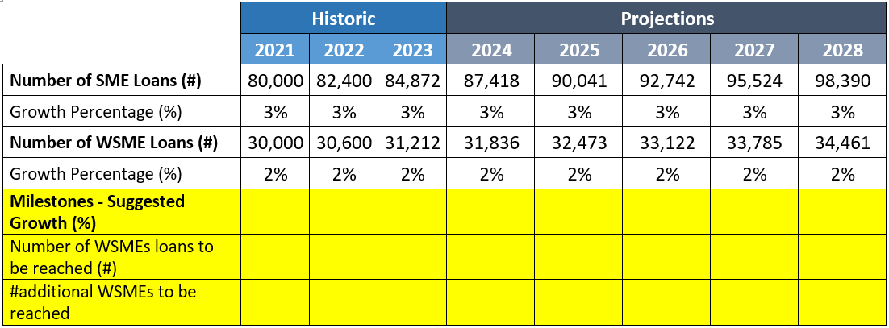
Case Study - Commercial Bank of Meta (CBM) - Colombia
Assumptions:
Ops Cost of managing an additional WSME -> US$500
Bank X, operates in the same city is growing 15% SME and 10% WSME.
Bank Y, operates in rural areas in Colombia and is growing 8% SME and 1%WSME.

Slide 9
Step-by-Step
Agree on the baseline and projections based on WeFi definition.
Understand the regional and national context of WSMEs access to finance and markets.
Benchmarking
Negotiate with the client the annual % growth of the WSME portfolio.
Calculate absolute numbers
Calculate the additional WSMEs the bank will reach, beyond the projected
Incentive sizing: agree with the Client on a metric. Could be direct or proxy.

Slide 10
B. Lessons Learned
Notes:
Change tittle – to the exact name of Allianz

Slide 11
Lessons Learned from We-Fi Deployment
PBI Design
Concessionality
Implementation Challenges
1
2
3
Data management pre-advisory (e.g. gender disaggregation)
Adapting PBI design over the life of the transaction based on return of experience
Absolute targets (increase in # of WSMEs) vs. relative targets (increase in % of WSMEs relative to portfolio)
Use of thematic Sub-PBIs / Sub- Milestones (e.g. indigenous population, migrants, or other minorities)
Project preparation – data baseline.
Lower baseline requires higher subsidy per unit
Corporate client access to market interventions require higher subsidies per unit
Cumulative incentive payments
Interpretation of US$5,000 sub loan floor (e.g. multiple loans exceeding the floor?). National definition of WSMEs vs. We-Fi definition.
Share of mobilization attributable to We-Fi in corporate clients
#/US$ of Loans vs. # WSMEs
Adapting gender strategy to external disruption (e.g. pandemic, macro issues, financial system)
Notes:
Systems can track the data – Corp and Fis.
Extend advisory to do
Adapt the contract baseline can change.
Em[hasize absolute targets.
Concessionality: the grant element of the tranch. We are giving more $ for some client or other. Not all have the same level of subsidy.
Issue is 5k-> why 5k, in some of our markets is very low floor, for client consider pyme, and in other markets it might be too high.

Slide 12
Let’s continue the conversation Matthieu Pegon Head, Blended Finance matthieup@idbinvest.org
www.idbinvest.org
www.idbinvest.org/linkedin
www.idbinvest.org/twitter
www.idbinvest.org/facebook
Blog - www.idbinvest.org/blog

