Slide 1


IDB Invest – GDI Advisory Services
Strategy for connecting WSMEs with corporates

Slide 2


IDB Group Approach towards Inclusive Value Chains
Demand: WSMEs
And SMEs
Supply: Anchor Companies

Slide 3

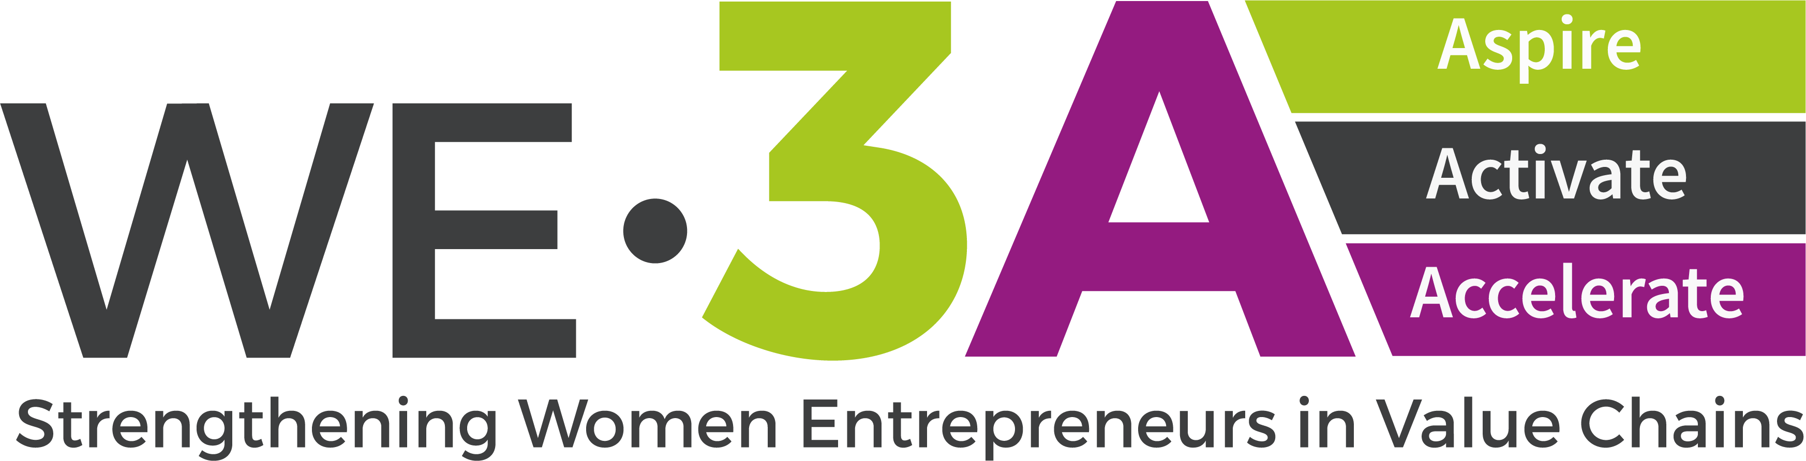







IDB Lab
COMPONENTS
RESULTS
COMPONENTS
OBJECTIVES
Aspire: Reduces gender biases of women, communities, and markets. Offers training to corporations.
Over 380.000 people have seen inspiring videos of WSMEs.
Over 190 representatives of corporations and financial sector trained
Knowledge: Develop capabilities in digital technologies, adoption of sustainable practices, and mproved business performance.
4000 beneficiaries
Market Linkages: Connect WSMEs to new markets and
satisfy corporate demand for diverse suppliers.
480 WSMEs with new market connections
Activate: Offers capacity building to WSMEs to create a business plan; access to finance; be part of value chains; pitch de product/service etc
Over 2000 women registered
Over 800 women graduated
Access to Finance: Mobilize capital from allies to support WSMEs
148 WSMEs with new access to finance
Accelerate: 6 month accelerator program for WSMEs to create a growth plan and be certified as WSME.
Over 30 women enrolled
1 Demo Day
Information Exchange Platform: strengthen WSMEs negotiation power through their data.
17 partners with links through the platform
Notes:
BARRIERS:
WE3A (IDB Lab)
WSMEs who could sell to corporations lack basic digital practices, such as revising emails and responding on time. There is a culture of communicating through Whatsapp or informal communication that could be the first barrier for maintaining a business relationship with bigger corporations.
In rural areas, to sell to corporations, WSMEs need to be part of a cooperative, for which they need specific support.
WeCount (IDB Lab):
focus groups with corporates have shown that traditional market actors seem to have diverse, and at times, unscalable ways of evaluating SMEs for their value chain.
Processes can range from being fully manual and owned by one person, to having multiple departments engaged with conditions that may be interpreted as detrimental by WSMEs
When asked to prioritize which barriers were more relevant to establishing higher-value business partnerships, corporations selected the following: 1) low levels of formalization and data collection and 2) little to no familiarity with technology tools that could enable them to better register and track their business transactional data and that could support internal processes standardization

Slide 4
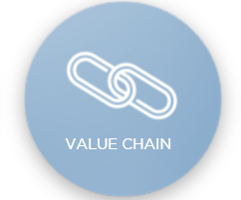








Supporting clients to create more inclusive and sustainable value chains by increasing the # of diverse providers in their supply and distribution chain
KEY STEPS:
Identifying the business opportunity on their markets, industry sector and purchasing key categories
Guidelines on suppliers’ data base segmentation by sex (and/or race/ethnicity, others)
Support on new diverse suppliers' identification/attraction
Support on the development of supplier diversity & inclusion programs (program design, metrics, KPIs, policies, etc.)
Procurement policies reviews and improvement recommendations
Trainings for procurement team and key internal clients
Key lever to mainstream diversity

Slide 5
IDB Invest – Elcatex Deep Dive
Working with corporates: expanding corporate supplier networks to include WSMEs

Slide 6








Promoting Women Owned/Led SME growth through the supply chain of manufacture companies in Honduras.
Elcatex
Advisory:
Inclusive and diverse value chains by integrating WSMEs into the value chain
Challenge
Grupo Elcatex is a textile company that produces over 120 million pieces of clothing in a year. Today, the company is the market leader in Honduras with an annual production of 85 million pounds of fabric and generation of 7,000 direct jobs impacting 18,000 people. To date, only 5% of the total products and services are sourced from Women Owned/Led SMEs (WSMEs). The company has identified the opportunity to work with IDB Invest to support them in the process of onboarding and integrating more women-owned/led business into their supply chain.
Investment Summary
Solution
IDB Invest is supporting Elcatex in the diversification of their value chain by developing a strategy to increase the number of WSMEs suppliers which includes (i) disaggregation of their tracking system; (ii) recommendations to improve the onboarding process and procurement policies; and (iii) creating partnerships and training top management and the procurement teams on gender-sensitive sourcing. IDB Invest is also incentivizing Elcatex to achieve annual targets for the increase of WSMEs in their supply chain through the use of gender-based Performance-Based Incentives. These incentives amount to up to US$210,000 in We-Fi¹ funds.
Client: San Juan Textiles
Country: Honduras
Results
By the end of the transaction, in 2027, Elcatex is expected to increase the number of WSMEs suppliers from 5% to 24%, this is equivalent to sourcing from a total of 155 WSME providers, and/or to increase the volume of purchases from 16% to 40%, which is equivalent to US$ 5.6 million.
Financing: US$96 million
AS: $140,000
Year: 2020
1: Women’s Entrepreneurship Finance Initiative Fund I 2: Performance-Based Incentives

Slide 7
Group Exercise:
Have your Post-its ready
Group by tables and discuss challenges to promote inclusive procurement for WSMEs in your contexts
  Internal Barriers
  External Barriers
Group them by topics

Slide 8
Lessons Learned from the Advisory Service
Value chain assessment: The first step to integrate female suppliers into the supply chain is to perform a thorough assessment of the existing supply chain to define a correct baseline
Supplier database: It is essential to develop a unified database to manage suppliers.
Business case, commitment and communication: A study by Hackett Group discovered that companies with a more diverse supplier base usually achieved higher customer satisfaction rates.
Capacity building and training: The procurement team needs to be trained to work with female suppliers and to understand their role in the supply chain integration.
Focus on businesswomen: As a way of completing the cycle, relationship-building with female suppliers must be encouraged, making sure that they receive financing and technical assistance to continue growing their business and improving the quality of their products and services.
Financing and factoring: A common barrier for female suppliers is access to financing.
Value chain management: The role of the business managers and executives is crucial to lead all the staff in the right direction.
Tools: The tools that are currently available in the market are fundamental to connect with new businesswomen.
Incentives: A company must set clear goals and objectives to incentivize diverse supply.

Slide 9
Group Exercise:
Think of systematic solutions
What support can we offer to corporates to support their engagement with WSMEs?
What are we missing to achieve scale?

Slide 10
Thank you!
Laura Giraldo
GDI Officer at IDB Invest

