Slide 1
Women in Business Programme A direct and holistic approach to working with women-led MSMEs We-Fi Knowledge Exchange Forum 7 June 2023, Marrakech, Morocco

Slide 2
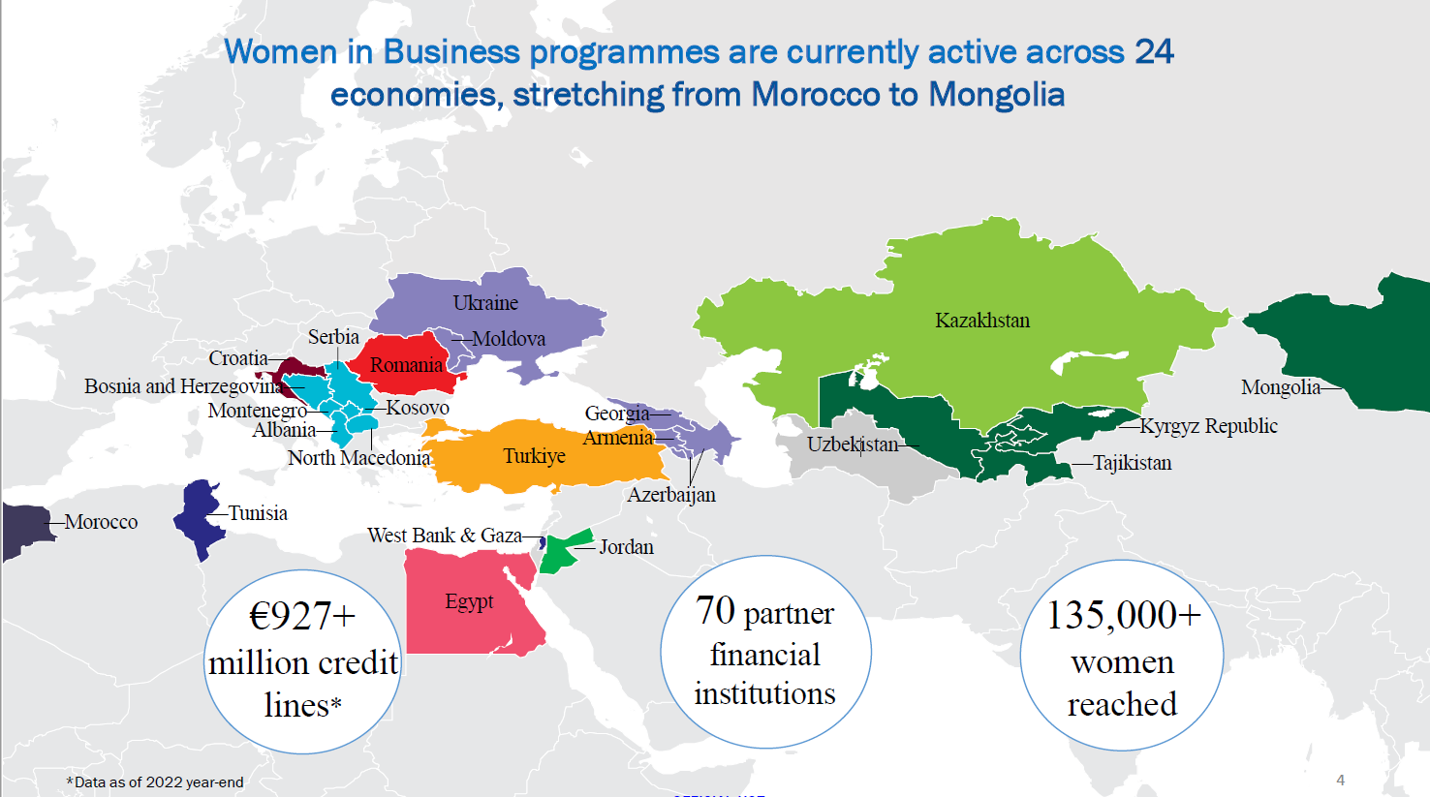
Women in Business globally

Slide 3
Empowering WSMEs to engage with corporate suppliers by providing direct access to financial and non-financial services
Global Women in Business Programme
WSMEs global portfolio: 50% small (10-49 employees), 25% micro (1-9). Medium-sized are the minority. Micro WSMEs are more easily reached via group advisory projects and close connection with local stakeholders.
Access to finance is crucial: partnering with local banks helps providing direct access to liquidity, however it's useful to work with a broader range of partner financial institutions (PFIs), including MFIs.
Non-financial assistance is provided by supporting their development in specific areas, such as: sales automation, website development, optimisation of business processes, development of e-commerce, ISOs --> stronger links to aggregators and markets
Central Asia We-fi supported Women in Business Programme
High PFI interest: despite current geopolitical events and rising cost of local currency funding, interest of PFIs in the region for the WIB remains high.
Awareness building: substantial efforts were made ahead of launching WiB to build awareness as well as make inroads with local communities of women entrepreneurs.
Close collaboration with local PFIs on trainings and outreach events, providing the EBRD with the means to increase awareness of We-Fi-funded capacity building support to more WSMEs (especially in rural locations and to sub-borrowers of We-Fi-supported credit lines).
Agribusiness focused: WSMEs in the region tend to concentrate significantly in the agribusiness sector, mainly as micro enterprises, smallholder farms, cooperatives.
Demand for digitally delivered trainings: especially on topics associated with digitalization; however, there are few platforms to make them accessible in the format (i.e., mobile) and language (i.e., Uzbek) of preference --> work with partners addressing these gaps.
Continued access to know-how: to Youth MSMEs via advisory, training, and networking. EBRD will seek close cooperation and joint delivery of such services with the PFIs with a view to maximise synergies between the finance and know-how component of the Programme.
Notes:
Main points to mention here:
WiB has evolved into a more "grassroots" programme, meaning that over the years it provided direct support to WSMEs, but increasingly via connecting with local associations and organisations. This was, it's easier to identify women-led SMEs and, at the same time, it showed that the prevalence of women entrepreneurs tend to be concentrated in the small and micro segments
Access to finance is crucial for businesses, both in the form of loans and grants. Unorthodox financial institutions (i.e. MFIs) provide credit which might be more convenient to access for micro SMEs, hence EBRD "opened" up to this type of institutions
To help WSMEs better connect with aggregators in the supply chains, non-financial services in the form of local consultancy projects are provided; in the past 1.5 years, a considerable increase of ICT projects (in the areas mentioned above), which makes it easier for SMEs to be integrated into supply chains
In Central Asia specifically, we observed a prevalence of WSMEs in the Agri sector - the EBRD, however, received guidance from the Governing Committee to prioritize supply chains attracting or with the capacity to incorporate non-micro WSMEs, which has unfortunately ruled out working with several willing partners (MORE ON NEXT SLIDE)

Slide 4
Non-Financial Services: EBRD's structure
Advisory and coaching projects
Business advice offered in a wide range of areas, to help WSMEs develop;
Completely bespoke projects, adapted to the needs and potential of each business;
EBRD support throughout project design and delivery process, to ensure relevance and value for money;
Access to EBRD network of pre-qualified consultants;
Costs are reimbursed through a grant as a % of the project cost
Online and in-person mentoring
Through an EBRD partnership, WSMEs can access MicroMentor, a mentoring platform with the world’s largest community of entrepreneurs and mentors;
Entrepreneurs can seek out sector or thematic experts to develop their professional skills, share experiences and get support during crises;
In each country, in-person mentoring sessions are organised with local partners (NGOs, associations, etc).
Online and in-person trainings
Interactive workshops led by experienced trainers, providing innovative tools to develop key leadership, financial and management skills;
Local trainers and adapted, relevant localised delivery;
Adapted for interactive digital delivery and in-person or hybrid delivery models;
Access to global learning solutions providers such as Coursera and LinkedIn Learning.
Building a network
Events, roundtables and more informal networking opportunities allowing women entrepreneurs to build a sustainable network;
Awareness-raising events, creating public awareness and promoting entrepreneurship as a viable employment opportunity for women;
200,000+ reach on social media platforms across countries;
Bringing role models of women entrepreneurs.
Programme value​ EUR 122 million
Notes:
Areas of advice are: Strategy, Engineering Solutions, Marketing, Quality Management, Organisation, Energy/Resource Efficiency, Operations, Environmental Management, ICT, Accounting and Financial Reporting.
Mentoring services are also offered in person through local NGOs, associations and organisations (i.e. Women's Forum Kurak in Kyrgyz Republic)
Mention that some of these activities are organised in partnership with PFIs
Main topics of trainings are: digital marketing, financial management, corporate governance, leadership, digital tools for SMEs

