Slide 1
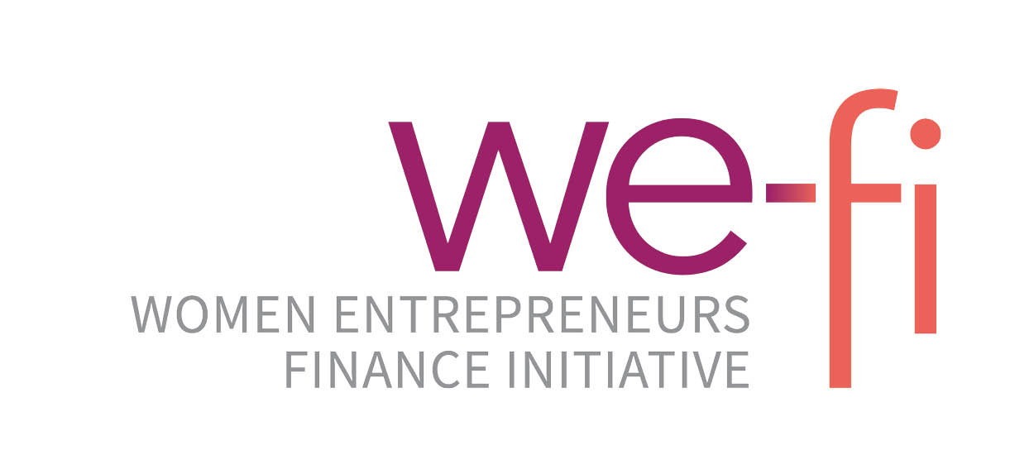
We-Fi Knowledge Exchange Forum Marrakesh, Morocco Day 1: Scaling Success A Forum For Implementation Partners To Share Strategies And Solutions

Slide 2
CompONENTS Component 1 – “Affirmative procurement reform” Regional policy dialogue; better (gender responsive) procurement policies and regulations; strengthened capacity of public sector to implement them; strengthened capacity of women-led businesses to access procurement; enhanced awareness of private sector about gender responsive supply chain practices; Component 2 –”Affirmative Procurement For COVID19 Response And Recovery” Increased Capacity Of Women-led Businesses To Operate In A Post-covid19 Economy
PROGRAM UNDER IMPLEMENTATION:
Women’s Economic Empowerment Through Affirmative Procurement Reform in West Africa
LOCATION
COTE D’IVOIRE
MALI
NIGERIA
SENEGAL
DURATION
March 2022-
March 2025
BUDGET
USD 4 millions
Funded by We-Fi through the African Development Bank
IMPLEMENTING PARTNER
UN WOMEN
targets •Enhance the capacity of 1360 women SMEs in Nigeria, Senegal, Mali, and Cote d’Ivoire to access procurement opportunities.
•Ensure that at least 400 women-owned/-led businesses can access new procurement opportunities in the four countries.
•Improve the understanding of 270 government officials on how to implement affirmative procurement reform.
•Adopt four legal/regulatory reforms that facilitate women-led businesses' access to procurement opportunities.

Slide 3
Women entrepreneurs access to markets via the public PROCUREMENT and private SUPPLY CHAINS

Slide 4
The case of Nigeria: focus on public procurement
Advocacy and awareness leading to behavioral change for public officials and Women Owned businesses. This led to the development of state-level action plans and the prioritization of affirmative procurement at the national level.
Institutional capacity-building for over 70 public officials and 200 women owned/led businesses, resulting in the development of feasible strategies for implementing affirmative procurement and the establishment of gender desks in procurement agencies.
Policy and regulatory reforms: inclusion of affirmative procurement as a key accelerator in Nigeria’s National Policy on Women Economic Empowerment. At the state level, action plans and policy initiatives are being developed to incorporate gender-responsive clauses in procurement guidelines and regulations.
Data collection and research on procurement legal and policy framework, including baseline dataset allowing for evidence-based policy recommendations and advocacy.

Slide 5
The case of Nigeria: focus on supply chains
Collaboration between UN Women key private sector partners and allies to successfully increased the adoption of Women's Empowerment Principles (WEPs) with over 150 new signatories awaiting approval.
Convening private sector representatives to raise awareness about the importance of WEPs and highlighted the business case for becoming a signatory.
The establishment of a private sector forum to serve as a platform for dialogue, knowledge sharing, and collaboration, driving positive change and promoting gender-responsive supply chains to create a more inclusive business environment.
Provide technical support for implementing gender-responsive practices through the private sector forum, catalyzing the integration of gender considerations in supply chain management processes and providing greater opportunities for women entrepreneurs.
The strategic selection of Key private sector partners who have already embraced WEPs, and collaboration with other partners (IFC, UNGC, NGX), to leverage their influence and resources in championing women-owned businesses, leading to sustainable outcomes for women's economic empowerment.

Slide 6
The case of Mali: focus on public procurement
UN Women has partnered with the Autorité de Régulation des marchés publics et des Délégations des services Publics (ARMDS) to build capacity and support women entrepreneurs on accessing public procurement opportunities.
UN Women is working with the government to integrate gender principles in Evaluation of the public procurement system (MAPS II) on aspects related to the business environment and the perception of fraud and corruption in public procurement.
UN Women is working with ARMDS for the reform of decree n°2018-0473/PM-RM of May 28, 2018 adopting measures to orient public bidding towards small and medium-sized enterprises and national production.
54 women entrepreneurs are being trained in digital technology and procurement
150 women entrepreneurs are to be trained by ARMDS on the procedures of public procurement starting on June 26th
In Mali, UN Women organized a Business Seminar in collaboration with MINUSMA, where 86 women's businesses were registered on the United Nations Global Market (UNGM) and learned about the procurement procedures of the UN. 54 women's enterprises were trained on United Nations procurement processes and were registered on UNGM.
30 women's businesses accessed the Trade Facilitation Office (TFO)'s e-commerce platform for exports to Canada, enhancing their capacity to leverage technology in the post-COVID-19 context.

Slide 7
The case of Mali: focus on focus on supply chains
UNW Mali has been working with the private sector by sensitizing the on the WEPS and integrating the Women empowerment principles into their business Model. Two enterprises to date have started the process
UNW is working with the National council of malian employers-CNPM to organize the private sector supply chain and CSR forum for September

Slide 8
The case of SENEGAL: focus on public procurement
UN Women has partnered with the Autorité de Régulation de la Commande Publique (ARCOP) and the Agence de Développement et d'encadrement des PME (ADEPME) to build capacity and support women entrepreneurs, with a focus on training and sensitizing contracting authorities to promote gender-sensitive procurement practices.
In addition, the memorandum of understanding signed with the National Guarantee Fund (CDMP) as part of this project aims to help women entrepreneurs obtain the necessary guarantees for public contracts, opening up opportunities for them to win larger contracts.
UN Women has trained 30 officials from the national SME agency in gender-sensitive public procurement. The aim of the programme was to build the capacity of women entrepreneurs and facilitate their access to public contracts.
UN Women has worked closely with the government to integrate gender principles into the regulatory framework, leading to the adoption, for the first time, of a decree on the public procurement code integrating a clear definition of women-owned enterprises and introduces a quota for women entrepreneurs, thereby increasing their participation in public procurement processes.
118 women entrepreneurs are being trained in digital technology and procurement

Slide 9
The case of SENEGAL: focus on focus on supply chains
We have approached the following companies, which are willing to sign the WEPS and incorporate the principles of gender-responsive procurement into their purchasing procedures:
Sabodola Godl Operation (mining sector);
These private sector companies are ready to sign the WEPS and integrate the principles of gender-responsive procurement into their supply chain.
Assurance la Providence (insurance sector);
Baobab Senegal Bank (banking sector)
Ecobank Senegal (banking sector)

Slide 10
Improving enabling environment at the regional level FOR A BETTER REGIONAL INTEGRATION
In West Africa, while some countries have adopted national public procurement provisions for women, women's businesses cannot fully take advantage of procurement opportunities of regional integration due to the:
A non-harmonization of the definition of SMEs or WOB across countries
-The lack of quota or a minimum regional target level of public procurement spending that should be allocated to WOB businesses in the zone
There is a need to improve the regional gender-responsive public procurement environment by:
Establishing or strengthening an appropriate regional legal and regulatory affirmative strategy, supported by the commitment of their member states to accelerate gender equality objectives through public procurement.
Harmonizing the definition of women-owned SMEs in member countries by adopting a universal definition using comparable reporting parameters
Setting a quota or target level of public procurement spending that should be allocated to women-owned businesses.
Developing regional gender-responsive benchmarks and indicators for conducting annual procurement audits.
Encouraging greater transparency to enable women-owned SMEs to respond better to tenders
Join our webinar on “Regional policy dialogue on gender-responsive public procurement reforms in West Africa”
on Tuesday, 13 June at 1 pm UTC https://bit.ly/UNWomenOCPWebinar

Slide 11
Thank you

