Slide 1
Implementing Partners
Meeting
June 2023

Slide 2
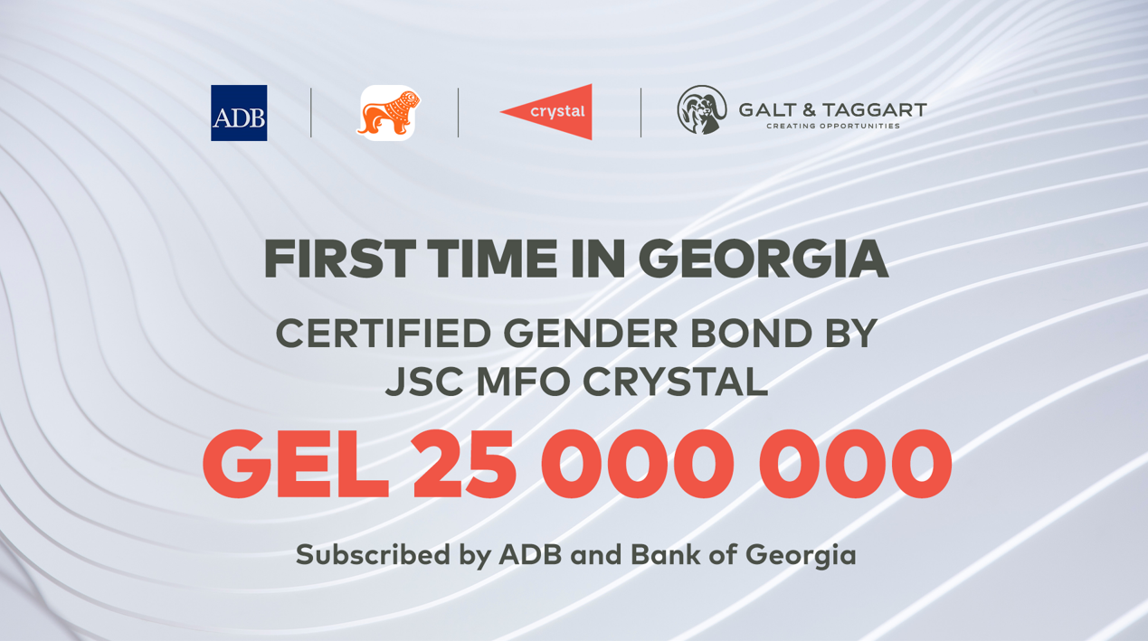

Slide 3
Challenges
Data
Market Infrastructure
Gender Bonds
Issuers
Investors

