Slide 1
Asian Development Bank Two examples of We-FI Supported Digital Initiatives

Slide 2
Women’s Finance Exchange

Slide 3
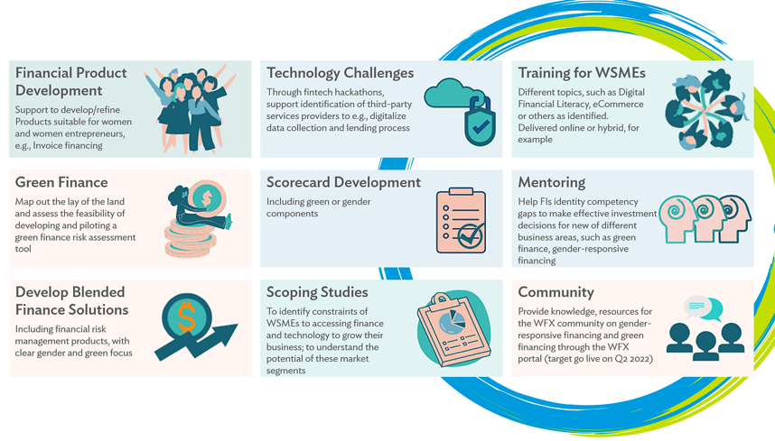
What WFX does…

Slide 4
WFX Pilot in Papua New Guinea
Pilot activities
Results to date
300+ trained in financial management, technology and digital tools, and e-commerce
45 trained on the app (pilot size)
22 received loans (48% of pilot size; average loan size K8,200/USD~2,300)
Talks of commercialization between fintech and bank are underway
Business case
Credit Scoring Model
Hackathon
Using digital technology to enhance WSMEs' access to finance
"This training connected me with other women small business owners and provided us with an opportunity to share our experiences in managing our businesses," said Cecilia.
Alternative Data
FSP – Fintech partnership
Training
*FSP = Financial Service Provider

Slide 5
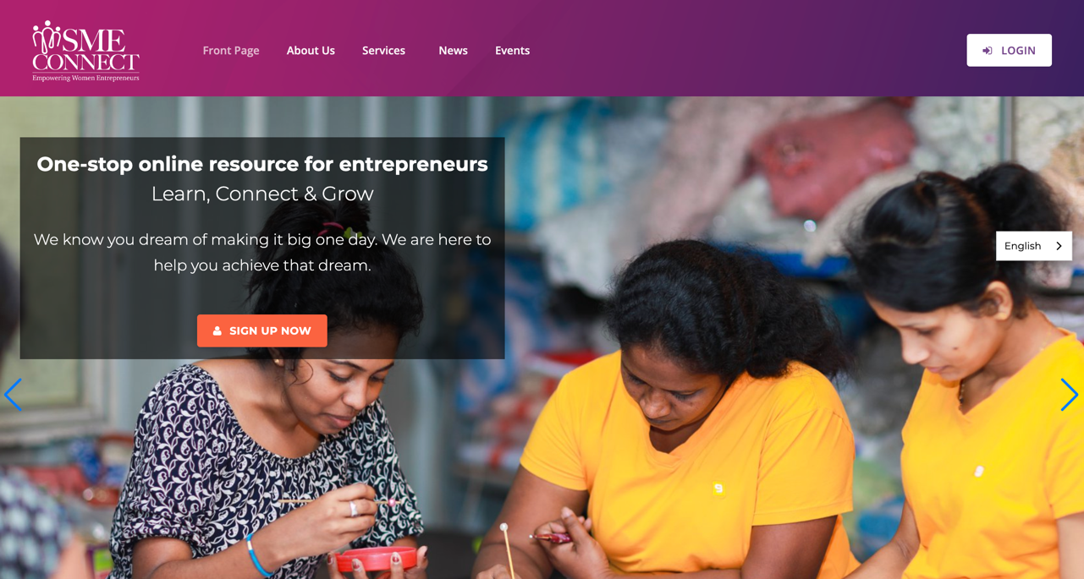
Sri Lanka: SME Connect

Slide 6
SME Connect Features
Learning
An online platform which would provide a wider base of WEs with a means for continuous engagement and sustainable capacity building
Knowledge sharing
User accessibility
Trilingual, mobile-friendly online platform that targets SME women entrepreneurs throughout the country
Open to all entrepreneurs but with special focus on women-led SMEs
Focuses on 3 key aspects – Learning, Mentoring and Networking
Connecting with peers and experts
One-on-one advice from mentors
Networking
Mentoring
Accessing a “one-stop” resource base
Notes:
To capture a few key points :
The focus of the platform is to provide access to a wide range of resources relevant to MSMEs- as a ‘one stop’ resource base to learn, connect and grow.
It is trilingual and mobile friendly- providing accessibility to a broad base
Open to all entrepreneurs, with a special focus on women
While some basic information is available when you visit, registration is encouraged to access the more detailed resources
At the moment all resources are provided free of charge and the intention is to keep the key services that way
Partners may have additional fee based services offered through the platform as we move forward

Slide 7
Platform engagement status – June 2023
Total registered users - 968
Female users - 865 (89%)
Registered mentors - 23
Registered mentees - 82
Partners on-board – 13
Total unique visitors (May-June 2023) – 1,100

Slide 8
Thank you.

