Slide 1
Women in Fragile States

Slide 2
To what extent is investing in women-led SME and entrepreneurship a priority and focus for IsDB and why? How does this fit into IsDB’s overall development strategy and specifically its approach to addressing fragility and building resilience in fragile and conflict-affected situations?

Slide 3
The Role of SMEs in Fragile Setting
Fragility, poverty and gender inequality are interrelated. So are entrepreneurship, emancipation, and closing of gender gaps.
Increased research to better understand the experience and needs of SMEs in fragile settings has revealed that local firms are essential in times of fragility.
Local SMEs are shown to have greater flexibility enabling them to have a business continuity
SMEs also provide jobs for people in need, essential for both livelihood support during times of conflict and fragility and in reconstruction and development to bring about stability.
Many SMEs are forced to close during these critical and the majority of them are women-owned or led SMEs exacerbating the barriers to women entrepreneurship.
During periods of conflict, women have even less opportunities for employment. According to the OECD, 43% of those in severe poverty live in countries in fragile situations, 70% of which are women, youth and children.

Slide 4
The Role of SMEs in Fragile Setting
In fragile situations, women tend to invest back into the family and the community, making entrepreneurship a coping strategy to poverty reduction.
there is a strong link between entrepreneurship and reduction of gender gaps in certain indicators such as education, health, and household nutrition.
GEM, 2017 reports that 85% of countries assessed showed 10% increase in overall female Entrepreneurial Activity and a 5% reduction of the gender gap.
Creating more opportunities for women entrepreneurs to engage successfully in business activities can produce considerable benefits for women, their families and communities.
It delivers society-wide gains as a result of inclusive economic growth.

Slide 5
The Typical Constraints Faced by Women Entrepreneurs
Lack of access to finance,
Lack of sound business skills,
Lack of skilled labor,
Limited access to market,
Lack of equipment and technology,
Restrictive regulatory frameworks
The effect of these constraints are detrimental. Recent estimates show 4% and 7% income losses (in GDP per capita) respectively on aggregate productivity and resource allocation as a result of gender gaps across developing regions

Slide 6
Evidence has shown the following:
Interventions that combine finance and business training are seen to be more effective than other individual interventions;
There is early evidence that business training combined with follow-up technical assistance, and business grants together with business training may be effective in supporting the business growth of existing female entrepreneurs;
There is evidence that entrepreneurship programs have been more effective in stimulating the creation of women’s new microenterprises than in supporting the growth of women’s existing businesses;
To effectively support the business success of women entrepreneurs at the microenterprise level, WED interventions should address more barriers to women’s entrepreneurship beyond limited access to finance and business skills.

Slide 7
Bank 10YS has private sector development and inclusive social development as two of its pillars in addition to Islamic Finance. All of these pillars tackle barriers that entrepreneurs face in terms of access to financial and non financial services in addition to the promotion of SME development as engines for economic growth.

Slide 8
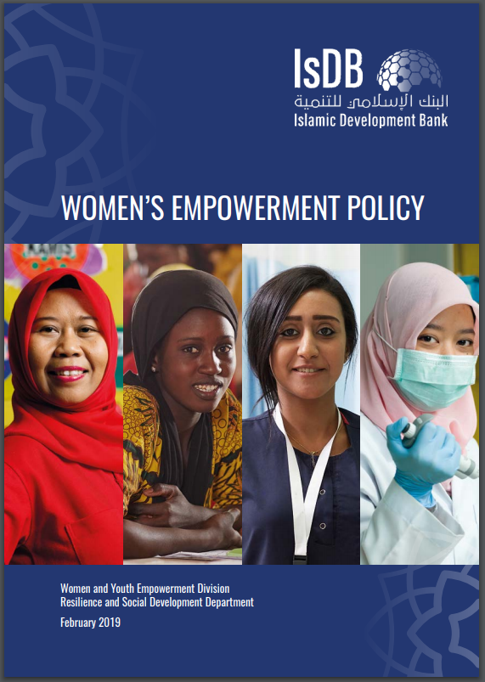
Women Empowerment Policy:
Improving access to resources and services:
IsDB will ensure that its programmes facilitate equitable access to financial and technical resources and services for all women, regardless of age, disability status, ethnicity, socio-economic status, geographical area or any other condition.
IsDB will provide economic opportunities and equitable and decent employment, with a focus on supporting the conditions necessary for women-owned and women-led micro-, small and medium-sized enterprises, women entrepreneurs, farmers, traders and those in the informal sector
IsDB will support to finance and productive resources, including technology; and market opportunities and advancement within the value chain with engagement from the private sector.
Promoting women’s agency and participation:
IsDB will support operations that contribute to enhancing women’s participation, with special attention to women in fragile and crisis situations.

Slide 9
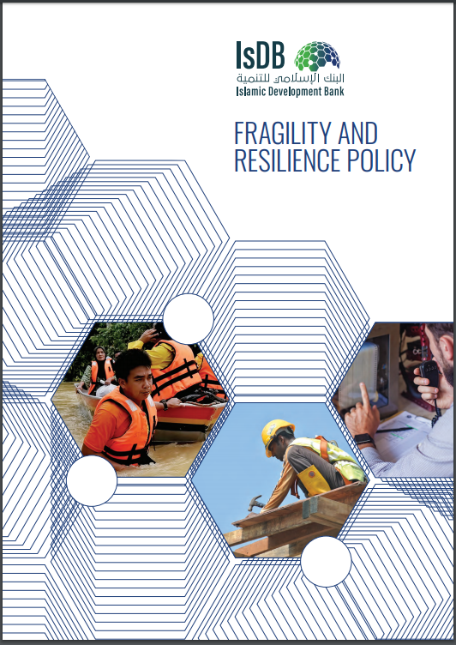
Fragility policy:
Investing in Prevention:
IsDB will ensure promoting growth and equity, which is strengthening prevention aim not only to support growth but, most importantly, support equitable and inclusive access to resources, services, livelihoods, and employment opportunities.
Facilitating inclusion:
IsDB will ensure the inclusion of individuals, households, and groups in society, institutions, the economy, development policies, justice, and security provision greatly contributes to state-building and capacity. this Inclusion includes access to services and to livelihood opportunities contributes to the legitimacy of the state and reinforces state-citizen relations

Slide 10
Deprived Families Economic Empowerment Program - DEEP
Overall Objective
DEEP aimed to empower and graduate marginalized poor families, especially female heads of households, from being economically dependent to independent providers of income, through accessing promotional safety net activities and financial services that address their specific needs.
Key Components
Promotional Social Safety Net Activities (PSSNA), which include enterprise development and livelihood activities, provided by local partner NGOs to address the needs and empower families too poor for conventional microfinance, but with great potential to become independent providers.
Key Results
16,042 Palestinian families lifted out of poverty through the implementation of successful economic SMEs projects; 79% of families improved their income by 64%.
The strong sponsorship of IsDB to DEEP did not only help the program to succeed in a conflict area like Palestine, it also created a visible funding vehicle that mobilized additional resources for the program through cooperation with many donors.
Project Beneficiaries
16,042 Palestinian families (direct beneficiaries), including women, youth, persons with disabilities, university graduates, small farmers, leaders and innovators.
Communities
Access to Financial Services from Microfinance Institutions/Programs provided to entrepreneurial poor families
Institutional Capacity Building to partner NGOs and Microfinance Institutions to reach and address the needs of the Palestinian deprived families.
✓4331 women owned their projects.
✓14,040 jobs created for women.
✓4,980 women trained in business services and coaching.
✓87% of SMEs projects still operating.
✓96% of women reduced their dependence on others by more than 75%.
✓40% improvement in the child education, housing conditions, self-confidence and the relationship with family and community.
✓Economic Empowerment Fund for the Palestinian People (EEFPP) established by the IsDB to upscale the empowerment efforts and ensure its long-term sustainability.

Slide 11
Gender Dimension
DEEP employed a holistic family analysis approach, which included analyzing the gender roles’ distribution and relating them to the changing position of women. This analysis was important as the program employed its findings to accommodate for gender sensitivities and relations within families and communities. The program was also very vigilant to mainstreaming women’s empowerment across its different phases and sectors, including selecting implementing partners, technical staff, and implementation mechanisms. The program adopted the values of accompaniment of women beneficiaries to maximize their social capital through fostering strong relations with Community-Based Organizations (CBOs) and merchants. This was strongly supported by dedicated social workers from the Ministry of Social Development, who managed the cases of these women.
The program also developed a referral system through the Ministry of Social Development, which linked DEEP with social protection services, health, education, psychological and legal services. This created a safety net for many women starting or expanding their businesses to overcome challenges they faced in or outside their homes in order to empower them and pave their path out of poverty. The different program’s monitoring and evaluation reports depicted that the community’s level of awareness on women’s positive role as entrepreneurs has increased sharply and their attitude towards women’s engagement in the public realm has positively changed.

Slide 12
Youth Employment Support Program (YES) - YES-EGYPT
Overall Objective
YES-Egypt, part of a broader MENA-focused program addressing youth unemployment, aimed to improve the livelihoods and quality of life of Unemployed Potentially Active Youth (UPAY), including young women, to enable them to develop sustainable income generating activities and graduate from dependency to self-sufficiency
Key Components
YES-Egypt undertook interventions targeting young women and men, as well as Participating Financial Institutions (PFIs) and training providers with the aim to:
Key Results
24,000 MSEs created or developed.
Project Beneficiaries
80,000 Unemployed Potentially Active Youth (Alumni of Universities and Vocational/ Professional Institution and Higher Institutes of Technology), young women (40%) and young men (60%).
Bolster youth’s technical skills and capacities through increasing their access to i) a mix of Micro & Small-to-Medium size Enterprise (MSEs) financial services, ii) market-oriented trainings and entrepreneurship facilities; and iii) business and market opportunities and networks, with active private sector engagement; and,
Increase young entrepreneurs’ access to Islamic microfinance services through increasing the capacity of PFIs and training providers by extending: i) MSEs lines of financing for promising rural and urban business activities; and ii) capacity building programs for delivering youth-oriented sustainable MSEs Islamic lending schemes.
86,000 employment opportunities created.
80,000 Unemployed Potentially Active Youth benefited from market training and entrepreneurship programs.
10 universities and professional schools acquired enhanced Business Development Centres (BDC.)
The Project
The project implemented the Ard El Kheir initiative under the YES-Egypt project, targeting 90% of poor women, who had little or no education. It involved incubating young women entrepreneurs and developing their capacities on the best practices of cattle raising, including modern techniques of feeding, as well as mobilizing the required resources and providing a market to sell the cattle for sustainability. A total of 540 poor women befitted from this initiative, lifting them out of poverty.

