Slide 1
Women, Business and the Law in Jordan
Dr. Abla Amawi
General Secretary
Higher Population Council
Jordan

Slide 2
Contextualizing the Concepts
Enabling
Environment
Level
Institutional
Level
Individual & Community Level
Law
Women
Business

Slide 3
Contextualizing the Concepts
Enabling
Environment
Level
Institutional
Level
Individual & Community Level
Only 2.6% of women closed their business as a result of government policies.
13.2% lack of finance.
Inability to provide collaterals.
Businesses financed through personal sources, savings, friends and family and reinvesting their earnings.
15.8% for family reasons
Family Obligations
Fear of failure: 42.3%.
Below average skills rate.
Self-perception
Low networking rates: 18.3% in 2016
60.5% business non-profitable. Most operate in consumer oriented services and are providing no new products

Slide 4
We need to know why women are not looking for jobs
Human Resources: Equality in Education Attainment
9.5%
6.3%
18.6%
18.6%
Bachelor degree or higher
غير ناشطة اقتصاديا
1,994,008
Housewife
68.6%
Profitable business
0.5%
Informal economy
Other
1.3%
Special needs
Student
17%
Diploma
Not reflected into equal access to economies
9.5%
Labor Force +15 years old
(Active and inactive economically)
265,382
1,145,882
Employed
2,356,662
2,432,952

Slide 5
Total Entrepreneurial Activity for Women
Women seek jobs in the educational sector, human health and social work activities and public administration - employment benefits such as (maternity leave, social insurance, medical Insurance, family leave, pensions, and job protection) all of which reduces preferences for entrepreneurship.
Choice of entrepreneurship is influenced by income per capita, unemployment rates; employment benefits and cultural aspects
Female TEA rate is the lowest compared to other countries in the region, as only 3.3% of female population aged 18-64 are engaged in starting a business or who recently started one.
Only 34% of Jordanian business women have a bank credit. Low land ownership; homes; no collateral; financing through loans from micro funds and not commercial banks
Female entrepreneurial intension been decreasing. Established business decreased to reach 2.7% compared to 5.28% in 2009; self-employment and business ownership for women also decreased.
37% of female TEA pursed business out of necessity compared to 56% pursed business out of opportunity.

Slide 6
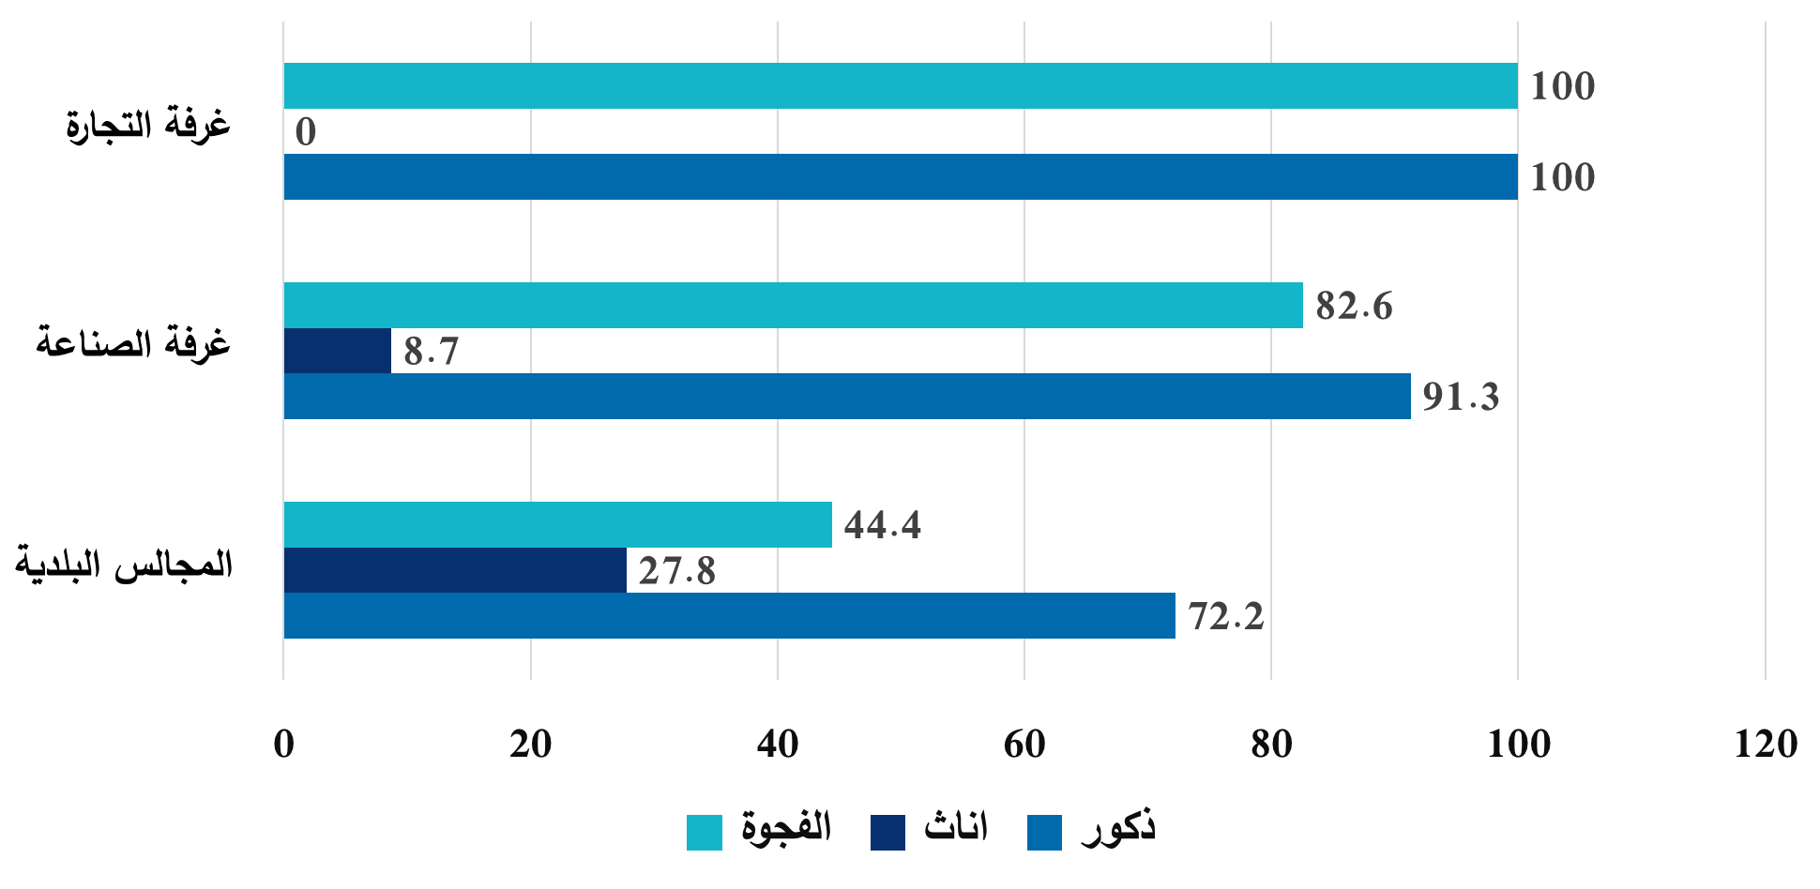
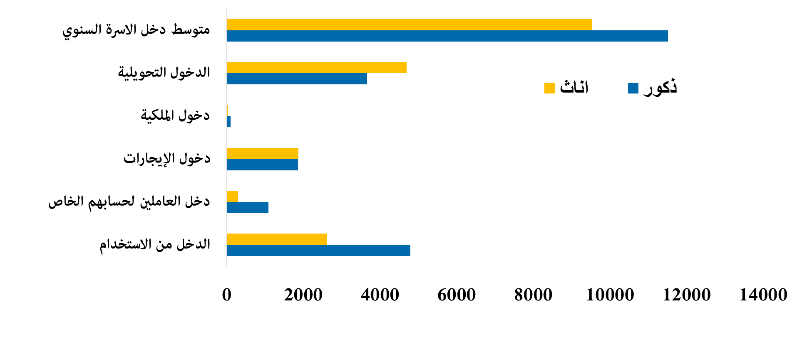
Financial Capital
Weak female representation in Industry and Trade Chamber and Municipalities
Unequal access to resources
Household
average income
Transfer income
Ownership income
Rental income
Self employment income
Employment income
Trade Chamber
Industry Chamber
Municipalities
Females
Males
Exclusion from the labor force prevents women from obtaining economic assets in the form of incomes and related benefits, which would otherwise be useful in terms of women exerting further control over their own lives.

Slide 7
What are the most recent reforms taken for women’s economic inclusion?
Jordan removed all job restrictions on women, allowing them to work the same hours and in the same jobs and industries as
men.
Article (69) in Labor Law was repealed on February 10th, 2020 upon the decision of the Parliamentary Labor Committee and the approval of the Government.
Jordan eliminated legal restrictions on women’s ability to work at night and introduced the principle of equal remuneration for work of equal value.
Equal payment Labor Law Article (53): The Employer or whoever acts of him shall be for every incident wherein a payment below the minimum wage, in addition to passing judgment in favor of the Employee of the wage difference.
Flexible Working Model Law
Notes:
http://www.jfranews.com.jo/post.php?id=257876#.XkL-ZmJ1KTk.whatsapp

Slide 8
Women need extra step to start her business
Challenges facing women entrepreneurs in Jordan :
Indicator | Women | Men
Procedure (Number) | 8 | 7
Time (Days) | 13 | 12
Cost (% of income per capita) | 23.3 | 23.3
Source: Doing Business 2020 Economy Profile Jordan
Notes:
Resource: Doing Business 2020 Economy Profile Jordan

Slide 9
Recommendations
Access to loan and credit in general and from formal institutions in particular
Promote entrepreneurship culture among educated unemployed females
Polices should be adopted to increase awareness of entrepreneurship.
Provide cash support for working mothers to
access childcare services
Recommendations
Increase Micro financing and loan guarantee programs for women
entrepreneurs.
Enhance business environment and simplifying registration procedure.
Investment in non-financial business services.
Gender-equality in collateral; no guarantees.

Slide 10
The economies that improved the most
75%
50%
Saudi Arabia
the United Arab Emirates
Nepal
South Sudan
São Tomé and Príncipe
Bahrain
The Democratic Republic of Congo
Djibouti
Jordan
Tunisia
Notes:
All over the world, discriminatory laws continue to threaten women’s economic security, career growth, and work–life balance. Such barriers to employment and entrepreneurship at every stage of life limit equality of opportunity, creating a business environment that does not adequately support working women. In the Middle East and North Africa, women have only half the legal rights of men; worldwide, it is just 75 percent. Although many economies have acted to reduce barriers to women’s economic participation over the last 50 years, the progress made cannot be equated with success (WBL 2020 report)

Slide 11
Global Gender Gap Report
Global Index |  |  | Economic participation and opportunity |  | Educational attainment |  | Health and wellbeing |  | Political empowerment
Country | Rank | Score | Rank | Score | Rank | Score | Rank | Score | Rank | Score
Jordan | 138 | 0.605 | 144 | 0.375 | 45 | .998 | 102 | 0.971 | 129 | 0.075
2006 | 93 | 0.611 | 105 | 0.442 | 70 | 0.979 | 62 | 0.975 | 100 | 0.048
Iceland | 1 | 0.858 | 16 | 0.793 | 39 | 0.999 | 121 | 0.968 | 1 | 0.674

Slide 12
Thank You

