Slide 1


WE Finance Code
WMSME Data Mapping Guidelines
PARTNER / CO-ORGANIZER LOGOS:
COORDINATED BY:

Slide 2
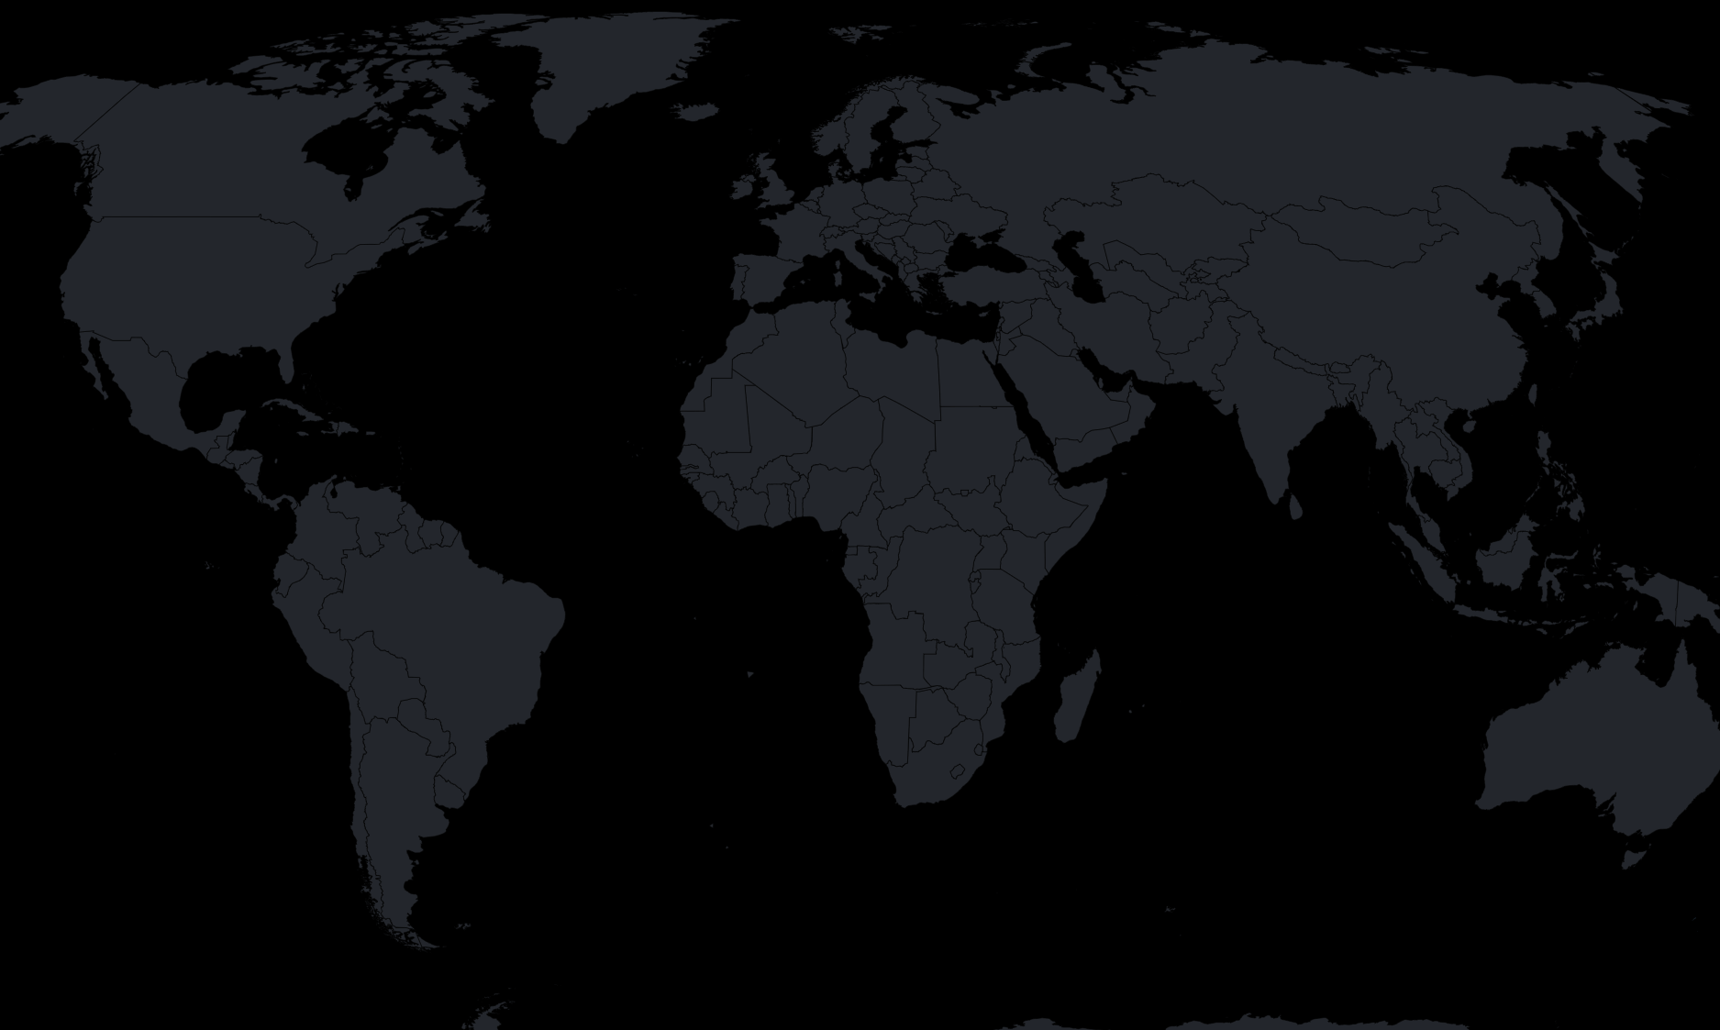

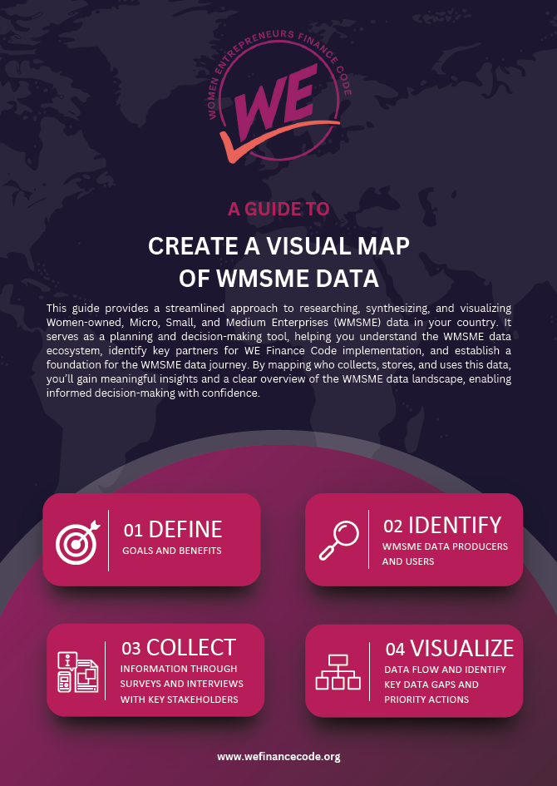
A GUIDE TO
CREATE A VISUAL MAP
OF WMSME DATA
SUMMARY
The guide provides a streamlined approach to researching, synthesizing, and visualizing Women-owned, Micro, Small, and Medium Enterprises (WMSME) data in a country.
This document with its annexes is a tool for planning and decision-making meant for national coordinators and aggregators working on the WE Finance Code, to gain a comprehensive picture of the data ecosystem and flows related to finance for women-led businesses. It also supports identifying key partners for the WE Finance Code implementation and provide the foundation to the WSME data journey track.
By mapping who collects, stores, and uses this data, you’ll gain meaningful insights and a clear overview of the WMSME data landscape, enabling informed decision-making with confidence.

Slide 3
Background: framework for implementing the WE Finance Code
The framework combines two critical dimensions essential for the success of the project:
1. Coalition Engagement:
Axis X, emphasizes creating alliances and defining structures that will drive the project forward. It involves engaging public and private sector stakeholders, forming national coalitions, and setting up mechanisms to ensure the progress and sustainability of the Code.
2. WMSME Data Journey:
Axis Y, focuses on assessing the state of WMSME data and establishing a structured data reporting process to collect relevant information from the market. It involves identifying key roles and responsibilities and building relationships among stakeholders.
The steps within each dimension are not necessarily sequential and could be happening at the same time, in Nigeria, some of the data work preceded the Code Launch happened, for example.
Link to the WE Finance Code Implementation Resources
Continue to refine data collection, reporting and dissemination
Scale the data pilot to all market players, produce market insights report
WMSME Data Journey
Pilot data collection and reporting
Align on data aggregator,
data reporting process, and WMSME definition
I
II
III
IV
V
Conduct WMSME data ecosystem diagnostic
WE Finance Code Coalition Engagement
Identify Public & Private Sector Anchors
Build a National Coalition
Set up for
Implementation
Launch the Code
Track & Accelerate Progress

Slide 4
Step 2 – Identify WMSME data producers and users
To understand the local WMSME data ecosystem, we need to map out where and how WMSME data is being generated, reported, and utilized. This involves identifying key producers¹ and users² of data, reports and analysis within the ecosystem, and categorizing the data they handle.
Types of data to consider:
Business Data: Information that helps define/identify SMEs (and WMSMEs) such as business revenue, number of full-time employees (FTEs), and data on ownership and management.
Financial Data: Details on access to and usage of formal financial services by WMSMEs (total number of business accounts/clients, share of businesses with a loan, business deposits total/average).
Contextual Data: Broader sociodemographic information and other indicators related to financial inclusion (e.g., adult population to calculate financial inclusion [divide number of individuals with account by the adult population], labor force participation rate, education).
Guidelines for Research:
Investigate the local WMSME and financial ecosystem, including compiling an exhaustive list of public and private sector actors. Whenever possible, collect contact information for the institutions to be able to reach out to them directly for Step 3’s primary data collection.
Collect national data from public reports, surveys, and official statistics and databases, focusing on SMEs and WMSMEs.
Review reports published by local and international organizations. Analyze their data sources and note the frequency of updates.
Refer to the Data Indicators Reference Guide in the annex for the WE Finance Code indicators and WMSME Data sources.
By mapping these elements, you will accomplish an important first step towards getting a comprehensive view of the local WMSME data ecosystem and identify the key players driving data production and usage. You should start collecting key findings for Step 3’s summary report to synthesize all the learnings from the secondary.
Outcome
Identify an exhaustive list of key stakeholders in the WMSME data ecosystem
Initial understanding of the WMSME data flow based on secondary data
Basic understanding of demand- and supply-side WMSME data generation
Checklist
List of relevant stakeholders created
  Public institutions
  Private institutions
  NGOs, local and international stakeholders
Key contact persons identified for each organization to be included in the surveying &/or interviews
Create an inventory of all demand- and supply-side data collection efforts (including regular, ad-hoc, and one-time reports) to capture the full scope of available data on WMSMEs created
¹ – Data producers: Are entities that generate or collect data, such as government agencies, financial institutions, or research organizations.
² – Data users: are those who collect, analyze, or apply the data for decision-making, including policymakers, researchers, and businesses.

Slide 5
Step 1 – Define goals and desired outcomes
To begin the exercise, the first step is aligning on the goals and desired outcomes for the WMSME Data Mapping. Start by defining the audience: who will be using the data map and with what objective? Identifying potential WE Finance Code Champions helps as they are the early adopters of and active contributors to the Code and Code-related materials. providing clarity to the exercise and efforts needed to achieve it.
General benefits/outcomes of doing the exercise include:
Getting a clear picture of what data is being generated and reported within the country.
Identifying key stakeholders and data sources to be used in (W)MSME market sizing.
Establishing the foundation for the WE Finance Code implementation’s Data Journey.
Raise awareness of the WE Finance Code implementation among ecosystem stakeholders.
Collect baseline of the Code’s minimum key indicators*.
Keep in mind the following recommendations :
Consider short-term and long-term objectives to ensure comprehensive data collection and utility.
Define minimum requirements to accomplish, and out-of-scope limitations.
Integrate different stakeholders to listen, consider their expectations, and define the audience of the project. Start listing all and each stakeholder mentioned or invited to the conversation.
Use this step to add any additional goals you would like to accomplish during the exercise beyond WMSME data mapping.
Outcome
Reach consensus on the data mapping exercise’s target audience, and the goals, and expected outcomes for them.
Identify Code champions: key stakeholders to act as and first adopters.
Checklist
Objectives defined
Audience defined

Slide 6
Step 3 – Collect information through surveys and interviews with key stakeholders
In this step, the goal is to evaluate from firsthand the current state of WMSME data collection, quality, and usage to develop a comprehensive understanding of the strengths and limitations within the local WMSME data ecosystem and reporting processes. This assessment will help identify gaps or discrepancies in sex-disaggregated data, highlight areas where critical data is missing or outdated, and determine priorities for further research. Additionally, it will provide insights into non-public data and reporting between financial service providers (FSPs) and regulators, including details on the WMSME portfolio.
To achieve this, the following primary research should be conducted with representatives from FSPs serving WMSMEs and key data users:
Online survey to FSP¹: This survey aims to capture insights on the WMSME clientele and FSPs’ attitudes towards serving them. It should focus on establishing a baseline for key areas such as WMSMEs definition, indicators collected, financial inclusion metrics, and service usage.
Qualitative, in-depth interviews: To complement the survey, it is also recommended to conduct qualitative interviews* with a select group of FSPs. The interviews provide a deeper understanding of the types of data being collected, the analytical efforts in place, and the baseline capabilities of existing systems. They also help uncover barriers and challenges faced by both data producers and users, giving a chance to identify opportunities for improvement.
  Key areas for data users: Current policies/practices for collecting and analyzing gender-disaggregated data, WSME policies.
  Key areas for data providers/FSPs: portfolio size, definitions, WMSME propositions and solutions, data collection and reporting with key challenges (availability, quality, and usage).
  An alternative approach to the detailed primary research could be a co-creation workshop, bringing together the top 10 experts in the country to map out key insights in a single day. This rapid assessment method could streamline data collection while still providing valuable input, making it a viable option in cases where extensive primary research is not feasible.
  At the end of this step, you should be able to produce a summary report to synthesize all the key findings to review & share with other parties.
Outcome
Collect data to understand main data users and providers attitude towards WSME data and serving the WSME market
Compile a comprehensive summary report highlighting key findings, focusing on trends, gaps, and insights related to WMSMEs data and reporting.
Strengthen relationships with FSPs and other key stakeholders
Checklist
Survey designed and conducted
Interviews conducted
Summary report updated with insights and inputs from the interviews
Update Data inventory to reflect any new learnings from Step 3 research
* – Template can be found in the annex

Slide 7
Step 4 – Visualize data flow and identify key data gaps and priority actions
Now it’s time to bring everything together into a visual map that shows how WMSME data flows within the local system. The goal here is to create a clear, easy-to-read representation of how stakeholders interact identifying the demand/supply side and the availability of disaggregated WMSME data by sex.
Here’s how to approach this step:
Group Stakeholders by sector: Group institutions, organizations, or other stakeholders in a way that reflects how the local financial system operates. Consider their roles and interactions within the WMSME ecosystem.
Highlight Producers and Users of Data: Clearly mark which stakeholders are producing data and which are using it. This helps to visualize the flow of information and understand its lifecycle.
Map Sex-Disaggregated Data: Differentiate between flows of sex-disaggregated and non-sex-disaggregated data. This distinction is critical for identifying areas where gender-related insights are lacking.
Follow the Template including shapes and legends: Use the provided template as a starting point to structure your map. This will ensure consistency and make it easier to communicate findings to others.
The map should help identify data gaps and priority actions at a glance, making it easier for everyone involved to align on next steps.
Outcome
Visualized WMSME data ecosystem (data producers, data users, disaggregated WMSME data flow)
Key data gaps and priority areas identified
Checklist
Map/data flowchart created
Different data roles and data flows mapped within the chart
Key data gaps template* filled out
* – Template can be found in the annex

Slide 8
Annex 1 – WMSME Data Mapping Guide and Template and Data Indicators Reference Guide

Slide 9

Data visualization template – Visualization Step A
How to?
FSPS/DATA PROVIDERS
Start off the visualization / mapping by collecting and adding the data providers.
Besides the FSPs, list other stakeholders generating data relevant for the SMEs (e.g., # of FTEs, annual turnover, ownership / management structure)
You can refer to the stakeholder list in the Stakeholder Template (see Annex 2). This list represents a non-exhaustive selection of key stakeholders, outlining commonly involved parties.
Regulated FSPs
Banks and Credit Institutions (xx)
Microfinance Institutions (xx)
Other Financial
Service Providers
Credit Bureaus
Public Registry
Revenue Service / Tax Authority
National Statistical Bureau
LEGEND:
Data Providers

Slide 10
Data visualization template – Visualization Step B
How to?
REGULATORS, MAIN AGGREGATORS
FSPS/DATA PROVIDERS
Add the identified Regulators and other main aggregators to the map on the left-hand side. Use the Data Users color from the legend.
You can refer to the stakeholder list in the Stakeholder Template (see Annex 2). This list represents a non-exhaustive selection of key stakeholders, outlining commonly involved parties.
Regulated FSPs
Financial Regulator
Banks and Credit Institutions (xx)
Microfinance Institutions (xx)
Other Financial
Service Providers
Other Aggregator
Credit Bureaus
Public Registry
Revenue Service / Tax Authority
National Statistical Bureau
LEGEND:
Data Providers
Data
Users

Slide 11
Data visualization template – Visualization Step C
How to?
REGULATORS, MAIN AGGREGATORS
FSPS/DATA PROVIDERS
OTHER STAKEHOLDERS
Map out other Stakeholders identified to be relevant or to participate in the local MSME data flow. Use the Data Users color from the legend.
As with the other steps, you can freely add, remove, or edit the existing shapes as needed to better align with the insights from your market research.
You can choose to list each stakeholder separately, or group them as it makes sense (e.g., with ministries).
You can refer to the stakeholder list in the Stakeholder Template (see Annex 2). This list represents a non-exhaustive selection of key stakeholders, outlining commonly involved parties.
Ministry of Finance
Regulated FSPs
Financial Regulator
Other Ministries & Agencies
Banks and Credit Institutions (xx)
Microfinance Institutions (xx)
Other Financial
Service Providers
Industry Associations (Bankers/Microfinance/Fintech/etc.
Other Aggregator
Donors / Impact Investors
National Chamber of Commerce
Credit Bureaus
Public Registry
Revenue Service / Tax Authority
National Statistical Bureau
Other stakeholders
Investors
LEGEND:
Data Providers
Data
Users

Slide 12
Data visualization template – Visualization Step D
How to?
REGULATORS, MAIN AGGREGATORS
FSPS/DATA PROVIDERS
OTHER STAKEHOLDERS
Visualize the data flow between entities using the arrows from the legend. Use different colors for sex-disaggregated and non-disaggregated data reporting.
You can include brief notes on the data arrows to indicate the type or scope of data being reported.
After mapping the current WMSME data flow in your country, analyze the findings to design a proposed data reporting flow (including what could be reported by whom and what data sources might be proposed to use for sex-disaggregation of the data).
Determine which stakeholder(s) could be identified as the National Aggregator(s) for the Code. For more details on the Aggregator role and responsibilities, please refer to the
WE Finance Code Implementation Guide - Step 2A: Establish Roles and Responsibilities.
Sex-disagg. data on deposits and credit (#,$)
Ministry of Finance
Regulated FSPs
Financial Regulator
Other Ministries & Agencies
Banks and Credit Institutions (xx)
Microfinance Institutions (xx)
Other Financial
Service Providers
Industry Associations (Bankers/Microfinance/Fintech/etc.
PROPOSED CODE AGGREGATOR
Donors / Impact Investors
Loan data not including gender marker
National Chamber of Commerce
Credit Bureaus
Public Registry
Revenue Service / Tax Authority
National Statistical Bureau
Ownership data, including gender marker
Other stakeholders
Investors
LEGEND:
Data Providers
Data
Users
Proposed Code National Aggregator
Sex-disaggregated data reporting
Data reporting
Proposed
data reporting
Sex-disaggregated data reporting: Current data flow between institutions with sex-disaggregated information
Data reporting: Current data flow between institutions
Proposed data reporting: Proposed data flow between institutions with sex-disaggregated information

Slide 13
An example from the Dominican Republic WMSME data mapping
REGULATORS, MAIN AGGREGATORS
FSPS/DATA PROVIDERS
OTHER STAKEHOLDERS
Regulated FSPs
Ministry of Commerce
Central Bank
Ministry of Women
Banks and Credit Institutions (32)
Associations of Credit and Loans (10)
Credit Corporations (2)
Bankers Association (ABA)
Superintendency of Banks
Fintech Association
Donors / Impact Investors
Chamber of Commerce
DGII
(Local Tax Authority)
National Statistical Bureau
PROMIPYME
Women Entrepreneur Association
Legend
Data Providers
Data Users
Code National Aggregator
Sex-disaggregated data reporting
Data reporting
Proposed
data reporting
The Dominican Republic has a robust financial ecosystem with extensive data flows between institutions.
The Central Bank (responsible to ensure price stability in the country and regulate the financial system) and the Superintendency (responsible to supervise financial institutions to ensure compliance with laws and regulations) have a significant role in collecting and reporting detailed credit service data, which is made accessible to the public through an online portal (SIMBAD Portal).
The local Banking Association (La Asociación de Bancos Múltiples de República Dominicana, ABA) was chosen as the National Coordinator and Aggregator thanks to the leadership of the institution, the fact of being an independent actor, and its strong relationships with financial service providers (FSPs) and regulators, as well as its organizational capacity in IT, legal, and project management.
However, legal and security considerations prevented the ABA from directly receiving personally identifiable information from FSPs. Through the mapping exercise, a solution was identified: leveraging the Superintendency as the primary data collector, where data anonymization processes would be implemented.
The mapping also highlighted potential future signatories, such as PROMIPYME (local organization promoting the SME sector), to further strengthen the initiative.
Outcomes

Slide 14
Step 2
Data Indicators Reference Guide – WE Finance Code indicators
The Code Commitment
Global Minimum Requirements
Strongly Encouraged
Proposed extra indicators
2. Track and report Data
Core Indicators to be reported on a sex-disaggregated basis
  MSME business customers (#)
  MSME business outstanding loans (# & $)
  MSME business loan applications and approvals (# & $)
  MSME business Non-Performing Loans (%)
  MSME business deposits ($) & depositors (#)
Indicators to understand the quality of access to WMSMEs (financing conditions) and strengthen the business case:
  New MSME loans disbursed (#/$)
  MSME collateralized loans (#/$)
  MSME short-term loans (#/$)
  MSME products per customer (#/$)
Any additional indicators proposed for the implementing country (if applicable):
  Indicator A
  Indicator B
  Indicator C
Other indicators:
  Housing loans (#/$)
  Consumer loans (#/$)
  Digital transactions (#/$)
  Equity (#/$)
All indicators will be disaggregated by women/non-women led AND SME/Micro.

Slide 15
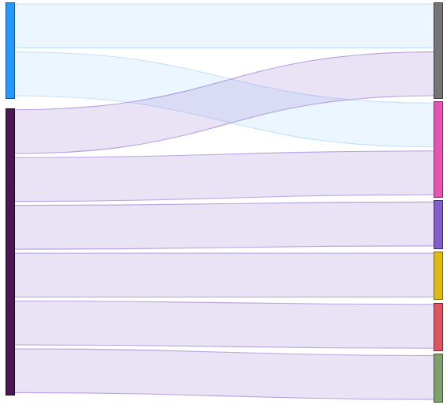
Step 2
Data Indicators Reference Guide – WMSME Data sources
To collect the WMSME Data Indicators, the following introduces the key data attributes necessary for disaggregating data by sex for sole proprietors and business enterprises. Additionally, we have included potential data sources. Please note that the availability of these data sources can vary significantly across different markets.
Business type
Data attributes
Explanation
Potential data sources
National ID offers unique identification for all individuals (both sole proprietors and SME owners/managers). The gender disaggregation is based on the unique IDs in one of two possible ways:
The gender information is coded into the National ID number (e.g., IDs ending in odd number are females, in even numbers are males). This allows sex-disaggregation to all stakeholders who has the ID number data.
The gender information is not coded into the National ID number – in this case, during the disaggregation it must be triangulated with a database that has gender information (such as National ID database at the Ministry of Interior)
Any stakeholders with ID data stored upon registration. ²
Public institution responsible for national ID registration / national ID database management (e.g., Ministry of Interior, Public Registry)
Individual / Sole Proprietors
Individual ID¹
Annual revenue is most often used as the main criterion for categorizing SMEs by size.
FSPs, Tax Authority / Revenue Services
Annual Revenue
Business IDs are essential data attributes for mapping SME data, as they provide a unique identifier for each enterprise. They enable accurate data integration across different sources, helping to create a comprehensive and cohesive view of the SME ecosystem.
Any stakeholders with business ID data stored upon registration.
Chamber of Commerce, Tax Authority / Revenue Services
Business ID*
MSME /
Business Partnerships
The number of full-time employees (FTEs) is another commonly used criterion for categorizing SMEs by size. Some existing definitions also take into account the gender ratio of employees to identify WMSMEs, considering enterprises with a higher proportion of female employees to qualify as such.
Chamber of Commerce, Business Registry, National Statistics Agencies
Number of FTEs
One of the two main criteria when defining WSMEs, this refers to the proportion of a business owned by women. A business is typically classified as women-owned if women hold at least 51% of its ownership.
FSPs if recording upon account registration / loan request
Chamber of Commerce, Tax Authorities, Public Registry, National Statistical Offices
Ownership gender ratio
The other key dimension in defining WSMEs, this reflects the percentage of leadership or decision-making roles held by women. It highlights businesses where women play a significant role in driving strategy and operations (e.g., share of women in senior management, or share of women on the Board).
FSPs if recording upon account registration / loan request
Chamber of Commerce, Tax Authorities, Public Registry, National Statistical Offices
Leadership gender ratio
¹ – The individual ID and Business ID are the most important data attributes for WMSME data mapping. They help identify unique sole proprietors and businesses and connect information from different sources.
² – Besides referring to country-level sources (such as Business Registry or Statistical Bureau data), you can also refer to the World Bank’s Entrepreneurship Database, which also collects data on female entrepreneurial activity.

Slide 16
Annex 2 – Stakeholder List

Slide 17
Stakeholder list
Step 2
Category | Inst./Org. | Short description and relevance
FSP | Commercial bank | Offering financial and non-financial services for WSMEs. Data providers on financial inclusion data. Understand if sex-disaggregated data is being generated, reported, and used as part of their strategy / product development.
 | Development bank
 | Microfinance bank
 | Microfinance institution
 | Fintech
 | Other financial institutions
 | Cooperatives
 | Credit Unions
 | Payment Service Providers (PSPs)
Public Institutions | Central Bank | Oversees financial stability and inclusion. Key for macro-level data on credit, lending, and WSME financial access.
 | Regulatory Agencies | Ensure compliance and governance within the financial sector, providing insights into regulatory impacts on WSMEs. Collect/aggregate data from regulated institutions.
 | National statistical bureau | Produces official statistics, including data on WSMEs, which form the backbone for policy analysis and planning.
 | Tax authority / Revenue service | Tracks tax compliance and revenue contributions of WSMEs, providing insights into their economic footprint.
 | Ministries (Finance, Commerce, Women) | Responsible for policies impacting WSMEs. Key for accessing data on programs, budgets, and gender-focused initiatives.
Other Stakeholders | Chamber of commerce | Represents the business community, including WSMEs. Key for understanding business challenges and aggregating membership data.
 | Women’s chamber of commerce | Focuses on women-led businesses, offering critical data on the needs and contributions of women entrepreneurs.
 | Credit Bureaus or Credit Registries | Store credit history and scoring data, which is vital for understanding WSMEs’ access to credit and their financial health. Valuable consolidated and detailed data.
 | Industry Associations (banking, fintech, VC, cooperatives, etc.) | Represent the subsector and provide aggregated data and insights into WSME-related initiatives across members.
 | Guarantee Agencies (Public/Private) | Provide financial guarantees to reduce credit risk for lenders, facilitating access to finance for small and medium enterprises, including women-owned businesses.
 | Collateral Registries | Systems that record and publicize security interests in movable and immovable assets to facilitate secured transactions and improve access to credit.
 | International donors and investors | Entities (such as multilateral development banks) providing financial resources, technical assistance, and investment to support economic development, including initiatives targeting women-owned and small businesses. Requesting data from FSPs or data aggregators who are funded by their projects.
 | Pro-MSME organizations | Advocate for and support MSME development, often collecting specific data to track progress and challenges.
 | Funds/VCs | Provide funding and programs for women-led businesses, influencing data-driven policy and financial inclusion strategies.

Slide 18
Annex 3 – Other Templates

Slide 19
Click on the links below to download the editable templates for:
Annex 3a – FSP survey template
(Word document)
Annex 3b – FSP and other stakeholders
interview guide template
(Word document)
Step 3
Step 3
Annex 3c – Key data gaps template
(PPT document)
Annex 3d – Data inventory template
(Excel document)
Step 4
Step 4
Note to the Team / web designer: The templates will be separate files which should be linked in separate subpages on the website. The links should be added after the subpages are created, or shared with us so we can add it and export the file as PDF for the final report.

